Slide 1
MGT-555
PERFORMANCE AND CAREER MANAGEMENT
LECTURE NO - 10

Slide 2
Recap of Previous Lecture
Environmental Analysis – Internal Factors
Gap Analysis
Gap Analysis – Competitive Situations
Mission
Vision

Slide 3
Agenda of Today’s Lecture
Characteristics of Good Vision statements
Goals
Strategies
Strategies – HR Function
Developing strategic plans at unit level
Job descriptions

Slide 4
Characteristics of a Good Vision Statement
1. Brief
2. Verifiable
3. Bound by Timeline
4. Current
5. Focused
6. Understandable
7. Inspiring
8. A Stretch

Slide 5
Characteristics of a Good Vision Statement
• Brief A vision statement should be brief so that employees can remember it.
• Verifiable. A good vision statement should be able to stand the reality test. For example, how can we verify if indeed becomes "one of the most desirable companies to work for in our industries, focusing on establishing a work atmosphere in which our employees can excel"?
• Bound by a timeline. A good vision statement specifies a timeline for the fulfillment of various aspirations.

Slide 6
Characteristics of a Good Vision Statement
• Current. Outdated vision statements are not useful. Vision statements should be updated on an ongoing basis, ideally as soon as the old vision is fulfilled.
Focused. A good vision statement is not a laundry list of aspirations, but rather focuses on just a few (perhaps not more than three or four) aspects of an organization's performance that are important to future success.

Slide 7
Characteristics of a Good Vision Statement
• Understandable. Vision statements need to be written in a clear and straightforward manner so that they are understood by all employees.
• Inspiring. Good vision statements make employees feel good about their organization's direction and motivate them to help achieve the vision.

Slide 8
Characteristics of a Good Vision Statement
• A stretch. Consider Microsoft's vision statement of "putting a computer on every desk and in every home," which was the vision when. CEO Bill Gates started the MS-DOS operating system in the 1980s. This vision statement was such a stretch that it was considered ludicrous at a time when the mainframe computer still reigned supreme and the first minicomputer models (now PCs) were being made and sold. But that vision is now a reality. Microsoft has come up with a new vision: "putting a computer in every car and every pocket."

Slide 9
Goals
After an organization has analyzed its external opportunities and threats as well as internal strengths and weaknesses and has defined its mission and vision, it can realistically establish goals that will further its mission.

Slide 10
Goals (Contd.)
The purpose of setting such goal is to formalize statements about what the organization hopes to achieve in the medium to long term achievement.

Slide 11
Goals (Contd.)
Goals provide more specific information regarding how the mission will be implemented.
Goals can also be a source of motivation and provide employees with a more tangible target for which to strive.

Slide 12
Goals (Contd.)
Goals also provide a good basis for making decisions by keeping desired outcomes in mind.
Finally, goals provide the basis for performance measurement because they allow for a comparison of what need to be achieved verses what each unit ,group, and individual is achieving.

Slide 13
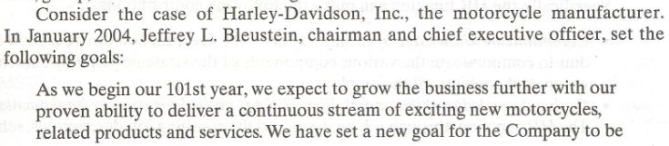
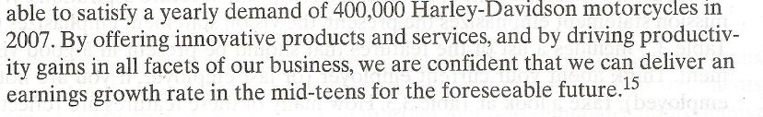
CASE EXAMPLE: Goals (Contd.)

Slide 14
CASE EXAMPLE: Goals (Contd.)
These goals provide a clear direction for Harley Davidson.
In-fact, they provide useful information to guide unit level goals as well as individual and team performance.
The entire organization has a clear sense of focus because all members know that there is a goal to deliver 400,000 motorcycles in 2007.

Slide 15
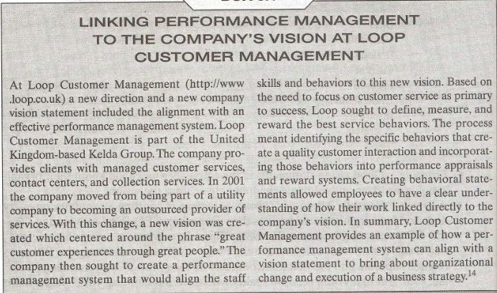

Slide 16
Strategies
At this point, we know that organization is all about mission, what it needs to be in future(vision), and some intermediate steps to follow to get there(goals).
What remains is a discussion of how to fulfill the mission and vision and how to achieve the stated goals.

Slide 17
Strategies (Contd.)
This is achieved by creating strategies, which are description of game plans, or how to proceed to reach the stated objectives.
The strategies could address issues of growth, survival, turn around, stability, innovation and leadership, among others.

Slide 18
Strategies- HR Function
Human resources function play a critical role in creating and implementing the strategies that will allow the organization to realize its mission and vision.

Slide 19
Strategies- HR Function (Contd.)
HR function can make the following contributions:
Communicate knowledge of strategic plans:
  The HR function can be a good conduit to communicate the various components of strategic plan(e.g., mission, vision, and goals) to all the employees.

Slide 20
Strategies- HR Function (Contd.)
Outline knowledge, skills, and abilities needed for strategic implementation:
  The HR function through job analyses and the resulting job descriptions, serves as a repository of knowledge regarding what KSAs are needed for successful implementation of the strategic plans.

Slide 21
Strategies- HR Function (Contd.)
Propose reward system:
  The HR function can provide useful information on what type of reward system should be implemented to motivate employees to support the strategic plan.

Slide 22
Developing strategic plans at unit level
The organization’s strategic plan has a direct impact on the unit’s strategic plan.
This illustrates that a mission statement is aligned with the overall organization’s mission statement.

Slide 23
Developing strategic plans at unit level (Contd.)
Similarly, the vision statement, goals and strategies of various units need to be congruent with the overall organizational vision, goals, and strategies.

Slide 24
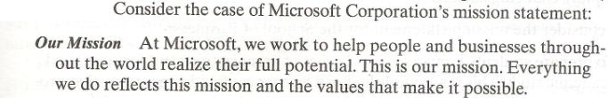

Slide 25
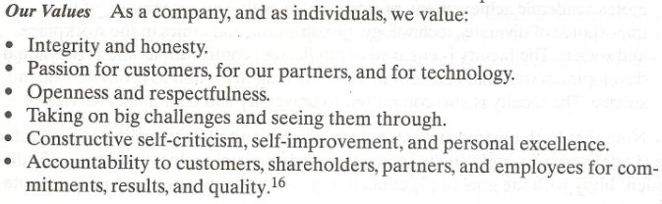

Slide 26
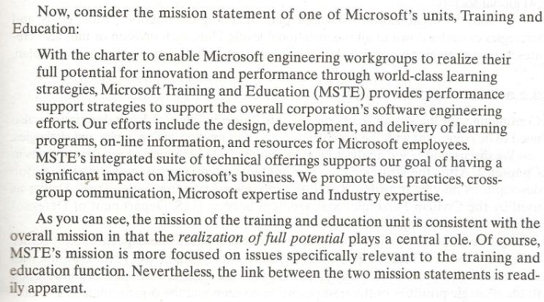

Slide 27
Developing strategic plans at unit level (Contd.)
As you can see, the mission of the training and education unit is consistent with the overall mission in that the realization of full potential plays a central role.
MSTE’s mission is more focused on issues specifically relevant to the training and education function.

Slide 28
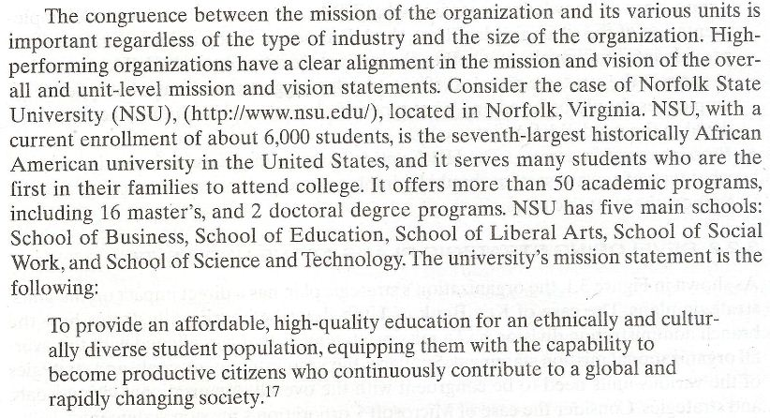

Slide 29
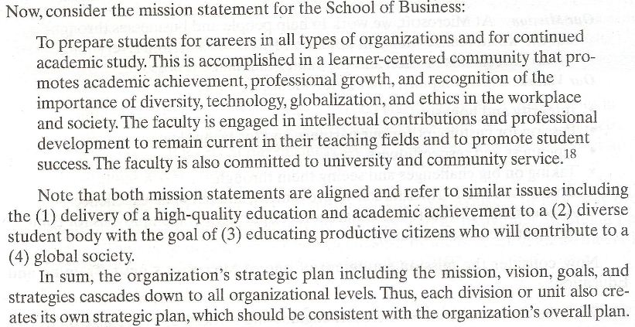

Slide 30
Job descriptions
Job description also need to be congruent with the organization and unit mission, vision and goals and strategies.
The job analysis process leads to the creation of job description.

Slide 31
Job descriptions (Contd.)
After the strategic plan is completed, some rewriting of the existing job descriptions may be in order.
Example : Trailer Truck CASE

Slide 32
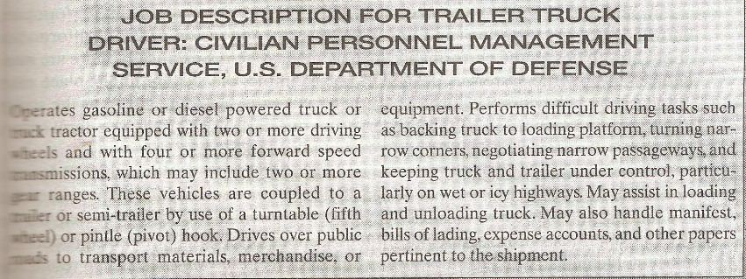

Slide 33
Job descriptions (Contd.)
Job description provide information about the various tasks performed together with a description of some of KSAs required for the position.

Slide 34
Job descriptions (Contd.)
But what is the link with the organization and unit strategic plans?
How do the specific tasks make a contribution to the strategic priorities and the organization as a whole?

Slide 35
Job descriptions (Contd.)
The description includes only cursory and indirect information regarding these issues.
For example, one can assume that;
  The proficient handling of bills of landing,
  expense accounts, and
  other papers pertinent to the shipment
Contributes towards a smooth shipping operation and therefore, make a contribution to the transportation division.

Slide 36
Summary of Today’s Lecture
Characteristics of Good Vision statements
Goals
Strategies
Strategies – HR Function
Developing strategic plans at unit level
Job descriptions

Slide 37
Thank You

