Slide 1
MGT-555
PERFORMANCE AND CAREER MANAGEMENT
Session: One
WASEEM UR REHMAN

Slide 2
Self Introduction
Finance Graduate;
  Associate Chartered Certified Accountant (ACCA, UK)
  M.Com- Majors Finance / HRM (Punjab University)
  Certified Financial Consultant (IFC , Canada)
  Certifications in Project Management, HRM, Strategic Management.
Consultant with USAID.
Finance Manger in various national and multinational organizations.
Visiting Faculty various universities and institutes.

Slide 3
Course Objective
This course will examines the importance of an effective performance and career management system in helping organizations define and achieve short and long term goals.
It explains and reinforces the concept that performance and career management is not a one-time supervisory event, but an ongoing process of planning, facilitating, assessing, and improving individual and organizational performance.

Slide 4
Course Objective (Contd.)
In addition, the course emphasizes the importance of measuring the effectiveness of human resource activities that are designed to enhance individual and organizational performance.

Slide 5
Key Learning Outcomes
After the successful completion of this course, students will be able to :
1. Design an organization’s performance management process that is compliant with law and supports organizational mission and strategy.

Slide 6
Key Learning Outcomes (Contd.)
2. Compare and contrast various organizational performance and career management programs and best practices and define attributes of effective performance and career management systems.

Slide 7
Key Learning Outcomes (Contd.)
3. Employ job-related performance standards and performance indicators that reflect the employee’s range of responsibilities.
4. Assess how increased employee involvement can contribute to effective performance and coach employees to identify career paths and resources available to support individual development.

Slide 8
Key Learning Outcomes (Contd.)
5. Identify and communicate appropriate actions with employees (e.g. training and development, wage increase, promotion, bonus etc.) based on their performance strengths and weaknesses.

Slide 9
Course Contents/ Structure
SECTION 1: HUMAN RESOURCE MANAGEMENT
  CHAPTER 1: Human Resource Management.
  CHAPTER 2: Strategic Human Resource Management

Slide 10
Course Contents/ Structure
SECTION 2: PERFORMANCE MANAGEMENT - STRATEGIC AND GENERAL CONSIDERATIONS
  CHAPTER 3: Performance Management in Context
  CHAPTER 4: Performance Management Process
  CHAPTER 5: Performance Management role in Strategic Planning

Slide 11
Course Contents/ Structure
SECTION 3: PERFORMANCE MANAGEMENT SYSTEM IMPLEMENTATION
  CHAPTER 6: Defining Performance and Choosing a Measurement Approach
  CHAPTER 7: Measuring Results and Behavior
  CHAPTER 8:Gathering Performance Information
  CHAPTER 9: Performance Management System Implementation

Slide 12
Course Contents/ Structure
SECTION 4: COMPENSATION AND PERFORMANCE MANAGEMENT
  CHAPTER 10: Compensation and Legal Issues
  CHAPTER 11: Managing Performance

Slide 13
Course Contents/ Structure
SECTION 5: CAREER MANAGEMENT
  CHAPTER 12: Career Management
  CHAPTER 13: Career Development
  CHAPTER 14: Career Stages
  CHAPTER 15: Career Choices and Preferences

Slide 14
Course Contents/ Structure
SECTION 6: EMPLOYEE DEVELOPMENT
  CHAPTER 16: Employee Development – Performance and Career
  CHAPTER 17: Enhancing Performance Management Skills

Slide 15
Summary of Today’s Lecture
After studying this chapter, you should be able to:
Define human resource management.
Describe the functions of human resource management.
Summarize the types of assistance the human resource department provides.
Explain the desired relationship between human resource managers and operating managers.

Slide 16
Summary of Today’s Lecture(cont.)
Identify several challenges today’s human resource managers currently face.
Outline several potential challenges and contributions that an increasingly diverse workforce presents.
Discuss the role of human resource managers in the future.
Explain how human resource managers can affect organizational performance.
Summarize several guidelines to follow when communicating human resource programs.

Slide 17
Human Resource Management
Definitions
According to Johnson, P. (2009)
Human resource management (HRM, or simply HR) is a function in organizations designed to maximize employee performance in service of their employer’s strategic objectives.
The process of hiring and developing employees so that they become more valuable to the organization. Human resource Management includes conducting job analyses, planning personnel needs, recruiting the right people for the job, orienting and training, managing wages and salaries, providing benefits and incentives, evaluating performance, resolving disputes, and communicating with all employees at all levels.

Slide 18
Human Resource Management
Human Resource Management
  Activities designed to provide for and coordinate the human resources of an organization
  Traditionally referred to as personnel administration or personnel management
Human Resource Functions
  Tasks and duties performed in large and small organizations to provide for and coordinate human resources
Talent management
  The broad spectrum of HR activities involved in obtaining and managing firm’s human resources

Slide 19
Human Resource Management Process
Human Resource Planning
Recruitment
Selection
Orientation
Training & Development
Performance management
Compensation & Benefits
Career Development

Slide 20
Who Performs the Human Resource Functions?
Operating manager
  Person who manages people directly involved with the production of an organization’s products or services
  Production manager in a manufacturing plant, loan manager in a bank

Slide 21
Who Performs the Human Resource Functions?
Human resource generalist
  Person who devotes a majority of working time to human resource issues, but does not specialize in any specific areas.
Human resource specialist
  Person specially trained in one or more areas of human resource management
  labor relations specialist, wage and salary specialist

Slide 22
The Human Resource Department
Primary function – Provide support to operating managers on all human resource matters
Fulfills a traditional staff role and acts in an advisory capacity
Depending upon the organization, functions may be split between operating managers and human resource department

Slide 23
The Human Resource Department
Other functions:
Customarily organizes and coordinates hiring and training
Maintains personnel records
Acts as a liaison between management, labor, and government
Coordinates safety programs

Slide 24
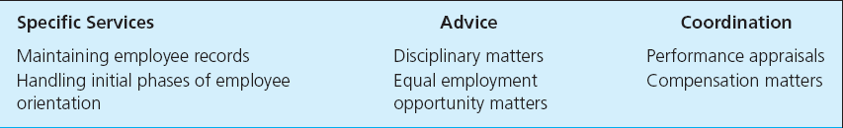
Examples of Types of Assistance Provided by Human Resource Departments

Slide 25
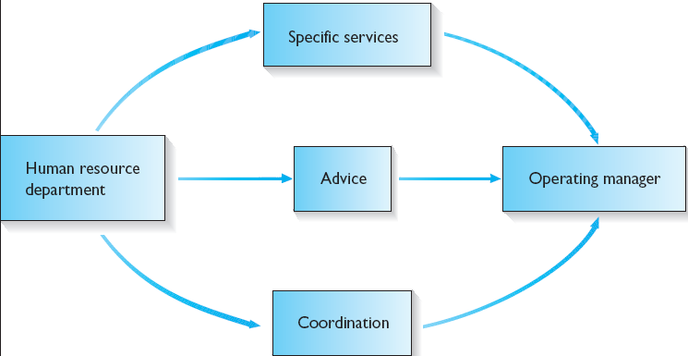
Three Types of Assistance Provided by Human Resource Department

Slide 26
Challenges For Today’s Human Resource Managers
Diversity in the workforce
Result of changes in government requirements
Organizational structures
Technology
Management approaches

Slide 27
Diversity in Workforce
Between years 2004-2018:
  Almost half the new entrants will be women
  White, non-Hispanic males will comprise fewer than one-third of new labor force entrants
  Average age of employees will climb to 42.3

Slide 28
Diversity in Workforce
Increasing globalization of many companies
Defining diversity in global terms
  Looking at all people and everything that makes them different from one another, as well as the things that make them similar
  Values, habits, and customs

Slide 29
Key Human Resource Related Challenges Facing global Companies
Cultural differences
Compliance with data-privacy regulations
Varying economic conditions across countries
Time zone differences
Legal environment
International compliance

Slide 30
Challenges and Contributions of Diversity
Organizations must get away from fitting employees into a single corporate mold
  Must create new human resource policies to explicitly recognize and respond to unique needs of individual employees
Communication problems that arise will necessitate additional training in written and spoken language skills

Slide 31
Regulatory Changes
Organizations face new regulations routinely issued in areas of:
Safety and health
Equal employment opportunity
Pension reform
Quality of work life

Slide 32
Structural Changes to Organizations
Downsizing
  Laying off large members of managerial and other employees
Outsourcing
  Subcontracting work to an outside company that specializes in that particular type of work

Slide 33
Structural Changes to Organizations
Rightsizing
  Continuous and proactive assessment of mission-critical work and its staffing requirements
Reengineering
  Fundamental rethinking and radical redesign of business processes to achieve dramatic improvements in cost, quality, services, and speed

Slide 34
Technological and Managerial Changes within Organizations
Computerized information systems are now being used to maintain easily accessible employee data that are valuable in job placement and labor utilization
Also being used in employee training, succession planning, and compensation management, and to track and report affirmative action activity

Slide 35
Technological and Managerial Changes within Organizations
Many organizations have implemented Web-based human resource systems that allow employees to complete many HR-related tasks online.
Referred to as electronic human resources (eHR)

Slide 36
Advantages of eHR
Employee convenience
Immediate response
Increased accuracy
Reduced costs

Slide 37
Technological and Managerial Changes within Organizations
Telecommuting
  Working at home by using an electronic linkup with a central office
  Applicable to employees in home country or on different continents

Slide 38
Technological and Managerial Changes within Organizations
Empowerment
  Form of decentralization that involves giving subordinates substantial authority to make decisions
Self-managed work teams
  Groups of peers that are responsible for a particular task or area

Slide 39
Human Resource Management In the Future
Human resource managers must be integrally involved in organization’s strategic and policy-making activities
Human resource managers need to:
  Overcome negative impressions and biases sometimes associated with this field
  Become well-rounded businesspeople
  Understand business complexities and strategies

Slide 40
Human Resource Management In the Future
Becoming more familiar with the business:
Know the company strategy and business plan
Know the industry
Support business needs
Spend more time with the line people
Keep your hand on the pulse of the organization
Learn to calculate costs and solutions in hard numbers

Slide 41
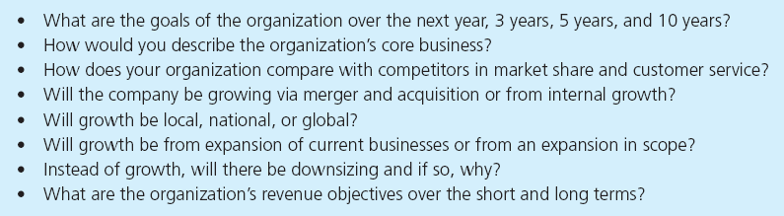
Questions for Understanding the Organization’s Business Strategies

Slide 42
Impact of the HR Manager on Organizational Performance
Reducing unnecessary overtime expenses by increasing productivity during a normal day
Staying on top of absenteeism and instituting programs designed to reduce money spent for time not worked
Eliminating wasted time by employees with sound job design

Slide 43
Impact of the HR Manager on Organizational Performance
Minimizing employee turnover and unemployment benefit costs by practicing sound human relations and creating a work atmosphere that promotes job satisfaction
Installing and monitoring effective safety and health programs to reduce lost-time accidents and keep medical and workers’ compensation costs low

Slide 44
Thanks

