Slide 1
Introduction to
Human Resource Development
Moving from HRM to HRD

Slide 2
What is HR?
Human Resources is the part of the organization that deals with people
Managing the human resource
This means acquiring developing and supporting staff as well as ensuring they fulfill their role at work

Slide 3
Define HRM
Torrington et al “ It is a series of activities which; first enables working people and the organisation which uses their skills to agree about the objective and nature of their working relationship and secondly, ensure that the agreement is fullfilled.”

Slide 4
Major HRM functions
EXTERNAL ENVIRONMENT
INTERNAL ENVIRONMENT
Staffing
Human
Resource
Development
Employee
& Labor
Relations
HR Management
Functions
Safety
& Health
Compensation
& Benefits

Slide 5
Continue
So the Human Resource Manager job includes:
Conducting Job analysis ( determining the nature of each job)
Planning labour needs and recruiting job candidated
Selecting Job candidates
Orienting and training new employees
Managing wages and salaries (compensating employees)
Providing incentives and benefits
Appraising performance
Communicating ( interviewing, counselling, disciplining)
Training and development

Slide 6
Cont.
Training and Developing managers
Building employee commitment
And what a HRM Manger should know about
Equal opportunity and affirmative action
Employee health and safety
Handling grievances and labour relations

Slide 7
Personnel Management V Resource Management
Personnel Management is ‘workforce’ centred
HR is resource centred
Does not identify with Management interests
Directed at management needs for deployment
People have the right to proper ‘treatment’
Focus is on individuals and needs and potential
Intervene between manager - subordinate relationships
Planning, monitoring and control rather than mediation

Slide 8
Why is it Important?
Staff are the largest revenue cost of any organisation.
Staff are a volatile resource, they can leave you any time.
Staff are a store of corporate knowledge and the means of service delivery.
Retaining and developing good staff allows you to use skills and develop as a business.
Individuals should contribute more than they cost.
In the industry customer care critical and delivered by staff as representatives.

Slide 9
Hard and Soft HRM
'Storey (1989) has distinguished between hard and soft forms of HRM, typified by the Michigan and Harvard models respectively. 'Hard' HRM focuses on the resource side of human resources. It emphasizes costs in the form of 'headcounts' and places control firmly in the hands of management. Their role is to manage numbers effectively, keeping the workforce closely matched with requirements in terms of both bodies and behaviour. 'Soft' HRM, on the other hand, stresses the 'human' aspects of HRM. Its concerns are with communication and motivation. People are led rather than managed. They are involved in determining and realizing strategic objectives.'

Slide 10
Factors Affecting HR
Legislation
The Economic environment
The global economy
The structure of the labour market
The Political environment
Changes in technology
Need to constantly retrain staff

Slide 11
HRM Function
The company rather than the state or trade union provide employee security and welfare
HRM focuses on achieving organisational goals through individual achievement
Providing the right person in the right place
Directing positive employee communication and involvement
Optimise co-operation and loyalty
Imposition of different forms of control to develop management

Slide 12
Moving with the Times
Forces interact in complex ways to move and change markets, businesses and the economics of regions.
  The changing expectations of a growing population.
  a greater sense of self-determination
  expectation of rewards and recognition for efforts expended
  a growing appetite for a better life.

Slide 13
Business Changes
HRM equipped with strategy - a new set of tools and measures
People issues are now recognised as being central to the success of any organisation
as a consequence, human resources has assumed a higher profile.
senior management meeting address concerns
  staffing levels,
  recruitment,
  management development
  retention.

Slide 14
Mutuality between Employers and Employees
The theory that policy will elicit commitment which in turn will yield better economic performance and greater human development
  Mutual goals
  mutual influence
  mutual respect
  mutual rewards
  mutual responsibility
    Walton, 1985

Slide 15
Introduction to
Human Resource Development

Slide 16
Learning Objectives
After learning this chapter, you should be able to:
Define human resource development (HRD)
Relate the major historical events leading up to the establishment of HRD as a profession
Distinguish between HRD and Human Resource Management (HRM)
Identify and describe each of the major HRD functions
Recognize the various roles and competencies of an HRD professional
Identify some of the challenges facing HRD professionals
Identify the major phases of the training and HRD process

Slide 17
Definition of HRD
A set of systematic and planned activities designed by an organization to provide its members with the necessary skills to meet current and future job demands.

Slide 18
Evolution of HRD
Early apprenticeship programs
Early vocational education programs
Early factory schools
Early training for unskilled/semiskilled
Human relations movement
Establishment of training profession
Emergence of HRD

Slide 19
Early Apprenticeship Programs
Artisans in 1700s
Artisans had to train their own workers
Guild schools
Yeomanries (early worker unions)

Slide 20
Early Vocational Education Programs
1809 – DeWitt Clinton’s manual school
1863 – President Lincoln signs the Land-Grant Act promoting A&M colleges
1917 – Smith-Hughes Act provides funding for vocational education at the state level

Slide 21
Early Factory Schools
Industrial Revolution increases need for trained workers to design, build, and repair machines used by unskilled workers
Companies started machinist and mechanical schools in-house
Shorter and more narrowly-focused than apprenticeship programs

Slide 22
Early Training for Unskilled/Semiskilled Workers
Mass production (Model T)
  Semiskilled and unskilled workers
  Production line – one task = one worker
World War I
  Retool & retrain
  “Show, Tell, Do, Check” (OJT)

Slide 23
Human Relations Movement
Factory system often abused workers
“Human relations” movement promoted better working conditions
Start of business & management education
Tied to Maslow’s hierarchy of needs

Slide 24
Establishment of the Training Profession
Outbreak of WWII increased the need for trained workers
Federal government started the Training Within Industry (TWI) program
1942 – American Society for Training Directors (ASTD) formed

Slide 25
Emergence/appearance of HRD
Employee needs extend beyond the training classroom
Includes coaching, group work, and problem solving
Need for basic employee development
Need for structured career development
ASTD changes its name to the American Society for Training and Development

Slide 26
Relationship Between HRM and HRD
Human resource management (HRM) encompasses many functions
Human resource development (HRD) is just one of the functions within HRM

Slide 27
HRD Functions
Training and development (T&D)
Organizational development
Career development

Slide 28
Training and Development (T&D)
Training – improving the knowledge, skills and attitudes of employees for the short-term, particular to a specific job or task – e.g.,
  Employee orientation
  Skills & technical training
  Coaching
  Counseling

Slide 29
Training and Development (T&D)
Development – preparing for future responsibilities, while increasing the capacity to perform at a current job
  Management training
  Supervisor development

Slide 30
Organizational Development
The process of improving an organization’s effectiveness and member’s well-being through the application of behavioral science concepts
Focuses on both macro- and micro-levels
HRD plays the role of a change agent

Slide 31
Career Development
Ongoing process by which individuals progress through series of changes until they achieve their personal level of maximum achievement.
  Career planning
  Career management

Slide 32
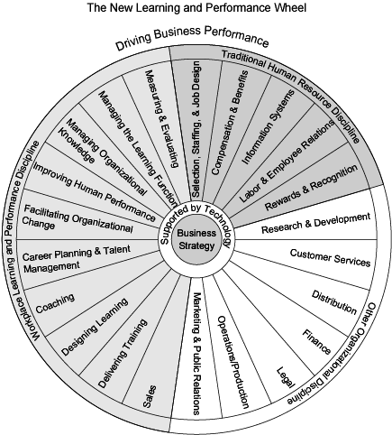
Learning & Performance
By Permission: Naughton & Rothwell (2004)

Slide 33
Critical HRD Issues
Strategic management and HRD
The supervisor’s role in HRD
Organizational structure of HRD

Slide 34
Strategic Management & HRD
Strategic management aims to ensure organizational effectiveness for the foreseeable/projected future – e.g., maximizing profits in the next 3 to 5 years
HRD aims to get managers and workers ready for new products, procedures, and materials

Slide 35
Supervisor’s Role in HRD
Implements HRD programs and procedures
On-the-job training (OJT)
Coaching/mentoring/counseling
Career and employee development
A “front-line participant” in HRD

Slide 36
Organizational Structure of HRD Departments
Depends on company size, industry and maturity
No single structure used
Depends in large part on how well the HRD manager becomes an institutional part of the company – i.e., a revenue contributor, not just a revenue user

Slide 37
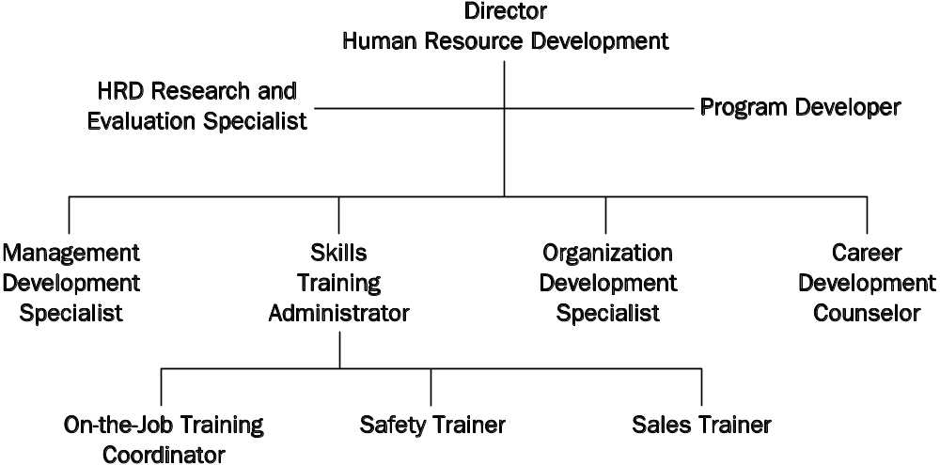
HRD Organization in a Large Company

Slide 38
Roles and competencies of an HRD professional
Main roles:
- Learning strategies – involved in higher level of decision making concerning how HRD initiatives the goals and strategies of O.
Buss. partner – work together with other manager to implement evaluate HRD initiatives.
The project manager – involved in day to day planning, funding and monitoring HRD initiatives.
Professional specialist – add their expertise in particular area ex. designing, developing, delivering and evaluating the HRD initiatives.

Slide 39
Roles and competencies of an HRD professional
Executive/Manager
HR Strategic Advisor
HR Systems Designer/Developer
Organization Change Agent
Organization Design Consultant
Learning Program Specialist

Slide 40
Sample HRD Jobs/Roles – 2
Instructor/Facilitator
Individual Development and Career Counselor
Performance Consultant (Coach)
Researcher

Slide 41
HR Manager Role
Integrates HRD with organizational goals and strategies
Promotes HRD as a profit enhancer
Tailors HRD to corporate needs and budget
Institutionalizes performance enhancement

Slide 42
HR Strategic Advisor Role
Consults with corporate strategic thinkers
Helps to articulate goals and strategies
Develops HR plans
Develops strategic planning education and training programs

Slide 43
HR Systems Designer/Developer
Assists HR manager in the design and development of HR systems
Designs HR programs
Develops intervention strategies
Plans HR implementation actions

Slide 44
Organization Change Agent
Develops more efficient work teams
Improves quality management
Implements intervention strategies
Develops change reports

Slide 45
Organization Design Consultant
Designs work systems
Develops effective alternative work designs
Implements changed systems

Slide 46
Learning Program Specialist
Identifies needs of learners
Develops and designs learning programs
Prepares learning materials and learning aids
Develops program objectives, lesson plans, and strategies

Slide 47
Instructor/Facilitator
Presents learning materials
Leads and facilitates structured learning experiences
Selects appropriate instructional methods and techniques
Delivers instruction

Slide 48
Individual Development and Career Counselor
Assists individuals in career planning
Develops individual assessments
Facilitates career workshops
Provides career guidance

Slide 49
Performance Consultant (Coach)
Advises line management on appropriate interventions to improve individual and group performance
Provides intervention strategies
Develops and provides coaching designs
Implements coaching activities

Slide 50
Researcher
Assesses HRD practices and programs
Determines HRD program effectiveness
Develops requirements for changing HRD programs to address current and future problems

Slide 51
Challenges to organization and to HRD professionals
Changing workforce demographics
Competing in global economy
Eliminating the skills gap
Need for lifelong learning
Need for organizational learning

Slide 52
Changing Demographics in the U.S. Workplace
By 2020, it is predicted that:
African-Americans will remain at 11%
Hispanics will increase from 9% to 14%
Asians will increase from 4% to 6%
Whites will decrease from 76% to 68%
Women will increase from 46% to 50%
Older workers (>55) will increase to 25%

Slide 53
Competing in the Global Economy
New technologies
Need for more skilled and educated workers
Cultural sensitivity required
Team involvement
Problem solving
Better communications skills

Slide 54
Eliminating the Skills Gap
Example: In South Carolina, 47% of entering high school freshmen don’t graduate.
  Best state is Vermont, with 81% graduating
Employees need to be taught basic skills:
  Math
  Reading
  Applied subjects
Need to improve U.S. schools!

Slide 55
Need for Lifelong Learning
Organizations change
Technologies change
Products change
Processes change
PEOPLE must change!!

Slide 56
Need for Organizational Learning
Organizations must be able to learn, adapt, and change
Principles:
  Systems thinking
  Personal mastery
  Mental models
  Shared visions
  Team learning

Slide 57
A Framework for the HRD Process
HRD efforts should use the following four phases (or stages):
Need assessment
Design
Implementation
Evaluation

Slide 58
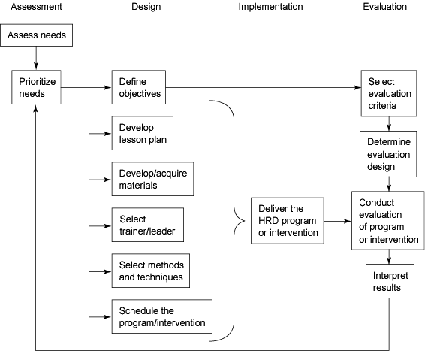
Training & HRD Process Model

Slide 59
Needs Assessment Phase
It used to address some need or gap within an organization by:
- Establishing HRD priorities
- Defining specific training and objectives
- Establishing evaluation criteria

Slide 60
Design Phase
Selecting who delivers program
Selecting and developing program content
Scheduling the training program

Slide 61
Implementation Phase
Implementing or delivering the program

Slide 62
Evaluation Phase
Determining program effectiveness – e.g.,
Keep or change providers?
Offer it again?
What are the true costs?
Can we do it another way?

Slide 63
Summary
HRD is too important to be left to amateurs
HRD should be a revenue producer, not a revenue user
HRD should be a central part of company
You need to be able to talk MONEY

