Slide 1
Lesson 1
Lecture 8 (Part 2)
  Overview of Human Resources and Professional Development

Slide 2
Quality Human Resources for development & training
The Recruitment and Monitoring of quality Staff
( ` Part 2)

Slide 3

Human Resources - Retention
Human Resource Management and
Human Resource Development Components

Slide 4
Actions and Behaviour |  | Communication and Information Systems (Technology) |  | Management and Leadership Styles (Vision and Mission) |  | HRD
Values |  | Involvement and Empowerment |  | Employment and Reward Strategies |  | Motivation
Beliefs |  | Commitment |  | Trust and Integrity |  | Psychological contract
Mankin, D.P (2001) A model for human resource development

Slide 5
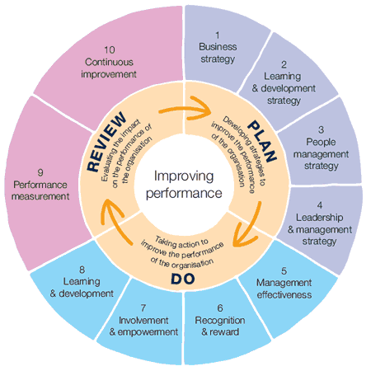
Investors in People

Slide 6
Performance and Retention
Induction
Probation
Staff Performance Review
Staff Development – Career Development/Succession Planning
Total Reward Package

Slide 7
Induction – [risk and benefit]
Unsatisfactory performance and low job satisfaction
Absenteeism, high labour turnover and resignations or dismissals
Tribunal cases if employees complain of unfair dismissal because of inadequate training
High demands on managers
Accidents leading to injuries and/or prosecution
Mistakes which are costly to the company

Slide 8
Induction (continued)
With the best will in the world, induction cannot be described as a glamorous, exciting facet of people management. In fact, it often degenerates into a hastily organised chore – a task that line managers can see as being merely a distraction from more important duties…
(Rankin, 2006)

Slide 9
Probation
“a testing of conduct or character of person, especially of candidate …… for employment.” (Concise Oxford Dictionary)
Staff grades 1 to 5, up to a maximum of 06 months [reviewed at 4/12/20 weeks]
Staff grades 6 to 9, up to a maximum of 12 months [reviewed at 8/26/42 weeks]
Temporary or casual staff, grades 1 to 9, up to a maximum of 3 months [reviewed at 3/7/11 weeks]

Slide 10
Staff Performance Review
“a cultural shift within a resource towards an acceptance of performance management…..so that performance review becomes the norm, rather than the exception. This will involve tackling poor performance, but also managing good performance”.
(KPMG, 2005)
Staff Review and Development Scheme (2002)
Staff Performance Review Scheme (2007)

Slide 11
Staff Performance Review
The scheme aims to:
Match individual and organisational needs
Structured objective setting linked to corporate plans
Review individual performance
Identify personal development needs
Identify any factors which may affect future objectives and priorities
Allow staff to feedback on unit and organizational strategies and plans

Slide 12
Staff Performance Review
FIRST REVIEW
AUGUST JULY
COMMUNICATION
MID-TERM
REVIEW

Slide 13
Staff Performance Review
SPECIFIC -
MEASURABLE -
ACHIEVABLE -
REALISTIC -
TIMED –

Slide 14
Career Development and Succession Planning
Corporate Staff Development Activities
Coaching and Mentoring Framework
Continuing Professional Development

Slide 15
Total Reward Package
a safe and amiable working environment;
job security;
induction;
staff development;
flexible working;
fair recruitment, appraisal, promotion and
redundancy policies and procedures
(Herriot et al. 1997)

Slide 16
Actions and Behaviour |  | Communication and Information Systems (Technology) |  | Management and Leadership Styles (Vision and Mission) |  | HRD
Values |  | Involvement and Empowerment |  | Employment and Reward Strategies |  | Motivation
Beliefs |  | Commitment |  | Trust and Integrity |  | Psychological contract
Mankin, D.P (2001) A model for human resource development

Slide 17
Quality Standards Framework
Core areas of Knowledge
Our Values
Our Ethos
Five Core Competencies
Fourteen Higher Education Role Analysis elements
Seven Principles of Public Life

Slide 18
Actions and Behaviour |  | Communication and Information Systems (Technology) |  | Management and Leadership Styles (Vision and Mission) |  | HRD
Values |  | Involvement and Empowerment |  | Employment and Reward Strategies |  | Motivation
Beliefs |  | Commitment |  | Trust and Integrity |  | Psychological contract
Mankin, D.P (2001) A model for human resource development

Slide 19
Management standards
Support the development of job descriptions and person specifications;
Underpin the recruitment, induction and probation of new managers
Provide a platform for self-appraisal or audit of existing skills and knowledge
Underpin the identification of appropriate development needs
Form a basis for career development/succession planning

Slide 20

A Final Thought……..
QUALITY STAFF = A QUALITY ORAGANIZATION

