Slide 1
Quick Recap of Lecture 4

Slide 2
Internal and External Trends
Increasingly, legislative, socio-demographic and business trends are exerting pressures for organizational change (Solomon, 1994). Many organizations are finding it easier to make technical changes than to make accompanying human resources changes. In fact, the ability to adapt their human resources to new requirements is proving to be a limiting factor to success for many organizations (Coates, 1990; Towers Perrin, 1992).

Slide 3
Reasons why HRP&D is becoming more important
    Skill shortages in key areas (e.g., systems analysts, engineers, data base specialist, information/communications specialists) caused by a greater demand for information processing/skills along with a shrinking labour force (the baby bust) making it increasingly important to plan for, and to develop staff effectively.

Slide 4
Human Resources/Succession Planning
There is sometimes confusion in the difference between human resources planning and succession planning. We have found the following rule of thumb to be useful in distinguishing between the two (see also, Walker, 1980):
Human resources planning is aimed at resolving gaps that may exist for human resources of certain skills, whether across the organization, or in specific organizational units.
Succession planning, is aimed at determining how specific key, and/or vulnerable positions are to be filled appropriately.
Thus, in operating specifically at the position, or individual level succession planning may be regarded as a subset or special application of human resources planning.

Slide 5

What is a Personal Development Plan?
Organisations are increasingly using Personal Development Plans as a way to form the basis of training and career development of individuals.
Learners hoping to continue studies into higher education are likely to be expected to complete a Personal Development Plan.

Slide 6
Lesson 1
Lecture 5
  Overview of Human Resources and Professional Development

Slide 7
SUCCESSION PLANNING
OVERVIEW

Slide 8
SUCCESSION PLANNING
May be used to help line management answer such questions as:
are there any special business/economic factors that are likely to have major effects on the organization over the next one to five years?
what will the organizational unit look like one year from now? Two years from now? Three years from now?
what organizational problems are being experienced?
what human resources problems are being experienced?

Slide 9
Core Principles Underlying Succession Planning
1. Leaders really do matter … in managing/driving accountability, results, culture.
2. Performance is what counts … top performers over high potentials
(the “what” & “how” both count).
3. Today’s top performing leaders aren’t necessarily tomorrow’s …
even our best leaders can fall behind or derail.
4. Talent is an enterprise resource … willingness to share talent makes
the system work.
5. A broad set of experience & assignments is the best classroom …
yet a balanced approach is still necessary for development.
6. It’s incumbent upon today’s “top-100” to leave a legacy of
future talent … current leaders must teach, mentor, & role model others on what
it takes to succeed.
7. Invest in the best … focus the rest.

Slide 10
FOUR LEVERS FOR LEARNING
5-10%
5-10%
55-65%
25-30%

Slide 11
“There are two kinds of people in organizations: Those with 20 years experience and those with one year experience repeated 20 times.”
—Gene Dalton, BYU

Slide 12
“We put good people in big jobs before they are ready.”
—Pepsi Co.

Slide 13
Leadership Development =
V+C+L
Variety of Experiences +
Challenging Assignments +
Ability & Willingness to Learn
—Center for Creative Leadership

Slide 14

Succession Planning: Key Elements
Assessment of
Key Positions
Identification of
Key Talent
Key
Elements
Development
Monitoring & Review
Assessment of
Key Talent
Generation of
Development Plans

Slide 15
Succession Planning: Key Elements
1. Assessment of Key Positions:
• What are the competencies and experiences needed
to qualify for each key position?
2. Identification of Key Talent:
• Typically people at the top two levels of the organization
and high potential employees one level below.
• Identified by their management’s assessment of their
performance and potential for advancement.
3. Assessment of Key Talent:
• For each person on the radar screen, primary development
needs are identified focusing on what they need in order
to be ready for the next level.

Slide 16
Succession Planning: Key Elements
4. Generation of Development Plans:
• A development plan is prepared for how we will help the
person develop over the next year.
5. Development Monitoring & Review
• An annual or semi-annual succession planning review is
held to review progress of key talent and to refresh or
revise their development plan.

Slide 17
ADC Telecommunications
Experiences Profile
General Manager
1. Bottom line accountability; Has managed a P&L
2. Experience in several different functional assignments
3. Negotiation of a relationship with an external partner
4. Living and working in multiple locations including overseas
5. Has multi-company or multi-divisional experience
6. Management of a unit during a downturn; Has effected a turnaround
7. Successful product creation and deployment
8. Heading up a start-up or new venture assignment
9. Significant customer contact; Has demonstrated the ability to close big deals
10. Successful experience in transforming the culture of an organization

Slide 18
XYZ CONTROLLER COMPETENCIES
Reporting & Report Reading
Financial Reporting & Data Recording
Integrity & Trust
Cash Management
Investment
Leadership & Influence
Fund Accounting
Internal Control
Management Accounting
Assertiveness & Confidence
Resource Planning
HR Systems & Policies
Regulatory Compliance
Technical Competence
Industry Knowledge
Travel & Procurement

Slide 19
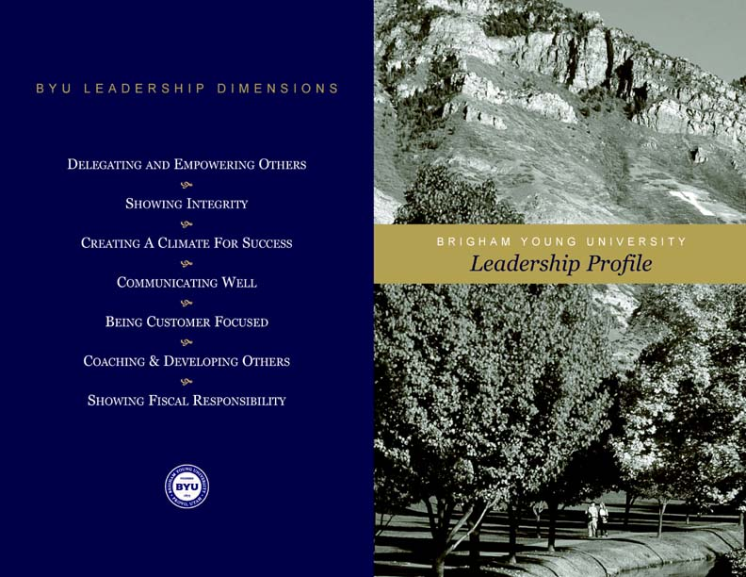

Slide 20
SUCCESSION CANDIDATES
KEY POSITION TITLE ________________________
Backup Candidate Name: ______________________
Current Title: ________________________________
Div: ______________ Level of Readiness (Circle One):
Within 1 Yr. 1–3 Yrs. 3–5 Yrs.
__________________________________________________
Strengths for this position:
Developmental needs for this position:
Comments:
__________________________________________________
Date: FY:
Completed by: Division:

Slide 21
SUCCESSION PLAN SUMMARY
ORGANIZATION:_____________________
Key Position Title | Incumbent Name | Position Vulnerability |  |  | Succession Candidate Names
 |  | Open in < 1 Yr | Open in 1–3 Yrs | Open in 3 + Yrs | Ready in < 1 Yr | Ready in 1–3 Yrs | Ready in 3 + Yrs

Slide 22
EXECUTIVE DEVELOPMENT PLAN
NAME: ________________ TITLE: ________________
2. Special Assignment: (What task force, projects, or special
assignments will be given this year to aid development?)
3. Training: (What specific training or seminars are
recommended this year for his/her development?)
Potential For Promotion:
(Indicate this persons readiness to be promoted to the next
organizational level.)
Ready now for the next level.
Ready in the next 24 months.
Ready in 2 to 3 years.
Recommended Next Position: (List the next assignment that
would most benefit the individual in his/her development.)
Overall Performance Summary:
(Indicate recent performance including major accomplishments
or performance issues.)
Key Strengths:
(List 2 - 3. Indicate key technical or professional competencies,
skills, or knowledge the person has.)
Development Needs:
(List 2 or 3. Indicate key experiences, skills, or knowledge the
person lacks in order to move to the next level.)
Development Actions:
1. On The Job: (What new responsibilities do you plan to assign
to help this person develop this year?)

Slide 23
PLANS FOR SELECTED TALENT
ORGANIZATION:_____________________
Name | Title | High Level Plan

Slide 24
Development Toolbox
Highest Return…
❖ Full Job Change Focused On Development Needs
❖ Job Restructuring Based On Development Needs
❖ Mini P&L Assignments
❖ Cross Divisional Project Leadership Or Assignment
❖ Focused Coaching & Counseling
❖ Industry Representation
❖ Customer Visits Accompanying Senior Executives
❖ Formalized Education Programs
❖ Full 360 Degree Feedback and Evaluation
❖ Motivated Self Development
❖ Seminars and Conferences
… Lowest Return

Slide 25
DEVELOPMENT TOOLBOX
On The Job:
• Job Enrichment
• Special Projects
• Committee Assignments
• Task Force Participation
• Lead Person Responsibilities
• Giving Presentations
• Preparing Proposals
• Installing A New System
• Leading A New Program
• Temporary Job Assignments
• Full Job Change
Learning From Others
• Working With a Mentor
• Teaming with an Expert
• 360 Feedback
• Focused Interviews
Training & Education
• Seminars & Conferences
• Continuing Education
• E Learning
• Cross Training

Slide 26
Semi-Annual Succession Planning Review
Review of succession candidates and development plans in each organizational unit
Report development progress and make necessary adjustments to the plan
Orchestrate moves for the next six months

