Slide 1
Lecture 32

Slide 2
Human Resource Development
Course Summary

Slide 3
Definition of HRD
A set of systematic and planned activities designed by an organization to provide its members with the necessary skills to meet current and future job demands.

Slide 4
Emergence of HRD
Employee needs extend beyond the training classroom
Includes coaching, group work, and problem solving
Need for basic employee development
Need for structured career development
ASTD changes its name to the American Society for Training and Development

Slide 5
Relationship Between HRM and HRD
Human resource management (HRM) encompasses many functions
Human resource development (HRD) is just one of the functions within HRM

Slide 6
Primary Functions of HRM
Human resource planning
Equal employment opportunity
Staffing (recruitment and selection)
Compensation and benefits
Employee and labor relations
Health, safety, and security
Human resource development

Slide 7
Secondary HRM Functions
Organization and job design
Performance management/ performance appraisal systems
Research and information systems

Slide 8
HRD Functions
Training and development (T&D)
Organizational development
Career development

Slide 9
Training and Development (T&D)
Training – improving the knowledge, skills and attitudes of employees for the short-term, particular to a specific job or task – e.g.,
  Employee orientation
  Skills & technical training
  Coaching
  Counseling

Slide 10
Training and Development (T&D)
Development – preparing for future responsibilities, while increasing the capacity to perform at a current job
  Management training
  Supervisor development

Slide 11
Organizational Development
The process of improving an organization’s effectiveness and member’s well-being through the application of behavioral science concepts
Focuses on both macro- and micro-levels
HRD plays the role of a change agent

Slide 12
Career Development
Ongoing process by which individuals progress through series of changes until they achieve their personal level of maximum achievement.
  Career planning
  Career management

Slide 13
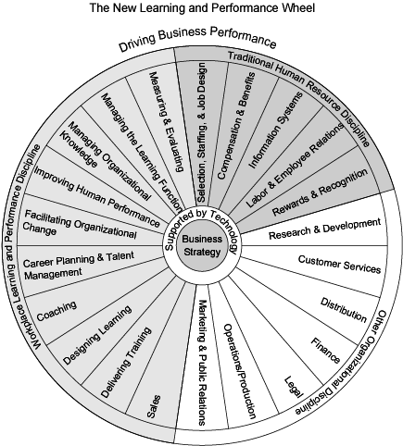
Learning & Performance
By Permission: Naughton & Rothwell (2004)

Slide 14
Supervisor’s Role in HRD
Implements HRD programs and procedures
On-the-job training (OJT)
Coaching/mentoring/counseling
Career and employee development
A “front-line participant” in HRD

Slide 15
Organizational Structure of HRD Departments
Depends on company size, industry and maturity
No single structure used
Depends in large part on how well the HRD manager becomes an institutional part of the company – i.e., a revenue contributor, not just a revenue user

Slide 16
Sample HRD Jobs/Roles
Executive/Manager
HR Strategic Advisor
HR Systems Designer/Developer
Organization Change Agent
Organization Design Consultant
Learning Program Specialist

Slide 17
Sample HRD Jobs/Roles – 2
Instructor/Facilitator
Individual Development and Career Counselor
Performance Consultant (Coach)
Researcher

Slide 18
HR Manager Role
Integrates HRD with organizational goals and strategies
Promotes HRD as a profit enhancer
Tailors HRD to corporate needs and budget
Institutionalizes performance enhancement

Slide 19
HR Strategic Advisor Role
Consults with corporate strategic thinkers
Helps to articulate goals and strategies
Develops HR plans
Develops strategic planning education and training programs

Slide 20
HR Systems Designer/Developer
Assists HR manager in the design and development of HR systems
Designs HR programs
Develops intervention strategies
Plans HR implementation actions

Slide 21
Organization Change Agent
Develops more efficient work teams
Improves quality management
Implements intervention strategies
Develops change reports

Slide 22
Organization Design Consultant
Designs work systems
Develops effective alternative work designs
Implements changed systems

Slide 23
Learning Program Specialist
Identifies needs of learners
Develops and designs learning programs
Prepares learning materials and learning aids
Develops program objectives, lesson plans, and strategies

Slide 24
Instructor/Facilitator
Presents learning materials
Leads and facilitates structured learning experiences
Selects appropriate instructional methods and techniques
Delivers instruction

Slide 25
Individual Development and Career Counselor
Assists individuals in career planning
Develops individual assessments
Facilitates career workshops
Provides career guidance

Slide 26
Performance Consultant (Coach)
Advises line management on appropriate interventions to improve individual and group performance
Provides intervention strategies
Develops and provides coaching designs
Implements coaching activities

Slide 27
Researcher
Assesses HRD practices and programs
Determines HRD program effectiveness
Develops requirements for changing HRD programs to address current and future problems

Slide 28
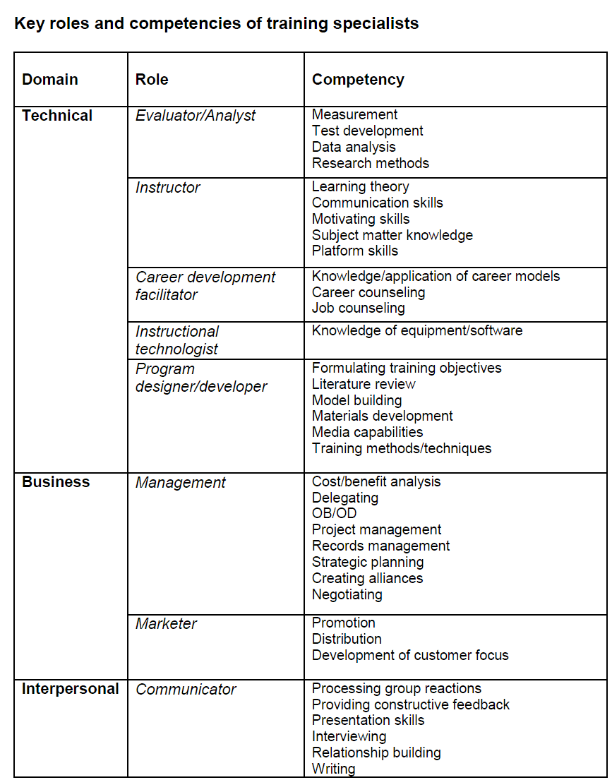

Slide 29
Challenges for HRD
Changing workforce demographics
Competing in global economy
Eliminating the skills gap
Need for lifelong learning
Need for organizational learning

Slide 30
Changing Demographics in the Workplace
By 2020, it is predicted that:
African-Americans will remain at 11%
Hispanics will increase from 9% to 14%
Asians will increase from 4% to 6%
Whites will decrease from 76% to 68%
Women will increase from 46% to 50%
Older workers (>55) will increase to 25%

Slide 31
Competing in the Global Economy
New technologies
Need for more skilled and educated workers
Cultural sensitivity required
Team involvement
Problem solving
Better communications skills

Slide 32
Eliminating the Skills Gap
Example: In South Carolina, 47% of entering high school freshmen don’t graduate.
  Best state is Vermont, with 81% graduating
Employees need to be taught basic skills:
  Math
  Reading
  Applied subjects
Need to improve U.S. schools!

Slide 33
Need for Lifelong Learning
Organizations change
Technologies change
Products change
Processes change
PEOPLE must change!!

Slide 34
Need for Organizational Learning
Organizations must be able to learn, adapt, and change
Principles:
  Systems thinking
  Personal mastery
  Mental models
  Shared visions
  Team learning

Slide 35
A Framework for the HRD Process
HRD efforts should use the following four phases (or stages):
Need assessment
Design
Implementation
Evaluation

Slide 36
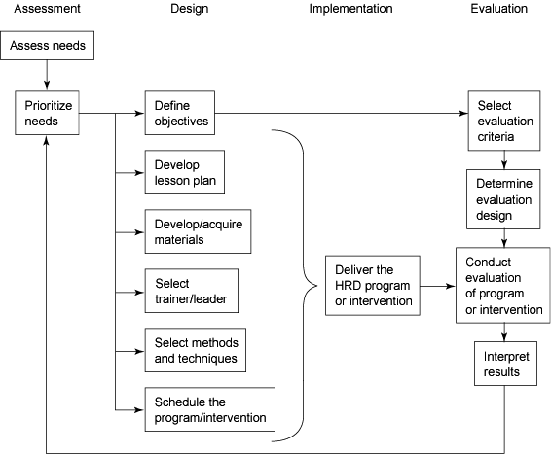
Training & HRD Process Model

Slide 37
Needs Assessment Phase
Establishing HRD priorities
Defining specific training and objectives
Establishing evaluation criteria

Slide 38
Design Phase
Selecting who delivers program
Selecting and developing program content
Scheduling the training program

Slide 39
Implementation Phase
Implementing or delivering the program

Slide 40
Evaluation Phase
Determining program effectiveness – e.g.,
Keep or change providers?
Offer it again?
What are the true costs?
Can we do it another way?

