Slide 1
Quick Recap of Lesson 2

Slide 2
Impact of the HR Manager on Organizational Performance
Reducing unnecessary overtime expenses by increasing productivity during a normal day
Staying on top of absenteeism and instituting programs designed to reduce money spent for time not worked
Eliminating wasted time by employees with sound job design

Slide 3
Communicating Human Resource Programs
Communication
  The transfer of information that is meaningful to those involved
Human resource managers must develop an appreciation for the importance of communication

Slide 4
Myths that keep HR from being a profession
New Realities
HR departments are not designed to provide corporate therapy or to act as social or health-and-happiness retreats. HR professionals must create the practices that make employees more competitive, not more comfortable.
HR activities are based on theory and research. HR professionals must master both theory and practice.
Old Myths
People go into HR because they like people.
Anyone can do HR.

Slide 5
Lesson 1
Lecture 3
  Overview of Human Resources and Professional Development

Slide 6
”Soft” and ”Hard” HRM
Soft HRM emphasizes the importance of high commitment, learning, enlightened leadership; human resources are valuable assets, not variable costs. Models and theories focus on tapping the human potential, based on organizational behavior theories (e.g. Maslow, 1954; Herzberg, 1966; McGregor, 1960)
Hard HRM emphasizes the calculative, quantitative and strategic management aspects of managing the workforce in a rational way (Storey, 1989).

Slide 7
Evolution of HRM
1917-18: 1st formal personnel department created to deal with tight labor market, high turnover, waste and inefficiency, widespread strikes, union growth, government intervention, takeovers
1920’s: HR used to “win” worker cooperation, through ensuring job security, benefits, etc.
1930’-50’s: “Human Relations” recognizes that there are psychological and social influences to worker satisfaction, cooperation, performance; first focus on groups (not teams).

Slide 8
Evolution of HRM (cont’s)
1960’s: Work design, rather than communication and cooperation in groups, is the key to increasing worker motivation. Small work group design leads to greater employee effort, group work provides opportunities for “self-actualization”; work is more interesting and fulfilling.
1970’s: Quality of Work Life (QWL): emphasis on the value of human resources. PM becomes HR.
1990’s-Present: TQM, reengineering, globalization, strategic HR, new technologies, diversity, contingency models, holistic approaches to HR. HRM models include “high involvement”, “high commitment”, “high performance work system”, “innovative work practices”. HR becomes HRM.

Slide 9
Major HRM functions
EXTERNAL ENVIRONMENT
INTERNAL ENVIRONMENT
Staffing
Human
Resource
Development
Employee
& Labor
Relations
HR Management
Functions
Safety
& Health
Compensation
& Benefits

Slide 10
Staffing
(Planning, Recruitment, Selection)
Conducting job analysis to establish the specific requirements of individual jobs within the organization.
Forecasting the human resource requirements the organization needs to achieve its objectives.
Developing tand implementing a plan to meet these requirements.
Recruiting the human resources to fill specific jobs within the organization.

Slide 11
Job Analysis
JA: the process of determining and reporting pertinent information relating to the nature of a specific job. Involves the determination of the tasks which comprise the job and of the “KSA’s” and responsibilities required of the person(s) holding that job, for successful job performance; defines the what, how, why of a job.
Methods of conducting JA: observation, motion and time study, interviews, questionnaires (off-the-shelf; custom)
JA leads to the job description (summary statement + duties and responsibilities) and job specifications (skills, education, experience required).
JA is the foundation for all traditional HR functions (as well as some others!).

Slide 12
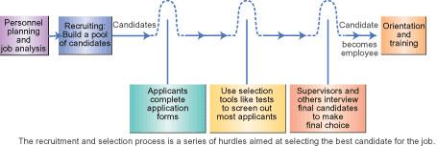
Recruitment and Selection

Slide 13
Linking JA and Selection
How do we know who will perform successfully?
The job description helps us know how successful performance of the job can be measured, “criteria of job success” (performance appraisals, production data, personnel data).
The job specification helps identify factors that can predict successful job performance, “criterion predictors” (education, work experience, test scores, interview data).
Validity: how accurately does a predictor actually predict the criteria of job success?

Slide 14
Employee Training
Training is a learning process that involves the acquisition of skills, concepts, rules, or attitudes; designed to enhance performance (also through helping employees meet own objectives of job security, financially and intellectually rewarding work, recognition, status, responsibility, achievement).
Orientation
On-the job training; apprenticeships

Slide 15
Management Training
Intended to develop the experience, attitudes, and skills necessary to be an effective manager
Should be tied to organizational objectives
Often include team work, project work, and leadership training
Methods include coaching, job rotation, project assignments, classroom training (case studies, role playing, in-basket techniques, business games.

Slide 16
Career Development and Planning
  On going formal effort to develop and enrich the organization’s human resources so as to meet both the organization’s and employees objectives; concrete action plan for the individual to meet these goals.
  Increases attractiveness of company to job seekers
  Supports retention
  Addresses needs of minorities, women, >50 professionals
  Mechanism for dealing with downsizing, reengineering, restructuring

Slide 17
Performance Appraisal
PA is a feedback system that involves the direct evaluation of individual or group performance by a supervisor, manager, or peers.
Used for performance feedback, pay administration, counseling and developing employees.
Represents an importan link between goal-setting processes and reward systems.

Slide 18
Performance Appraisal Methods
Goal setting (MBO)
360-degree feedback
Work standards approach
Critical-incident appraisal
Graphic rating scales
Behaviorally Anchored Rating Scale (BARS)

Slide 19
Behaviorally Anchored Rating Scale
Job: Production Line Supervisor - Work Dimension: Work Scheduling
Have no plan or schedule of work and no concept of realistic due dates
Make a list of due dates and revise them but are frequently surprised by unforeseen events
Develop a comprehensive schedule, observe target dates, and update the status of operations relative to plans, making schedule modifications as quickly as necessary
1
2
3
4
5
Have a sound plan but neglect to keep trace of target dates or to report schedule slippages or other problems as they occur
Usually satisfy time constraints, with time and cost overruns coming up infrequently
Sources: Based on J.P. Campbell, M.D. Dunnette, R.D. Arvey, and L.V. Hellervik, “The Development and Evaluation of behaviorally Based Rating Scales,”Journal of Applied Psychology 57 (1973), 25-22; and Francine Alexander, ‘performance Appraisals,” Small Business Reports (March 2989), 20-29.

Slide 20
Organizational Reward Systems
Both intrinsic and extrinsic rewards received as a result of employment by the organization.
Ideally, rewards are linked to performance.
  Rewards “cause” satisfaction
  Rewards based on performance “cause” improved performance
  Satisfaction does not (necessarily) “cause” better performance; performance “causes” satisfaction

Slide 21
Job Satisfaction
Workplace support (flexible schedules, child care, etc), autonomy; meaningfulness; opportunities for leaning and advancement and job security are highly related to job satisfaction; pay and benefits have little effect on job satisfaction.
Job satisfaction leads to organizational commitment; job dissatisfaction may lead to turnover, absenteeism, tardiness, accidents, strikes, grievances.
Job satisfaction is NOT the same as motivation!

Slide 22
Pay
Skill-based pay plans
  General Mills, General Foods, Northern Telecon
All salaried workforce
  IBM, Gillette, Dow Chemical
Lump-sum salary increases
  Timex, BFGoodrich, Westinghouse
Performance-based pay (indiv, group, org)
  American Express, DuPont
Gain Sharing
  Georgia Pacific, GE

Slide 23
Benefits
Legally mandated
  Unemployment; workers’ compensation
Traditional
  Health insurance; paid vacations
Recent
  Child care; parent leave; education; retirement plans
Based on position vs ”Cafeteria-style”

Slide 24
Employee and Labor Relations
Administration of discipline and grievance-handling procedures.
Organizational discipline: action taken against an employee who has violated an organizational rule or whose performance is below satisfactory.
“Should be” viewed as a learning opportunity for the employee and a tool to improve productivity and human relations.

Slide 25
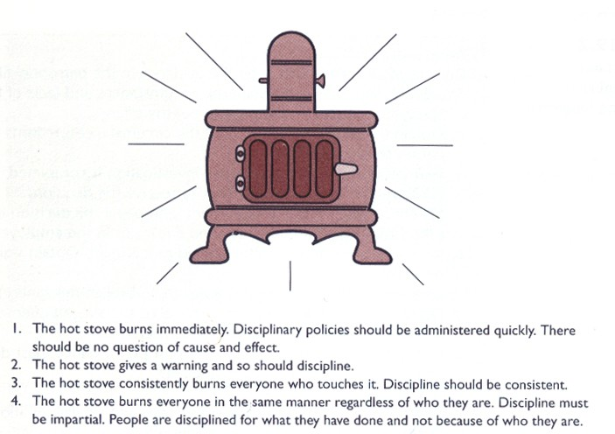
The Hot Stove Rule of Discipline

Slide 26
Employee Safety
Most industrial countries have formal agencies for the purpose of planning, monitoring, evaluating, and ensuring employee safety.
Safety most often measured by accident frequency and severity.
Organizational safety programs emphasize accident prevention, from standardizing operating procedures to redesigning work to establishing “contests”, holding periodic safety workshops, seminars, etc., clearly posting safety rules and regulations.

Slide 27
Employee Health
Occupational diseases may cost industry as much or more than occupational accidents.
Number of job-related accidents has decreased; number of job-related illnesses has risen.
Many diseases and health-related problems that are not necessarily job-related may affect job performance (alcohol & drug abuse, AIDS).
Many companies now offer wellness programs, including fitness centers, EAP programs.

Slide 28
Stress
Stress is the mental and physical condition that results from a perceived threat of danger (physical or emotional) and the pressure to remove it. Sources include: Threat of job loss; job mismatch; conflicting expectations; role ambiguity; role overload; fear/responsibility; working conditions; working relationships, alienation.
Signs of stress in the workplace include absenteeism, job turnover, lower productivity, and increased mistakes. Stress-related disorders include tension and migraine headaches, coronary heart disease, high blood pressure, sleep disorders, problems with concentration, appetite, etc.
Burnout: work is no longer meaningful

Slide 29
“New Trends”
Fewer and fewer HR departments have retained or are limited to traditional, standard HR functions.
Corporate universities are becoming common place; HRM supporting the “Learning Factory”; outsourcing often used for benefit and training functions; staffing being delegated to line managers and autonomous teams.

Slide 30
Strategic HRM
“The process of linking HR practices to business strategy” (Ulrich, 1997, p. 89); “the process by which organizations seek to link the human, social, and intellectual capital of their members to the strategic needs of the firm” (Bamberger & Meshoulam (2000, p. 6).
Affirms the importance of the effective management of people as a source of competitive advantage.

Slide 31
Global HRM
GHRM: utilization of global human resources to achieve organizational objectives without regard to geographic boundaries.
“Going Global” has a major impact on all HRM functions, from planning, recruitment, and selection to compensation and benefits, to human resource development, to safety and health issues, to employee and labor relations. Each of the various functions has an even greater impact on organizational performance than in domestic companies.
Additional challenges include: political and legal factors, cultural/language issues and maintaining corporate identity/culture, economic factors, and labor-management relations.

Slide 32
E-HR
E.HR: the application of conventional, web, voice and m-technologies to improve HR administration, transactions and process performance. “Speed” and “agility” have become key words for HRM.
E-HR survey in 91 international organizations: 76% have redesigned or introduced new HR technologies/systems in the past year and 90% of the remaining expect to do so within the coming year.
While very cutting edge, total e-HR is expensive and time consuming. Many companies focus on recruitment, web training and web approaches to reporting, appraisal, and reporting.
  1998: 17% of Fortune Global 500 companies recruited on the net; 1999, 45%
  $1.7 billion on recruitment in 2003
  Estimated 2.5 million resumes on the internet

