Slide 1
Lecture 29

Slide 2
Results-Based Management:
Logical Framework Approach

Slide 3
Topics To Be Covered
What is Results-Based Management (RBM)?
Key Features of RBM
Why is Results-Based Management necessary?
What is a Result?
Key RBM Terms
Logical Framework Approach (LFA)

Slide 4
What is Results-Based Management (RBM)?
RBM is a management approach aimed to improve management effectiveness and accountability in achieving results.
RBM is focused on chain results: output, outcomes, and impact.

Slide 5
Key Features of RBM
Focus on:
Analyzing problems and determining their causes;
Identifying measurable changes (results) to be achieved based on problem analysis;
Designing strategies and activities that will lead to these changes (results);
Balancing expected results with the resources available;

Slide 6
Key Features of RBM
Monitoring progress regularly and adjusting activities to ensure results are achieved
Evaluating, documenting and incorporating lessons learned into next planning phase;
Reporting on the results achieved and their contribution to achieving goals;

Slide 7
Key Features of RBM….
Alternative Approaches to RBM :
  Inputs
  Activities
  Success is measured by expenditure

Slide 8
Key Features of RBM….
Alternative Approaches to RBM :
  Inputs
  Activities
  Success is measured by the extent of goods/services delivered and the ratio of inputs to outputs.

Slide 9
Why Results-Based Management?
Resources are shrinking and increasing demand for better quality results (statistics).
Increasing needs to improve efficiency and accountability for results
It is a global trend: using results-based management to improve the efficiency of development program
NSOs need to improve statistical support for monitoring development goals

Slide 10
What Is a Result?
A result is a describable or measurable change that derived from a cause and effect relationship.
RESULT = CHANGE
CAUSE EFFECT

Slide 11
Key RBM Terms (i)
Activities
Results
Inputs

Slide 12
Definitions (i)
Input: these are human, material, financial and other resources that are required to undertake activities.
Activities: Actions taken or work performed to produce specific outputs through mobilizing inputs.

Slide 13
Key RBM Terms (ii)
Results
Activities
Outputs
Outcomes
Impact
Inputs
(human
material
financial
other resources)

Slide 14
Definitions (ii)
Output: these are immediate results as a consequences of completed activities
Outcome: these are likely or achieved short-term and medium-term effects of outputs.
Impact: long-term effects that are the logical consequence of the achievement of the outcomes.

Slide 15
Key RBM Terms (iii)
What we want?
Why?
Activities
Outputs
Outcomes
Impact
How?
Inputs

Slide 16

Input? Activity? Output? Outcome? Impact?
Splash
(cause)
Ripple
(effect)

Slide 17
Key RBM Terms (iv)
What we want?
Why?
Activities
Outputs
Outcomes
Impact
How?
Immediate
results
End-of-project/ programme results
A long-term
result as a
logical
consequence
of the outcomes
Inputs

Slide 18
Key RBM Terms (v)
Short-term
Outputs
Medium-term
Outcomes
Long-term
Impact
Activities
NSO
Society
Intermediate
users
End users
Inputs

Slide 19
The Core of RBM is the Results Chain
The levels of results:
  short-term results or outputs;
  medium-term results or outcomes; and,
  longer-term results or impact.
These are linked together into what is referred to as a results chain.

Slide 20
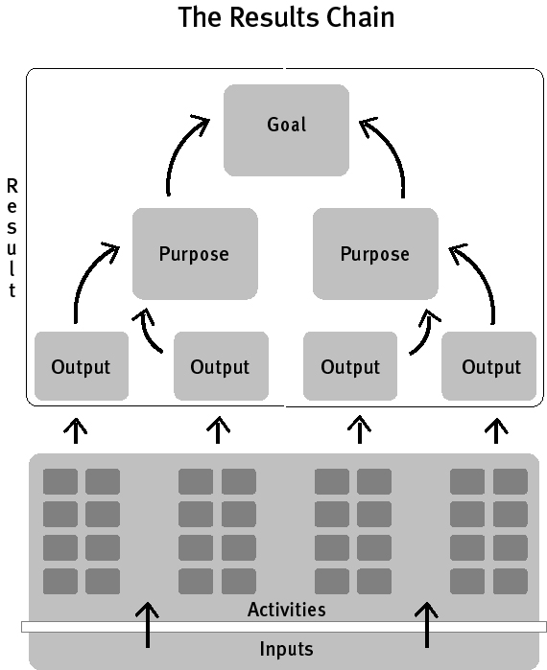

Slide 21


Example: training courses
training
Economic
Statistics
Staff,
budget,
equipment,
facilities etc.
Knowledge base for development policy
Social
Statistics
MDGs etc.
input

Slide 22
Example of SIAP Training Results Chain
Impact | Improved reliability, relevancy and timeliness of official statistics.
Outcome | Improved statistical capability of NSO staff
Output | Improved knowledge and skills of participants
Activity | Conducting training courses for participants from the countries of Asia and the Pacific
Input | SIAP staff, funding, equipment, facilities … etc.

Slide 23
Example of Improving Supply of Potable Water and Sanitation Facilities
Impact | Improved health and sanitary conditions in targeted communities.
Outcome | Improved access to sustainable water and sanitation services for target communities.
Output | Improved and renovated water systems
Activity | Designing, constructing new water and sanitation facilities.
Input | Human resources, training, expert, funding etc.

Slide 24
Key principles of RBM
Define expected results first and activities later
Foster the active participation of stakeholders
Ensure that all stakeholders work towards achieving expected results
Apprise your work critically and learn the lessons

Slide 25
Hierarchy of RBM Terms
  IMPACT
  Sustainable improvements in society or well-being of people
  OUTCOME
  Changes in behavior or improvements in access or quality of resources
  OUTPUT
  Product of project/ program activities
  ACTIVITIES
  Activities done by project/program
  INPUT
  Resources needed to undertake activities

Slide 26
RBM and Logical Framework Approach (LFA)
The LFA is an RBM tool used for systematic planning, implementing, monitoring, and evaluating projects/ programmes.

Slide 27
The Logical Framework Approach (i)
Features of LFA :
stakeholder involvement
needs-based approach
logical intervention approach
framework for assessing relevance, feasibility and sustainability

Slide 28
The Logical Framework Approach (ii)
Features of LFA :
results-oriented – not activity driven
logically sets objectives and their causal relationships
shows whether objectives have been achieved: Indicators (for M&E)
describes external factors that influence the project’s success: assumptions and risks

Slide 29
LFA Key Features
Main steps:
Stakeholder Analysis
SWOT Analysis
Problem Tree Analysis
Objective Tree Analysis
Logical Framework Matrix
Monitoring and evaluation

Slide 30
Stakeholder Analysis
Stakeholder is any individuals, group or organization, community, with an interest in the outcome of a programme/project.

Slide 31
Stakeholder Analysis
Purpose: To identify:
  The needs and interest of stakeholders
  The organizations, groups that should be encouraged to participate in different stages of the project;
  Potential risks that could put at risk programme;
  Opportunities in implementing a programme;

Slide 32
SWOT Analysis (i)
Purpose:
To assess the performance and capacity of the participating units, divisions of organization.
Each participating unit has to undertake SWOT analysis.

Slide 33
SWOT Analysis (ii)
SWOT analysis is a tool for institutional appraisal and a brainstorming exercise in which the representatives of the organization participate fully.

Slide 34
SWOT Analysis (iii)
SWOT stands for:
Strengths - the positive internal attributes of the organisation
Weaknesses - the negative internal attributes of the organisation
Opportunities - external factors which could improve the organisation’s prospects
Threats - external factors which could undermine the organisation’s prospects

Slide 35
Problem Tree Analysis
Purpose:
- to identify major problems and their main causal relationships.
Output:
problem tree with cause and effects

Slide 36
Steps in Undertaking Problem Tree
Identify the major problems that the project will address. State problems in negative manner.
Group problems by similarity of concerns.
Develop the problem tree:
  Choose a focal problem from the list and relate other problems to the focal problem.
  If the problem is a cause of the focal problem it is placed below the focal problem
  If the problem is an effect of the focal problem is goes above

Slide 37
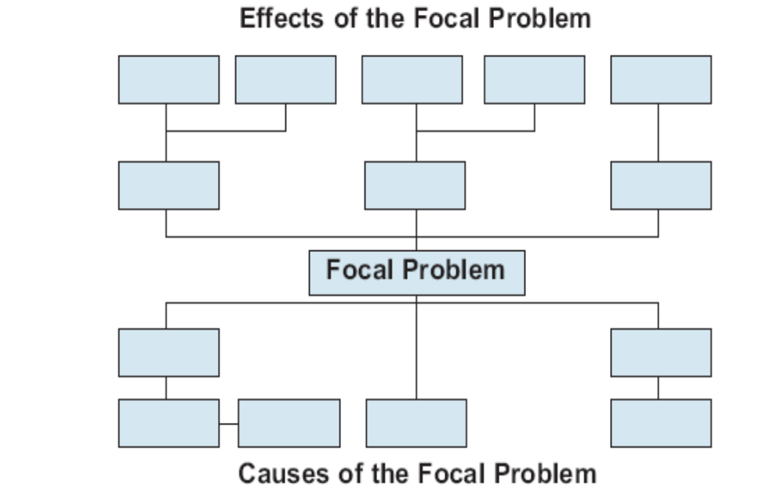
Problem Tree
EFFECT
CAUSE

Slide 38
Analysis of Objectives
Transforming the problem tree into an objectives tree by restating the problems as objectives.
Problem statement converted in to positive statements
Top of the tree is the end that is desired
Lower levels are the means to achieving the end.

Slide 39
The relationship between the problems tree and the objective tree
PROBLEM TREE OBJECTIVE TREE
Effects Development Objectives
Starter/Focal problem Project Purpose
Causes Results

Slide 40
The relationship between the problems tree and the objective tree
PROBLEM TREE OBJECTIVE TREE
Focal problem Project Purpose
Effects Development Objectives
Causes Results

Slide 41
Strategy Analysis (i)
The aim of strategy analysis is division of the objectives tree into more consistent smaller sub-units that may, compose the core for a project.
Each of the sub-units of the objective tree can represent an alternative strategy for the future project.
The project objectives set the framework for the strategy of the project.

Slide 42
Strategy Analysis (ii)
Criteria for selection of the project strategy:
1. RELEVANCE: the strategy corresponds to the needs of the stakeholders.
2. EFFECTIVENESS: the lower level objectives of the strategy will contribute to achievement of the project purpose
3. EFFICIENCY: cost-effectiveness of the strategy in transforming the means into results.
4. CONSISTENT with development policies
5. SUSTAINABILITY of the project
6. ASSUMPTIONS and RISKS

Slide 43
The Logframe Matrix
The Logical Framework Matrix is used to present information about project objectives, outputs and activities in a systematic and logical way.
The basic Logframe matrix contains 16 cells organized into 4 columns and 4 rows, as indicated in the next slide:

Slide 44
The Logical Framework Matrix
Objectives & activities
Indicators
Means of verification
Assumptions
Goal
(Impact)
Purpose/ (Outcome)
Outputs
Activities

Slide 45
Results Chain & Logical Framework Matrix
RBM
LFA
Result
Goal/Impact
Result
Purpose/
Outcome
Result
Output
Result
Activities

Slide 46
Key RBM Techniques
Start with the results
Determine indicators to measure progress towards achieving each result
Define explicit targets for each indicator to judge achievement
Collect information to verify/monitor the achievement/progress
Review, analysis and report actual results

Slide 47
RBM
RBM are good and useful techniques
But it won’t work itself and not sufficient to achieve results
RBM depends on the organization's ability to create a management culture that is focused on results
Manage change in your organization.

Slide 48
Monitoring and Evaluation
Based on the logical framework
Strengthens accountability and transparency
Provides information for effective management
Helps determine what works well and what requires improvement
Builds knowledge

