Slide 1
Careers and Career Management

Slide 2
Introduction (1 of 2)
Career development is important for companies to create and sustain a continuous learning environment
The biggest challenge companies face is how to balance advancing current employees’ careers with simultaneously attracting and acquiring employees with new skills
The growing use of teams is influencing the concept of careers
  e.g., project careers

Slide 3
Introduction (2 of 2)
Changes in the concept of career affect:
  employees’ motivation to attend training programs
  the outcomes they expect to gain from attendance
  their choice of programs
  how and what they need to know

Slide 4
What Is Career Management?
Career management is the process through which employees:
  Become aware of their own interests, values, strengths, and weaknesses
  Obtain information about job opportunities within the company
  Identify career goals
  Establish action plans to achieve career goals

Slide 5
Why Is Career Management Important? (1 of 2)
From the company’s perspective, the failure to motivate employees to plan their careers can result in:
  a shortage of employees to fill open positions
  lower employee commitment
  inappropriate use of monies allocated for training and development programs

Slide 6
Why Is Career Management Important?
(2 of 2)
From the employees’ perspective, lack of career management can result in:
  frustration
  feelings of not being valued by the company
  being unable to find suitable employment should a job change be necessary due to mergers, acquisitions, restructuring, or downsizing

Slide 7
Career Management and Career Motivation (1 of 2)
Career motivation refers to:
  Employees’ energy to invest in their careers
  Their awareness of the direction they want their careers to take
  The ability to maintain energy and direction despite barriers they may encounter
Career motivation has three aspects:
  Career resilience
  Career insight
  Career identity

Slide 8
Career Management and Career Motivation (2 of 2)
Career resilience – the extent to which employees are able to cope with problems that affect their work
Career insight involves:
  how much employees know about their interests, skill strengths, and weaknesses
  the awareness of how these perceptions relate to their career goals
Career identity – the degree to which employees define their personal values according to their work

Slide 9
The Value of Career Motivation
Components of Career Motivation
Career Resilience
Company Value
Innovation
Employees adapting to unexpected changes
Commitment to company
Pride in work
Career Insight
Employee Value
Be aware of skill strengths and weaknesses
Participate in learning activities
Cope with less than ideal working conditions
Avoid skill obsolescence
Career Identity

Slide 10

Careers and Career Planning
Career
  The series of work-related positions a person occupies through life.
Career Paths
  Represent employees’ movements through opportunities over time.

Slide 11

Different Views of Careers
Individual Career Views
Protean career
Career without boundaries
Portfolio career
Authentic career

Slide 12
Careers and Career Planning (cont’d)
Organization-Centered Career Planning
  Focuses on jobs and on identifying career paths that provide for the logical progression of people between jobs in the organization.
Individual-Centered Career Planning
  Focuses on an individual’s career rather than in organizational needs.

Slide 13
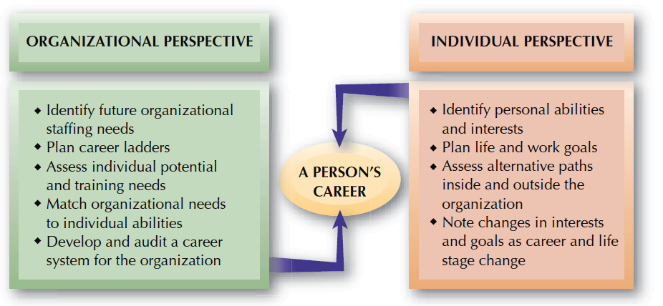
FIGURE 9–4
Organizational and Individual Career Planning Perspectives

Slide 14

Individual-Centered Career Planning
Individual Career Management
Feedback
on Reality
Setting of
Career Goals
Self-Assessment

Slide 15
Individual Career Choices
Career Choice
Interests
Self-Image
Personality
Social Background

Slide 16
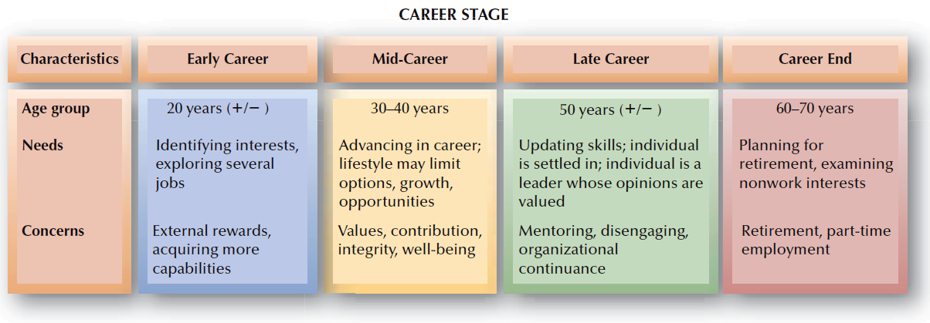
FIGURE 9–5
General Career Periods

Slide 17
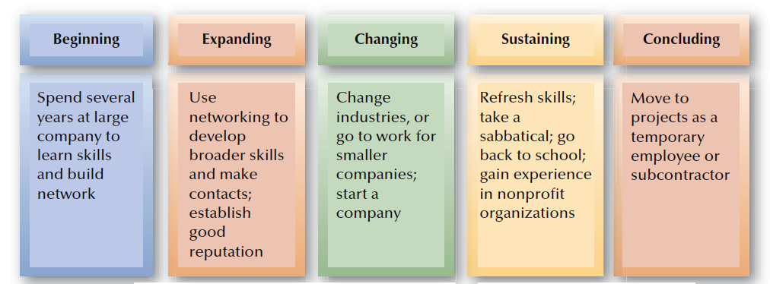
FIGURE 9–6
Portable Career Path

Slide 18
Career Transitions and HR
Entry Shock for New Employees
Supervisors
Feedback
Time
The Work

Slide 19
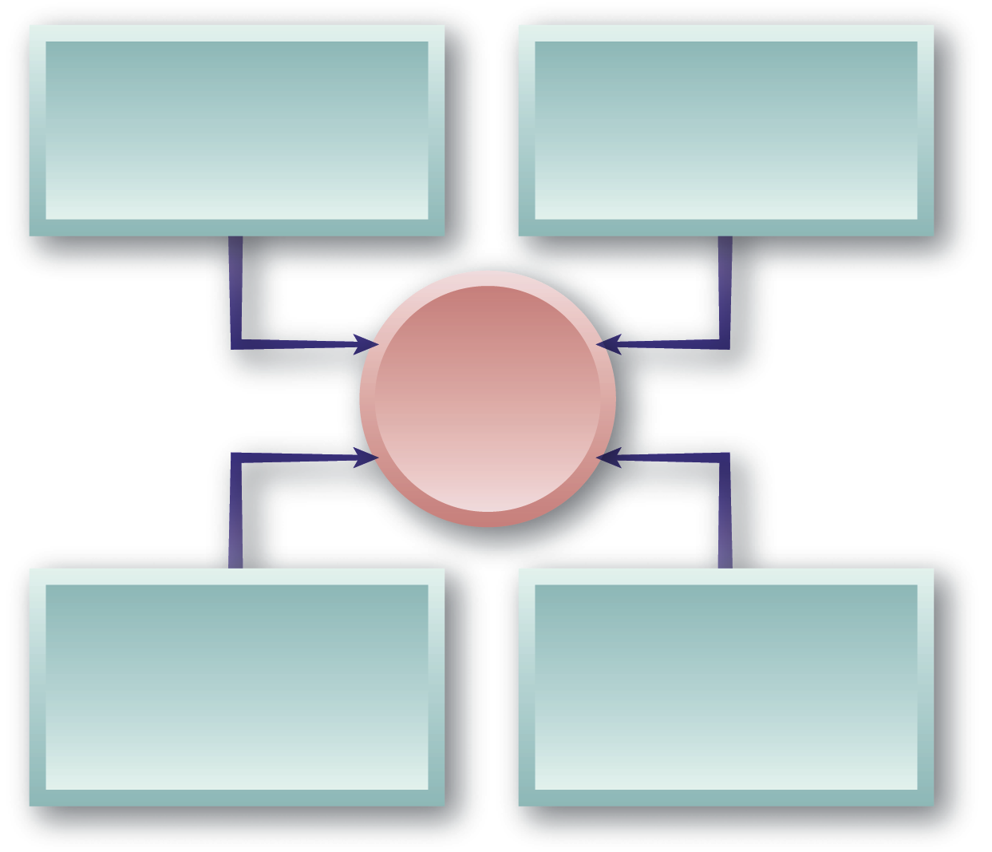
Special Individual Career Issues
Technical and Professional Workers
Dual Career Ladders
Women and Careers
Sequencing
Glass Ceiling
Special Individual Career
Issues
Global Career Concerns
Repatriation
Global Development
Dual-Career Couples
Family-Career Issues
Relocation

Slide 20
What Is A Career?
Traditional Career
  Sequence of positions held within an occupation
  Context of mobility is within an organization
  Characteristic of the employee
Protean Career
  Frequently changing based on changes in the person and changes in the work environment
  Employees take major responsibility for managing their careers
  Based on self-direction with the goal of psychological success in one’s work

Slide 21
Comparison of Traditional Career and Protean Career:
Dimension | Traditional Career | Protean Career
Goal | Promotions Salary increase | Psychological success
Psychological contract | Security for commitment | Employability for flexibility
Mobility | Vertical | Lateral
Responsibility for Management | Company | Employee
Pattern | Linear and expert | Spiral and transitory
Expertise | Know how | Learn how
Development | Heavy reliance on formal training | Greater reliance on relationships and job experiences

Slide 22
Different generations of employees have different career needs and interests:
Millennium
(0 to early 20s)
Generation X
(mid-20s to
early 40s)
Baby Boomers
(mid-40s to
mid-50s)
Traditionalists
(late 50s to
early 80s)
Notes:
4

Slide 23
A Model of Career Development
Career development is the process by which employees progress through a series of stages
Each stage is characterized by a different set of developmental tasks, activities, and relationships
There are four career stages:
  Exploration
  Establishment
  Maintenance
  Disengagement

Slide 24
A Model of Career Development (continued)
 | Exploration | Establishment | Maintenance | Disengagement
Developmental tasks | Identify interests, skills, fit between self and work | Advancement, growth, security, develop life style | Hold on to accomplishments, update skills | Retirement planning, change balance between work and non-work
Activities | Helping Learning Following directions | Making independent contributions | Training Sponsoring Policy making | Phasing out of work
Relationships to other employees | Apprentice | Colleague | Mentor | Sponsor
Typical age | Less than 30 | 30 – 45 | 45 – 60 | 61+
Years on job | Less than 2 years | 2 – 10 years | More than 10 years | More than 10 years

Slide 25
The career management process:
Self-Assessment
Reality Check
Action Planning
Goal Setting

Slide 26
Components of the Career Management Process: (1 of 2)
Self-Assessment
  Use of information by employees to determine their career interests, values, aptitudes, and behavioral tendencies
  Often involves psychological tests
Reality Check
  Information employees receive about how the company evaluates their skills and knowledge and where they fit into company plans

Slide 27
Components of the Career Management Process: (2 of 2)
Goal Setting
  The process of employees developing short- and long-term career objectives
  Usually discussed with the manager and written into a development plan
Action Planning
  Employees determining how they will achieve their short- and long-term career goals

Slide 28
Design factors of Effective Career Management Systems: (1 of 2)
System is positioned as a response to a business need or supports a business strategy
Employees and managers participate in development of the system
Employees are encouraged to take active roles in career management
Evaluation is ongoing and used to improve the system
Business units can customize the system for their own purposes

Slide 29
Design factors of Effective Career Management Systems: (2 of 2)
Employees need access to career information sources
Senior management supports the career system
Career management is linked to other human resource practices such as training, recruiting systems, and performance management
System creates a large, diverse talent pool
Information about career plans and talent is accessible to all managers

Slide 30
Elements of Career Management Websites
User Access | Website Features
Self-assessment tools | Jobs database
Training resources | Employee profile database
Job data | Matching engine
Salary information | Tools and services – Assessment, online
Career management advice | Training programs, development resources

Slide 31
Shared Responsibility:
Roles in Career Management
Employees
Manager
Company
HR Manager

Slide 32
Employees’ Role in Career Management
Take the initiative to ask for feedback from managers and peers regarding their skill strengths and weaknesses
Identify their stage of career development and development needs
Seek challenges by gaining exposure to a range of learning opportunities
Interact with employees from different work groups inside and outside the company
Create visibility through good performance

Slide 33
Managers’ Role in Career Management
Roles | Responsibilities
Coach | Probe problems, interests, values, needs Listen Clarify concerns Define concerns
Appraiser | Give feedback Clarify company standards Clarify job responsibilities Clarify company needs
Advisor | Generate options, experiences, and relationships Assist in goal setting Provide recommendations
Referral agent | Link to career management resources Follow up on career management plan

Slide 34
HR Manager’s Role in Career Management
Provide information or advice about training and development opportunities
Provide specialized services such as testing to determine employees’ values, interests, and skills
Help prepare employees for job searches
Offer counseling on career-related problems

Slide 35
Company’s Role in Career Management
Companies are responsible for providing employees with the resources needed to be successful in career planning:
  Career workshops
  Information on career and job opportunities
  Career planning workbooks
  Career counseling
  Career paths

Slide 36
Evaluating Career Management Systems
Career management systems need to be evaluated to ensure that they are meeting the needs of employees and the business
Two types of outcomes can be used to evaluate:
  Reactions of the customers (employees and managers) who use the career management system
  Results of the career management system
Evaluation of a career management system should be based on its objectives

