Slide 1
Lecture 25

Slide 2
Employee Socialization and Orientation - HRD

Slide 3
Organizational Socialization
How employees adjust to a new organization
What is at stake:
  Employee satisfaction, commitment, and performance
  Work group satisfaction and performance
  Start-up costs for new employee
  Likelihood of retention
  Replacement costs

Slide 4
Two Approaches to Socialization
Realistic Job Preview (RJP)
Employee Orientation

Slide 5
Organizational Socialization Defined
“The process by which an individual acquires the social knowledge and skills necessary to assume an organizational role.”

Slide 6
Organizational Role
A set of behaviors expected of individuals who hold a given position in a group.

Slide 7
Dimensions of Organizational Roles
Inclusionary – social dimension (e.g., outsider, probationary, permanent status)
Functional – task dimension (e.g., sales, engineering, administrative)
Hierarchical – rank dimension (e.g., line employee, supervisor, management, officer)

Slide 8
Role Situations
Role – a set of behaviors expected of individuals holding a given position in a group
  Role overload – more than can be reasonably expected from an individual
  Role conflict – unclear expectations from others
  Role ambiguity – role itself is unclear
    Common in newly created positions

Slide 9
Issues Relevant to Socialization
Role communication – how well the role is communicated to the individual and the group
Role orientation – how innovative an individual is in interpreting an organizational role
  Custodial
    Status quo
  Innovative
    Redefining role

Slide 10
Group Norms
Unwritten rules of conduct established by group members
Types:
  Pivotal – essential to group membership
  Relevant – desirable, but not essential
  Peripheral – unimportant behaviors

Slide 11
Expectations
A belief or likelihood that something will occur

Slide 12
Socialization Categories
Preliminary learning
Learning about the organization
Learning to function in the work group
Learning to perform the job
Personal learning

Slide 13
Feldman’s Stage Model of Socialization
Three stages:
Anticipatory socialization
Encounter
Change and Acquisition

Slide 14
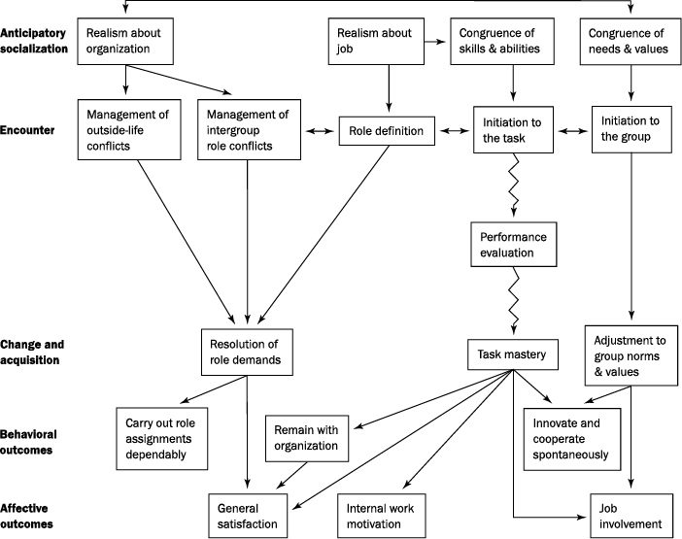
Feldman’s Model of Organizational Socialization
By Permission: Feldman (1981)

Slide 15
Anticipatory Socialization
Setting of realistic expectations
Determining a match with newcomer

Slide 16
Encounter
Formal commitment made to join the organization
“Breaking in” (initiation into the job)
Establishing relationships
Roles clarified

Slide 17
Change and Acquisition
New employee accepts group norms and values
Employee masters tasks
Employee resolves any role conflicts and overloads

Slide 18
People Processing Strategies
Formal versus Informal
Individual versus Collective
Sequential versus Nonsequential
Fixed versus Variable
Tournament versus Contest
Serial versus Disjunctive
Investiture versus Divestiture

Slide 19
Formal versus Informal
Formal – outside the daily work environment
Informal – part of the regular work environment

Slide 20
Individual versus Collective
Are newcomers part of a new group, or are they treated individually?
Group camaraderie formed, versus feeling of isolation
Generally, Collective is less expensive

Slide 21
Sequential versus Nonsequential
Sequential – individual progresses through a series of established stages to achieve a position
  e.g., mail clerk, mailroom supervisor, information manager
Nonsequential – individual achieves position immediately
  e.g., six-month training program to become a bank branch manager

Slide 22
Fixed versus Variable
Fixed – employee knows when transition period will end
Variable – length of transition period varies from individual to individual

Slide 23
Tournament versus Contest
Tournament – as time passes, candidates are sorted according to potential, ambition, background, etc., and then assigned to various tracks
Contest – all individuals pass through all stages according to observed abilities and interests

Slide 24
Serial versus Disjunctive
Serial – using senior employees to provide a mentoring approach
  Tends to perpetuate the status quo
Disjunctive – uses outsiders to provide mentoring
  Encourages innovation

Slide 25
Investiture versus Divestiture
Investiture – preserves newcomer’s identity, such as in recruiting upper management
Divestiture – suppressing certain characteristics (e.g., basic military training)

Slide 26
Insider Advantages
Accurate expectations
Knowledge base
Relationships with other insiders

Slide 27
What Do Newcomers Need?
Clear information on:
  Expectations
  Norms
  Roles
  Values
Assistance in developing needed KSAOs
Accurate help in interpreting events

Slide 28
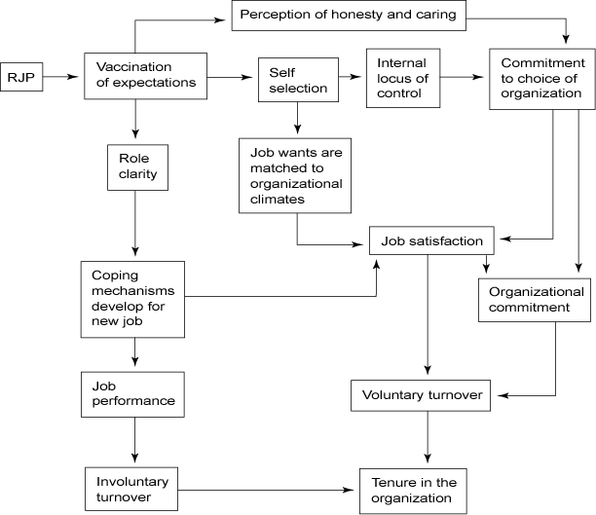
Effects of Realistic Job Preview
By Permission: Wanous (1978)

Slide 29
The Realistic Job Preview
Vaccination Against Unrealistically High Expectations
Self-Selection
  Does it meet individual and job needs?
Coping Effect
  Develops coping strategies
Personal Commitment
  Based on personal choice

Slide 30
When to Use Realistic Job Previews (RJPs)
When candidates can be selective about jobs
When there are more applicants than jobs
When recruits lack necessary information
When replacement costs are high

Slide 31
Issues in RJP Content
Descriptive or Judgmental Content
  Facts or feelings?
Extensive or Intensive Content
  All information stressed, or pertinent only?
Degree of Content Negativity
  Positive or negative approach?
Message Source
  Actors or company members?

Slide 32
Employee Orientation Programs
Reduce newcomer stress
Reduce start-up costs
Reduce turnover
Expedite proficiency
Assist in newcomer assimilation
Enhance adjustment to work group and norms
Encourage positive attitude

Slide 33
Orientation Program Content
Information about company as a whole
Job-specific information

Slide 34
Company Information
Overview of company
Key policies and procedures
Mission statement
Company goals and strategy
Compensation, benefits, safety
Employee relations
Company facilities

Slide 35
Job-Specific Information
Department functions
Job duties and responsibilities
Polices, rules, and procedures
Tour of department
Introduction to departmental employees
Introduction to work group

Slide 36
A Large Company Procedure
Material distribution
Pre-arrival period
First day
First week
Second week
Periodic updates

Slide 37
Orientation Roles
Supervisor
  Information source
  Guide for new employees
Coworkers
  Socialize into organization
  Help learn norms of the work group and organization

Slide 38
Orientation and the HRD Staff
HRD staff designs and implements new employee orientation program
HRD schedules participation by various level of management
HRD staff evaluates orientation program and implements needed changes

Slide 39
Common Problems in Employee Orientation
Too much paperwork
Information overload
Information irrelevance
Scare tactics
Too much “selling” of the organization

Slide 40
Common Problems in Employee Orientation – 2
Too much one-way communication
One-shot mentality
No evaluation of program
Lack of follow-up

Slide 41
Designing and Implementing an Orientation Program
Set objectives
Research orientation as a concept
Interview recent new hires
Survey other company practices
Review existing practices
Select content and delivery method
Pilot and revise materials

Slide 42
Designing and Implementing an Orientation Program – 2
Produce and package the printed and audiovisual materials
Train supervisors and install program
Evaluate program effectiveness
Improve and update program

Slide 43
Summary
New employees face many challenges
Realistic job previews and employee orientation programs can:
  Reduce stress
  Reduce turnover
  Improve productivity

