Slide 1
Lecture 22

Slide 2
`
Basic
Program Evaluation
Contd…

Slide 3
Module 8 – How to Collect Data
Module 7 – Data Collection Plan
Module 8 – How to Collect Data
Module 9 – Using Commercial Instruments
Module 10 – Using Self-Constructed Instruments
Module 11 – Collecting Data

Slide 4
Data Collection Options
Commercial instrument
Survey/questionnaire
Focus group/interviews
Observations
Archived information

Slide 5
Module 9 – Using Commercial Instruments
Module 7 – Data Collection Plan
Module 8 – How to Collect Data
Module 9 – Using Commercial Instruments
Module 10 – Using Self-Constructed Instruments
Module 11 – Collecting Data

Slide 6
Commercial Instruments
Sometimes best to use published or research instruments
  particularly for tough constructs
  since its not made specifically for you, may not answer your question entirely

Slide 7
Sources of Information on Instruments
Counselors Guide to Career Assessment Instruments
Relevance, the Missing Link ─ A Guide for
Promoting Student Success Through Career
Development Education, Training, and
Counseling
The Buros Institute
ETS Test Collection
The Association for Assessment in Counseling and Education

Slide 8
Exercise 6: Decision-Making Checklist
This checklist will help you conduct a review of data collection instruments that you are considering using in your evaluation

Slide 9
Module 10 – Using Self- Constructed Instruments
Module 7 – Data Collection Plan
Module 8 – How to Collect Data
Module 9 – Using Commercial Instruments
Module 10 – Using Self-Constructed Instruments
Module 11 – Collecting Data

Slide 10
Self-Constructed Instruments: Questionnaires
Focus on evidence you need
Use simple language
Ask only what you need; keep it short
Don’t use jargon
Each question should focus on one idea
Make sure terms are clear
Make it easy for person to answer the questions (check rather than write, where possible)
Use extended response when you want details

Slide 11
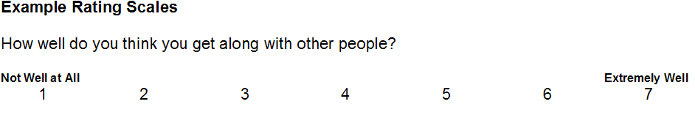
Types of Scales (1)
Specific (yes, no; number; gender)
Extended (1-3, 1-5, 1-7)

Slide 12
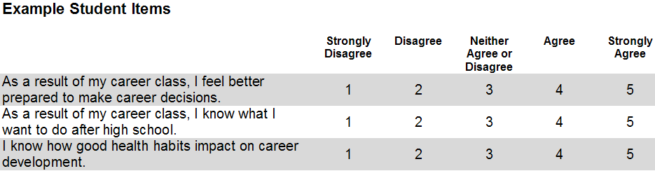
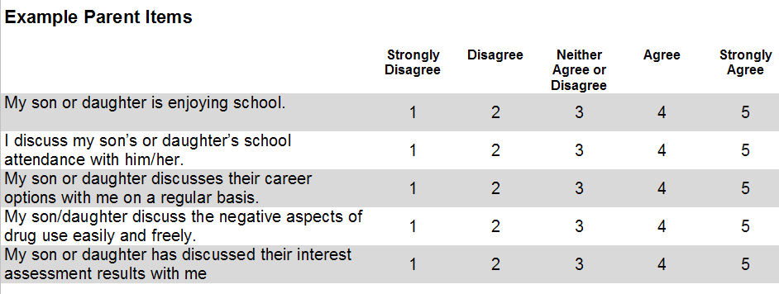
Types of Scales (2)

Slide 13
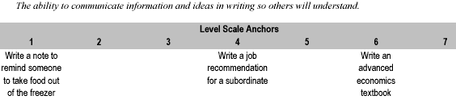
Anchored Scales

Slide 14


Scales for Younger Students

Slide 15
Self-Constructed Instruments: Focus Groups/Interviews
Good to use when you want extended and detailed responses
Craft an agenda and stick to it
Keep groups small (6-10); time short (1-1.5 hours)
Specify objectives of session
Questions need to be clear; one question at a time
Encourage everyone to participate
Use opportunity to probe deeper on a topic

Slide 16
Observations and Observational Checklist
“You can observe a lot just by watching.”
        -- Yogi Berra
Go to pages 8 and 9 of your Workbook and review an example of an observational checklist

Slide 17
Archives and Documents
Examine What’s Already Available
Examples
  Attendance records
  Truancy reports
  Grades
  Bullying incidents
  Report cards
  Portfolios
  Discipline referrals
  Public service hours
  Police reports

Slide 18
Exercise 7 - Data Collection Action Plan
Review examples of a completed
Data Collection Action Plan on any of the previous plan

Slide 19
Module 11 – Collecting Data
Module 7 – Data Collection Plan
Module 8 – How to Collect Data
Module 9 – Using Commercial Instruments
Module 10 – Using Self-Constructed Instruments
Module 11 – Collecting Data

Slide 20
9-step Evaluation Process
Step 5: Collect Data

Slide 21
How Much Data Should You Collect?
How much data do you need?
  100% of target audience is ideal; may be too expensive and time consuming
  If not 100%, sample is OK if group is representative of group as a whole (population)

Slide 22
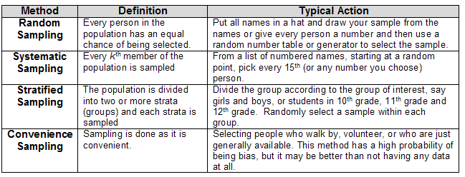
Types of Samples

Slide 23
Data Collection Considerations
When should you collect the information?
Who should collect it?

Slide 24
Module 12 – Analyzing Data
Module 12 – Analyzing Data
Module 13 – Drawing Conclusions and Documenting Findings
Module 14 – Disseminating Information
Module 15 – Feedback for Program Improvement
Module 16 – Conclusion

Slide 25
9-step Evaluation Process
Step 6: Analyze Data

Slide 26
What is Data Analysis?
Data collected during program evaluation are compiled and analyzed (counting; number crunching)
Inferences are drawn as to why some results occurred and others did not
Can be very complex depending on your evaluation questions
We will focus on simple things that can be done without expert consultants

Slide 27
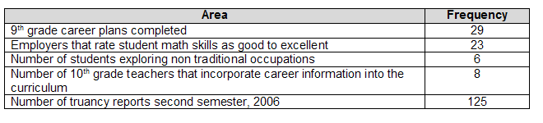
Types of Data Analysis
Simple Frequency Counts

Slide 28
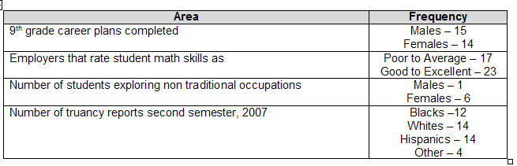
Types of Data Analysis
Sort by Relevant Categories

Slide 29
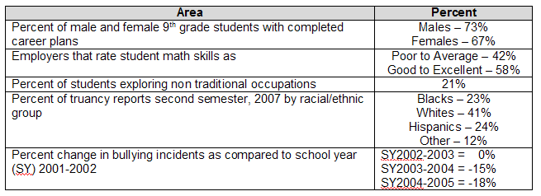
Types of Data Analysis
Calculate Percentages – Exercise 8

Slide 30
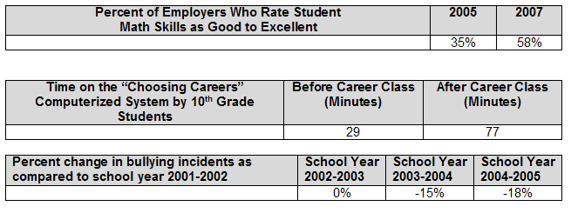
Types of Data Analysis
Showing Change or Differences

Slide 31
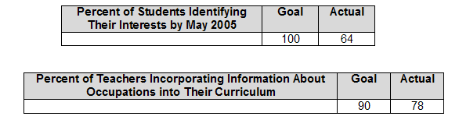
Types of Data Analysis Reaching an Objective or Goal

Slide 32

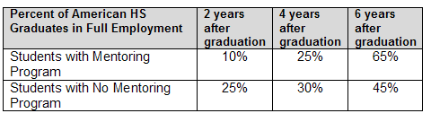
Types of Data Analysis Observing Trends

Slide 33
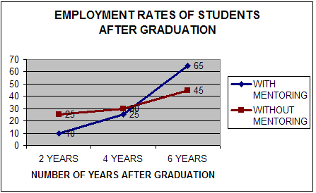
Types of Data Analysis Graph Results

Slide 34
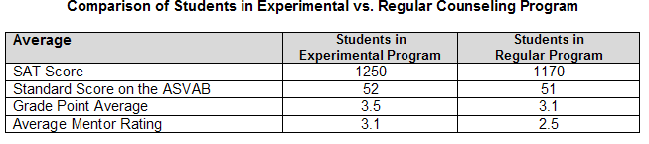
Types of Data Analysis Calculate Averages – Exercise 9

Slide 35
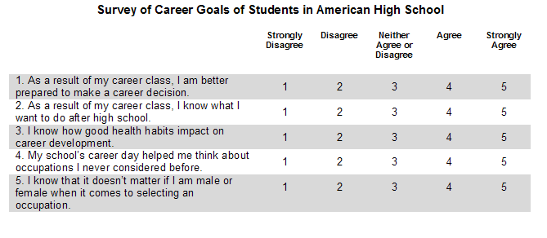
Types of Data Analysis Calculate Weighted Averages

Slide 36
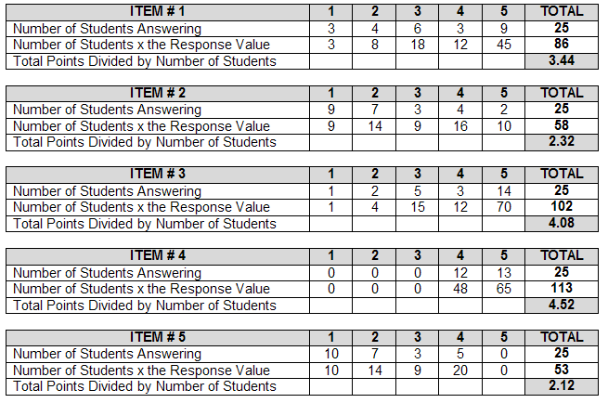
Types of Data Analysis Calculate Weighted Averages

Slide 37
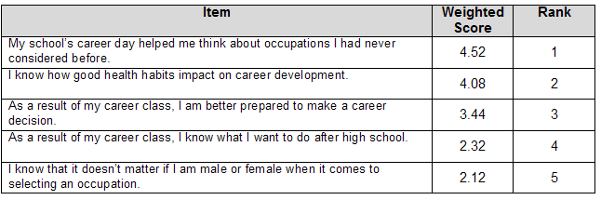
Types of Data Analysis
Rank Order Weighted Averages

Slide 38
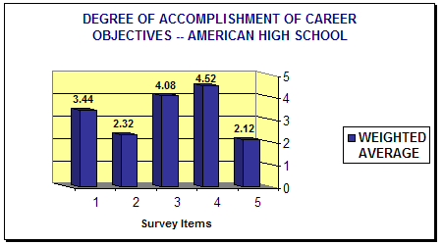
Types of Data Analysis Graph Weighted Averages

Slide 39
Using Focus Group/Interview Information
Qualitative findings from focus groups, extended response items, etc., should be analyzed in a different way
  Code words/frequency
  Identify themes
  Pull quotes
  Summarize and draw conclusions

Slide 40
Module 13 – Drawing Conclusions and Documenting Findings
Module 12 – Analyzing Data
Module 13 – Drawing Conclusions and Documenting Findings
Module 14 – Disseminating Information
Module 15 – Feedback for Program Improvement
Module 16 – Conclusion

Slide 41
9-step Evaluation Process
Step 7: Drawing Conclusions and Documenting Findings

Slide 42
Drawing Conclusions
Examine results carefully and objectively
Draw conclusions based on your data
What do the results signify about your program?

Slide 43
Exercise 10 – Interpreting Results
Complete the Interpreting Results of any plan

Slide 44
Unintended Consequences
Watch for positive and negative outcomes that you did not plan on
- For example, if your career development program focuses on increasing students’ awareness of how to identify their interests and skills, it may have the unintended consequence of leaving little time for students to explore occupations and jobs in their area.
- Or, if your program has overemphasized the importance of getting a college education, students may not be considering the positive benefits of other kinds of postsecondary training.

Slide 45
What to Include in Your Documentation
Program description
Evaluation questions
Methodology (how and from whom and when)
Response rate
Methods of analysis
Conclusions listed by evaluation question
General conclusions and findings
Action items
Recommendations for program improvement and change

Slide 46
Document the
Successes and Shortfalls
Highlight and brag about positive outcomes
Document shortfalls
  Provides opportunities to
    improve program
    make recommendations to benefit the program

Slide 47
Module 14 – Disseminating Information
Module 12 – Analyzing Data
Module 13 – Drawing Conclusions and Documenting Findings
Module 14 – Disseminating Information
Module 15 – Feedback for Program Improvement
Module 16 – Conclusion

Slide 48
9-step Evaluation Process
Step 8: Disseminate Information

Slide 49
Determining Dissemination Methods
Inform all your relevant stakeholders on results
Dissemination methods should differ by your target audience

Slide 50
Potential Audiences
  Your program staff
  Businesses
    Partners that work with your program
    Employers
    School Level
      School administrators
      Counselors
        Teachers
        Students
        Parents

Slide 51
Potential Audiences
Media
  Local newspaper
  TV station
  Radio program
  Community or school newsletter
Education Researchers
Members of Community or faith based organizations
  Church members
  Religious leaders
  Rotary club
  Boys or girls club
Anyone who participated in your evaluation!

Slide 52
Dissemination Techniques
  Reports
  Journal articles
  Conferences
  Career Newsletter/Tabloids
  Presentations
  Brochures
  TV and newspaper interviews
  Executive summary
  Posting on Web site

Slide 53
Exercise 11 – Disseminating Information
Using the information that you have, describe how you would disseminate the information to
  Program funders
  Parents

Slide 54
Module 15 – Feedback for Program Improvement
Module 12 – Analyzing Data
Module 13 – Drawing Conclusions and Documenting Findings
Module 14 – Disseminating Information
Module 15 – Feedback for Program Improvement
Module 16 – Conclusion

Slide 55
9-step Evaluation Process
Step 9: Feedback to Program Improvement

Slide 56
Opportunities to Fix Shortfalls
Evaluation results may show areas where improvement is necessary
- 25% of 11th graders are unable to complete a skills based resume
- 85% of our students drop out of college in the first year
- Most employers do not want your students to serve an interns in their companies

Slide 57
Feedback to Program Improvement
You can use evaluation findings to make program improvements
  Consider adjustments
  Re-examine/revise program strategies
  Change programs or methodologies
  Increase time with the program
Use your results as a needs assessment for future efforts

Slide 58
Module 16 - Conclusion
Module 12 – Analyzing Data
Module 13 – Drawing Conclusions and Documenting Findings
Module 14 – Disseminating Information
Module 15 – Feedback for Program Improvement
Module 16 – Conclusion

Slide 59
Conclusion
Evaluation helps you:
determine the effects of the program on recipients
know if you have reached your objectives
improve your program

Slide 60
Conclusion
The 9-step process works
A credible evaluation can be done with careful planning and some basic math skills

Slide 61
Exercise 12 – Developing a Data Collection Action Plan
Using all the information you have gathered from the exercises and the PowerPoint slides, you can develop your own Data Collection Action Plan.

