Slide 1
Lecture 21

Slide 2
`
Basic
Program Evaluation

Slide 3
Purpose/Objectives
Increase your knowledge of processes involved in program evaluation
Provide information and resources to help you design and conduct your own program evaluation

Slide 4
Program Evaluation Training
This training presentation is in 16 modules, encompassing 9 steps in the evaluation process

Slide 5
Program Evaluation Training – Modules
Module 1 – Introduction
Module 2 – Overview
Module 3 – Defining the Purpose
Module 4 – Specifying the Questions
Module 5 – Identifying Evidence Needed
Module 6 – Specifying the Design

Slide 6
Program Evaluation Training – Modules
Module 7 – Data Collection Plan
Module 8 – How to Collect Data
Module 9 – Using Commercial Instruments
Module 10 – Using Self-Constructed Instruments
Module 11 – Collecting Data

Slide 7
Program Evaluation Training – Modules
Module 12 – Analyzing Data
Module 13 – Drawing Conclusions and Documenting Findings
Module 14 – Disseminating Information
Module 15 – Feedback for Program Improvement
Module 16 – Conclusion

Slide 8
Program Evaluation Training – Modules
Module 1 – Introduction
Module 2 – Overview
Module 3 – Defining the Purpose
Module 4 – Specifying the Questions
Module 5 – Identifying Evidence Needed
Module 6 – Specifying the Design

Slide 9
Module 1 – Introduction
Module 1 – Introduction
Why evaluate?
What is evaluation?
What does evaluation do?
Kinds of evaluation

Slide 10
Why Evaluate?
Determine program outcomes
Identify program strengths
Identify and improve weaknesses
Justify use of resources
Increased emphasis on accountability
Professional responsibility to show effectiveness of program

Slide 11
What is Program Evaluation?
Purposeful, systematic, and careful collection and analysis of information used for the purpose of documenting the effectiveness and impact of programs, establishing accountability, and identifying areas needing change and improvement

Slide 12
What Evaluation Does
Looks at the results of your investment of time, expertise, and energy, and compares those results with what you said you wanted to achieve

Slide 13
Kinds of Evaluation
Outcome
Implementation
Formative
Summative

Slide 14
Outcome Evaluation
What: Identifies the results or effects of a program
When: You want to measure students’ or clients’ knowledge, attitudes, and behaviors as a result of a program
Examples: Did program increase achievement, reduce truancy, create better decision-making?

Slide 15
Implementation Evaluation
What: Documents what the program is and to what extent it has been implemented
When: A new program is being introduced; identifies and defines the program; identifies what you are actually evaluating
Examples: Who receives program, where is program operating; is it being implemented the same way at each site?

Slide 16
Timing of Evaluation
Formative
  as the program is happening to make changes as program is being implemented
Summative
  at the end of a program to document results

Slide 17
Module 2 – Overview
Module 1 – Introduction
Module 2 – Overview
Module 3 – Defining the Purpose
Module 4 – Specifying the Questions
Module 5 – Identifying Evidence Needed
Module 6 – Specifying the Design

Slide 18
Overview – The 9-step Process
Planning
Development
Implementation
Feedback

Slide 19
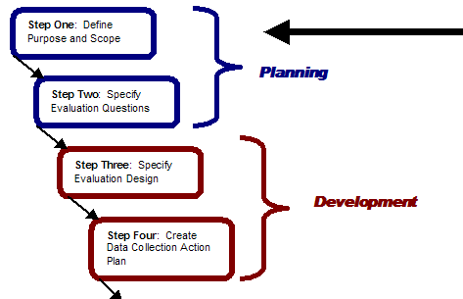
Overview – The 9-step Process

Slide 20
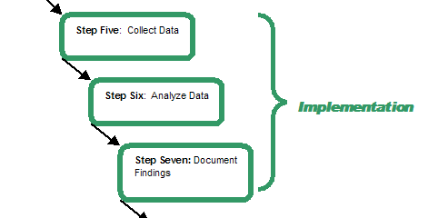
Overview – The 9-step Process

Slide 21
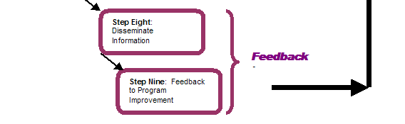
Overview – The 9-step Process

Slide 22
Module 3 – Defining the Purpose
Module 1 – Introduction
Module 2 – Overview
Module 3 – Defining the Purpose
Module 4 – Specifying the Questions
Module 5 – Identifying Evidence Needed
Module 6 – Specifying the Design

Slide 23
9-step Evaluation Process
Step 1: Define Purpose and Scope

Slide 24
Step 1: Scope/Purpose of Evaluation
Why are you doing the evaluation?
  mandatory? program outcomes? program improvement?
What is the scope? How large will the effort be?
  large/small; broad/narrow
How complex is the proposed evaluation?
  many variables, many questions?
What can you realistically accomplish?

Slide 25
Resource Considerations
  Resources
    $$
    Staff
      who can assist?
      need to bring in expertise?
      do it yourself?
      advisory team?
    Time
  Set priorities
  How you will use the information

Slide 26
Module 4 – Specifying the Questions
Module 1 – Introduction
Module 2 – Overview
Module 3 – Defining the Purpose
Module 4 – Specifying the Questions
Module 5 – Identifying Evidence Needed
Module 6 – Specifying the Design

Slide 27
9-step Evaluation Process
Step 2: Specify Evaluation Questions

Slide 28

Evaluation Questions
What is it that you want to know about your program?
  operationalize it (make it measurable)
Do not move forward if you cannot answer this question.

Slide 29
Sources of Questions
Strategic plans
Mission statements
Policies
Needs assessment
Goals and objectives
National standards and guidelines

Slide 30
Broad Questions
Broad Scope
  Do our students contribute positively to society after graduation?
  Do students in our new mentoring program have a more positive self-concept and better decision-making skills than students without access to the mentoring program?
  To what extent does the state’s career development program contribute to student readiness for further education and training and success in the workforce?

Slide 31
Narrow Questions
Narrow Scope
  Can our 6th grade students identify appropriate and inappropriate social behaviors?
  How many of our 10th grade students have identified their work-related interests using an interest inventory?
  Have 100% of our 10th grade students identified at least 3 occupations to explore further based on their interests, abilities, and knowledge of education and training requirements?

Slide 32
Exercise 1 – Scope
Please identify those areas that might be considered broad and those that might be considered narrow
How large will the resources need to be to answer the question?

Slide 33
Exercise 2 – Scope Write
List one broad evaluation question and one narrow evaluation question

Slide 34
Module 5 – Identifying Evidence Needed
Module 1 – Introduction
Module 2 – Overview
Module 3 – Defining the Purpose
Module 4 – Specifying the Questions
Module 5 – Identifying Evidence Needed
Module 6 – Specifying the Design

Slide 35
Identifying Evidence Needed to Answer Your Questions
What evidence do you have to answer your question?

Slide 36
Identifying Evidence Needed to Answer Your Questions
Need to think about what information you need in order to answer your evaluation questions

Slide 37
Example Evidence – Broad Scope
Do our students contribute positively to society after graduation?
Percent of our students that are employed, in education or training programs, in the military, are supporting a family by working at home, and/or are volunteering for charitable causes 3 years after high school graduation
Percent of our students that vote in local and national elections 5 years after graduation

Slide 38
Example Evidence – Narrow Scope
Have 100% of our 10th grade students identified at least 3 occupations to further explore that are based on their interests, abilities, and knowledge of the education and training requirements?
Number of 11th and 12th grade students participating in the career class that demonstrated increased career maturity from a pre- and post-test

Slide 39
Exercise 3 – Evidence (p. 4 of Workbook)
List evidence you need to have to answer the question

Slide 40
Module 6 – Specifying the Design
Module 1 – Introduction
Module 2 – Overview
Module 3 – Defining the Purpose
Module 4 – Specifying the Questions
Module 5 – Identifying Evidence Needed
Module 6 – Specifying the Design

Slide 41
9-step Evaluation Process
Step 3: Specify Evaluation Design

Slide 42
Types of Designs
Relates to when data should be collected
Status (here and now; snapshot)
Comparison (group A vs. group B; program A vs. program B)
Change (what happened as a result of a program; what differences are there between time A and time B)
Longitudinal (what happens over extended time)

Slide 43
Exercise 4 – Design (p. 5 of Workbook)
What type of design fits each evaluation question?
  Status
  Comparison
  Change
  Longitudinal

Slide 44
Module 7 – Data Collection Plan
Module 7 – Data Collection Plan
Module 8 – How to Collect Data
Module 9 – Using Commercial Instruments
Module 10 – Using Self-Constructed Instruments
Module 11 – Collecting Data

Slide 45
9-step Evaluation Process
Step 4: Create a Data Collection Action Plan

Slide 46
Organize Your Evaluation With a Data Collection Action Plan
Evaluation Question 1
What is Collected
How Collected/What Technique
From Whom/
Data Sources
When Collected and By Whom
How Data are to be Analyzed

Slide 47
Components of a Data Collection Action Plan
What Will be Collected?
  based on evidence required
How Collected? Instrumentation
  surveys? published instrument? focus group? observations?

Slide 48
Components of a Data Collection Action Plan
From Whom Collected?
  who or what provides evidence
When Collected and by Whom?
  specific dates, times, persons
How Data are to be Analyzed?

Slide 49
Data Sources — Who and What
Students
Parents
Teachers
Counselors
Employers
Friends
Documents and other records

Slide 50
Exercise 5 – Data Sources
Who/what are the data sources for the following questions?

