Slide 1
Lecture 20

Slide 2
DESIGNING TRAINING PROGRAMS

Slide 3
INTRODUCTION
This Learning Topic gives a broad overview of learning program design, including:
the definition of a learning program
how learning programs relate to learning bigger learning strategies
the design skills you need to develop a learning program
the steps in the design and development process

Slide 4
What is a learning program
Learning programs in this context relate to a vocational training program based around a unit, or units, of competency from an endorsed Training Package (or the modules in an accredited course).
you could also design and develop learning programs
  delivering short courses,
  providing workplace learning that is not nationally recognised
  induction training or other professional development.

Slide 5
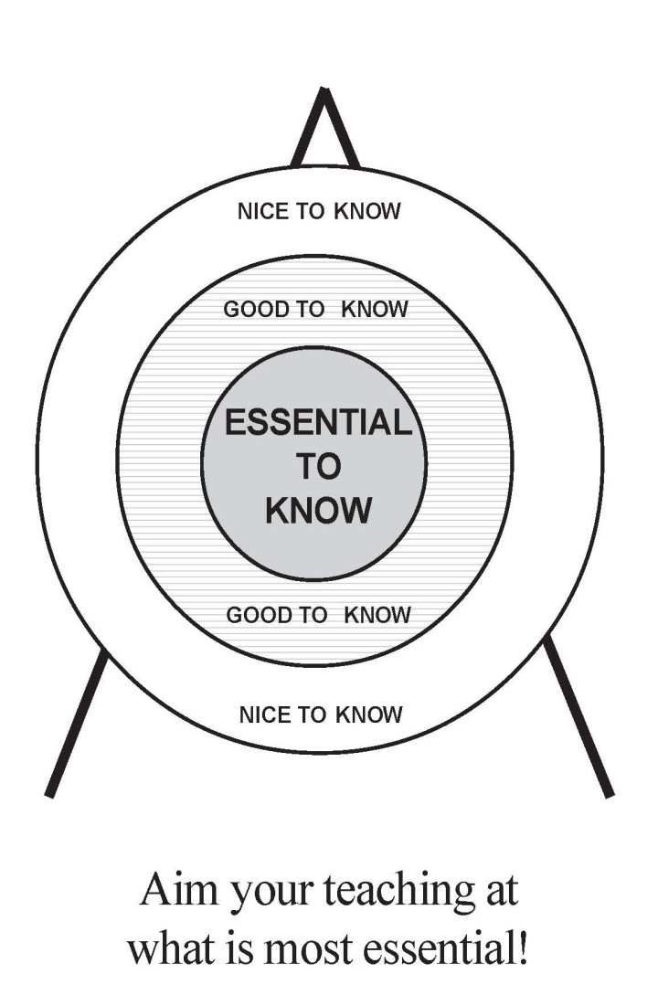
Setting Learning Objectives:
Hit the Bull’s Eye

Slide 6
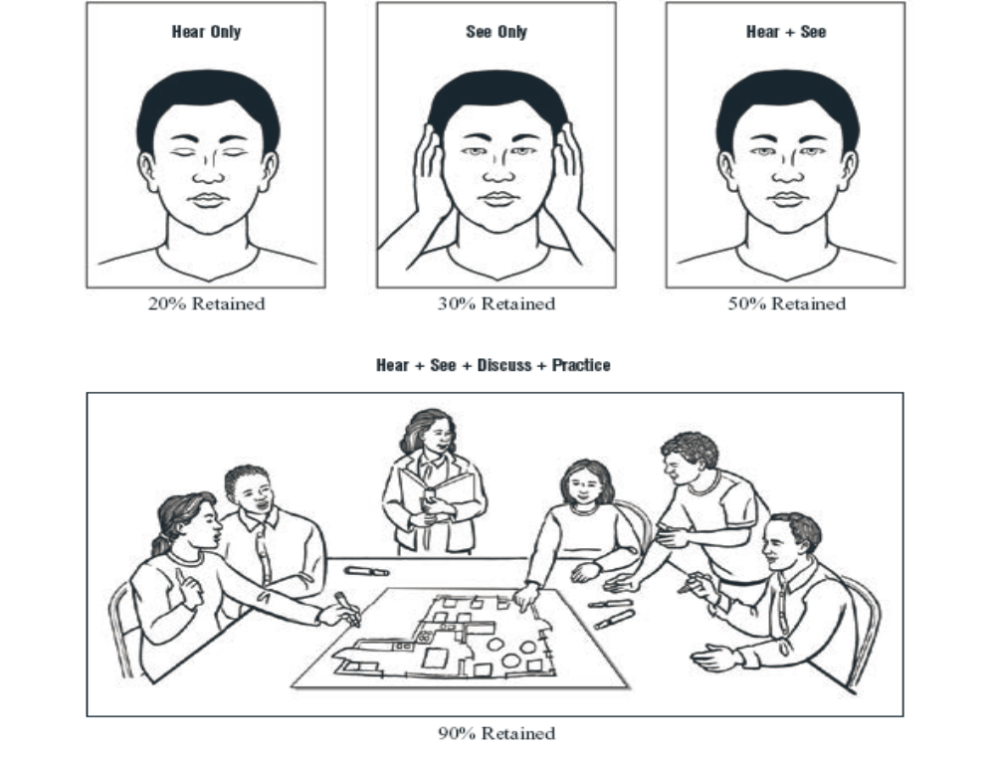
Selecting Teaching Methods – Use Diverse Methods
Tell me – I Forget
Show me – I Remember
Involve me – I Understand

Slide 7
A learning program should identify:
its purpose
the target group, their needs and characteristics
the outcomes to be achieved, such as the units of competency or other benchmarks
the learning and assessment activities including any flexibilities with this
any required resources.
It should also include:
learning objectives
a plan of how the learners will achieve the objectives
a structure and sequence for learning
content of the learning
delivery and assessment methods
assessment requirements.

Slide 8
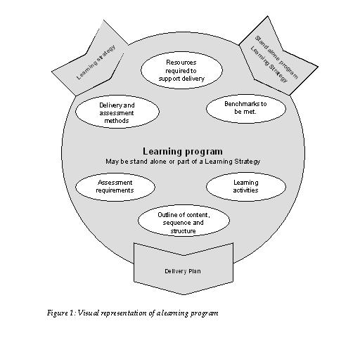
Figure 1: Visual representation of a learning program

Slide 9
Contextualisation
Contextualisation is the process of taking a learning program or resource and making it meaningful to individual learners. It could mean that the learning program is modified for:
a particular workplace
individual learning styles
groups of learners who are unable to access the planned environment
learners with special language, literacy and numeracy requirements
learners with disabilities
particular age groups and levels of previous experience.

Slide 10
Learning programs and learning strategies
A learning program could be a subset of a bigger learning strategy. The learning strategy can provides an organising framework for the delivery and assessment of a full Australian Qualifications Framework (AQF) qualification.

Slide 11
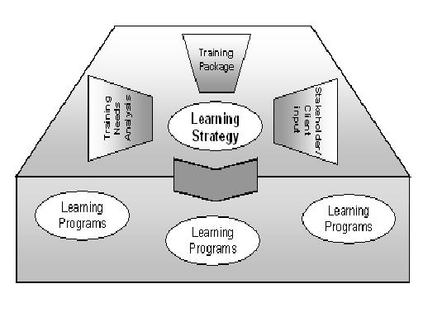
Relationship between learning programs and learning strategies

Slide 12
Skills of a designer
WHAT SKILLS DO YOU THINK A COURSE
DESIGNER SHOULD HAVE ?

Slide 13
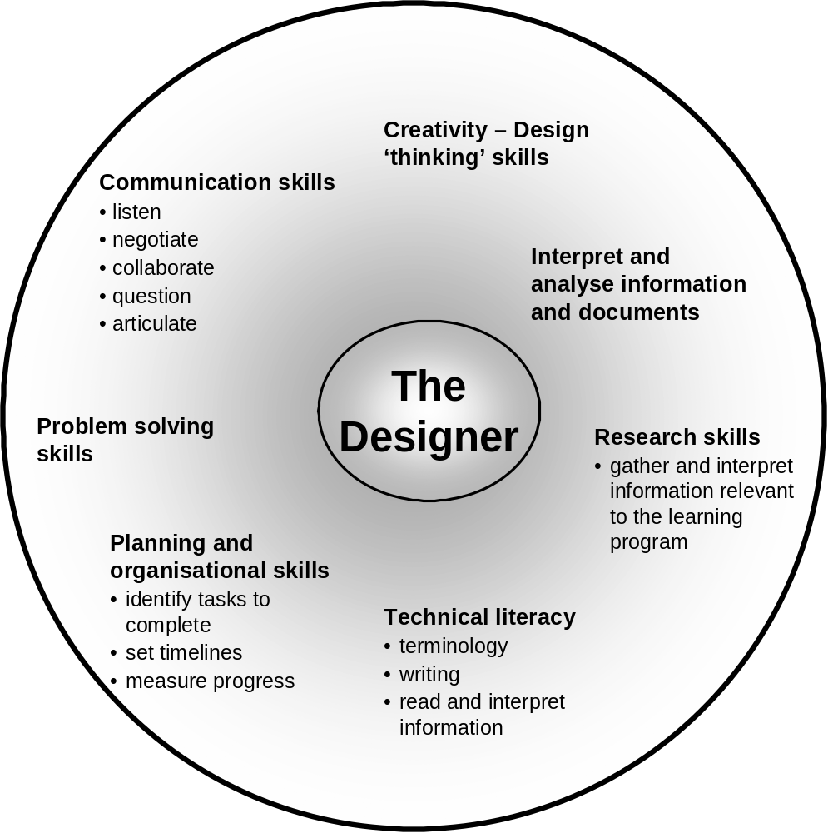
DESIGNER SKILLS

Slide 14
Influences on learning program design
In designing the learning program, you need to know about the environment in which the learning will take place. For example, you are required to have knowledge of the relevant:
national standards, codes of practice, and Commonwealth and State/Territory legislation including licensing requirements,
OHS policies and procedures business or industry knowledge specific to the training
Training Packages and their competency standards.

Slide 15
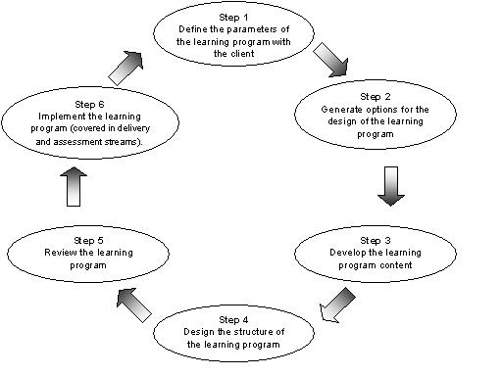
DESIGN
STEPS

Slide 16
Step 1 - Defining the parameters of the learning program with the client
define the ‘why, who and what’ of your learning program.
When designing a learning program, be sure you are clear on its purpose. That is, why does it need to be designed? In broad terms, what outcomes will it achieve, how will it be used, and who will be involved?

Slide 17

The purpose of the learning program
The benchmarks to be achieved
The specific learning objectives for the learning program
The scope and breadth of the learning program – Look at the Training package
The target group learners
The learning environment
The operational resource requirements
Access to other sources of information

Slide 18
1a - The purpose of a learning program
Think about any progam that you teach, what is it’s purpose? Some examples:
Accreditation
Organisational change
New skills
Update of skills
Legislative requirements

Slide 19
1b- Learner characteristics
You need to know about the learners:
Who they are; employment status; learning experiences; place of residence.
Learning styles
Special needs
How they will use the information
physical or psychological disability
level of maturity and motivation
cultural background; length of time as a resident in Australia
level of formal schooling

Slide 20
Consider The learners -
Adult learning principles
Some key adult learning principles:
Adults have a need to be self-directing.
Adults have a range of life experience, so connecting learning to experience is meaningful
Adults have a need to know why they are learning something.
Training needs to be learner-centred to engage learners.
The learning process needs to support increasing learner independence.
Emphasis on experimental and participative learning.
Use of modelling.
Reflecting individual circumstances.

Slide 21
Learning styles
An excellent resource that enables you to assess your own learning style and at the same time learn about learning styles can be found at the following web site.. Give it a go!!

Slide 22
Activity – Parameters of your Training program
Think about a Training program that you will design or that you are currently working with. Describe the parameters of the program

Slide 23
2. Generating options for designing the learning program
A program may be structured around:
independent units of competency
clustering of units of competency to correspond with specific work activities
clustering units of competency to reflect learning within a specific project
common knowledge clusters—required knowledge common to a number of units of competency is clustered for learning but application of the knowledge is assessed in other components of the program
knowledge and application clusters—similar to the previous program design option, but a structured work experience component forms part of the learning program. Suitable for traineeships and/or apprenticeships.

Slide 24
2a - generate a range of options for the learning program content
The content can come from:
Competency standards
People’s knowledge of jobs/skills
Legislative requirements
Training needs analysis
Skills analysis & skills audits
THINK?? Where else can you generate ideas for content?

Slide 25
2b – Identify resources required
Some examples:
other published, commercially available materials to support Training Packages or courses
competency standards as a learning resource
equipment and tools
Existing learning materials may include:
handouts for learners, references and texts
Worksheets, workbooks, prepared case studies; prepared task sheets, prepared activity sheets
prepared topic, unit, subject information sheets
prepared role-plays
prepared presentations and overheads
ENSURE THAT YOU RESEARCH EXISTING RESOURCES FIRST

Slide 26
Activity Learning program content
Generate ideas for possible content for your learning program, using an appropriate format to present your options. You should include:
activities
learning styles
possible assessment methods
delivery modes
existing resources
learning resources to be developed
work-based tasks
on-the-job learning.

Slide 27
2c - Timeframes
Your planning may be guided by a number of factors:
Training Packages and units of competency will provide guidelines
The client may specify the amount of time learners can dedicate to the learning program.
You may need to present options to the client and justify the time required by learners in the suggested learning programs.
based on previous learning programs
Your prior experience in designing learning programs and delivering training will provide you with an estimated timeframe.
Other experts

Slide 28
2d - Budgets, costs & logistics
You will need to consider:
Your budget
Costs of running the program..it could involve travel and expenses for participants, resource costs, etc…
The logistics..replacing people away from jobs, keeping the work flowing etc…

Slide 29
3. Develop the learning program content
Content can come from:
Training packages and associated resources
Needs analysis
Assessment requirements
Time allocated for training
Skills required
And many more..THINK…What are they?

Slide 30
Content (continued)
You can:
Contextualise existing resources
Develop new resources….if , think about:
  How will the material for this learning program be presented
  Are learners going to receive course notes; etc
  Will you require assistance from a technical or subject matter expert?
  What is the most logical flow of information for the learner?
  How will the learner be engaged in the learning process in the program?

Slide 31
Specifying assessment requirements
Assessment requirements may include:
meeting the rules of evidence
physical resource requirements
specialist support
reasonable adjustments to the assessment process
assessment tools and methods
formative assessment processes
legislative requirements.

Slide 32
Activity Learning program content
Generate ideas for possible content for your learning program, using an appropriate format to present your options. You should include:
activities
learning styles
possible assessment methods
delivery modes
existing resources
learning resources to be developed
work-based tasks
on-the-job learning.
Assessment strategy

Slide 33
A program delivery plan
A program delivery plan is a tool to use for designing and developing a learning program. It outlines each component of the program, so you can see a clear breakdown of the program.. The outline will clearly show:
the competencies or other benchmarks to be achieved
the specific learning outcomes for each session or part of the learning program
the content and learning activities for each session
the delivery methods for each session
workplace tasks or applications
practice opportunities
assessment points in the program where the learners’ progress is measured
assessment methods and tools used to gather evidence of competency
the personnel assigned to facilitate the implementation of each session.

Slide 34
Sample plans - structure
Make an example of a specific learning program which takes you through all the various stages including identifying the needs, and developing and designing the program

Slide 35
4a. Sequencing information
What should they learn first?
What skills need to be developed and practised before moving to the next stage of developing their competence?
What is the logical flow of learning to be followed?

Slide 36
4b - The learning program timeframe
Your plan should map the program to a timeframe. It can be affcetd by many factors that you should research.

Slide 37
4 c. Delivery methods
The plan needs to state the delivery methods to be employed in the learning program. The learning may take place in the workplace or in a training room. Methods could include:
face-to-face delivery
online delivery
distance learning
coaching or mentoring
workplace applications
simulated workplace applications
or will a number of delivery methods be used in the program?

Slide 38
4d - Assessment methods and tools
The program plan needs to include how the learners’ competence is going to be assessed. What methods will be used in the learning program to assess learners?

Slide 39
Activity Create a program delivery plan
Determine how your learning program will be sequenced and delivered
clearly state the competencies or benchmarks to be achieved and then show a breakdown of the program into sessions or parts
For each session, list:
  the competencies or other benchmarks to be achieved
  the specific learning outcomes for each session or part of the learning program
  learning activities for each session or part of the learning program
  delivery methods for each session or part of the learning program
  workplace tasks or applications
  practice opportunities
  Assessment stratgey
  the personnel assigned to facilitate the implementation of each session.

Slide 40
5. Review the learning program
Quality criteria to measure in a review process may stipulate that the learning program:
content and structure addresses all aspects required by the units of competency or other benchmarks
sequence provides effective and manageable blocks of learning
activities are interesting, relevant and appropriate to outcomes and learner characteristics
assessment points, methods and tools are appropriate and effective
effectively addresses equity needs
identifies risk areas and contingencies.

Slide 41
5a - Evaluation tools
Examples of include:
a questionnaire—with open or closed questions
a mapping tool
a checklist
a focus group discussion
a structured interview.

Slide 42
6 – Implement the program
After the program has been reviewed and all stakeholders accept the program, you are ready to implement the program

