Slide 1
Quick Recap of Lesson 1

Slide 2
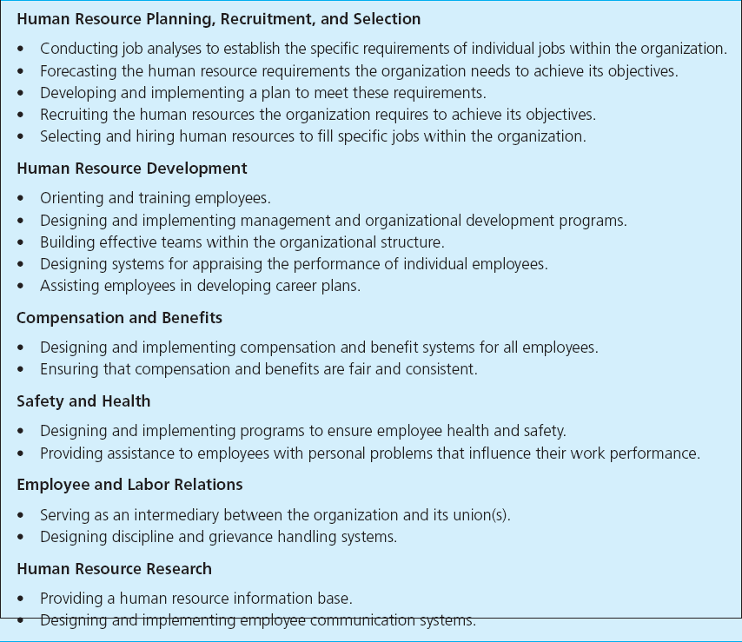
HR & HRD

Slide 3
Human Resource Functions
Human resource planning, recruitment, and selection
Human resource development
Compensation and benefits
Safety and health
Employee and labor relations
Human resource research

Slide 4
Lesson 1
  Overview of Human Resources and Professional Development

Slide 5
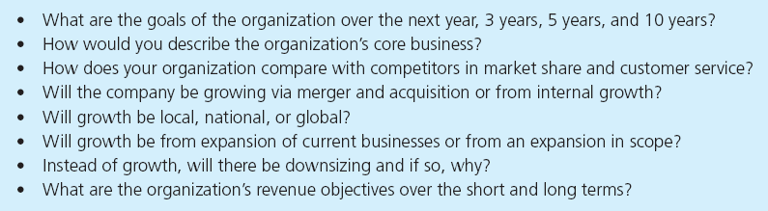
Questions for Understanding the Organization’s Business Strategies
Figure 1.2

Slide 6
Impact of the HR Manager on Organizational Performance
Reducing unnecessary overtime expenses by increasing productivity during a normal day
Staying on top of absenteeism and instituting programs designed to reduce money spent for time not worked
Eliminating wasted time by employees with sound job design

Slide 7
Impact of the HR Manager on Organizational Performance
Minimizing employee turnover and unemployment benefit costs by practicing sound human relations and creating a work atmosphere that promotes job satisfaction
Installing and monitoring effective safety and health programs to reduce lost-time accidents and keep medical and workers’ compensation costs low

Slide 8
Impact of the HR Manager on Organizational Performance
Properly training and developing all employees to improve their value to company and do a better job producing and selling high-quality products and services at lowest possible cost
Decreasing costly material waste by eliminating bad work habits, attitudes and poor working conditions that lead to carelessness and mistakes
Hiring the best people available at every level and avoiding overstaffing

Slide 9
Impact of the HR Manager on Organizational Performance
Maintaining competitive pay practices and benefit programs to foster a motivational climate for employees
Encouraging employees to submit ideas for increasing productivity and reducing costs
Installing human resource information systems to streamline and automate many human resource functions

Slide 10
Metrics and the HR Scorecard
Metrics
  Any set of quantitative measures used to assess workforce performance
Analysis of cost per hire
Average length of time to fill a position
Training cost per employee
Turnover cost per employee
New-hire performance by recruiting strategy

Slide 11

Metrics and the HR Scorecard
HR Scorecard
  Measurement and control system using a mix of quantitative and qualitative measures to evaluate performance
  Modified form of the balanced scorecard system

Slide 12
Communicating Human Resource Programs
Communication
  The transfer of information that is meaningful to those involved
Human resource managers must develop an appreciation for the importance of communication

Slide 13
Guidelines for Communicating Human Resource Programs
Avoid communicating in peer group or “privileged-class” language by focusing on the audience
Don’t ignore cultural and global aspects of communication
Back up communications with management action
Periodically reinforce employee communications

Slide 14
Guidelines for Communicating Human Resource Programs (cont.)
Transmit information and not just data
Don’t ignore perceptual and behavioral aspects of communication; anticipate employee reactions and act accordingly

Slide 15
Guidelines for Communicating Human Resource Programs (cont.)
Data
  Raw material from which information is developed
  composed of facts that describe places, people, things, or events and that have not been interpreted
Information
  Data that have been interpreted
  meet a need of one or more managers

Slide 16
Myths that keep HR from being a profession
New Realities
HR departments are not designed to provide corporate therapy or to act as social or health-and-happiness retreats. HR professionals must create the practices that make employees more competitive, not more comfortable.
HR activities are based on theory and research. HR professionals must master both theory and practice.
Old Myths
People go into HR because they like people.
Anyone can do HR.

Slide 17
Old Myths
HR deals with the soft side of business and therefore is not accountable.
HR focuses on costs, which must be controlled.
New Realities
The impact of HR practices on business results can and must be measured. HR professionals must learn to translate their work into financial performance.
HR practices must create value by increasing the intellectual capital within the firm. HR professionals must add value, not only reduce costs.

Slide 18
Old Myths
HR’s job is to be the policy police and the health-and-happiness patrol.
HR is full of fads.
New Realities
The HR function does not own compliance.
HR practices have evolved over time. HR professionals must see their current work as part of an evolutionary chain and explain their work with less jargon and more authority.

Slide 19
Old Myths
HR is staffed by nice people.
HR is HR’s job.
New Realities
At times, HR practices should force vigorous debates. HR professionals should be confrontative and challenging as well as supportive.
HR work is as important to line managers as are finance, strategy, and other business domains. HR professionals should join with managers in championing HR issues.

