Slide 1
Lecture 19

Slide 2
Basics for
Assessment of HRD Needs

Slide 3
Goals of HRD
Solving Problems
Preventing Anticipated Problems
Including as participants those individuals and units that can benefit most

Slide 4
Needs Assessment
Organizational Analysis
Task Analysis
Person Analysis

Slide 5
Unwillingness to Perform Needs Assessment
Can be a difficult time-consuming process
Action is valued over research
Unnecessary because available information already specifies organization needs (fads, etc.)
Lack of support

Slide 6
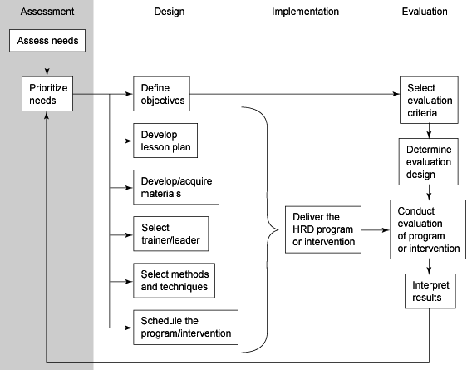
Model

Slide 7
Organizational Analysis
Organizational goals and strategy
Organizational resources (financial, facilities, resources)
Organizational culture/climate
Environmental constraints

Slide 8
Data Sources for Organizational Analysis – Part 1 of 3
Data Source Recommended | Training Need Implications | Example
Organizational Goals, Objectives and Budget | Where training emphasis can and should be placed. | To maintain a quality standard of no more than 1 reject per thousand Goal is to become ISO certified and 90,000 dollars has been allocated to this effort
Labor Inventory | Where training is needed to fill gaps caused by retirement, turnover, age, etc. | Thirty percent of our truck drivers will retire over the next four years

Slide 9
Data Sources for Organizational Analysis – Part 2 of 3
Data Source Recommended | Training Need Implications | Example
Organizational Climate Indices | These may help focus on problems that have training components
Grievances | Items related to productivity are useful in determining performance deficiencies | Seventy percent of grievances are related to behaviors of 6 supervisors
Absenteeism |  | High absences in clerical staff
Accidents |  | Accident rate for line workers increasing

Slide 10
Data Sources for Organizational Analysis – Part 3 of 3
Data Source Recommended | Training Need Implications | Example
Analysis of Efficiency Indices Cost of labor | Can help document difference between actual performance and desired performance | Labor costs have increased 8 percent in the last year
Changes in System or Subsystem | New or changed equipment may present training problem | The line has been shut down about once per day since the new machinery was installed. Waste has doubled since using the new cutting tool

Slide 11
Task Analysis
Overall job description
Task identification
What it takes to do the job/KSAs
Areas that can benefit from training
Prioritizing training needs

Slide 12
Data Sources For Task/Operational Analysis – Part 1 of 3
Sources for Obtaining Job Data | Training Need Implications | Practical Concerns
1. Job Descriptions | Outlines the job’s typical duties and responsibilities but is them not meant to be all inclusive | Often inaccurate due to time constraints or job knowledge.
2. Job Specifications | List specified tasks required for each job. | May be product of the job description and suffer from the same problems
3. Performance Standards | Objectives of the tasks of job, and standards by which they are judged. | Very useful if available, and accurate, but often organizations do not have formal performance standards

Slide 13
Data Sources For Operational Analysis – Part 2 of 3
Sources for Obtaining Job Data | Training Need Implications | Practical Concerns
4. Perform the Job | Most effective way of determining specific tasks, but has serious limitations in higher level jobs | Easy, short cycle type jobs are a possibility.
5. Observe Job—Work Sampling | Most effective way of determining specific tasks, but has serious limitations in higher level jobs | Useful again for very short cycle jobs. Be aware of the impact of being observed can influence behavior

Slide 14
Data Sources For Operational Analysis – Part 3 of 3
Sources for Obtaining Job Data | Training Need Implications | Practical Concerns
6. Questions directed to the job holder and the supervisor. |  | Most often used method the job holder and his supervisor have different perspectives and information
7. Review Literature concerning job in professional journals practitioner journals other industries | Useful for determining specific issues related to the job and what is being done by others and what the results are | Need to be sure information is relevant to your organization

Slide 15
Person Analysis
Performance deficiency
  Is performance substandard?
  Are current employees capable of training?
  Can performance be improved through training
Issue of whether to train, replace, motivate
Target population – values, education, prior knowledge, motivation

Slide 16
Data Sources for Person Analysis – Part 1 of 5
Data Sources for Obtaining Data | Training Need Implication | Remarks
Performance Data or Appraisals | Easy to analyze and quantify for purposes of determining subjects and kind of training needed. | Supervisor ratings are often done poorly as there is no real incentive to do them well, and a lot of good reasons not to
Observation – Work Sampling | More subjective technique. | Done effectively in some situations like customer service where you can monitor behavior
Interviews | Only individual knows what he believes he (she) needs to learn. | Be sure employee believes it is in his best interest to be honest

Slide 17
Data Sources for Person Analysis – Part 2 of 5
Data Sources for Obtaining Data | Training Need Implication | Remarks
Questionnaires | Same approach as the interview. | Same concerns as the interview
Tests a. Job knowledge b. Skills c. Achievement | Can be tailor-made or standardized. Care must be taken so that they measure job related qualities. | Care in the development of scoring keys is important and difficult to do if not trained in the process
Attitude Surveys | On an individual basis, useful in determining morale, motivation, or satisfaction of each employee. | Important to use well developed scales

Slide 18
Data Sources for Person Analysis – Part 3 of 5
Data Sources for Obtaining Data | Training Need Implication | Remarks
Checklists or Training Progress charts | Up-to-date listing of each employee’s skills. | Rely on supervisor ratings, see “Performance data or Appraisals”
Rating Scales | Care must be taken to ensure objective employee ratings. | Rely on supervisor ratings, see “Performance data or Appraisals”
Critical Incidents | Observe actions critical to successful and unsuccessful performance. | Rely on supervisor ratings, see “Performance data or Appraisals”

Slide 19
Data Sources for Person Analysis – Part 4 of 5
Data Sources for Obtaining Data | Training Need Implication | Remarks
Diaries | The individual employee records details of his (her) job.
Devised Situations | Certain knowledge, skills, and of attitudes are demonstrated in these techniques. | Useful, but again, care in development of scoring criteria is important
Assessment Centers | Combination of several of the above techniques. | Although expensive to develop and operate, these are very good

Slide 20
Data Sources for Person Analysis – Part 5 of 5
Data Sources for Obtaining Data | Training Need Implication | Remarks
Coaching | Similar to interview – one-to-one. | Must choose coaches carefully and train to be most effective
MBO or Work Planning | Provides actual performance data on a recurring basis related to organizational and group or individually negotiated standards. | Good process when implemented properly, and Review Systems are the support of top management

