Slide 1
Lecture 16

Slide 2
Maximize Learning
Train-The-Trainer

Slide 3
Unit Objectives
At the conclusion of this unit, the participants will be able to:
  Describe the ways in which people learn
  Explain how to create a positive learning environment
  Demonstrate how to maximize learning in a given scenario

Slide 4
Unit Objectives (contd.)
  State why trainers need to evaluate
  List formal and informal ways of evaluating
  Provide some guidelines for asking and answering questions
  Provide some guidelines for giving feedback

Slide 5
Exercise
Exercise: Positive
Learning Experiences

Slide 6
What Do You Think?
When you get a new gadget, how do you learn how to use it?

Slide 7


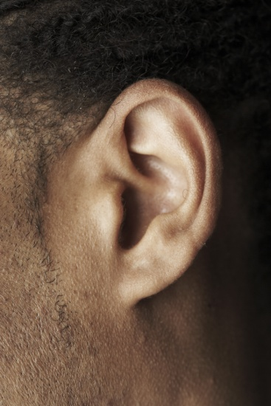
Learning Styles
Three primary learning styles
  Auditory
  Visual
  Tactile or kinesthetic
Combination

Slide 8
Auditory Learners
Learn through listening
  Lectures
  Discussions
  Talking things through
  Listening to what others have to say
Written information has little meaning
  Prefer to read text aloud
  Like to use tape recorder
Notes:
8

Slide 9
Visual Learners
Learn through seeing:
  Pictures
  Demonstrations
  Diagrams
  Illustrated text books
  PowerPoint slides
  Videos
  Flipcharts
  Handouts

Slide 10
Visual Learners (contd.)
Instructor’s body language and facial expressions help them understand
Sit at front of room
Remember by seeing
Like to take detailed notes to absorb information

Slide 11
Tactile Learners
Learn by doing, moving, touching
  Hands-on activities
Find it hard to sit still for very long
Want to actively explore physical world around them

Slide 12
Learning Styles and Teaching
Good instruction should combine auditory, visual, and tactile
Retention increases dramatically when learning involves more senses and is more active

Slide 13

To Retain Learning
Hear it
See it
Say it
Do it
Teach others

Slide 14
Learning Styles and Instructors
Instructors have a preferred learning style that may affect how they like to teach
Instructors need to incorporate elements that are less comfortable
CERT Basic Training Instructor Guide includes elements for all learning styles
Addressing all learning styles will help increase learners’ retention

Slide 15
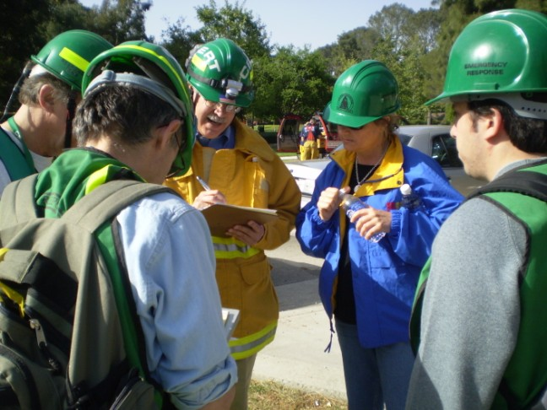
Create Positive Learning Environment
Three factors to accommodate:
  Physical
  Emotional
  Intellectual

Slide 16
What Do You Think?
What is a physically comfortable learning environment?

Slide 17
Physical Factors
What is a physically comfortable learning environment?
  Room not too hot or too cold
  People can see and hear instructor
  Lighting and amplification for people with reduced vision and hearing
  Don’t have to sit too long; take regular breaks
  Expectations account for reduced flexibility, reaction times, time of day

Slide 18
Emotional Factors
To be treated like adults (peers)
To direct their own learning whenever possible (self-motivated)
To know they are doing it right or at least that they are trying hard
To feel accepted as they are
To see a reason for the training

Slide 19
What Do You Think?
How could instructors respond to these emotional needs?

Slide 20
Provide Emotional Factors
How could instructors respond to these emotional needs?
  Be a learning resource
  Explain benefits; then let participants discover benefits themselves
  Respect them
  Teach to their level
  Don’t embarrass them
  Provide reinforcement and peer feedback
  Make learning non-threatening
  Make learning realistic and problem-centered

Slide 21
Intellectual Factors
To share their experiences
To connect new information to what they already know
To be involved in the learning
To learn the way they like to learn

Slide 22
What Do You Think?
How could instructors respond to these intellectual needs?

Slide 23
Provide Intellectual Factors
How could instructors respond to these intellectual needs?
  Use learners’ experiences to introduce concepts
  Build bridges between old and new information
  Make learning active
  Use variety of methods to reach all the learning styles

Slide 24
Differentiate Factors
Review the list generated in the first question of the unit and choose:
  “P” for Physical Factors
  “E” for Emotional Factors
  “I” for Intellectual Factors

Slide 25
Techniques to Maximize Learning
Motivation
  Especially at beginning of training
  What’s in it for me (WIIFM)
Reinforcement
  Frequently and positively
Repetition
  At least 3 times for learning retention

Slide 26
Motivation
Motivation is critical, especially at beginning of training
Adults need to know how it will benefit them
To motivate, instructors need to:
  Establish rapport
  Create open, friendly training atmosphere
  Keep stress low
  Challenge but don’t frustrate participants

Slide 27
Reinforcement
Instructors need to encourage and reinforce throughout training
Reward good behavior positively and frequently

Slide 28
Repetition
People need to hear something at least three times
  #1: Explain
  #2: Demonstrate
  #3: Have learners practice
For optimal learning, have learners also practice while explaining what they are doing

Slide 29
Exercise
Exercise: Power Outage

Slide 30
What Do You Think?
What is your job as a trainer?

Slide 31
Your Job as Trainer
What is your job as a trainer?
  To transfer knowledge
  Effective instructors use variety of training methods
    Interactive lecture
    Demonstrations
    Roleplays
    Exercises

Slide 32
What Do You Think?
Why do we use a variety of methods?

Slide 33
Training Methods
Why do we use a variety of methods?
  To appeal to all learning styles
    Auditory
    Visual
    Tactile

Slide 34
Assess Learning
Effective instructors assess learning to see that:
  The learners have understood what’s been said
  The learners “got it”

Slide 35
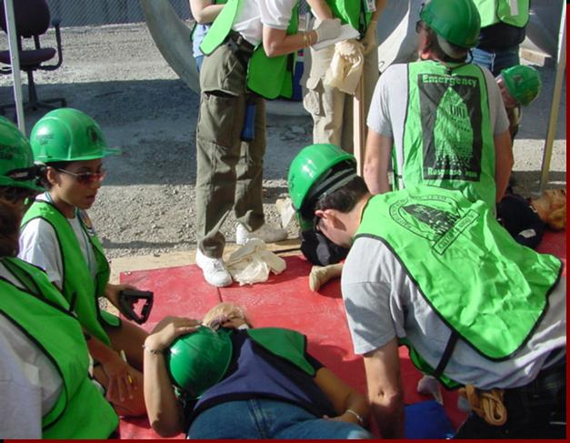
Why Evaluate?
Content
  Did learners “get it”?
Adult learner needs
  Physical
  Emotional
  Intellectual
Notes:
35

Slide 36
What Do You Think?
How can instructors find out if people have learned?

Slide 37
How To Assess Learning
How can instructors find out if people have learned?
  Instructors can find out if people have learned by:
    Asking questions
    Listening to questions
    Testing
    Observing hands-on exercises
    Observing body language

Slide 38
Types of Evaluation
Formal
  Tests
  Performance demonstrations
Informal
  Watching body language
  Questions
  Observation of hands-on activities
Notes:
38

Slide 39
What Do You Think?
What are some other reasons for asking questions?
Notes:
39

Slide 40
Why We Ask Questions
What are some other reasons for asking questions?
  Ask questions to:
    Get people involved/interested
    Stimulate discussion
    Channel thinking
Notes:
40

Slide 41
Kinds of Questions to Ask
Open and closed
To different audiences
  Direct question to one person
  Direct question to whole group
  Ask rhetorical question
Recall and apply
Notes:
41

Slide 42
What Do You Think?
What is the difference between an open question and a closed question?
Notes:
42

Slide 43
Closed Questions
What is the difference between an open question and a closed question?
  Closed questions:
    Answered by yes or no, true or false, or limited response
    Used to:
      Test knowledge
      Receive quick answers
      Maintain control of class
      End topic before a break
      Force a choice between correct and incorrect response
Notes:
43

Slide 44
Open Questions
What is the difference between an open question and a closed question?
  Open questions:
    Start with what, why, how, or describe
    Ask respondents to think and reflect
    Typically require a longer answer
    Often not one correct answer
    Used to:
      Generate discussion
      Find out how class is feeling
      Get people to open up
      Get class to think
Notes:
44

Slide 45
To Different Audiences
Instructor can direct a question to different audiences
  To one person
  To the whole group
  Rhetorical questions
Notes:
45

Slide 46
Recall and Apply
There are two kinds of evaluation questions:
  Recall question: Learners repeat what they learned
  Apply question: Learners think about what they learned and apply it to new situation
Notes:
46

Slide 47
How to Ask a Question
Be brief, clear, friendly
To group:
  Ask
  Plant
  Call
To individual:
  Call
  Ask
  Plant
Notes:
47

Slide 48
How to Answer a Question
You can ask someone else to answer question
Repeat question before answering it
Paraphrase any lengthy questions
Acknowledge questions that you cannot answer; get back to group as soon as possible
Notes:
48

Slide 49
Too Many Questions
If one learner asks too many questions, you can:
  Encourage others by recognizing their questions first
  As a last resort, take the individual aside
Notes:
49

Slide 50
What Do You Think?
What are some opportunities for giving feedback in CERT Basic Training?
Notes:
50

Slide 51
Feedback Opportunities
What are some opportunities for giving feedback in CERT Basic Training?
  During hands-on activities and skills training
  Tell how well CERT requirements are met
    Correct attire
    PPE
    CERT kits
  During class discussion
Notes:
51

Slide 52
Give Feedback
When to give feedback:
  To correct information
  For behavior that can be changed
  To acknowledge correct answers or performance of a technique
How to give feedback
  Compliment whenever possible, even when feedback is corrective
  Be specific
    Describe what needs to be corrected
    Describe how it needs to be corrected
Notes:
52

Slide 53
What Do You Think?
What if you ask a question and someone gives you a wrong answer? What would you do?
Notes:
53

Slide 54
Exercise
Exercise: Develop “What If” Questions
Notes:
54

Slide 55
Unit Summary
This unit has examined:
  How people learn
    Three learning styles: auditory, visual, and tactile
    Best teaching approach combines all three: hear it, see it, do it, teach it (say and do it)
  How to create positive learning environment
    Address physical, emotional, and intellectual needs
  Techniques that maximize learning
    Motivation
    Reinforcement
    Repetition (at least 3 times)

Slide 56
Unit Summary (contd.)
  Why instructors need to evaluate
  Formal and informal ways to evaluate
  Guidelines for asking and answering questions
  Guidelines for when and how to give feedback

