Slide 1
Lecture 15

Slide 2
Organizational Learning (OL)

Slide 3
Organizational Learning (OL)
Definition of OL:
“It involves the ways firms build, supplement and organize knowledge and routines around their activities and within their culture and adapt develop organizational efficiency by improving the use of the broad skills of their workforce” (Dogsdon, 1993).

Slide 4
Definition of OL:
“It is an org. which facilitates the learning of all its members and continuously transforms itself”.
“It creates the environment in which people spend most of their lives and subsequently, has major impact on their behavior”.
OL does not simply engage in a lot of training.

Slide 5
“learning organization (LO)”
refers to a very significant movement in organization development and was popularized by Peter Senge in his landmark book "The Fifth Discipline: The Art and Practice of Learning Organization”.

Slide 6
Continues
Also (Mark Addleson 1997) defines learning organization as
"an organization that builds collaborative relationships in order to draw strength from the diverse knowledge, experience, capabilities, and ways of doing things that people and communities have and use."

Slide 7
Continues
According to Peter Senge "learning organizations are: organizations where people continually expand their capacity to create the results they truly desire, where new and expansive patterns of thinking are nurtured, where collective aspiration is set free, and where people are continually learning to see the whole
together".(Senge 1990).

Slide 8
Characteristics of LO:
1. Learning Culture - an organizational climate that nurtures\fosters learning.
There is a strong similarity with those characteristics associated with innovation.
• Future, external orientation.
• Free exchange and flow of information.
• Commitment to learning, personal development.
• Valuing people.
• Climate of openness and trust.
• Learning from experience.

Slide 9
Characteristics of LO:
2 -Processes - processes that encourage interaction across boundaries.
These are infrastructure, development and management processes, as opposed to business operational processes
• Strategic and Scenario Planning.
• Competitor Analysis.
• Information and Knowledge Management.
• Capability Planning.
• Team and Organization development.
• Performance Measurement.
• Reward and Recognition Systems.

Slide 10
Characteristics of LO:
3 -Tools and Techniques - methods that aid individual and group learning, include a wide range of learning and creativity skills such as:
• Inquiry - interviewing, seeking information
• Creativity - brainstorming, associating ideas
• Making sense of situations - organizing information and thoughts
• Making choices - deciding courses of action
• Observing outcomes - recording, observation
• Reframing knowledge - embedding new knowledge into mental models, memorizing.

Slide 11
Characteristics of LO:
4 - Skills and Motivation - to learn and adapt.
Collective (i.e. team and organizational) learning require skills for sharing information and knowledge, particularly implicit knowledge, assumptions and beliefs that are traditionally "beneath the surface". Key skills here are:
• Communication, especially across organizational boundaries.
• Listening and observing.
• Monitoring and supporting colleagues.
• Taking a holistic perspective - seeing the team and organization as a whole.
• Coping with challenge and uncertainty.

Slide 12
Features of LO
It has a climate in which individual members are encouraged to learn and develop.
Extends this culture to include customers and other significant stakeholders.
Makes HRD strategy central to bus. policy.
A continuous process of org. transformation.

Slide 13
Organizational Learning (OL)
What OL includes?
1- R&D activities.
2- Formal & informal education of employees.
3- Involves the means that org. uses to disseminate information throughout its ranks and the way that this information is processed & stored.

Slide 14
Organizational Learning (OL)
What it should result?
1- Technological innovation.
2- Efficiency improvement.
3- Increase reliability & corp. adaptability.
The conclusion:
1- Higher level of competitiveness.
2- OL is a required element for long-term success.

Slide 15
Organizational Learning (OL)
In case of low level of OL, it leads to:
1- Stagnant organization that cannot adjust to environment changes or competitive challenges.
2- Limits the firm ability to reduce costs.
3- Limits the firm ability to change markets or product lines.

Slide 16
Factors contribute to OL
Corporate strategy: how org. is structured to learn from mistakes.
Resource allocation: exploration and exploitation.
Recognition for the employees’ motivation for learning.

Slide 17
Exploration & Exploitation in OL
Exploration: Means seeking new ideas.
Exploitation: Means incorporating the new ideas into what a business does.
The corporate culture & procedures reflect reality on OL.

Slide 18
Elements of LO
There are two elements (Narver & Slater, 1995):
1- Facilitative leadership.
2- Organizational structure conducive to learning.

Slide 19
OL from external relationships
Using facilities & R&D services of others through mutual collaboration.

Slide 20
Characteristics of LO members
Living with change and challenge.
Internal harmony: compromise is possible, no right or wrong.
Managing diversity within org.

Slide 21
A career in learning and development: HRD Perspective
Where do we want to take L&D and ourselves?

Slide 22
Agenda
What’s happening in L&D & how does this relate to what’s happening in HR?
What do people in organisations want from HR and L&D?
A bit of a SWOT?
Skills and careers in L&D – and how does this relate to bigger HR career picture?

Slide 23
What’s happening in L&D?

Slide 24
Three key shifts in thinking
Organisational as well as individual learning = business alignment (capability) + org. values + learning culture + sharing know-how
From ‘training’ to ‘learning’ = outcome & process, not input + varied methods + continuous & closer to the job
Impact on L&D of HR function moving to (shared) service delivery (increasingly electronic) + business partner + the line
Also context of national skills agenda + regulation

Slide 25
A lot is being asked of L&D – not just skilling
Individual learning Organisational learning
Employment relationship? Supporting business strategy
Individual capability……... Organisational capability
Individual performance… Organisational performance
Human capital……employability? Social capital
Developing potential/ career? Talent pipeline
Adjusting to change Managing change
Conforming or influencing? Supporting values/ culture
Continuous learning Learning organisation
Learning from others… Sharing to create value

Slide 26

Learning delivery: Methods and access
Line
Manager
(PDP)
Courses
Education
Rich feedback
Coaching by line
Formal coaching
or mentoring
Team learning
Learning
opportunities
‘Programmes’
‘Talent’
Unit or Function
Peers
Communities of practice
Planned experiences
ICT
Gateways
e-learning

Slide 27
Atomised or Holistic?
bite-sized modules
integrated ‘programmes’
matching menus
mentoring & coaching
self-service
experiential learning
e-learning
team learning
technical or generic
communities of practice
Looks systematic
Just-in-time
Bulk delivery
Low impact?
Social & cultural
Transfer into job
Hard to bulk deliver
Higher impact?

Slide 28
What is happening in HR? Structure!
The Ulrich model
is not the Ulrich model
It does not have
3 ‘legs’… but 4, even 5
Whatever the name, the ‘new’ structure
is less prevalent
than claimed
Where it appears,
it does so in lots
of different forms
More traditional models still widely used
eg single HR team

Slide 29
Structures and Roles in HR
Shared services – outsourced, insourced; single or cross-functional
Range of centres of expertise
  otherwise work done in business units
  or corporate centre
Business partners widespread
  may be solo operators or in teams
  do a lot of operational work, or not
  report to business unit heads or HR
The corporate centre is the fourth leg

Slide 30
L&D function: types of organisation
In-house service provider
Income generating business unit
Wholly
owned
subsidiary
Manage-ment
buy-out
Outsourced to third
party
partial
complete

Slide 31
Variables features of L&D structures
Shared services in HR and/or L&D
Business partners in HR – & how linked to L&D
Outsourced provision versus in-house delivery
Suppliers on framework agreements
L&D may or may not sit with HR function
M&L development sometimes separate, also OD
Location of L&D budgets – line v L&D, central v local v functional
Physical training centres

Slide 32
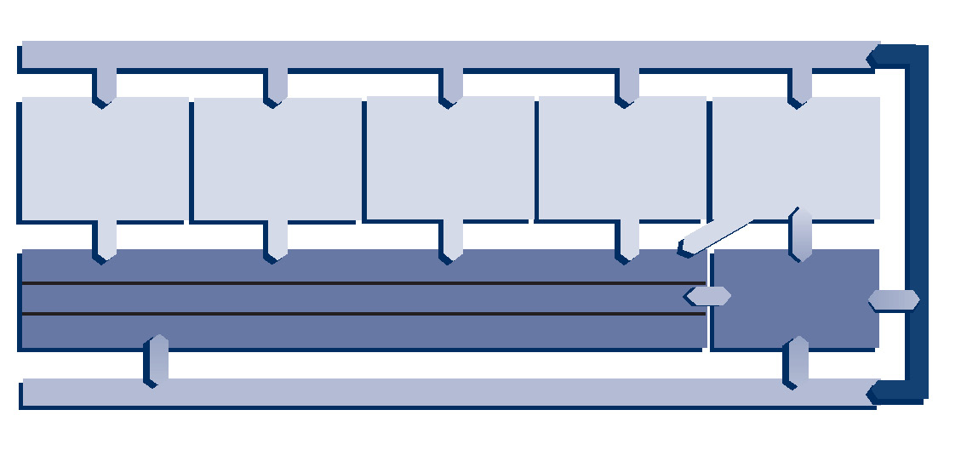
Who delivers learning?
Learning priorities
Short standard courses
Functional technical regulatory
Bespoke & team interventions
Corporate programmes
Self-help &
e-learning
Internal L&D people
Internal managers and technical experts
External suppliers
Business partners
Local L&D
Customer demand from the business

Slide 33
What do people in organisations want from HR and L&D?

Slide 34
Key messages about the role of HR
HR is there to support the business to perform
Keeping within the law
Paying people, recruiting, developing people
Not all leaders involve HR on ‘demand’ side issues
Looking ahead to avoid problems
HR needs to both serve management and support employees & balance these interests
Advising and equipping the line – more intimately linked to how managers work than other corporate functions
Source: What Customers Want from HR, IES

Slide 35
Messages about service & relationships
Seriously engaged with its customers’ needs
Responsive HR, which gets the basics right
An independent-minded HR function
HR solving problems that are strategically important for the business
A ‘proactive’ HR function, helping managers look ahead
Professional HR ― real ‘people partners’
responsive
proactive
professional

Slide 36
What do customers mean by ‘Proactive’ HR?
enables managers and employees to do business better by being more closely involved
helps ‘nip problems in the bud’ by spotting early
brings in good ideas from outside the business
assertive if managers are flouting policies or codes of behaviour
coaching and training managers to manage and motivate their people better
working ‘across the business’ for more consistency of people management, and better use of skills

Slide 37
What correlates with satisfaction with HR?
31% managers and 24% non-managers satisfied or very satisfied with HR services
About as many think it is getting better & worse
Satisfaction with HR correlates with:
  Being well supported in times of change
  Good advice for employees and for the line
  Well supported with difficult people/ situations
  HR getting the basics right
  Also the expertise of HR staff, understanding employee needs, reliability, responsiveness

Slide 38
L&D relative to other areas of HR
L&D often used by managers along with recruitment and performance/reward
Most used aspect of HR by non-managers along with performance/ reward
Non-managers see it as more effective (17% very) than managers do (13% very)
High value service to customers – 63% managers see it as potentially very high value, 57% non-managers
L&D satisfaction does not correlate very strongly with overall satisfaction with HR services

Slide 39
What customers want from L&D
Quick access to technical training key for knowledge workers & basic management training for new managers
Clear service offer & targetted info
Employees want clear budgets once agreed with managers – sometimes as ‘battlefield’
Managers want tailored development for their teams but not sure who provides this
Talent and OD of interest but offer not clear
Career development important & neglected – gap between HR/L&D
Lack of close enough dialogue with unit/ function managers on needs for groups of staff
Coaching by line/ peers needs to be built into resources/ time
Danger of L&D ‘nice’ and HR ‘nasty’

Slide 40
A bit of a SWOT

Slide 41
Some big assumptions in the L&D vision
Work context
Manager as coach
Culture change
Personal support + experiential learning
Self-managed learners

Slide 42
How do you see an L&D SWOT?
Strengths
Demand is there
A fresh vision & some theory
Some good people in L&D
Weaknesses
Prioritising needs – lack business focus
Timing & quality control
Bespoke not delivered
Opportunities
Business need accepted
Exciting technology
Talent, careers, OD, change – latent demand
Threats
Workforce passive
Managers don’t coach
A soft touch in recession
Too separate

Slide 43
Jobs and Skills in L&D

Slide 44
Types of work in L&D?
Trainer at varying levels of skill & on standard or bespoke programmes
Covering generic skills or also professional/ technical skills
Management & leadership development – often now with talent, graduates etc.
Procuring/ managing L&D services
Needs…. Design… Delivery… Evaluation can be cut differently
Occ pych work such as assessment etc.?
Coaching/ counselling?
OD – do we know what this is? Org design, org development, facilitation, change, org learning/knowledge management….

Slide 45
CIPD research – HR professionals
Most frequently listed competencies for successful international HR professionals in CIPD research:
Process skills
providing information and advice
mobilising and engaging
balancing
Political skills
facilitating
cultural sensitivity
ambiguity tolerance
team working
Technical skills
compensation
training
resourcing etc.
Business skills
strategic thinking
business understanding

Slide 46
Possible gaps in HR skills to overcome
Customer focus Solution focus Risk averse Courage to challenge Flexibility to adapt Motivated to improve Resilient to set backs | Influencing Business analysis Problem diagnosis Measurement Strategic focus Political sensitivity Personal impact Relationship building
 | Information systems Business processes Business activities Marketing techniques Process Technology International context Specialist HR areas
  Attitude
  Skills
  Knowledge

Slide 47
Skills in L&D – similar or different to HR?
Need for business understanding, line of sight with business needs and customer focus similar to those in HR?
What about relationships with employees? Mode of delivery closer
Works with line on service needs but also has to equip the line for people management & as coaches
Knowledge base around learning theory & practical skills in delivery distinct from HRM – are we clear what this body of knowledge is?
OD muddled and mysterious – obviously need to relate to business & to facilitate… but practical theories of org design, change etc?
More use of outsourced services so purchasing & quality key skill areas

Slide 48
Careers in HR and in L&D

Slide 49
Particular development challenges in HR
People moving in and out of function, sometimes at high level
People moving between areas of expertise
Emergent new fields (eg talent, OD) maybe extending core traditional HR skills
What do you need to get a job in HR?
How are skills brought quickly up to expected level?
Different needs for high level experts?
Particular challenges for business partners
Everyone needs updating

Slide 50
Possible HR career map in new model
Corporate HR
transfers from
line management
Centres of expertise
Business partner
Shared service

Slide 51
The zig-zag career in HR
Corporate HR
Centres of expertise
Business partner
Shared service

Slide 52
Careers in L&D?
L&D + reward & ER seen a key HR building blocks. Most likely to support specialist career
Also key skills for generalists, so smart HR people will be seeking L&D/OD experience
Qualifications? For HR, CIPD is “ticket to travel”
Career in HR, broad career in L&D, specialist L&D (eg M&L, OD, coach), in & out of L&D
Routes in from operational/ technical training differ from those now open in HR
Relationship with careers in education?
Fluid interface with self-employment & consulting

Slide 53
Is there more to be gained by thinking of L&D as a separate profession or part of HR?
Where do your career aspirations/ interests lie?
What are your hopes and fears for a future in L&D?

Slide 54
Some reading
What Customers Want from HR, IES report 453, www.employment-studies.co.uk
Managing and developing HR careers, CIPD Research Report
The Changing HR function, CIPD Research Report
Reilly P and Williams T, Strategic HR, Gower
Resourcing the Training and Development Function, IES report 390

