Slide 1
Lecture 14

Slide 2
Introduction to
Learning Theories & Styles

Slide 3
Definition of Learning
Learning
  a relatively permanent change in behavior brought about by experience
  distinguishes between maturation and experience
  distinguishes between short-term changes in performance and actual learning

Slide 4


Learning
How do we learn? Association
We connect events that occur in sequence… like a dog hearing his master say “Sit,” his sitting then receiving a biscuit from the master…

Slide 5
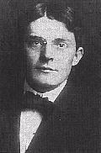
Behaviorism
Classical Conditioning
Operant Conditioning
Observation
“Forget the mind…”
Psychology should based on
observable behavior
John B. Watson
(Richardson, 1999)

Slide 6
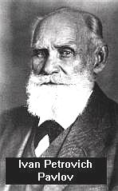
Classical Conditioning
Ivan Pavlov
1904 Nobel Prize in Medicine
20 years studying digestive system
30 years studying learning
Pavlov noticed that dogs would
drool in anticipation
of food.
What were dogs thinking or feeling? How did they know he was going to feed them? Did they see, smell or associate him with food?
Ivan Pavlov
(Richardson, 1999)

Slide 7
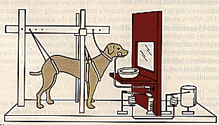
Classical Conditioning
Examines the phenomenon objectively using Experiments!
(Richardson, 1999)

Slide 8
Classical Conditioning
Classical Conditioning
  a type of learning in which an organism responds to a neutral stimulus that normally does not bring about that response; associative learning
  Thunder = Rain = Lightning = get umbrella
  “Sit” = biscuit
Neutral stimulus
  prior to conditioning, has no effect on the desired response
  Until you experience thunder with rain & lightning, you don’t think about getting your umbrella
  Until you pair “Sit” with the behavior of sitting and the reward of biscuit…. “Sit” had no meaning

Slide 9
Classical Conditioning
Unconditioned Stimulus (UCS)
  a stimulus that brings about a response without having been learned (smell of food causes salivation)
Unconditioned Response (UCR)
  a response that is natural and needs no training (e.g. salivation at the smell of food)

Slide 10
Classical Conditioning
Conditioned Stimulus (CS)
  a once-neutral stimulus that has been paired with a UCS to bring about a response formerly caused only by the UCS
  (bell rings, dog salivates because he has paired the bell with food due to condioning)
Conditioned Response (CR)
  a response that, after conditioning, follows a previously neutral stimulus (salivation caused by bell ringing)

Slide 11
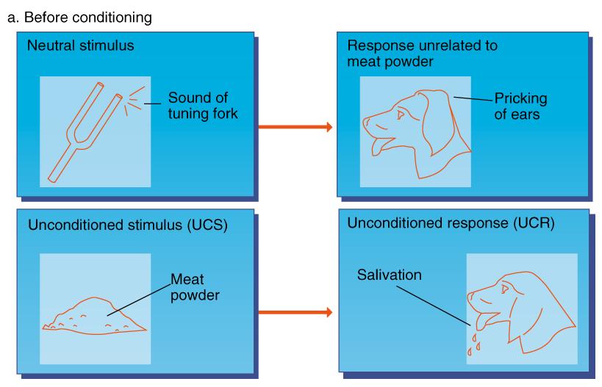
(Feldman, 1999)

Slide 12
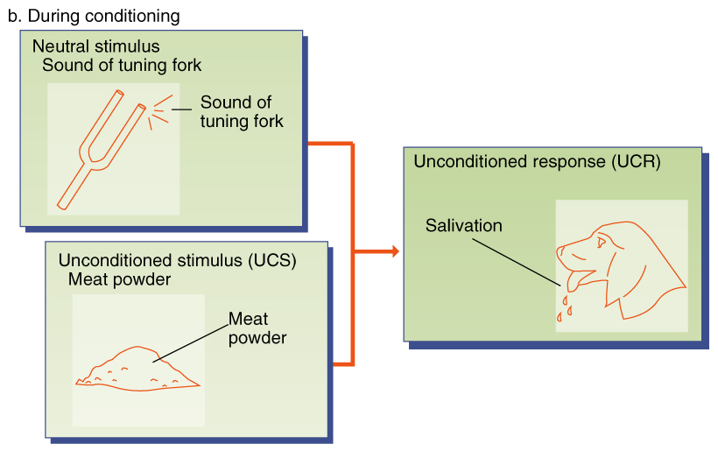
(Feldman, 1999)

Slide 13
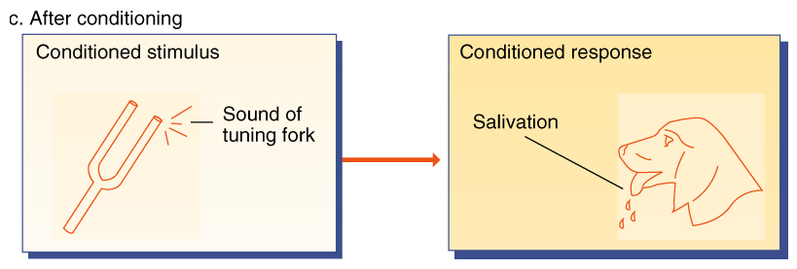
(Feldman, 1999)

Slide 14
Classical Conditioning
Extinction
  a previously conditioned response decreases in frequency and eventually disappears
Spontaneous Recovery
  the reappearance of a previously extinguished response after time has elapsed without exposure to the conditioned stimulus

Slide 15
Classical Conditioning
Stimulus Generalization
  conditioned response follows a stimulus that is similar to the original conditioned stimulus
Stimulus Discrimination
  organism learns to differentiate among stimuli
Higher-Order Conditioning
  pairing a previously conditioned stimulus with a neutral stimulus

Slide 16
Operant Conditioning
Operant Conditioning
  learning in which a voluntary response is strengthened or weakened, depending on its positive or negative consequences
Law of Effect
  responses that are satisfying are more likely to be repeated, and those that are not satisfying are less likely to be repeated

Slide 17
Operant Conditioning
Reinforcement
  the process by which a stimulus increases the probability that a preceding behavior will be repeated
Reinforcer
  any stimulus that increases the probability that a preceding behavior will occur again

Slide 18
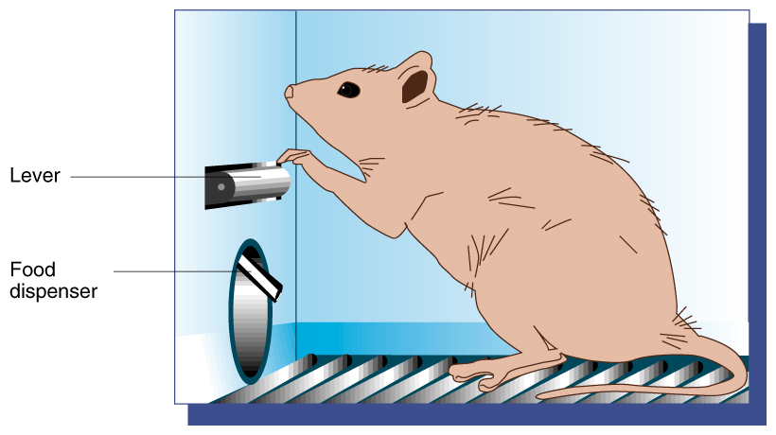
(Feldman, 1999)

Slide 19
Operant Conditioning
Primary Reinforcer
  satisfies some biological need and works naturally, regardless of a person’s prior experience
Secondary Reinforcer
  a stimulus that becomes reinforcing because of its association with a primary reinforcer

Slide 20
Positive Reinforcers, Negative Reinforcers, and Punishment
Positive Reinforcer
  added to the environment that brings about an increase in a preceding response
Negative Reinforcer
  unpleasant stimulus whose removal leads to an increase in the probability that a preceding response will occur again in the future

Slide 21
Positive Reinforcers, Negative Reinforcers, and Punishment
Negative Reinforcer (cont.)
  Escape conditioning
  Avoidance conditioning
Punishment
  unpleasant or painful stimuli that decrease the probability that a preceding behavior will occur again

Slide 22
Examples of Reinforcement
Positive when stimuli is added
  getting a promotion or raise for good performance at work
  increases frequency of good work
Punishment when stimuli is added
  getting a demotion or pay cut for poor work
  getting a spanking for misbehavior
  decreases frequency of poor work or misbehavior

Slide 23
Examples of Reinforcement
Punishment by removing positive stimuli
  removal of television or video games for getting bad grades
  decrease in frequency of bad grades
Negative reinforcement when stimuli is added
  getting rid of pain by taking medication
  increase in frequency of taking medication

Slide 24
Schedules of Reinforcement
Continuous Reinforcement
  behavior that is reinforced every time it occurs
Partial Reinforcement
  behavior that is reinforced some but not all of the time

Slide 25
Schedules of Reinforcement
Fixed-Ratio Schedule
  reinforcement is given only after a certain number of responses are made
Variable-Ratio Schedule
  reinforcement occurs after a varying number of responses rather than after a fixed number

Slide 26
Schedules of Reinforcement
Fixed-Interval Schedule
  provides reinforcement for a response only if a fixed time period has elapsed, making overall rates of response relatively low
Variable-Interval Schedule
  time between reinforcements caries around some average rather than being fixed

Slide 27
Discrimination and Generalization in Operant Conditioning
Stimulus Control Training
  behavior is reinforced in the presence of a specific stimulus, but not in its absence
Discriminative Stimulus
  signals the likelihood that reinforcement will follow a response

Slide 28
Shaping: Reinforcing What Doesn’t Come Naturally
Shaping
  the process of teaching a complex behavior by rewarding closer and closer approximations of the desired behavior
Biological constraints
  built-in limitations in the ability of animals to learn particular behaviors

Slide 29
Cognitive-Social Approaches to Learning
Latent Learning
  learning in which a new behavior is acquired but is not demonstrated until reinforcement is provided
Observational Learning
  learning through observing the behavior of another person (a “model”)

Slide 30
VARK Learning Styles
Visual Learners
  need to see photos, graphs, charts, pictures
Aural Learners
  need to hear and repeat aloud information
Read/Write Learners
  need to read books, write flash cards, etc.
Kinesthetic Learners
  need to DO something active, discuss, walk, create, move while learning

Slide 31
ILS online test
Index of Learning Styles (ILS) is an instrument used to assess preferences on four dimensions:
active/reflective
sensing/intuitive
visual/verbal
sequential/global
This learning style model was formulated by Richard M. Felder and Linda K. Silverman. The instrument is being developed by Barbara A. Soloman and Richard M. Felder of North Carolina State University.
Take the test at:
http://www.crc4mse.org/ILS/Index.html

Slide 32
Audio, Visual & Tactile Learning
Most noted three learning styles are:
Audio
Visual
Tactile

Slide 33
The Meyers Briggs Type Inventory (MBTI) has focused on the psychological type. New research indicates psychological type corresponds to various learning styles and preferences in the educational process. Our understanding of learning pattern differences is enhanced when the preferences are combined to produce the following patterns:
ES pattern: concrete-active
IS pattern: concrete-reflective
EN pattern: abstract-active
IN pattern: abstract-reflective
Learning Styles based on MBTI

Slide 34
These patterns are not evenly distributed in the general population.
The ES pattern is the most frequent, representing about 50 percent of high school seniors; the IN pattern is the least frequent, representing about 10 percent. The other two patterns fall fairly evenly between ES and IN.
On most college campuses, the distribution is similar, with students exhibiting the strongest preference for the ES (concrete active) pattern followed by IS, EN, and IN.

Slide 35
Concrete active (ES) learners are action-oriented realists, the most practical of the four patterns, and learn best when useful applications are obvious.
Concrete reflective (IS) learners are thoughtful realists preferring to deal with what is real and factual in a careful, unhurried way.
Abstract active learners (EN) are action-oriented innovators having wide- ranging interests and liking new possibilities as challenges to make something happen.

Slide 36
Abstract reflective learners (IN) are thoughtful innovators, introspective and scholarly, interested in knowledge for its own sake; they value ideas, theory, and depth of understanding.
Concrete active pattern is the most pragmatic and least academic of the four, whereas the abstract reflective is the most academic and least pragmatic.
Take the Keirsey Temperament Sorter to see which
MBTI type you might be and how that corresponds to your learning styles:
http://www.keirsey.com

Slide 37
References
Feldman, M. (1999). Making the grade. CD-Rom. McGraw Hill Company. Retrieved May 2002 from World Wide Web at: http://www.mcgrawhill.com.
Kohn, A. J. & Kohn, W. (1998). The Integrator, 2.0. CD-Rom. Brooks/Cole Thomson Learning.
Richardson, K. (1998). Introduction to psychology. Retrieved May 2002 from the World Wide Web at:
http://www.monmouth.edu.

Slide 38
The Learning Process

Slide 39
Learning – relatively permanent change in behavior
Learning
83 % - See
11% - Hear
3% - Smell
2% - Touch
1% - Taste
Retention
10% - Read
20% - Hear
30% - See
50% - See/Hear
70% - Discuss
80% - See/Hear/Do

Slide 40
Basic Principles of Learning:
Learning is continuous
Learning is purposeful & must make sense to the learner
Learning involves as many senses as possible
Learning activities must be appropriate for the situation

Slide 41
Basic Principles of Learning:
Learning must be stimulating
Learning must result in the ability to perform
Learning is affected by emotions
Learning is affected by the physical and social environment

Slide 42
Teaching/Instructing:
Success depends upon:
  Objectives for the Course
  Resources Available
  Characteristics of Participants
  Learning Environment
  Instructor(s)
Who’s Responsible ?
Instructor

Slide 43
Elements of Instructional Situation
Learning Objective
Learner
Teacher

Slide 44
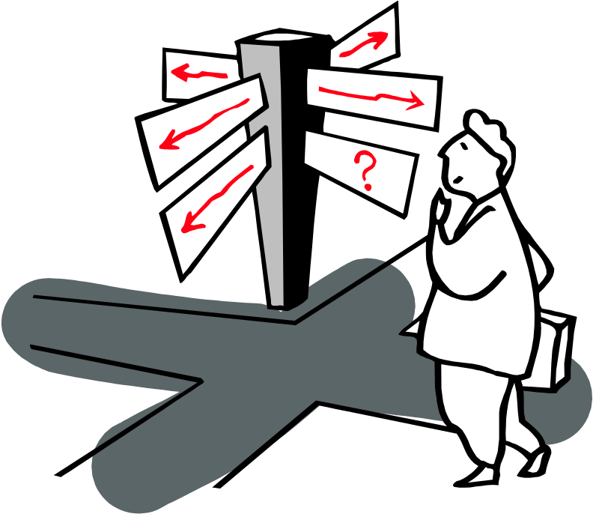
Objectives -
Written in behavioral terms
Outlined to participants clearly and specifically

Slide 45
Types of Objectives – Cognitive (Knowledge)
Tell what information the learner must know and describe how the knowledge will be demonstrated.
Require giving information to the learner.

Slide 46
Types of Objectives – Psychomotor (skill)
Tell what physical skills the learner will be able to perform.
Best learned in practice sessions as they require neuromuscular coordination.
Whole – Part - Whole

Slide 47
Types of Objectives – Affective (feelings)
Clarify feelings and attitudes of the learner
The most difficult to impart & evaluate
    A patient, confident, friendly, empathetic teacher can help learners feel comfortable and confident.

Slide 48

Why do you want to know if the objectives are being met?
How can you determine if the objectives are being met?
Evaluation

Slide 49
Evaluation
USE
  Determine readiness for new material
  Estimate progress
  Judge effectiveness
  Provide motivation/ feedback
  Provide a record
MISUSE
  Threaten students
  Classify students
  Misuse results
  Use for instructional design

Slide 50
Learner
Motivation
  Intrinsic
  Extrinsic
Past learning experience
  Length away from
  Positive or Negative
Needs

Slide 51
Learning Styles
Concrete
Experience
Active
Experimentation
Reflective
Observation
Abstract
Conceptualization

Slide 52
Instructor/Facilitator
Most important element to the learning experience
Provides guidance, support, and structure to the learning experience

Slide 53
Characteristics of a good Instructor/Facilitator:
Knowledge of the subject matter
Facilitator of learner participation
Ability to serve as a model
Ability to provide effective feedback
Ability to perform effective evaluation
Ability to administer & manage the course

Slide 54
The Good Speaker
Maintains Student Contact
Controls Nervousness
Avoids Distracting Mannerisms
Shows Enthusiasm
Develops Good Voice Quality
Avoids Excuses
Practices before Presents

Slide 55
Are you maintaining contact?
Get the attention of the class first
Look at and talk to your students
Speak in a conversational tone of voice
Pay close attention to student response
Be Alert!! Look Alert!!

Slide 56
Controling Nervousness
Be thoroughly prepared
Assume the proper mental attitude
Have initial remarks will in mind
Review previous instruction
Tell a story or anecdote
Show down – Be deliberate

Slide 57
Advise to Instructors -
DO
Take job seriously
Observe others
Develop relationships
Prepare your lesson
Practice your delivery
Don’t
Bluff
Use profanity
Ridicule students
Talk down to class
Lose your patients

Slide 58
Methods of Presentation
Present Material in small, learnable steps
Require maximum student participation
Present material in logical sequence
Design “work” to insure successful response

Slide 59
Methods of Presentation
Correct student errors ‘on-the-spot’
Maintain control of student learning

