Slide 1
Quick Recap of Lecture 12

Slide 2
Roles and Competencies
Role
  A set of task related behaviors required of a person by his or her position in the organization.
Competency
  A competency is an area of knowledge, ability, skill and other characteristics which an individual must possess in order to produce the outputs for his/her roles.

Slide 3
Senior Executives Roles in HRD
Instill a corporate HRD philosophy
Develop a leadership style congruent with this philosophy
Develop HRD strategies and plans
Create organizational status for HRD function
Staff HRD department with competent people
Ensure availability of adequate resources
Develop a positive climate for HRD
Develop professional competencies in HRD managers
Do not expect immediate and visible results

Slide 4
HRD Managers’ General Roles
Develop HRD policies and programmes
Plan HRD functions
Implement HRD mechanisms and processes
Monitor and evaluate HRD practices
Provide specialist/professional services
Advocate HRD philosophy and approaches
Establish linkage and coordination with managers and outside consultants

Slide 5
HRD Managers’ Specific Roles
Manager
Facilitator of learning
Consultant
Researcher

Slide 6
Lecture 13

Slide 7
“Learning” and “HRD”

Slide 8
Learning
Focus is upon change
Change must be long-lasting
The focus of learning can be cognitive, behavioral, or affective
Results from the individual’s interaction with the learning environment

Slide 9
Learning Outcomes
Outcomes can be:
Cognitive (Knowledge)
Psychomotor (Skill- or behavior-based)
Affective (Attitude)

Slide 10
Basic Learning Principles
Contiguity – things taught together become associated with each other
Law of Effect – a behavior followed by pleasurable experience is likely to be repeated
Practice – repetition increases association and knowledge

Slide 11
Limitations in the Foregoing
Based on strictly controlled tests (“lab studies”)
Practice doesn’t always make perfect

Slide 12
Improved Training Design
Task Analysis
Component Task Achievement
Task Sequencing

Slide 13
Task Analysis
Break each task down into a series of distinct component tasks
Keep breaking tasks down to the simplest level possible
Remember “K.I.S.S.”

Slide 14
Component Task Achievement
Each task must be completed fully before the entire task may be performed correctly
You have to specify what is to be done, under what conditions, and how it is to be evaluated

Slide 15
Task Sequencing
Each component task should be arranged in the proper sequence
Some are serial tasks
Some can be done in parallel

Slide 16
Instructional Psychology
What must be done before learning can take place
Describe the learning goal to be achieved
Analyze the initial state of the learner
Identify the conditions allowing the learner to gain competence
Assess and monitor the learning process

Slide 17
Maximizing Learning (Training)
Trainee Characteristics
Training Design
Transfer of Training

Slide 18
Trainee Characteristics
Trainability –
  Motivation
  Ability
  Perception of the work environment
Personality and attitudes

Slide 19
Training Design Issues
Conditions of practice
Retention of what is learned

Slide 20
Conditions of Practice
Active practice
Spaced versus massed practice
Whole versus part learning
Overlearning
Knowledge of results (feedback)
Task sequencing

Slide 21
Retention of What is Learned
Meaningfulness of the material
Degree of original learning
Interference
  Knowledge before training
  Changes after training

Slide 22
Transfer of Training
Does training make it to the job?
Positive transfer –
  Job performance improves after training
Zero transfer –
  No measurable changes
Negative transfer –
  Performance becomes worse after training

Slide 23
Other Types of Transfer
Near Transfer
  Ability to directly apply back to the job
Far Transfer
  Expanding upon or using in new and creative ways

Slide 24
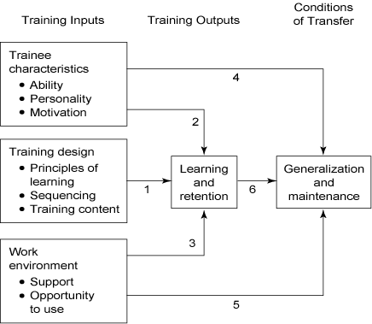
Baldwin & Ford’s Transfer of Training Model

Slide 25
Maximizing Transfer
Identical elements
Physical fidelity
Psychological fidelity

Slide 26
Identical Elements
The closer the training is to the job, the easier it is to achieve transfer
Direct relationship to the job
Example: Customer service and angry customers
Role playing, business games, etc.

Slide 27
Physical Fidelity
Same physically
Same procedurally
Example: Flight and submarine simulators

Slide 28
Psychological Fidelity
Trainee experiences same stresses and conditions as he/she is being trained for
Example: MS Flight Simulator

Slide 29
Support in Work Environment
Transfer of training into workplace is supported
A continuous learning environment
Supervisors support and help develop training
Training leads to promotion/better pay
Trainee has opportunity to perform

Slide 30
Individual Differences
Rate of Progress
  Learning charts/curves
Chart learning proficiency against time
  Measure proficiency with standardized tests
Charts show plateaus in learning as well as progress

Slide 31
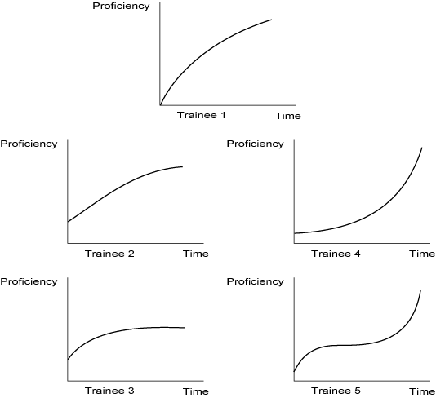
Some Learning Curves

Slide 32
Cognitive Resource Allocation Theory (How Brain is Used)
How well you pay attention determines how much you learn.
How well you pay attention determines how well you perform.
The greater your intelligence, the more you pay attention.
If you’re motivated, you pay attention.

Slide 33
Three Phases of Learning a Skill
Declarative knowledge
  Forming a mental picture of the task
Knowledge compilation
  Integrating knowledge and motor skills
Procedural knowledge
  Ability to perform task automatically, paying little attention to it

Slide 34
Andragogy (M. Knowles)
Adults are self-directed
Adults already have knowledge and experience
Adults are ready to learn relevant tasks
Adults are motivated to learn
Adults expect to apply learning immediately

Slide 35
How to Assess Trainee Differences
Instrumentality
  Does trainee think training is applicable?
Skepticism
  Degree trainee questions and demands facts.
Resistance to Change
  How well is change accepted?

Slide 36
How to Assess Trainee Differences – 2
Attention Span
  How long can trainee focus on the lesson?
Expectation Level
  What does trainee expect from the trainer/training?
Dominant Needs
  What drives/motivates the trainee?

Slide 37
How to Assess Trainee Differences – 3
Absorption Level
  How fast is new information accepted?
Topical Interest
  How interested is trainee in topic?
Self-Confidence
  Degree of independence and self-regard
Locus of Control
  Can trainee implement training on job?

Slide 38
Gerontology
Working with older people
Older people can and do develop
Older people should not be excluded from training
Training must be geared for adults, not children
Organizations must reward training
Look at overall career patterns

Slide 39
Learning Styles
Lots of research in this area
Many different tests are available to measure:
  Learning ability
  Individual learning preferences
It’s NOT all psychobabble!

Slide 40
Kolb’s Learning Style Inventory
Among most popular tests used
Proposes four modes of learning:
  Concrete Experience (CE)
  Abstract Conceptualization (AC)
  Reflective Observation (RO)
  Active Experimentation (AE)

Slide 41
Kolb’s Learning Styles
Convergent
  Thinking and Doing
Divergent
  Feeling and Watching
Assimilation
  Thinking and Watching
Accommodative
  Feeling and Doing

Slide 42
Kolb’s Learning Styles
CE
Accommodative Divergent
AE RO
Convergent Assimilation
AC

Slide 43
Five Learning Strategies
Rehearsal strategies
Elaboration strategies
Organizational strategies
Comprehension monitoring strategies
Affective strategies

Slide 44
Another Strategy
Identify assumptions
Test assumption validity
Generate and test alternatives
Decrease likelihood of errors

Slide 45
Perceptual Preferences
Print
  Reading and writing
Visual
  Graphs, charts, pictures
Aural
  Listening
Interactive
  Discussing, asking questions

Slide 46
Perceptual Preferences – 2
Tactile/manipulative
  Hands-on, touching
Kinesthetic/psychomotor
  Role playing, physical activity
Olfactory
  Smell, taste

Slide 47
Actual Preferences
Adults – generally prefer visual
Females – all sources
Males – selected sources
Young Adults – interactive, visual
CONCLUSION: Tailor your method to your audience.

Slide 48
Expert Performance
Definition:
Consistently superior performance on a specified set of representative tasks for a domain

Slide 49
Gagne’s Theory of Instruction
Verbal information
Intellectual skills
Cognitive strategies
Motor skills
Attitudes
  ALL ARE LEARNED IN DIFFERENT WAYS!

Slide 50
Instructional Events
Gain attention.
State the learning objective.
Stimulate recall of earlier lessons.
Present new material.
Provide learning guidance.
Have student perform.
Provide feedback.
Assess performance.
Enhance retention and training transfer.

Slide 51
Summary
Without learning, there would be no field of human resource development
To increase learning, we must consider:
  Trainee characteristics/individual differences
  Training design issues
  Retention and transfer of training issues

