Slide 1
Introduction to
Human Resource Development
Moving from HRM to HRD
Contd….
Lecture 10

Slide 2
Relationship Between HRM and HRD
Human resource management (HRM) encompasses many functions
Human resource development (HRD) is just one of the functions within HRM

Slide 3
HRD Functions
Training and development (T&D)
Organizational development
Career development

Slide 4
Training and Development (T&D)
Training – improving the knowledge, skills and attitudes of employees for the short-term, particular to a specific job or task – e.g.,
  Employee orientation
  Skills & technical training
  Coaching
  Counseling

Slide 5
Training and Development (T&D)
Development – preparing for future responsibilities, while increasing the capacity to perform at a current job
  Management training
  Supervisor development

Slide 6
Organizational Development
The process of improving an organization’s effectiveness and member’s well-being through the application of behavioral science concepts
Focuses on both macro- and micro-levels
HRD plays the role of a change agent

Slide 7
Career Development
Ongoing process by which individuals progress through series of changes until they achieve their personal level of maximum achievement.
  Career planning
  Career management

Slide 8
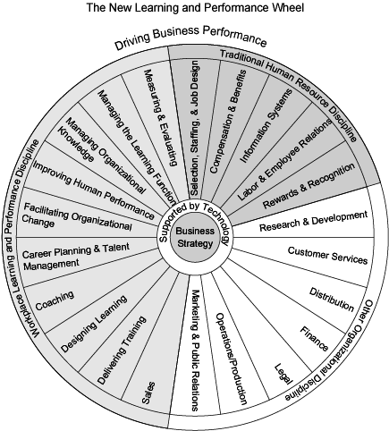
Learning & Performance
By Permission: Naughton & Rothwell (2004)

Slide 9
Critical HRD Issues
Strategic management and HRD
The supervisor’s role in HRD
Organizational structure of HRD

Slide 10
Strategic Management & HRD
Strategic management aims to ensure organizational effectiveness for the foreseeable/projected future – e.g., maximizing profits in the next 3 to 5 years
HRD aims to get managers and workers ready for new products, procedures, and materials

Slide 11
Supervisor’s Role in HRD
Implements HRD programs and procedures
On-the-job training (OJT)
Coaching/mentoring/counseling
Career and employee development
A “front-line participant” in HRD

Slide 12
Organizational Structure of HRD Departments
Depends on company size, industry and maturity
No single structure used
Depends in large part on how well the HRD manager becomes an institutional part of the company – i.e., a revenue contributor, not just a revenue user

Slide 13
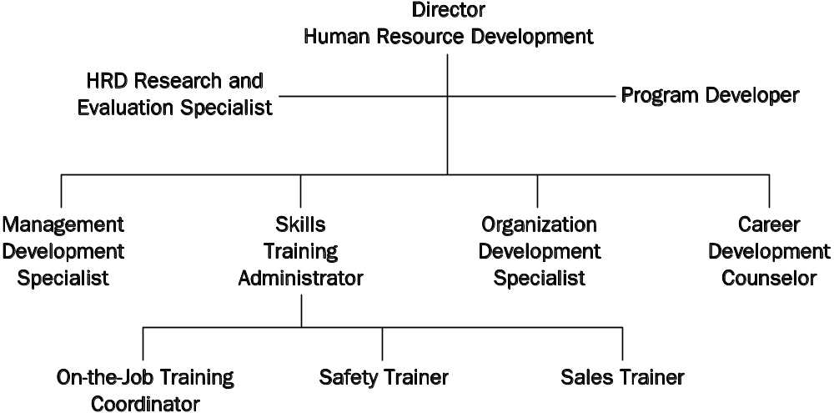
HRD Organization in a Large Company

Slide 14
Roles and competencies of an HRD professional
Main roles:
- Learning strategies – involved in higher level of decision making concerning how HRD initiatives the goals and strategies of O.
Buss. partner – work together with other manager to implement evaluate HRD initiatives.
The project manager – involved in day to day planning, funding and monitoring HRD initiatives.
Professional specialist – add their expertise in particular area ex. designing, developing, delivering and evaluating the HRD initiatives.

Slide 15
Roles and competencies of an HRD professional
Executive/Manager
HR Strategic Advisor
HR Systems Designer/Developer
Organization Change Agent
Organization Design Consultant
Learning Program Specialist

Slide 16
Sample HRD Jobs/Roles – 2
Instructor/Facilitator
Individual Development and Career Counselor
Performance Consultant (Coach)
Researcher

Slide 17
HR Manager Role
Integrates HRD with organizational goals and strategies
Promotes HRD as a profit enhancer
Tailors HRD to corporate needs and budget
Institutionalizes performance enhancement

Slide 18
HR Strategic Advisor Role
Consults with corporate strategic thinkers
Helps to articulate goals and strategies
Develops HR plans
Develops strategic planning education and training programs

Slide 19
HR Systems Designer/Developer
Assists HR manager in the design and development of HR systems
Designs HR programs
Develops intervention strategies
Plans HR implementation actions

Slide 20
Organization Change Agent
Develops more efficient work teams
Improves quality management
Implements intervention strategies
Develops change reports

Slide 21
Organization Design Consultant
Designs work systems
Develops effective alternative work designs
Implements changed systems

Slide 22
Learning Program Specialist
Identifies needs of learners
Develops and designs learning programs
Prepares learning materials and learning aids
Develops program objectives, lesson plans, and strategies

Slide 23
Instructor/Facilitator
Presents learning materials
Leads and facilitates structured learning experiences
Selects appropriate instructional methods and techniques
Delivers instruction

Slide 24
Individual Development and Career Counselor
Assists individuals in career planning
Develops individual assessments
Facilitates career workshops
Provides career guidance

Slide 25
Performance Consultant (Coach)
Advises line management on appropriate interventions to improve individual and group performance
Provides intervention strategies
Develops and provides coaching designs
Implements coaching activities

Slide 26
Researcher
Assesses HRD practices and programs
Determines HRD program effectiveness
Develops requirements for changing HRD programs to address current and future problems

Slide 27
Challenges to organization and to HRD professionals
Changing workforce demographics
Competing in global economy
Eliminating the skills gap
Need for lifelong learning
Need for organizational learning

Slide 28
Changing Demographics in the U.S. Workplace
By 2020, it is predicted that:
African-Americans will remain at 11%
Hispanics will increase from 9% to 14%
Asians will increase from 4% to 6%
Whites will decrease from 76% to 68%
Women will increase from 46% to 50%
Older workers (>55) will increase to 25%

Slide 29
Competing in the Global Economy
New technologies
Need for more skilled and educated workers
Cultural sensitivity required
Team involvement
Problem solving
Better communications skills

Slide 30
Eliminating the Skills Gap
Example: In South Carolina, 47% of entering high school freshmen don’t graduate.
  Best state is Vermont, with 81% graduating
Employees need to be taught basic skills:
  Math
  Reading
  Applied subjects
Need to improve U.S. schools!

Slide 31
Need for Lifelong Learning
Organizations change
Technologies change
Products change
Processes change
PEOPLE must change!!

Slide 32
Need for Organizational Learning
Organizations must be able to learn, adapt, and change
Principles:
  Systems thinking
  Personal mastery
  Mental models
  Shared visions
  Team learning

Slide 33
A Framework for the HRD Process
HRD efforts should use the following four phases (or stages):
Need assessment
Design
Implementation
Evaluation

Slide 34
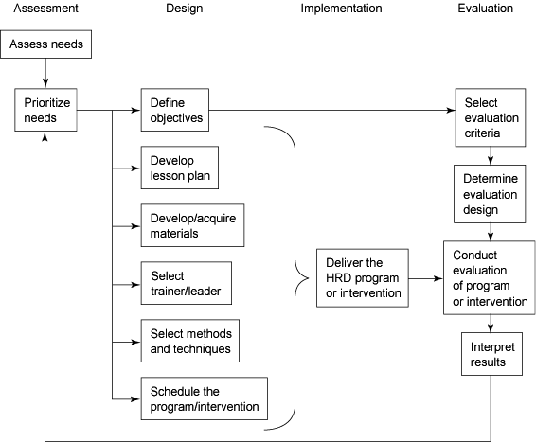
Training & HRD Process Model

Slide 35
Needs Assessment Phase
It used to address some need or gap within an organization by:
- Establishing HRD priorities
- Defining specific training and objectives
- Establishing evaluation criteria

Slide 36
Design Phase
Selecting who delivers program
Selecting and developing program content
Scheduling the training program

Slide 37
Implementation Phase
Implementing or delivering the program

Slide 38
Evaluation Phase
Determining program effectiveness – e.g.,
Keep or change providers?
Offer it again?
What are the true costs?
Can we do it another way?

Slide 39
Summary
HRD is too important to be left to amateurs
HRD should be a revenue producer, not a revenue user
HRD should be a central part of company
You need to be able to talk MONEY

