Slide 1
Lecture 09
International Crises & Cultural Competence

Slide 2
Communication Assumptions
Job to prevent illness or death, restore or maintain calm, engender confidence in response
Emergencies are chaotic so roles should be simplified
Confusion is reduced with fast, relevant, simple and consistent messages
Communication resources will be limited

Slide 3
What we know
The more the public knows about our efforts to openly share information, the more they trust us
Messages are judged based on trustworthiness
Some differences don’t matter, some do

Slide 4
Differences that matter
Role of culture
  All individuals like no other (individual)
  All individuals like some others (culture)
  All individuals like all others (homo sapiens)
Collectivism and Individualism (in-group versus out-group)
Cultural beliefs held more strongly during crisis
Communication styles differ by culture

Slide 5
Let’s discuss what culture is
Countless value, languages, customs, ethics . .
Culture-general knowledge and culture-specific knowledge
Example: culture general—enter new culture look for differences in: authority, delegation, etiquette, communication styles
Example: culture specific—know the specifics of a culture as it compares to your own

Slide 6
Value of cultural competence
Reduces ethnocentric thinking and behavior (adaptability in crisis is a strength)
Trust builds more quickly
Beware of cultural “gotchas” in self and others

Slide 7
Quick exercise: How cultures differ
  Crowd or audience behaviors
  How often we smile or to whom
  How we see old age
  How open or guarded we are with information
  What is or is not ethical behavior
  Importance of competition
How time is understood and used
The importance of harmony in a group
What’s polite or impolite
If, how and when we touch each other
What is beautiful or ugly
What we believe we need or don’t need

Slide 8
Cultural Conflict
Cultural conflict dimensions. content and relational all have, cultural conflict adds the third one--"a clash of cultural values."
Acknowledge conflict contains a cultural dimension
Understanding your own culture and developing cultural awareness by acquiring a broad knowledge of values and beliefs of other cultures

Slide 9
Cultural communication styles
Communication occurs when sender’s message is received
Messages that do not challenge cultural beliefs will be more easily received

Slide 10
Social Media: Crisis Role

Slide 11
Sources of Social Pressure
What will I gain?
What will it cost me?
What do those important to me want me to do?
Can I actually carry it out?

Slide 12
CDC: Why social media in a crisis
Need to be where people are
Leverage unique characteristics of emerging channels
Tailored health messages
Facilitates interactive communication and community
Empowers people in making health decisions

Slide 13
CDC Audiences Use Social Media
Those who use social media on CDC.gov:
  Have higher satisfaction ratings (84 out of 100) than those who do not use CDC social media tools (79 out of 100)
  Are more likely to return and recommend the site to others than those who do not use CDC social media tools
  Rate CDC as more trustworthy that those who do not use CDC’s social media tools

Slide 14
Trust, transparency & participation in government
Pilot to measure TTP in government
CDC scored higher than other Fed agencies/benchmark
Largest difference for collaboration online
Participant | CDC | Total | Difference
Online participation | 73 | 65 | 8
Collaboration | 80 | 68 | 12
Trust | 87 | 81 | 6

Slide 15
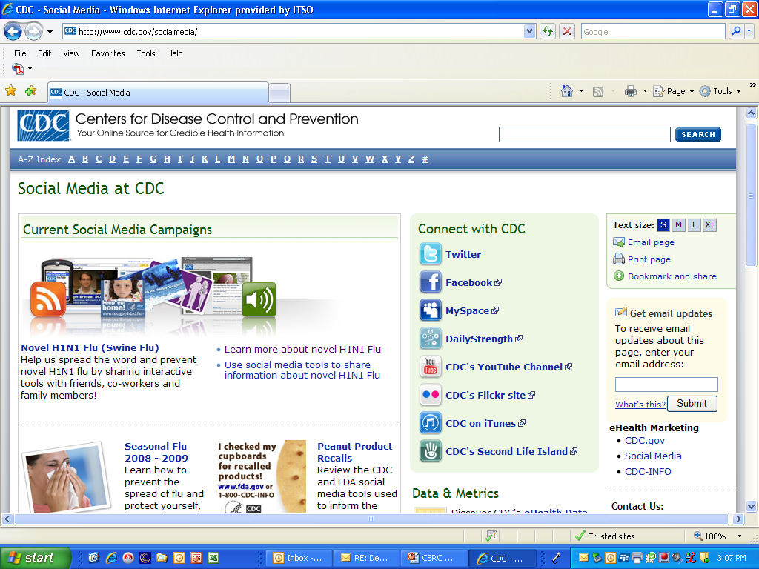
www.cdc.gov/socialmedia

Slide 16
Summary
Communication Assumptions
Value of cultural competence
Quick exercise
Cultural Conflict
Social Media: Crisis Role
Trust, transparency & participation in government

Slide 17
Thank You

