Slide 1
Lecture 07
Crisis and Emergency
Risk Communication

Slide 2
Risk Communication v/s Emergency Communication
During emergencies public health responders must effectively ensure the following types of communication
  Institutional
    Intra-inter-agencies/institutions, across levels
    Inter-sectorial
  Operational
    To health care workers and respondents (e.g. alerts, guidance documents
    To ensure the coordination of the response
  To the public (risk communication)

Slide 3




Health crisis are unique
Extremely time pressuring
Unpredictable & unfolding
Socially and economically disruptive
Behaviour–centred & anxiety generator
Involving multiple stakeholders
Shifting from national to international

Slide 4

Communicating during crisis is a capacity requirement under the IHR
Under the IHR, risk communication includes a range of interventions through preparedness, response and recovery of a health crisis for
  informed decisions
  positive behaviour interventions
  maintenance of trust
to minimize its public health impact.
Notes:
More trustful, timely, transparent communications are required under the IHR
Countries have committed themselves to notify any event that may constitute a public health emergencies of international concern.
WHO confidential but pro-active verification with countries of unofficial reports creates incentives for greater openness.
Risk communication is an integral component of public health risk management. It is focused on dialogue with those affected and concerned, and strives to ensure communication strategies are evidence based.
Under the IHR, risk communication for public health emergencies includes the range of communication capacities required through the preparedness, response and recovery phases of a serious public health event to encourage informed decision making, positive behaviour change and the maintenance of trust.

Slide 5
Risk assessment
Risk perception
Risk communication
Risk management
Notes:
Risk communication fills the gap between Risk assessment and Risk perception and is part of Risk management.

Slide 6
Do we have a shared understanding of
‘risk communication’?
Risk Communication – Outbreak Communication – Crisis Communication – Emergency Communication - Information – Education - Communication – Public Awareness – Public Education – Social Mobilization – Community Mobilization – Advocacy – Information Officer – Media Officer – Communication Officer – Reporting Officer – Advocacy Officer - Development Support Communication – Pandemic Communication – Animal Health Communication – Human Health Communication – Media Relations – Donor Relations – Corporate Relations – External Relations – Public Relations - Risk Communication – Outbreak Communication – Crisis Communication – Emergency Communication - Behaviour Change Communication – Development Communication – Participatory Communication – Programme Communication – Information – Education - Communication – Public Awareness – Public Education – Social Mobilization – Community Mobilization – Advocacy – Information Officer – Media Officer – Communication Officer – Reporting Officer – Advocacy Officer - Development Support Communication – Pandemic Communication – Animal Health Communication – Human Health Communication – Media Relations – Donor Relations – Corporate Relations – External Relations – Public Relations - Risk Communication – Outbreak Communication – Behaviour Change Communication – Development Communication – Participatory Communication – Programme Communication – Information – Education - Risk Communication – Outbreak Communication – Crisis Communication – Emergency Communication - Behaviour Change Communication – Development Communication – Participatory Communication – Programme Communication – Information – Education - Communication – Public Awareness – Public Education – Social Mobilization – Community Mobilization - Risk Communication – Outbreak Communication – Crisis Communication – Emergency Communication - Behaviour Change Communication

Slide 7
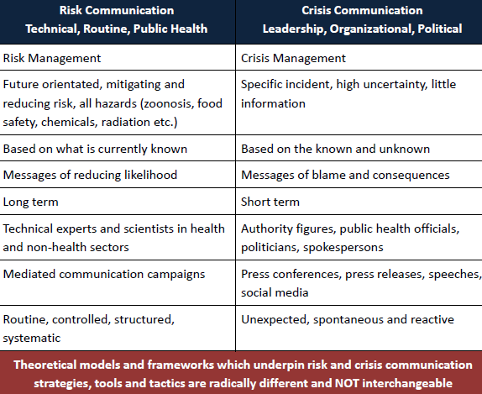

Slide 8
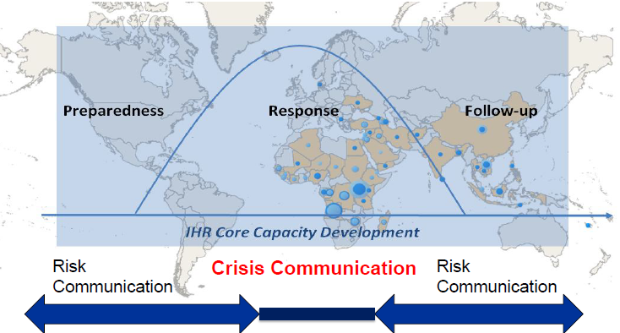
Notes:
IHR communication core capacity requires building up a communication plan and system during crises

Slide 9
Event management cycle
Event detection
WHO believes that it is high time to acknowledge
crisis communication
as essential to outbreak control as epidemiological training and laboratory analysis.
Risk assessment
Crisis communication
Evaluation
Control measures

Slide 10
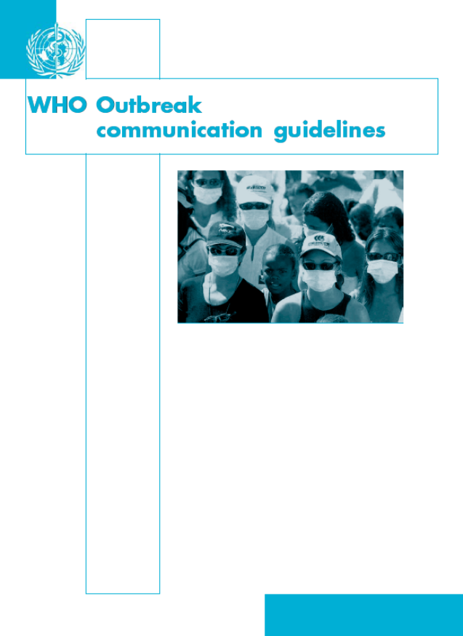

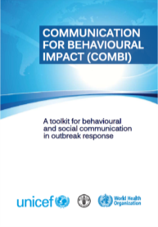
WHO crisis communication guidance started in 2004
Expert consultation on Outbreak Communication (2004)
WHO evidence-based communication guidance (2004)
Outbreak Communication Planning Guide (2008)
Communication for behavioural impact (COMBI) (2012)
Literature & field experience
Notes:
SARS 2003 and Avian Influenza 2004
COMBI - This interagency (FAO, UNICEF, WHO) toolkit will be useful for anyone wanting to design effective outbreak prevention and control measures in community settings. Although, this toolkit is primarily intended for risk communication, developmental communication and health promotion/education personnel working in multidisciplinary teams to investigate and respond to disease outbreaks, it will also be useful for epidemiologists, clinicians, and public health officers who need to understand the local contexts and dynamics of an outbreak. It is based on the premise that each outbreak is unique, and community understanding of diseases and their spread is complex, context dependent, and culturally-mediated. Therefore, a one-size-fits-all response is not sufficient.
The toolkit contains a 7-step approach, with corresponding tools, checklists and templates for designing behavioural and communication interventions that support the development of outbreak prevention and control measures that are not only technically-sound, but are also culturally appropriate, relevant and feasible for communities to act upon - to limit loss of life and minimize disruption to families, communities and societies.
The toolkit contains essential background information, case studies, and further references. It is to be used in conjunction with the “COMBI toolkit: field workbook for COMBI planning steps in outbreak response”.

Slide 11
« The overriding goal for outbreak communication is to communicate with the public in ways that build, maintain or restore Trust »
Notes:
Builds upon the outbreak guidelines. The emphasis on trust, or source credibility, has been echoed in every guideline on emergency risk communication. Although all effective communication relies to some degree on perceived credibility of message source, social science research provides some reason for us to believe that, as the emergency communication guidelines say, it may be even more important during an emergency.

Slide 12
Trust is the public perception of
Your motives
Are the risk managers acting to safeguard my health?
Your honesty
Are the risk managers holding back information?
Your skills
Are the risk managers skilled enough to do the job?

Slide 13
Trust is the pillar of outbreak control
« …the less people trust those who are supposed to protect them, the more afraid the public will be and less likely they will be to conform their choices and behavior with outbreak management instructions ».

Slide 14
Building trust is also an internal process
Trust is essential between
communicators and policy makers;
communicators and technical responders.
Technical responders
Communicators
Trust
Policy makers
The internal trust relationship is the “Trust Triangle”
Notes:
Trust is essential between
communicators and policy makers, as trust-building measures are often counter-intuitive;
communicators and technical responders, as these may not value communication as a tool to control the outbreak.

Slide 15
Crisis Communication - Core Capacity Components
1. Transparency and early announcement of a real or potential risk
2. Public communication
coordination
PLANNING
4. Listening
through dialogue
3. Information dissemination including media relations
Notes:
Transparency and Early announcement - « Maintaining the public's trust throughout an outbreak requires transparency ». «The parameters of trust are established in the outbreak's first official announcement ».
Listening - « Understanding the public is critical to effective communication. (…) it is nearly impossible to design successful messages that bridge the gap between the expert and the public without knowing what the public thinks »
Planning -is a core ability that is central to the effective implementation of the four components.

Slide 16

1. Transparency and Early announcement of a real or potential risk
Those at real or potential risk can protect themselves;
Trust between authorities populations and partners is maintained and strengthened.
Notes:
The management of information related to a health emergency, including the first announcement warning a population of a potential risk, and ongoing transparency of decision making, helps ensure that those at real or potential risk can protect themselves; and that trust between authorities, populations and partners is maintained and strengthened.

Slide 17

2. Public communication coordination
Existing public communication resources are used;
Messages are coordinated and confusion and overlap are reduced;
Reach and influence of provided advice are strengthened.
Notes:
The cross-jurisdictional nature of public health emergencies demands that public health authorities be able to effectively engage and coordinate public communication with other involved organizations including designating roles and responsibilities of lead and supporting agencies. This capacity helps takes advantage of available public communication resources; allows for coordinated messaging reducing the
possibility of confusion and overlap; and strengthens the reach and influence of the advice provided.

Slide 18

3. Information dissemination including Media relations
Rapid and effective dissemination of information is crucial during health crisis and mass media are the pillar of it.
Not only media!
Health care workers;
Local and religious leaders;
Citizens’ representatives;
SMS
Social media;
Internet;
Toll-free telephone numbers;
Door-to-door visits
Notes:
The extreme time pressure associated with emergencies, high demand for information, and the crucial role of advice and warning to minimize a threat makes the rapid and effective dissemination of information crucial during serious public health events. Mass Media relations remains a pillar of effective information dissemination, however, it is increasingly important to access other trusted information sources of the population group at risk, including new media channels, existing information sharing networks and non-traditional media.

Slide 19

4. Listening through dialogue
Community perceptions of risks are understood;
Adaptations to messages, materials and strategies are made;
Effectiveness of communication efforts is ensured to support sound decision making.
Notes:
Listening to those affected and involved, in an organized and purposeful manner, is a crucial capacity to ensuring communication efforts are effective and support sound emergency management decision making. Understanding community perceptions of risk and then acting upon that understanding by making appropriate adaptations
to communication messages, materials and strategies demands a meaningful engagement with those affected and involved.
Case study – Ebola in DRC

Slide 20
If crisis are difficult to predict, an outbreak communication strategy can be planned
People respond to what outberak controllers do, not just to what they say.
Crisis communication must be integrated in risk management form the start.
Assessment
Coordination
Transparency
Listening
Communication evaluation
Emergency communication plan
Training

Slide 21
Crisis Communication - Lifecycle
Pre-Crisis
Initial
Resolution
Explain
Inform
Establish credibility
Guide action
Commit to communication
about risks
Educate for future response
  Individual action
  Support for relevant policies
Promote agency activities
Maintenance
Evaluation
Prepare
Make alliances
Agree on recommendations
Test messages
Foster understanding of risks
Provide background
Foster support for plans
Listen
Empower
Evaluate plan
Lessons learned
Identify improvement

Slide 22
Communication planning allows decision making
What is the situation?
Why communicate?
To whom?
How?
When?
Who?
With what?
How is it going on?
How effective?
Evaluate the situation in context and time
Set objectives
Define target audience(s)
Outline strategy, channels and tools
Draw a timeline of action
Identify roles and partners
List human and economic resources
Monitor communication impact
Adjust the communication strategy

Slide 23
Gaps and challenges
(from experience and feedback)
General devaluation of communication, not seen as a science;
Disconnect between technical and communication responders;
Low recognition of crisis communication capacity needs before a crisis starts;
Perception of crisis communication as an “add-on” not integrated in planning processes;
Limited financial and human resources dedicated to communication planning;
Unsuitability of planned procedures due to other sectors’ involvement and/or lead taken by the highest government’s level.
Notes:
Crisis communication is often listed last when it comes to risk management, which is not an accurate reflection of its importance.
To be effective, crisis communication needs to be planned and initiated early in a risk assessment and to continue as an iterative process throughout all phases of the assessment.
If this does not happen, risk assessment is easily perceived as a process of expert risk assessors advising stakeholders of the result of their assessment and their proposed management strategies.
This topdown approach implies that communication is largely one-way and ignores the need for consultation throughout the whole process.
Poor crisis communication can provoke outrage among stakeholders.

Slide 24
Crisis communication is designed for health crisis
Extremely time pressuring
Unpredictable & unfolding
Socially and economically disruptive
Behaviour–centred & anxiety generator
Involving multiple stakeholders
Shifting from national to international
Information dissemination
Dealing with uncertainty
Coordination - Listening
Listening
Coordination
Coordination

Slide 25



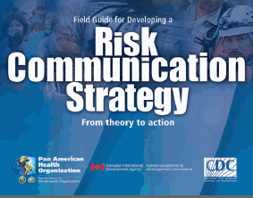
Crisis Communication Resources
WHO Outbreak Communication Guidelines (2005)
  www.who.int/infectious-disease-news/IDdocs/whocds200528/whocds200528en.pdf
WHO Outbreak Communication Planning Guide (2008)
  www.who.int/ihr/elibrary/WHOOutbreakCommsPlanngGuide.pdf
  WHO Communication for behavioural Impact (2012)
  http://www.who.int/ihr/publications/combi_toolkit_fieldwkbk_outbreaks/en/
  CDC Crisis and Emergency Risk Communication Manual
  http://emergency.cdc.gov/CERC/
PAHO Risk and Outbreak Communication http://new.paho.org/hq/index.php?option=com_content&view=article&id=1940&Itemid=1923&lang=en

Slide 26
Crisis Communication - Lifecycle
Pre-Crisis
Initial
Resolution
Explain
Inform
Establish credibility
Guide action
Commit to communication
about risks
Educate for future response
  Individual action
  Support for relevant policies
Promote agency activities
Maintenance
Evaluation
Prepare
Make alliances
Agree on recommendations
Test messages
Foster understanding of risks
Provide background
Foster support for plans
Listen
Empower
Evaluate plan
Lessons learned
Identify improvement

Slide 27
What the public seeks from your communication
5 public concerns. . .
Gain wanted facts
Empower decision making
Involved as a participant, not spectator
Provide watch guard over resource allocation
Recover or preserve well-being and normalcy

Slide 28
Crisis and Emergency Risk Communication impacts
5 organizational concerns -- you need to. . .
Execute response and recovery efforts
Decrease illness, injury, and deaths
Avoid misallocation of limited resources
Reduce rumors surrounding recovery
Avoid wasting resources

Slide 29
5 communication failures that kill operational success
Mixed messages from multiple experts
Information released late
Paternalistic attitudes
Not countering rumors and myths in real-time
Public power struggles and confusion

Slide 30
5 communication steps that boost operational success
Execute a solid communication plan
Be the first source for information
Express empathy early
Show competence and expertise
Remain honest and open

Slide 31
Summary
Risk Communication v/s Emergency Communication
Communicating during crisis is a capacity requirement under the IHR
Crisis Communication - Core Capacity Components
5 communication failures that kill operational success

Slide 32
Thank You

