Slide 1
Lecture 05
Crisis Management Strategies

Slide 2
Introduction and Overview
Despite best efforts, large losses are certainties throughout a risk professional’s career. A well-written, well-executed crisis management plan can mean the difference between an organization’s survival and demise. Exposures must be addressed in preplanning discussions along with post crisis strategies that include corporate communications and media relations as part of recovery to protect the intangible assets of brand and reputation. Learn the key elements of a crisis management plan, steps to effective execution and how to maintain and restore confidence in your business in the aftermath.

Slide 3

What is Crisis Management?
Also referred to as….
Disaster recovery
Business continuity planning
Crisis:
Any situation that is threatening or could threaten to harm people or property, seriously interrupt business, damage reputation and/or negatively impact share value.

Slide 4
Top 10 Crises of 2011
Tepco
Natural disaster
News Corp
Phone hacking scandal
Penn State
Misconduct allegations
Blackberry
Major outage
Dow Chemical
Olympic sponsorship
Netflix
Change in business model
Sony
Data breach
HP
Change in board members
Qantas
Labor dispute
ECB
Eurozone crisis

Slide 5
Cost of a Crisis Example - Data Breach
in millions
Reported number of data breaches involving personal data
Average organizational cost of a data breach involving
personal data
Business Insurance, March, 19, 2012

Slide 6
Business Continuity Measures
Top business-continuity measures being adopted by large companies.
Source: June 2011 international survey of 391 senior executives by the Economist Intelligence Unit on behalf of IBM. The survey covered all
industries; 48% of the respondents worked in companies of more than $1 billion in revenue.

Slide 7
Summary
Plan for
Ultimate goal
Predictable and quantifiable events
Minimize the impact
Unexpected and unwelcome events
Resume normal operations

Slide 8
Questions to Ask
What are the worst things that can happen to my organization?
What can we prevent?
What are we willing to do to prevent the event/incident?
Can we afford the risk?
How will we deal with it?
  What is the reporting and communication process during the crisis?

Slide 9
Common Mistakes
Inadequate planning
Failure to bring the business into the planning and testing of your recovery efforts
Failure to gain support from senior-level managers

Slide 10
3 Keys to Crisis Communications
Let everyone on your team know that your integrity is the most valuable commodity you have in a crisis and it must not be compromised.
The dynamics of a crisis can change based on external events. Once identified, empower your team to make the tactical decisions required to communicate events as they unfold.
People believe what they see over what they hear. You can have great talking points and a great spokesperson destroyed because the words are out of sync with the images coming from the scene.
Honesty
Speed
Images
http://signalbridge.blogspot.com/2011/07/3-keys-to-crisis-comms-in-digital-age.html

Slide 11
Crisis Management Strategies

Slide 12


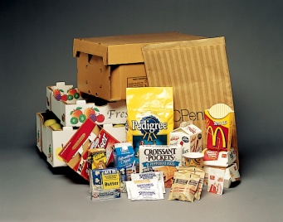

Global leader in paper and packaging
$30 billion in 2011 sales
70,000 employees in 24+ countries
Manufacturing locations (excludes JVs)
  39 pulp, paper and packaging mills
  300+ converting, packaging and recycling plants
  200+ distribution branches

Slide 13
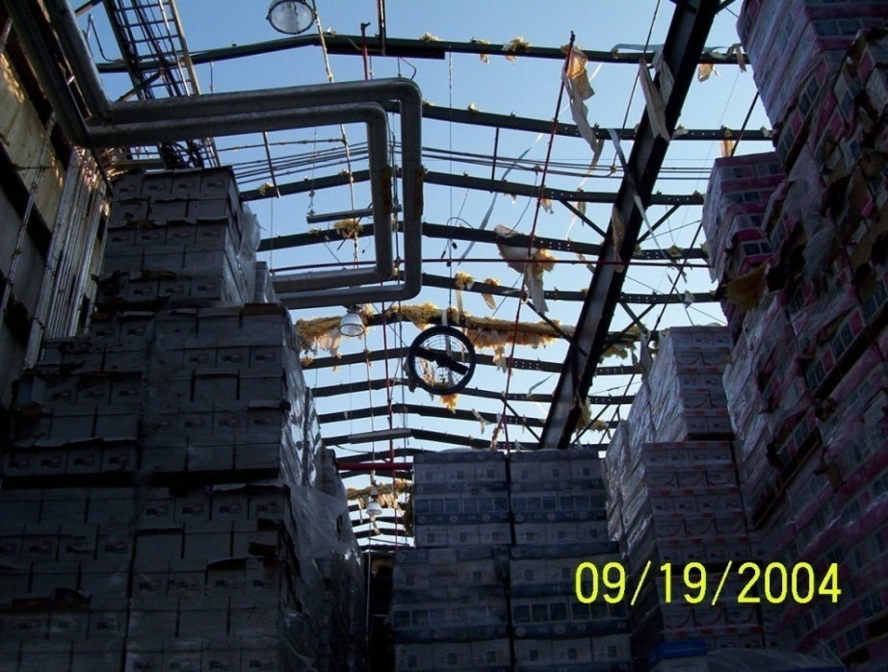
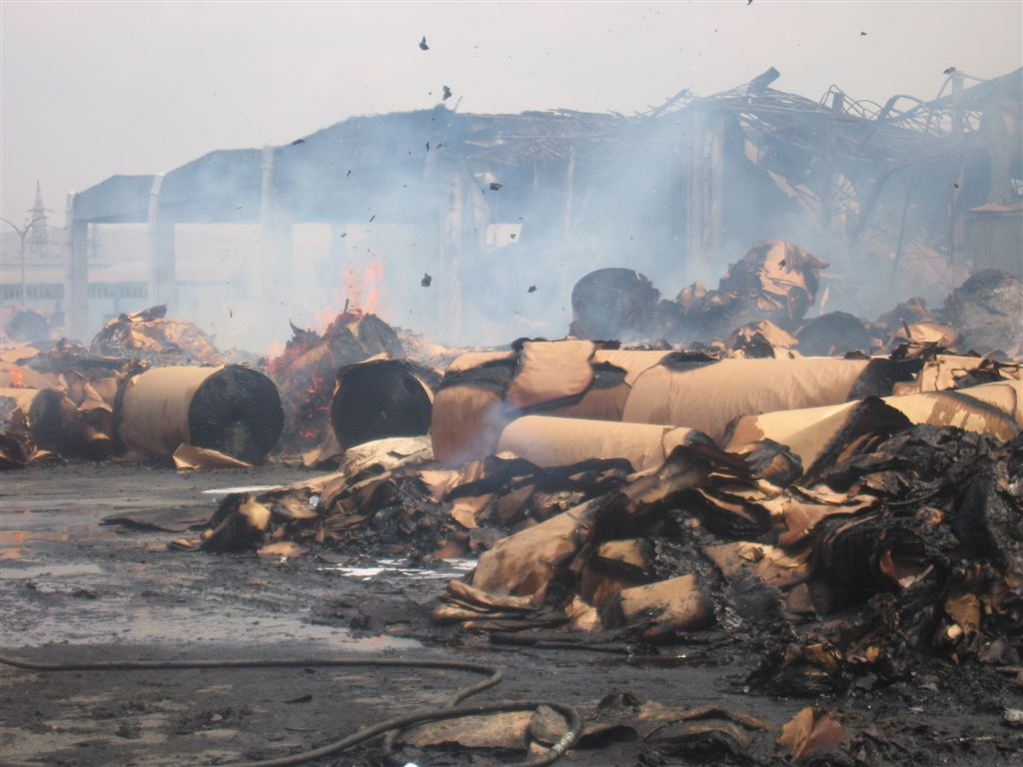
Crises Come in Many Varieties
  Manmade incidents, like fires & explosions
  Natural disasters, like hurricanes

Slide 14
A Historical View of Crisis Management Efforts
Facility-based
Uneven corporate involvement, awareness
FM Global recommendations
(flood, hurricane, fire brigades, emergency response, etc.)
Risk management
Information technology
Telephone hotline to corporate staff personnel
Environment, health & safety

Slide 15


Developing Management Support
December 2005 Meeting
  Executive offices relocating to Memphis
  Concerns raised post-Katrina: what if Memphis has “the BIG ONE” (i.e., a major earthquake)?
  What preparations have been made? What is needed? How is capital allocated for this?
Eventual outcome: BCP department

Slide 16
Crisis Management Timeline
General Management of the Organization
The Crisis Management Process
Risk management
Risk assessment
Loss prevention
Mitigation planning
Developing responsive, comprehensive
insurance program
Communicating risk issues
Business continuity plans
  Developing plans
  Testing plans
  Revising/updating plans
  Training personnel
Incident management
Incident response
Communications
Activating and executing plans
Mitigation
Business resumption
Business recovery
Insurance recovery
Pre-Event
Crisis/Event
After

Slide 17
Company Resources/Functions
HR/Communications
(incl. public affairs)
Information
Technology
Security
Legal
TEAM
Environment,
Health
& Safety
Operations
Finance &
Accounting

Slide 18
Risk Management’s Role in Crisis Management
Focus on driving loss prevention, facility response plans, and risk-based decisions
Complement BCP department efforts
  Insurer and broker resources
  Regular discussions and “moral support”
Ensure that company insurance programs evolve as IP’s understanding of possible scenarios evolves - understand coverage if/when it’s needed!

Slide 19
Some Closing Thoughts
support
guidance
on-going
Senior management support is critical
Plenty of external guidance if no in-house expert
The work isn’t done when the plans are!
  Regular exercises to test plans and current thinking, with plans updated as new learnings surface
  “Sustain mode” - must keep plans updated as the company evolves, and teams must stay active/current

Slide 20
Crisis Management Strategies

Slide 21

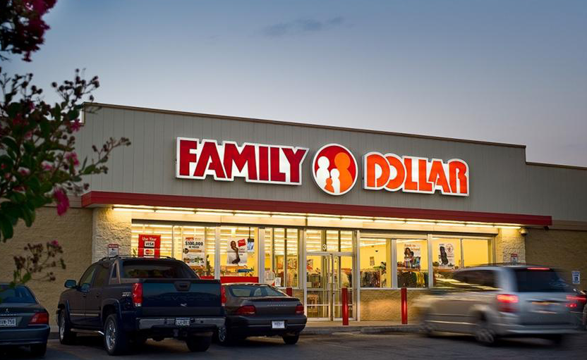
Charlotte, NC based Family Dollar stores offer quality merchandise at everyday low prices, in easy to shop neighborhood locations.
  53 years in business
  A Fortune® 300 company
  7,200 stores
    “Small Box”
    2 to 4 team members staff the stores
    Growth: 1 new store every 25 hours
    More than 850 million customers per year
  11 distribution centers
  45 states
  50,000 Team Members
  Annual sales in excess of $8.5 billion

Slide 22
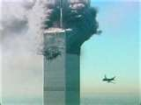
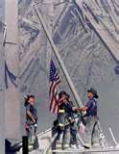
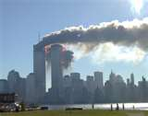
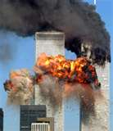
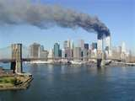
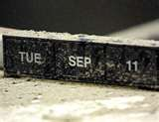
The Awakening......
“…… for those of us who lived through these events, the only marker we’ll ever need is the tick of a clock at the 46th minute of the eighth hour of the 11th day”
President George W. Bush
Notes:
9-11-01 – we were all victims in some way whether Active, Passive or Non-Participant
A time we remember exactly where we were & what we were doing when we heard.
What did you feel that day?
Whether you were at ground zero, the Pentagon, Pennsylvania or miles away as I was in North Carolina, we all needed support to get through that day and the days that followed.
To this day, if you are still not effected in some way you probably aren’t normal.
How did you react immediately and the days that followed. I immediately called my family in NJ to make sure my brother was not working in the city that day. I called my wife and we took my 12 year old daughter out of school for the rest of the day. We all needed to talk and feel safe.
We struggled with coping, with anger, trying to understand.
A week later – I received a WC claim on my desk – we insured a consulting company – the claim - a computer engineer from LA was on AA FLT # 11 that hit the north tower. He left a widow and dependent parents.
On the first anniversary of 9-11, I found myself on a 3 day memorial bike ride from ground zero to the pentagon with 1200 riders including survivors and family members victims.
To a certain degree on 9-11 all of us were victims and struggled with the assault.

Slide 23
Family Dollar’s Approach Since 9-11-01
Evolutionary
Experience Based
Initially IT Centric
Reactionary
Natural Disaster
Sr. Management ?
The “Windstorm” Phases:
Pre - Katrina
Ike (Katrina to Irene)
Irene & Forward
Risk Management
Store Operations
People Centric
Communications
Cross Functional/Global
Enterprise Risk Management Infiltration

Slide 24
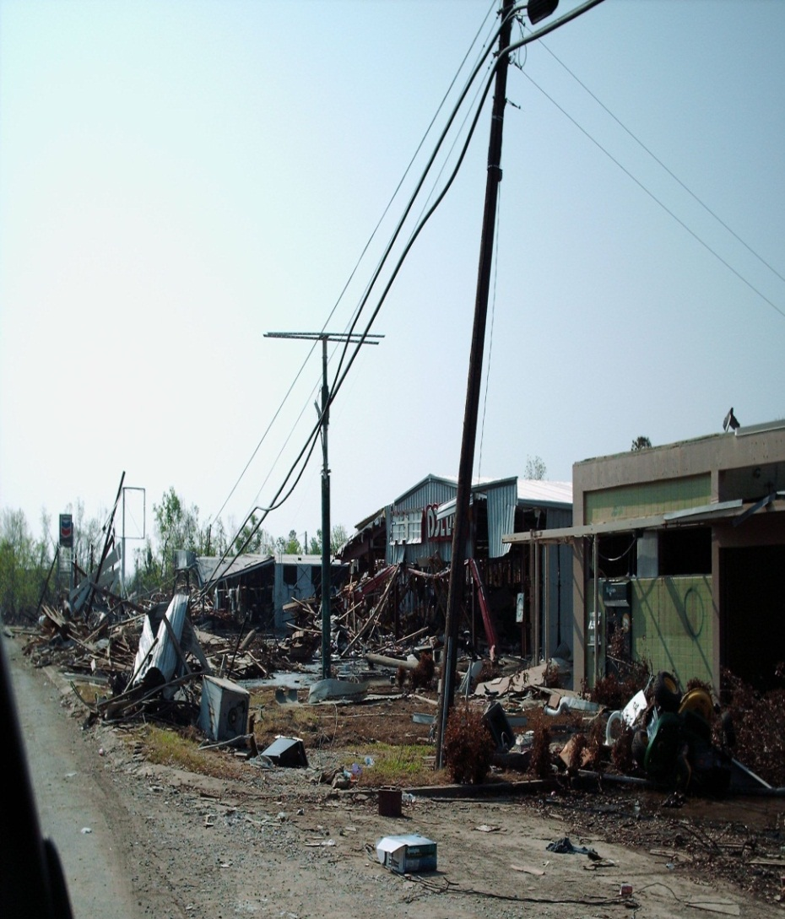
Post 9-11 to Katrina
IT Back Up Data Centers
  Internal
  Outsourced
  IT Business Continuity Plan
Statistically 2.5 Stores Impaired each Month
  Response Plan (Reactive)
TRIA

Slide 25
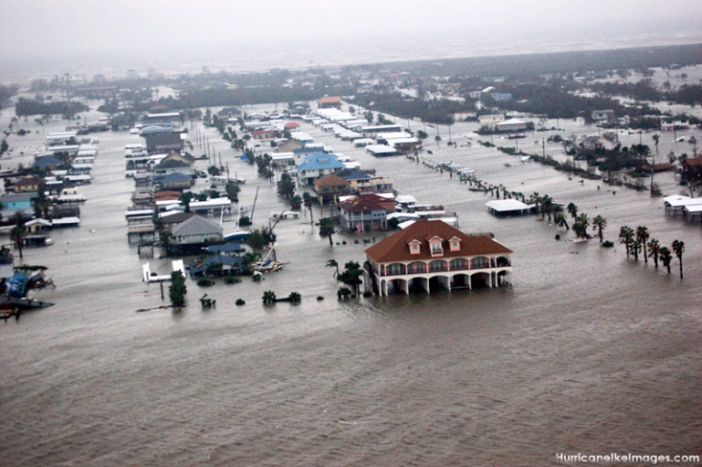
Katrina to Irene (Ike)
Business continuity plan in place and practiced
Interdepartmental
Multi-disciplined
Proactive/Loss Avoidance
Proactive Reactivity
People Centric
Safety
  Compassionate/supportive
  Communications

Slide 26
Communications is Critical
Communications
Risk Management
Operations
Decision Leaders
Internal Business Unit Experts
Community Response
Vendor Partners

Slide 27
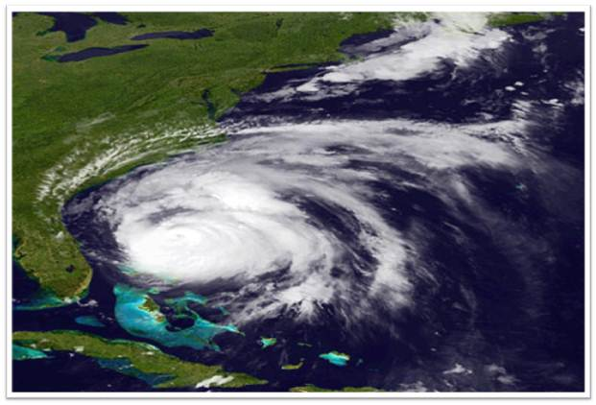
Irene & Forward

Slide 28
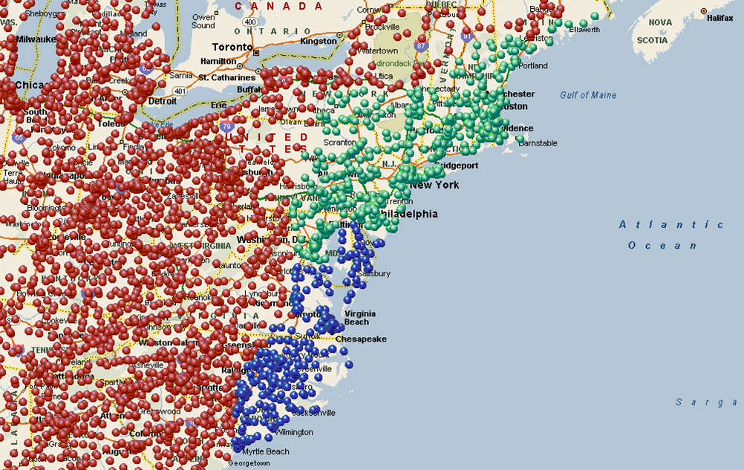
Communications
Hurricane Irene – Stores Strike Zone Mapping
Pre-Event
Regular internal meetings
Monitoring
Warning protocols
Direction
Staging
  Equipment
  Personnel
Safety
Insurance carrier
TPA
Corporate communications

Slide 29
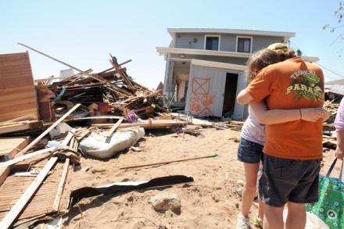
Communications – Post Event
Damage
Assessment
Deployment
Equipment
Personnel
Supplies
Crisis
Counseling
Communications
Safety
Team member
support

Slide 30
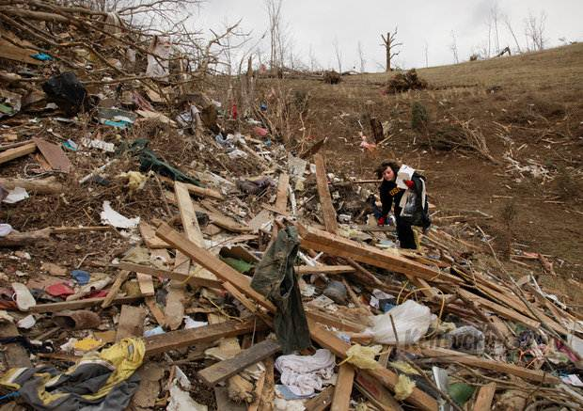
Success Drives Credibility
ERM – Natural Disasters & Beyond
People
Global
Trade disruption
Financial
Cyber
Information technology
West Liberty, KY,
March, 2012

Slide 31
Summary
Introduction and Overview
Top 10 Crises of 2011
3 Keys to Crisis Communications
Some Closing Thoughts
Communications – Post Event
Success Drives Credibility

Slide 32
Thank You

