Slide 1
Crisis And Conflict Management

Slide 2
Lecture 32
Key Elements

Slide 3
General causes of conflicts
Poorly defined goals
Divergent personal values
Lack of cooperation/trust
Competition of scarce resources
Unclear roles/lack of job description

Slide 4
Effects of conflict in organizations
Stress
Absenteeism
Staff turnover
De-motivation
Non-productivity

Slide 5
Functional and
Dysfunctional Conflict
Functional conflict: works toward the goals of an organization or group
Dysfunctional conflict: blocks an organization or group from reaching its goals
  Dysfunctionally high conflict: what you typically think about conflict
  Dysfunctionally low conflict: an atypical view
  Levels vary among groups

Slide 6
Stages of Conflict
Conflict arises
Positions are stated and hardened
Actions, putting into action their chosen plan
Resolution???

Slide 7
Levels and Types of Conflict
Level of conflict
Type of conflict
Organization
Within and between organizations
Group
Within and between groups
Individual
Within and between individuals

Slide 8
How can we keep conflict cognitive?
Make the approach
Share perspectives
Build understanding
Agree on solutions
Plan next steps

Slide 9
Steps for Conflict Resolution:
Understand the conflict.
Communicate with the opposition.
Brainstorm possible resolutions.
Use an impartial mediator.
Explore alternatives.
Cope with stressful situations and pressure tactics.
Choose the best resolution.

Slide 10
Conflict Management Model
Maintain conflict at functional levels
  Not complete elimination
  Reducing to functional levels
  Increasing dysfunctionally low conflict
  Choose desired level of conflict based on perceived conflict requirements
  Varies in different parts of an organization
  Manager’s tolerance for conflict plays a role

Slide 11
Steps in the Organizational Change Process
Assess need for
change
Find source of problem
Decide on the
change
Identify obstacles
Implement Change
Top-down or
Bottom-up
Evaluate Change
Is it successful?
Benchmark to others

Slide 12
Relationship Between Conflict, Politics and Change
Signal managers
change is
needed
Organizational
conflict & politics
Organizational
change
Change alters
goals of different
groups causing
conflict & politics

Slide 13
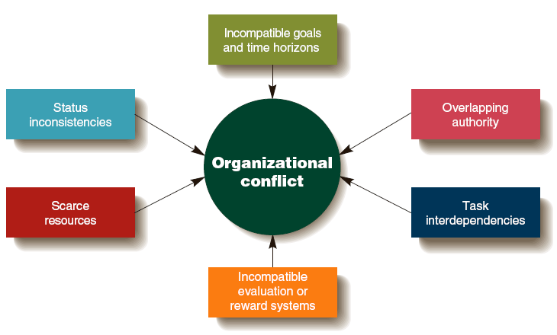
Sources of Conflict

Slide 14
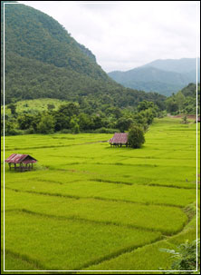
Human-Wildlife Conflict Driving Forces
Human Population Growth
  As populations increase, settlements expand leading to wildlife encroachment
Land Use Transformation
  Consequence of increasing demand for land, food production, energy, and raw materials
Species habitat loss, degradation, and fragmentation
  Interconnected with population growth and land use change

Slide 15
What causes industrial disputes?
Pay disputes
Working conditions
Unfair dismissals
Promotion
Poor industrial relations
Introduction to new technology
Discrimination

Slide 16
Match the Types of Conflict
__ Substantive
conflict
__ Affective
conflict
__ Procedural
conflict
Members disagree about the methods or process the group uses to achieve its goals.
Member emotions are aroused by personal disagreements, personality differences, communication styles, and member beliefs and values.
Members disagree about ideas, issue analysis, and potential solutions or actions.

Slide 17
Conflict Intensity Continuum
Annihilatory
Overt efforts to destroy
conflict
the other party
Aggressive physical attacks
Threats and ultimatums
Assertive verbal attacks
Overt questioning or
challenging of others
Minor disagreements or
No
misunderstandings
conflict

Slide 18
Distributive vs.
Integrative Bargaining
Bargaining Distributive Integrative
Characteristic Bargaining Bargaining
Available resources
Primary motivations
Primary interests
Focus of relationships
Fixed amount of resources to be divided
I win, you lose
Opposed to each other
Short term
Variable amount of resources to be divided
I win, you win
Convergent or congruent with each other
Long term

Slide 19
How to Negotiate
Five steps to negotiation:
  Developing a strategy.
  Definition of ground rules.
  Clarification and justification.
  Bargaining and problem solving.
  Closure and implementation.
Identify BATNA:
  Best Alternative To a Negotiated Agreement.

Slide 20
Thank You

