Slide 1
Crisis And Conflict Management

Slide 2
Communication Conflict
Lecture 30

Slide 3
Lecture Outline
The Communication Process
Barriers to Effective Communication
Current Issues in Communication
How Communication Breakdown Leads to Conflict
Conflict Resolution

Slide 4
Communication
How does communication work?
What are the barriers to communication?
What are other issues in communication?
What is conflict?
How can conflict be resolved?
How does one negotiate effectively?

Slide 5
Communication Problems
People spend nearly 70 percent of their waking hours communicating—writing, reading, speaking, listening.
WorkCanada’s survey of 2039 Canadians in six industrial and service categories found
  61 percent of senior executives believed that they did a good job of communicating with employees.
  only 33 percent of the managers and department heads believed that senior executives were effective communicators.
  Only 22 percent of hourly workers, 27 percent of clerical employees, and 22 percent of professional staff reported that senior executives did a good job of communicating with them.
Canadians reported less favourable perceptions about their company’s communications than did Americans.

Slide 6
The Communication Process Model
Chooses
Encodes the
Chooses the
a message
message
channel
Considers the receiver
Sender
Receiver
Considers the sender
Provides
Decodes the
feedback
message

Slide 7
Communication Terms
Message
  What is communicated.
Encoding
  Converting a message to symbolic form.
Channel
  The medium through which a message travels.
Decoding
  Retranslating a sender’s message.

Slide 8
Choosing Channels
Channels differ in their capacity to convey information.
Rich channels have the ability to
  Handle multiple cues simultaneously
  Facilitate rapid feedback
  Be very personal

Slide 9
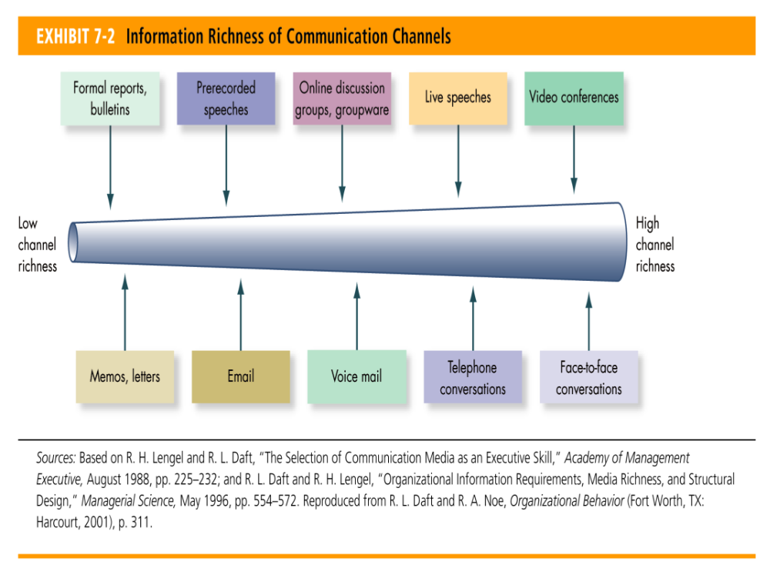
Information Richness of Communication Channels

Slide 10
Barriers to Effective Communication
Filtering
  Refers to a sender manipulating information so that it will be seen more favourably by the receiver.
Selective Perception
  Receivers in the communication process selectively see and hear based on their needs, motivations, experience, background, and other personal characteristics.

Slide 11
Barriers to Effective Communication
Defensiveness
  When individuals interpret another’s message as threatening, they often respond in ways that retard effective communication.
Information Overload
  When the information we have to work with exceeds our processing capacity.
Language
  Words mean different things to different people.

Slide 12
Communicating Under Stress
Speak clearly.
Be aware of the nonverbal part of communicating.
Think carefully about how you state things.

Slide 13
Emoticons: Showing Emoticons in Email
:)
Smile
:-e
Disappointed
<g>
Grin
:-@
Scream
:(
Frown
:-0
Yell
;)
Wink
:-D
Shock or surprise
:-[
Really sad face
:
’
(
Crying

Slide 14
Electronic Communications: Tips for Writing and Sending E-mail
Use a subject line.
Use emoticons and acronyms sparingly for business communications.
Write clearly and briefly.
Copy emails to others only if they really need the information.
Sleep on angry emails.

Slide 15
Nonverbal Communication
Messages conveyed through body movements, facial expressions, and the physical distance between the sender and the receiver
  Kinesics
    The study of body motions, such as gestures, facial configurations, and other movements of the body
  Proxemics
    The study of physical space in interpersonal relationships

Slide 16
Silence as Communication
Defined as an absence of speech or noise
Not necessarily inaction—can convey:
  Thinking or contemplating a response to a question
  Anxiety about speaking
  Agreement, dissent, frustration, or anger
Individuals should be aware of what silence might mean in any communication.

Slide 17
Communication Barriers Between Men and Women
Men use talk to emphasize status, women use it to create connection.
Women and men tend to approach points of conflict differently.

Slide 18
Communication Barriers Between Men and Women
Men and women view directness and indirectness differently.
  Women interpret male directness as an assertion of status and one-upmanship.
  Men interpret female indirectness as covert, sneaky, and weak.
Men criticize women for apologizing, but women say “I’m sorry” to express empathy.

Slide 19
Cross-Cultural Communication Difficulties
Sources of barriers
  Semantics
  Word connotations
  Tonal differences
  Differences in perceptions

Slide 20
Cross-Cultural Communications: Helpful Rules
Assume differences until similarity is proven.
Emphasize description rather than interpretation or evaluation.
Practise empathy.
Treat your interpretations as a working hypothesis.

Slide 21
Conflict Intensity Continuum
Annihilatory
Overt efforts to destroy
conflict
the other party
Aggressive physical attacks
Threats and ultimatums
Assertive verbal attacks
Overt questioning or
challenging of others
Minor disagreements or
No
misunderstandings
conflict

Slide 22
Research Findings
Cognitive
  Conflict related to differences in perspectives and judgments
    Task-oriented
    Results in identifying differences
    Usually functional conflict
Affective
  Emotional conflict aimed at a person rather than an issue
    Dysfunctional conflict

Slide 23
Conflict Resolution
Two Dimensions:
  Cooperativeness
    The degree to which one party attempts to satisfy the other party’s concerns.
  Assertiveness
    The degree to which one party attempts to satisfy his or her own concerns.

Slide 24
Summary
Lecture Outline
Communication
Conflict Intensity Continuum
Cross-Cultural Communication Difficulties
Research Findings
Conflict Resolution

Slide 25
Thank you

