Slide 1
Crisis And Conflict Management

Slide 2
Managing Conflict, Politics
Lecture 26

Slide 3
Learning Objectives
Explain why conflict arises, and identify the types and sources of conflict in organizations.
Describe conflict management strategies that managers can use to resolve conflict effectively.
Understand the nature of negotiation and why integrative bargaining is more effective than distributive negotiation.

Slide 4
Learning Objectives
Describe ways in which managers can promote integrative bargaining in organizations
Explain why managers need to be attuned to organizational politics, and describe the political strategies that managers can use to become politically skilled.

Slide 5

Organizational Conflict
Organizational Conflict
  The discord that arises when goals, interests or values of different individuals or groups are
  incompatible
  and those people
  block or thwart
  each other’s efforts
  to achieve their
  objectives.

Slide 6
Organizational Conflict
Organizational Conflict
  Conflict is inevitable given the wide range of goals for the different stakeholder in the organization.

Slide 7
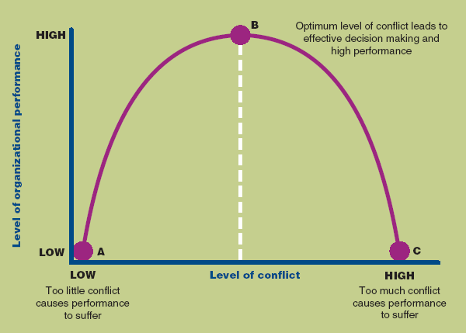
The Effect of Conflict on Organization Performance

Slide 8
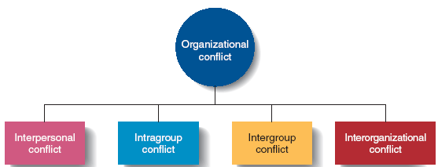
Types of Conflict

Slide 9
Types of Conflict
Interpersonal Conflict
  Conflict between individuals due to differences in their goals or values.
Intragroup Conflict
  Conflict within a
  group or team.

Slide 10
Types of Conflict
Intergroup Conflict
  Conflict between two or more teams, groups or departments.
  Managers play a key role in resolution of this conflict
Interorganizational Conflict
  Conflict that arises across organizations.

Slide 11
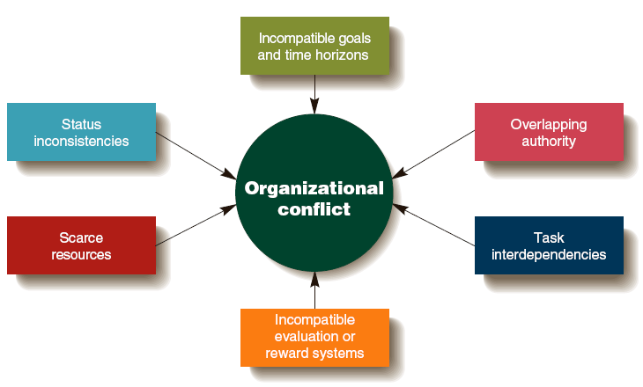
Sources of Conflict

Slide 12
Sources of Conflict
Different Goals and Time Horizons
  Different groups have differing goals and focus.
Overlapping Authority
  Two or more managers claim authority for the same activities which leads to conflict between the managers and workers.

Slide 13
Sources of Conflict
Task Interdependencies
  One member of a group or a group fails to finish a task that another member or group depends on, causing the waiting worker or group to fall behind.
Different Evaluation or Reward Systems
  A group is rewarded for achieving a goal, but another interdependent group is rewarded for achieving a goal that conflicts with the first group.

Slide 14
Sources of Conflict
Scarce Resources
  Managers can come into conflict over the allocation of scare resources.
Status Inconsistencies
  Some individuals and groups have a higher organizational status than others, leading to conflict with lower status groups.

Slide 15

Conflict Management Strategies
Functional Conflict Resolution
  Handling conflict by compromise or collaboration between parties.

Slide 16
Conflict Management Strategies
Compromise
  each party is concerned about their goal accomplishment and is willing to engage in give-and-take exchange to reach a reasonable solution.
Collaboration
  parties try to handle the conflict without making concessions by coming up with a new way to resolve their differences that leaves them both better off.

Slide 17
Conflict Management Strategies
Accommodation
  one party simply gives in to the other party
Avoidance
  two parties try to ignore the problem and do nothing to resolve the disagreement

Slide 18
Conflict Management Strategies
Competition
  each party tries to maximize its own gain and has little interest in understanding the other’s position

Slide 19
Strategies Focused on Individuals
Increasing awareness of the sources of conflict
Increasing diversity awareness and skills
Practicing job rotation
Using permanent transfers or dismissals when necessary

Slide 20

Strategies Focused on the Whole Organization
Changing an organization’s structure or culture
Altering the source of conflict

Slide 21
Organizational Politics
Organizational Politics
  The activities managers engage in to increase their power and to use power effectively to achieve their goals or overcome resistance or opposition.

Slide 22

Organizational Politics
Political strategies
  Specific tactics used to increase power and use it effectively to influence and gain the support of other people while overcoming resistance

Slide 23
The Importance of Organizational Politics
Politics
  Can be viewed negatively when managers act in self-interested ways for their own benefit.
  Is also a positive force that can bring about needed change when political activity allows a manager to gain support for needed changes that will advance the organization.

Slide 24
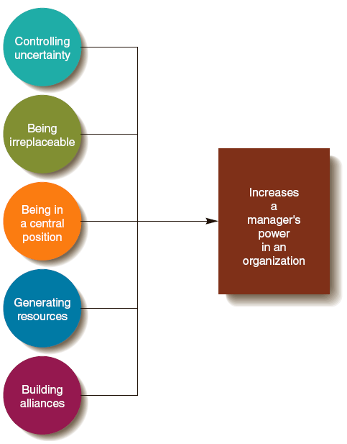
Political Strategies for Increasing Power

Slide 25
Political Strategies for Gaining and Maintaining Power

Slide 26
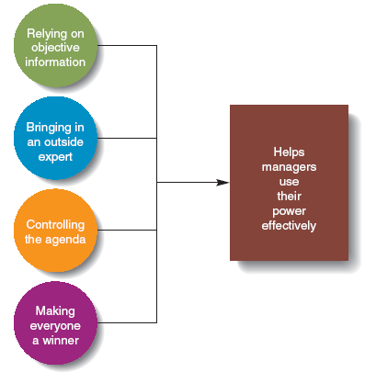
Political Strategies for Exercising Power

Slide 27
Strategies for Exercising Power

Slide 28
Summary
Learning objectives
Organizational conflict
Types of conflict
Sources of conflict
Conflict management strategies

Slide 29
Thank you

