Slide 1
Lecture 02
Planning for Crisis Management

Slide 2
Crisis Management Model
Crisis
Management
Planning
Crisis-
prepared
culture
Antecedent
conditions
Technical
Intelligence
Emotional
Intelligence
Intrinsic crisis
Perceived crisis
Authorisation
Procedures
Immature crisis
response
Crisis
Management
Implementation
Mature crisis
management
Integration
of learning
Review and Feedback

Slide 3
Gathering Intelligence
Who?
What?
When?
How?

Slide 4
Who for Government?
Ministers
Officials
Political parties
Sponsors
Voters
International allies
The public in general
Tax-payers
Consumer and lobby groups
Lawyers
The media
?

Slide 5
Who for medicine and drug safety?
Manufacturers
Regulators
Politicians
Employees
Health professionals
Pharmacists
Academics
The public
Patients
Consumer and lobby groups
Lawyers
The media
?

Slide 6
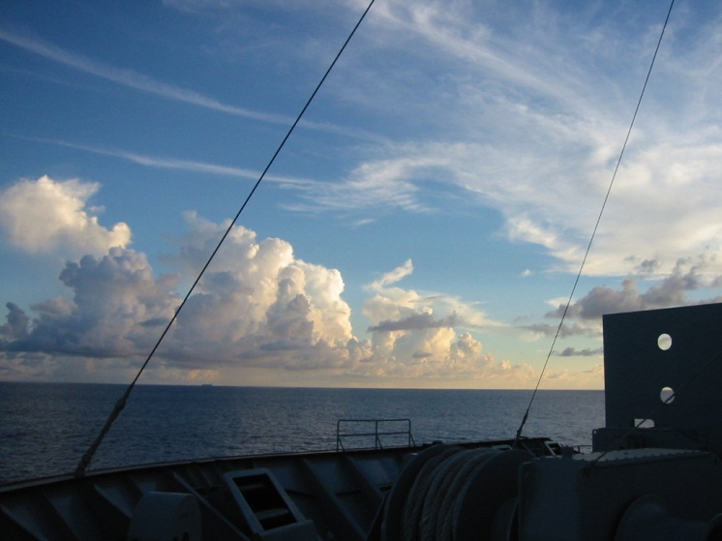
The first goal of crisis management is prevention

Slide 7
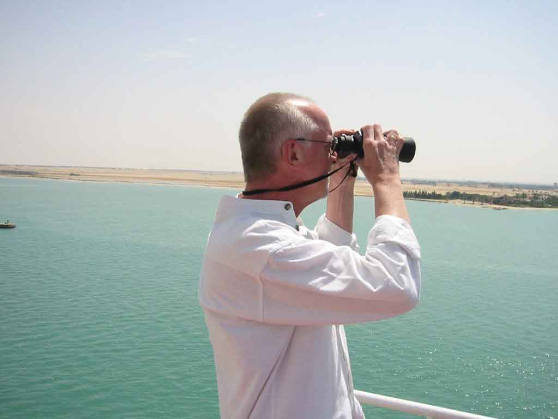
Intelligence
Continuous scanning (networks/media/public opinion, etc)
Outward focus
Collaboration
Positive relationships

Slide 8
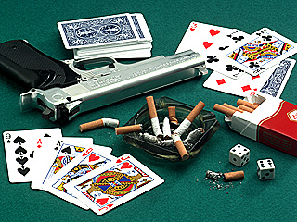
Assess risks

Slide 9
Risk assessment is,
Identification
  define and describe
Estimation
  likelihood and consequences
Evaluation
  acceptability of risk

Slide 10
Identification
Estimation
Evaluation
Medication in question could be mistaken for sweets by young children
Medium chance leading to severe health problems or death
Unacceptable
Recall of a defective batch of medication may lower consumer confidence and take-up rate
High chance that public and media criticism will arise
Acceptable

Slide 11
Identification
Estimation
Evaluation
Planning
Medication in question could be mistaken for sweets by young children
Medium chance leading to severe health problems or death
Unacceptable
Product needs to be re-designed to prevent the possibility
Recall of a defective batch of medication may lower consumer confidence and take-up rate
High chance that public and media criticism will arise
Acceptable
Priority actions to sensitively withdraw product whilst reassuring honestly and openly

Slide 12
Risk Management
Planning
Resourcing
Monitoring
Controlling

Slide 13
Crisis Planning
Assess risks
Produce plans
Define roles and responsibilities
Appoint crisis management team
Draw up communication plan
Produce contact and organisation chart
Promote crisis-ready culture
Publish plans and conduct training
Test, review and practise

Slide 14

Crisis Communications

Slide 15
Communication Plan
Core elements are:
Identifying audiences (Who?)
How communication is to take place (How?)
What messages are to be communicated (What?)
The core process is:
Active, two-way communication

Slide 16
Who matters and how will they be contacted?
Ministers
Officials
Political parties
Sponsors
Voters
International allies
Tax-payers
Manufacturers
Politicians
Health professionals
Pharmacists
Academics
Patients
Shareholders
Stock-market
Regulators
Senior executives
Experts
Employees
The public
Customers
Consumer and lobby groups
Lawyers
The media
?

Slide 17
Message Options [What?]
Full apology
Corrective action
Ingratiation
Justification
Excuse
Denial
Attack the attacker

Slide 18
What does the world want to see?
Acceptance of responsibility
Willingness to take positive steps

Slide 19
Message Option’s
Full apology
Corrective action
Ingratiation
Justification
Excuse
Denial
Attack the attacker

Slide 20
Critical Activities
Initial response
Lines to take

Slide 21
Initial Response
Tell the truth as it is known
Facts beyond question
Actions being taken
Acknowledgement of emotions/psychological needs

Slide 22
Lines to take
Essential responses planned
Each new authorised response is logged
  Database
  Book
  Wallchart
  Message board

Slide 23
Question | Is there a specific risk to aged patients from the medicine in question ? | Is the medicine known by any other trade names?
Source / Date | Regional Health Authority secretary by phone 1/2/02 | Feature editor Daily News by phone 2/2/02
Line to take | Patients over 65 and of frail health are considered to be high risk | Action to trace other trade marks is urgently proceeding
Source / Date | Professor Chang letter dated 2/2/02 | Crisis team leader document dated 1/2/02

Slide 24
Media demands [How?]
Accuracy and simplicity
Statistics which are explained
Context of information
Comments from highest authority
Some controversial elements
Both sides of the issue
Speed, speed and speed

Slide 25
The ideal spokesperson
Polite and patient
Well-informed and authoritative
Accurate and reliable
Articulate
Available
Trustworthy
Evidently committed to the process

Slide 26
Continuing public information and education
‘No drug is 100% safe’
Many drugs have potential side-effects and adverse effects
Complexity of benefit-harm / effectiveness-risk
Rational use of drugs

Slide 27
Elements increasing media interest
Dramatic emotional impact e.g. thalidomide and children
Large numbers affected
Unexpected links e.g. MMR vaccine and autism
Polarised opinions
Conflict e.g. health professionals vs. pharmaceutical companies, or between professionals
Geography e.g. proximity to own country, hospital etc
Emotive pigeonholes e.g. ‘miracle drug’, ‘poison’
Links to celebrities

Slide 28
Methods
Primary Purpose
Transmission
Access
Telephone
X
X
Hotlines
X
Interviews
X
X
News Releases
X
Conferences
X
X
Emails
X
X
Enquiry Desks
X
Web Site
X
X
Mobile Offices
X

Slide 29
Crisis Management Model
Antecedent
conditions
Intrinsic crisis
Perceived crisis
Immature crisis
response
Mature crisis
management
Review and Feedback

Slide 30
Crisis Management Model
Crisis
Management
Planning
Crisis-
prepared
culture
Antecedent
conditions
Technical
Intelligence
Emotional
Intelligence
Intrinsic crisis
Perceived crisis
Authorisation
Procedures
Immature crisis
response
Crisis
Management
Implementation
Mature crisis
management
Integration
of learning
Review and Feedback

Slide 31
Summary
Crisis Management Model.
Risk Management.
Crisis Planning.
Communication Plan.
Critical Activities.
Lines to take.

Slide 32
Thank You

