Slide 1
Lecture 10
Issues Management and Crisis Management
Notes:
1

Slide 2
Objectives
Distinguish between the conventional and strategic management approaches to issues management
Identify the stages in the issues management process
Describe the components in the issues development process and factors in actual practice
Define and identify the four crisis stages
Outline the stages in managing business crises
Notes:
2

Slide 3
Introduction
This chapter focuses on issue and crisis management and the planning processes required to improve stakeholder management and the response to stakeholder expectations.

Slide 4
Issues Management
Conventional Approach
Issues fall within the domain of public policy or public affairs management.
Issues have a public policy/public affairs orientation.
An issue is any trend, event, controversy, or public develop-
ment that might affect the
corporation.
Issues originate in social/
political/ regulatory/
judicial environments.
Strategic Management Approach
Issues management is the responsibility of senior line or strategic management staff.
Issues identification is more important than it is in the conventional approach.
Issues management is seen as management of external/internal challenges to company strategies, plans, and assumptions.

Slide 5
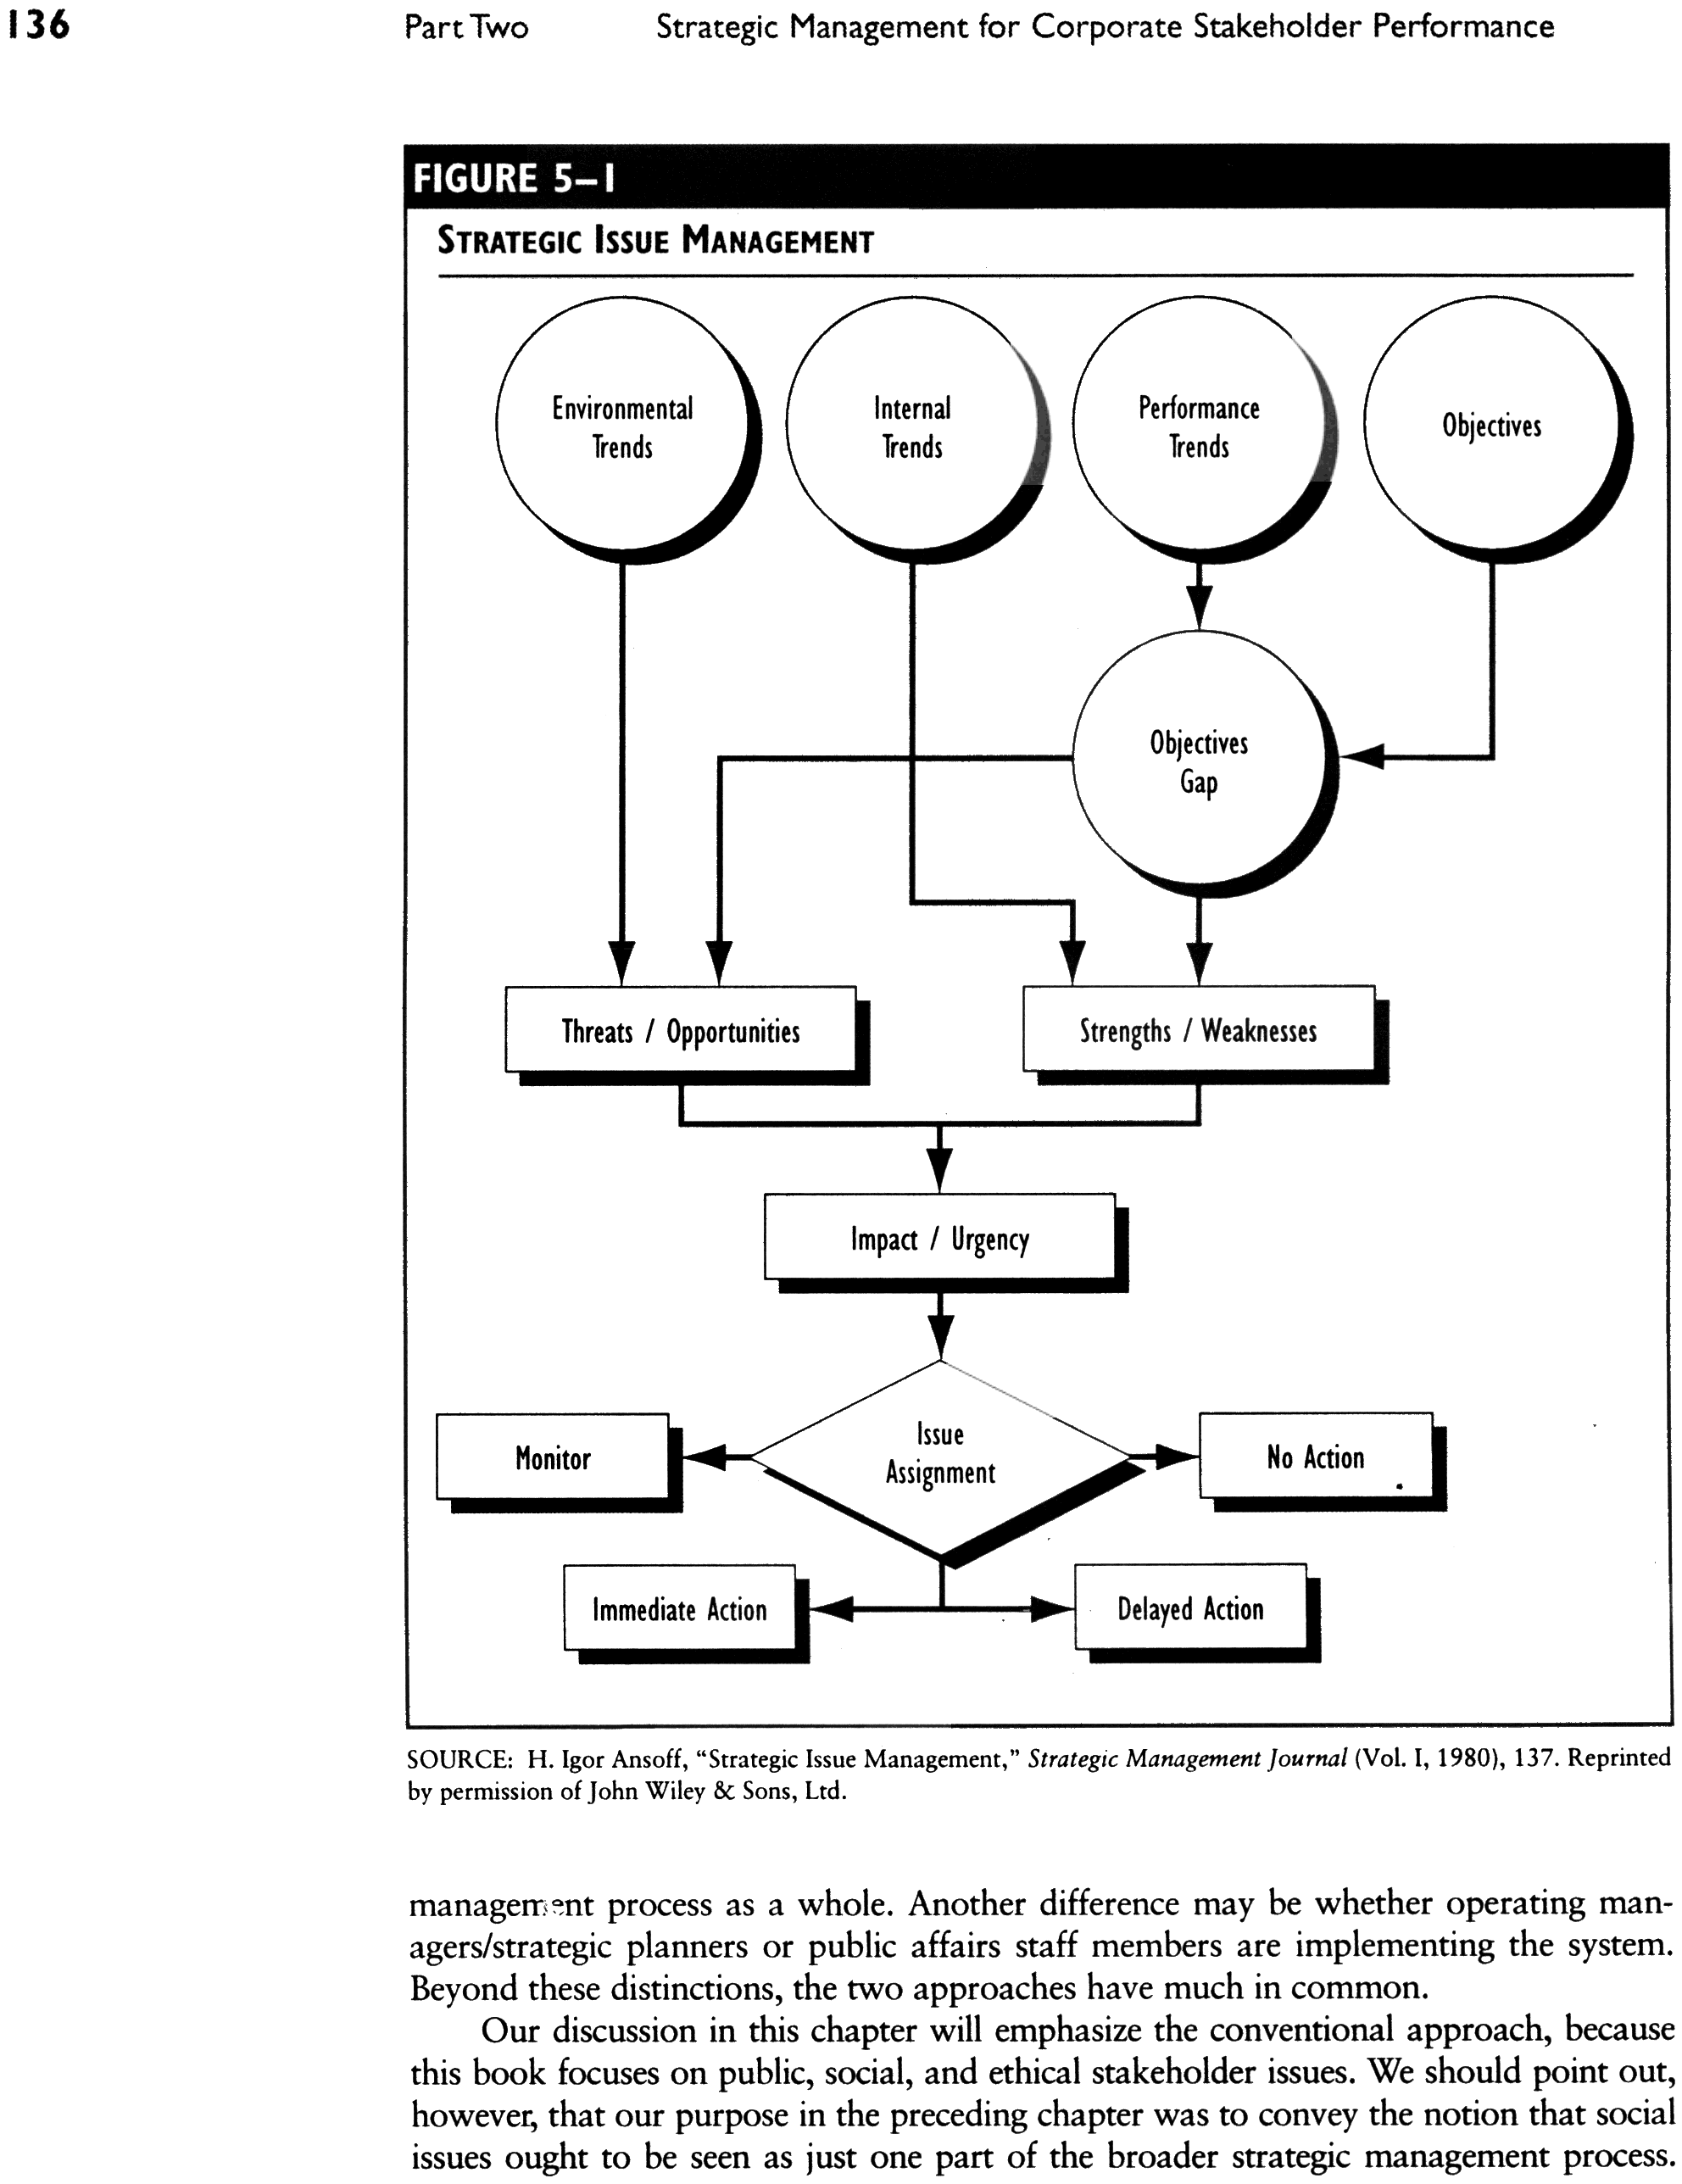
Issues Management

Slide 6
Issues Management
The Changing Issues Mix
A changing mix of issues often creates a cumulative effect that managers must face

Slide 7
Issues Management
The Issues Management Process
An issue is a matter that is in dispute between two parties

Slide 8
Issues Management
Emerging issues
  Terms of the debate are not clearly defined
  Parties have conflicting values and interest
  Automatic resolution not available
  Issues are often stated in value laden terms
  Trade-offs are inherent

Slide 9
Issues Management
Basic assumptions
  Issues can be identified earlier, completely, and reliably
  Early anticipation widens the range of options
  Early anticipation permits an understanding
  Early anticipation permits a positive orientation
  Early identification identifies the stakeholders
  Early identification provides the opportunity for the organization to supply information about the issue earlier

Slide 10

Model of Issues Management Process
Identification of Issues
Analysis of Issues
Prioritization of Issues
Formulation of Issue Responses
Implementation of Issue Responses
Evaluation, Monitoring, and Control of Results

Slide 11
Issues Management Process
Identification of Issues
Scan the environment
Identify emerging issues

Slide 12
Issues Management Process
Analysis of Issues
Which stakeholders are affected?
Who has a vested interest?
Who is in a position to exert influence?
Who is responsible for the issue?
Who started the ball rolling? (Past view)
Who is now involved? (Present view)
Who will get involved? (Future view)

Slide 13
Issues Management Process
Ranking of Issues
Xerox approach
  Is it a high priority?
  Is it beneficial to know?
  Questionable
Probability-Impact matrix
  Probability of occurrence?
  Impact on company?

Slide 14
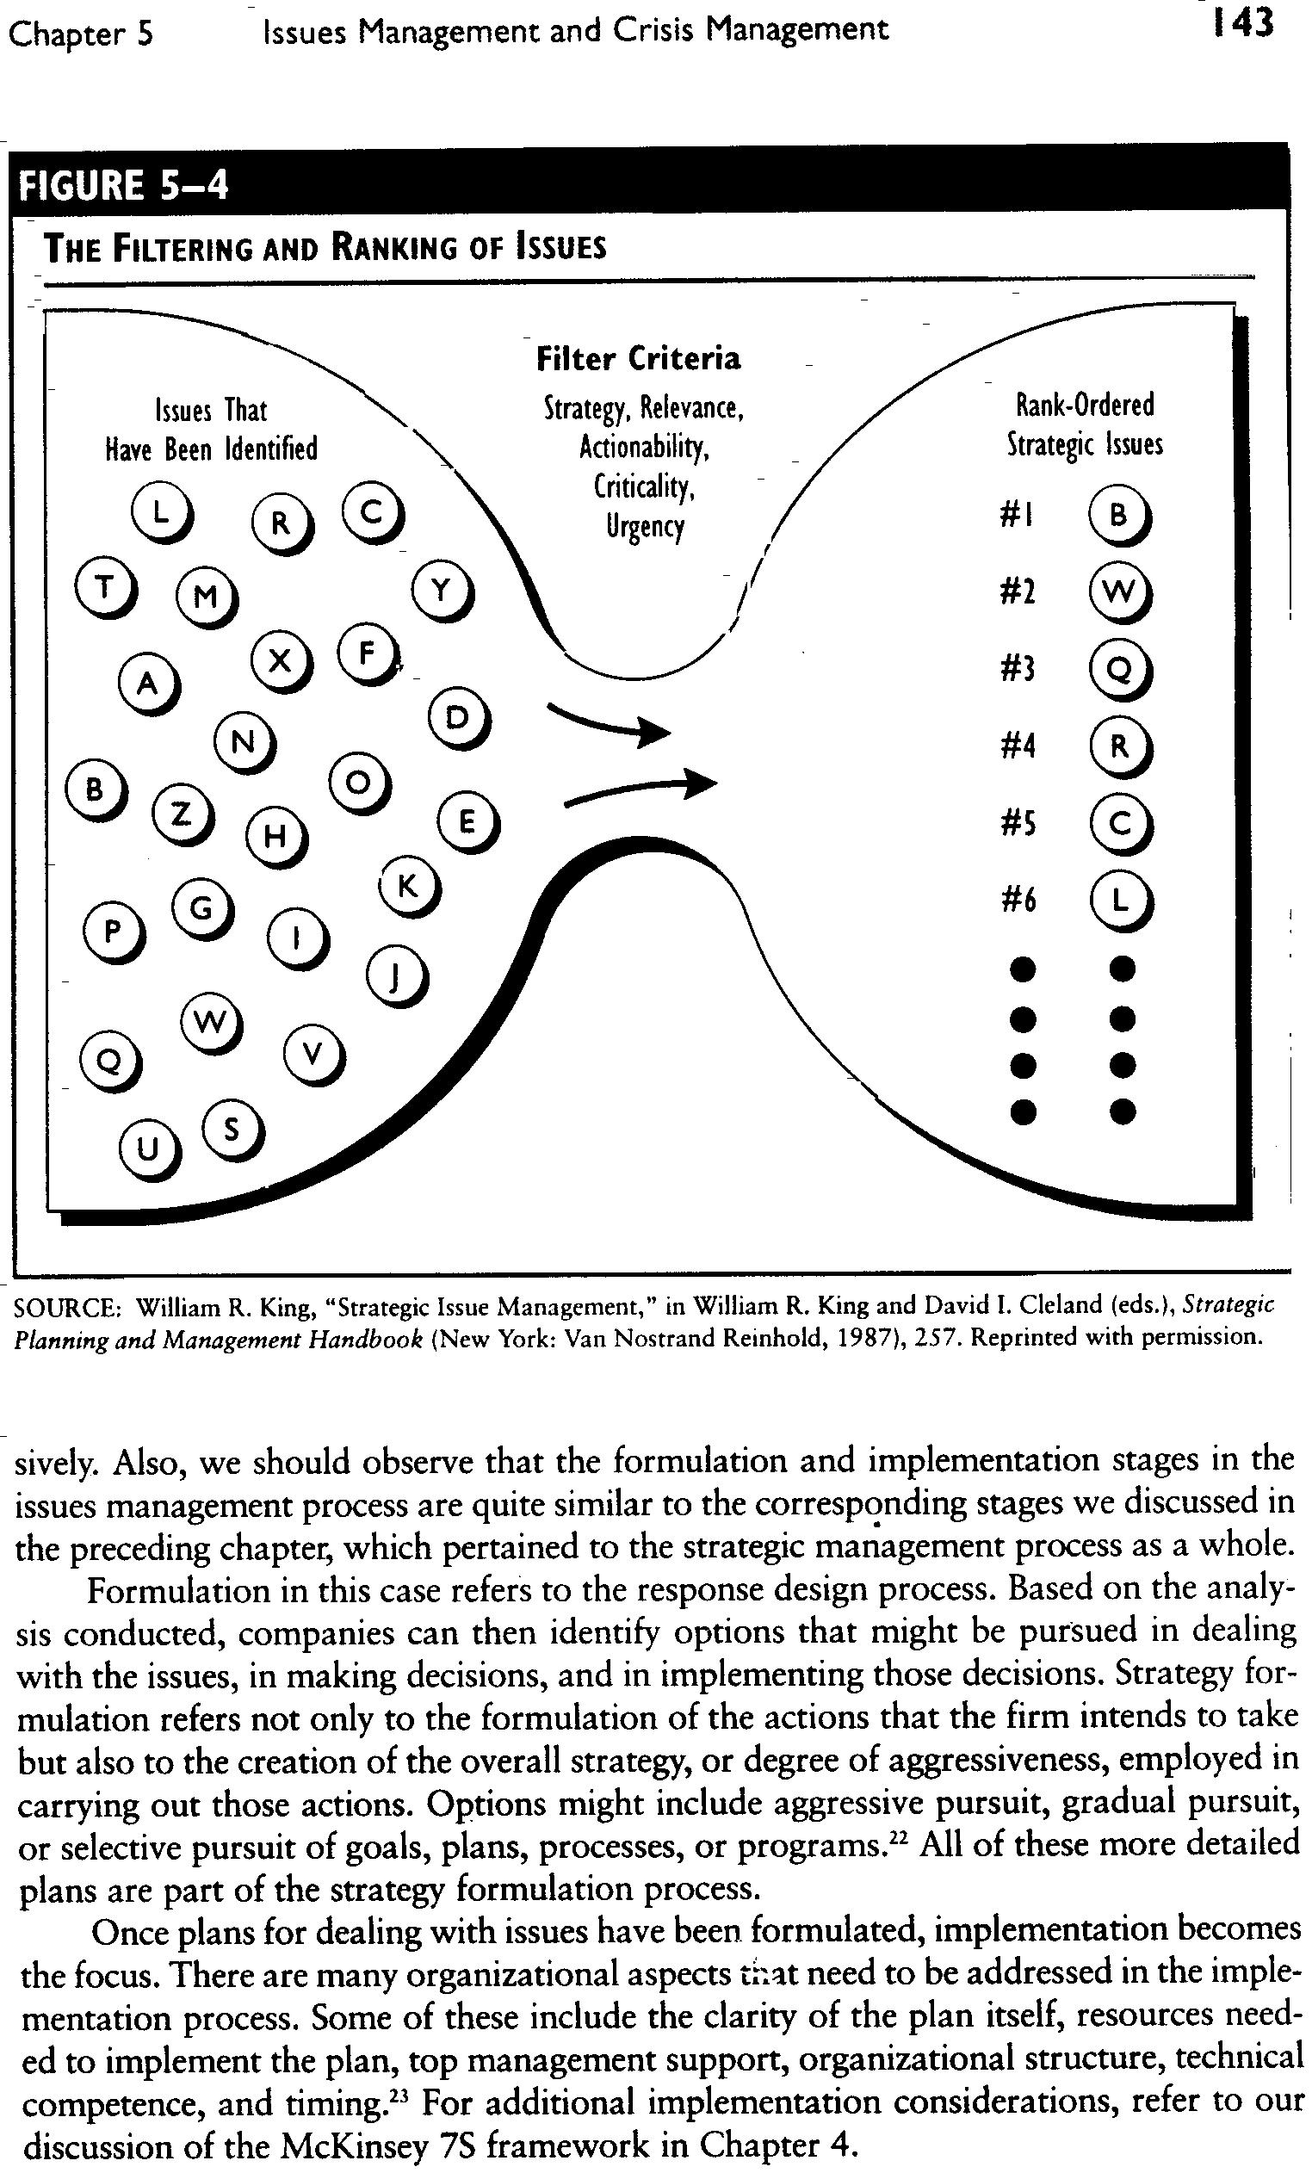
Issues Management Process

Slide 15
Issues Management Process
Formulation and Implementation of Responses
Formulation is the response design process
Implementation is the action design process
These may include:
  Plan clarity
  Resources needed
  Managerial support
  Organizational structure
  Technical competence
  Timing

Slide 16
Issues Management Process
Evaluation, Monitoring and Control
Constant evaluation of results of their responses to the issues to keep strategy on track
    Social audit

Slide 17
Issues Development Process
Issues development process is the growth process or life cycle of an issue

Slide 18
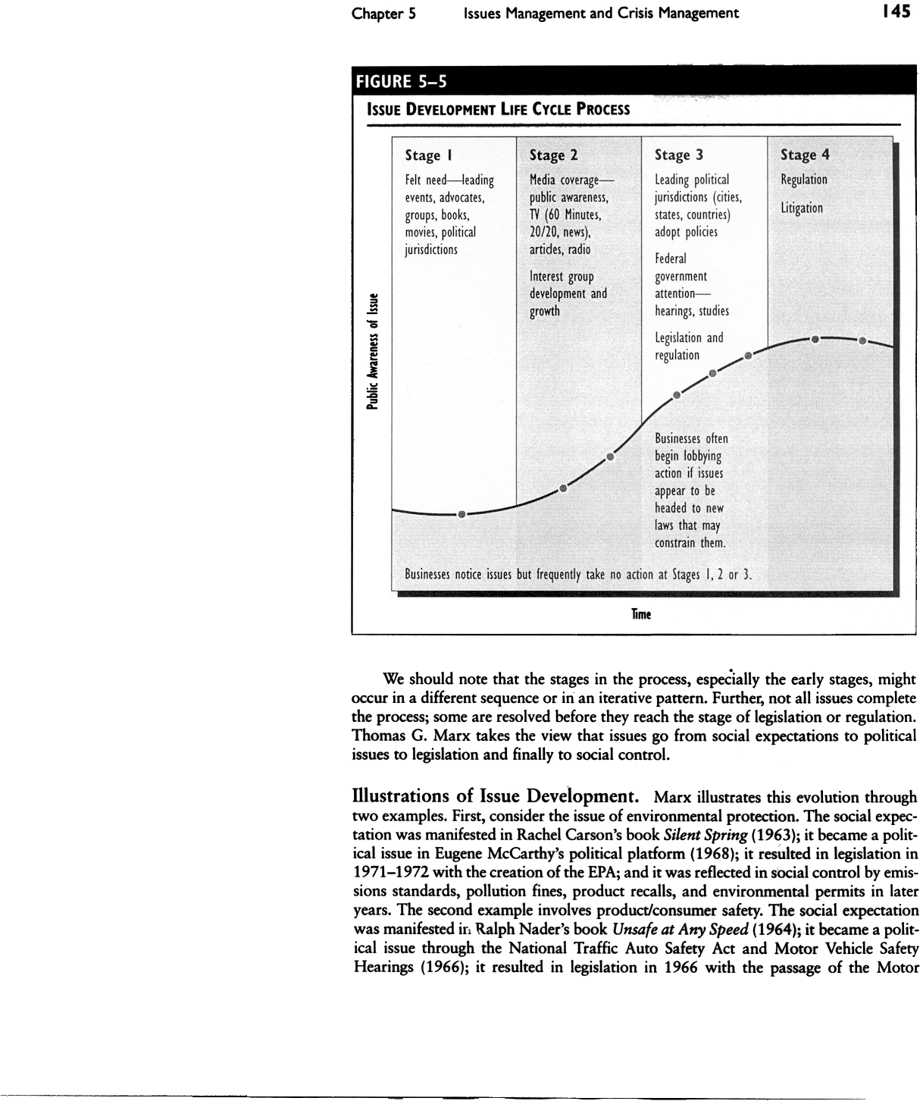
Issues Development Life Cycle Process

Slide 19
Crisis Management
  To manage a crisis one first must understand that a crisis:
    Can occur abruptly
    Cannot always be anticipated

Slide 20
The Nature of a Crisis
Crisis Definitions
A major, unpredictable event that has negative results that damages an organization
A low-probability event that threatens the viability of the organization and has an ambiguous cause, effect, and resolution

Slide 21
The Nature of a Crisis
Types of Crises
Economic
Informational
Human recourse
Reputation
Psychopathic
Natural

Slide 22
Crisis Management: 4 Stages
Prodromal Crisis Stage
Warning—precursor
Symptom —precrisis
Acute Crisis Stage
Point of no return
Crisis has occurred
Learning
Crisis Resolution Stage
The firm recovers
Chronic Crisis Stage
Lingering on—perhaps indefinitely; period of self-doubt and self-analysis

Slide 23
Managing Business Crises
Fink’s Three-Stage Model
Identifying the crisis
Isolating the crisis
Managing the crisis

Slide 24
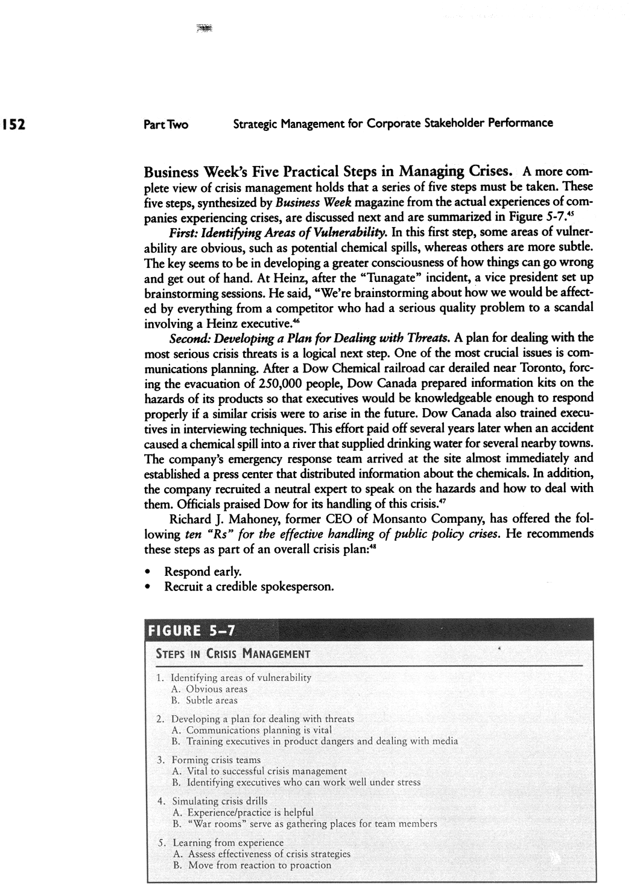
Managing Business Crises
Business Week’s Steps in Managing Crises

Slide 25
Managing Business Crises
Augustine’s Stages of Crisis Management
Avoid the crisis
Prepare to manage the crisis
Recognize the crisis
Contain the crisis
Resolve the crisis
Profit from the crisis

Slide 26
Crisis Communications
Identify crisis team
Identify key spokespersons
Train your spokesperson
Establish communications protocols
Know the audience
Anticipate crises
Assess the crisis
Identify key messages to communicate
Determine communication methods
Prepare to ride out the storm

Slide 27

Selected Key Terms
Acute crisis stage
Chronic crisis stage
Conventional approach
Crisis
Crisis communications
Crisis management
Crisis resolution stage
Crisis teams
Emerging issue
Issue
Issue development process
Issues management
Probability-impact matrix
Prodromal crisis stage
Strategic management approach to issues management
Ten steps in crisis communications

Slide 28
Summary
Objectives
Introduction
Issues Management
Model of Issues Management Process
Issues Development Life Cycle Process
The Nature of a Crisis
Crisis Communications

Slide 29
Thank You

