Slide 1
Lecture 01
Crisis Management
An Introduction

Slide 2
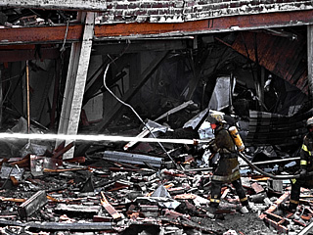
What is a crisis?
In general?
For an organisation?
For government or bureaucracy?
For a private company?
In healthcare?
In drug safety?

Slide 3
Topics
The nature of crisis
  Crisis management model
Planning
  Risk assessment
  Risk management
Crisis communications
Risk Communications

Slide 4
Key features of a Crisis
Low probability
High impact
Uncertain/ambiguous causes and effects
Differential perceptions

Slide 5
High level Threats
Safety
Health
Environment
National security

Slide 6
Specific Threats to Organization
Operational viability
Reputation
Credibility
Financial stability
Legal action

Slide 7
Consequential Effects
Uncertainty/ambiguity
Urgency of response
Strategic effects of decisions

Slide 8
Common Features of a Crisis
The situation materialises unexpectedly
Decisions are required urgently
Time is short
Specific threats are identified
Urgent demands for information are received
There is sense of loss of control
Pressures build over time
Routine business become increasingly difficult
Demands are made to identify someone to blame
Outsiders take an unaccustomed interest
Reputation suffers
Communications are increasingly difficult to manage

Slide 9
Purpose of Crisis Management
Prevention
Survival
Successful outcomes

Slide 10
Successful Outcomes
Positive balance of success/failure

Slide 11
Incident
Success outcomes
Failure outcomes
EXXON VALDEZ
- Financial losses were bearable
- Costs relating to clean-up were less than pre-emptive costs
- Image management recovered the Company’s reputation in business community
- Long term costs were transferred to public
- Delays in implementing clean-up leading to loss of wildlife.
- Image management failed to fully recover the Company’s reputation in wider community
TYLENOL TAMPERING
- Swift reactions reinforced Company reputation for integrity
- Stakeholders reported high degree of trust
- Product did not suffer in long term
- Perpetrator was never identified
- Future attempts cannot therefore be precluded

Slide 12
Three Criteria of Success
Has organisational capacity been restored?
Have losses been minimised?
Have lessons been learned?

Slide 13
Crisis Management Model
Antecedent
conditions
Intrinsic crisis
Perceived crisis
Immature crisis
response
Mature crisis
management
Review and Feedback

Slide 14
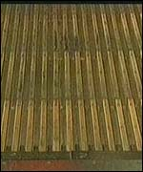
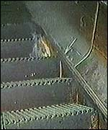
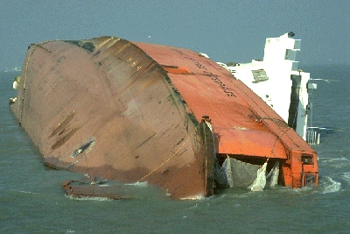
Existing Conditions
Culture or
environment
Open bow doors /
poor safety culture
Smoker / poor cleaning standards

Slide 15
Intrinsic crisis:
Perceived Crisis
As seen by all individuals from particular viewpoints
Total situation as seen by neutral observer with all the facts

Slide 16
Mature Crisis Management
Grasp of intrinsic crisis
Implementation of plans and procedures

Slide 17
Mature Crisis Management
Technical intelligence
Emotional intelligence

Slide 18
Review and feedback
Assessing success and failure
Feeding learning into future planning

Slide 19
Management Objective
Ad hoc emergency reaction?
OR
Building management capacity to handle unforeseen events?

Slide 20
Summary
What is a crisis?
Key features of a Crisis.
High level Threats.
Specific Threats to Organization.
Three Criteria of Success.
Crisis Management Model.

Slide 21
Thank You

