Slide 1
Course Title: | Financial Statement Analysis
Course Code: | MGT-537
Course Instructor: | Dr. Hafiz Muhammad Ishaq
Total Lectures: | 32

Slide 2
Previous Lecture Summary
Basics of Analysis,
Ratio Analysis, Common size analysis,
(Vertical and Horizontal),
Financial Statement Variations by type
of Industry, Comparison,
Trend Analysis,

Slide 3
Today's Lecture Topics
Practical Problems Related to:
Common Size Analysis, Vertical
Analysis, Horizontal Analysis
Trend Analysis,

Slide 4
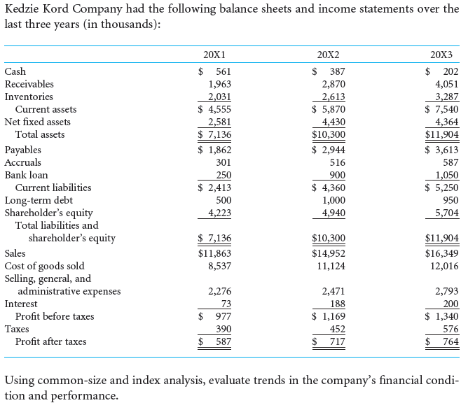

Slide 9
Practical Exercise
 | 2010 | 2009
Sales | $9,434,000 | $7,862,000
Cost of Sales | 7,075,400 | 5,660,640
Gross Profit | $2,358,600 | $2,201,360
Operating Expenses | 1,367,690 | 1,365,060
Operating Income | $ 990,910 | $ 836,300
Interest Expense | 157,500 | 126,000
Earnings Before Tax | $ 833,410 | $ 710,300
Income Taxes | 400,000 | 317,200
Net Income | $ 433,410 | $ 393,100
Comparative income statements for 2010 and 2009 follow.
Required:
a. | Prepare a vertical common-size analysis of this statement for each year, using sales as the base.
b. | Comment briefly on the changes between the two years, based on the vertical common-size statement.

Slide 11
Cost of sales as a percent of sales has risen substantially. This increase is nearly offset by a decline in operating expense.
Interest expense and taxes have both risen slightly in relation to sales.

Slide 12
Lecture Summary
Practical Problems Related to:
Common Size Analysis: Vertical
Analysis, Horizontal Analysis
Trend Analysis,

