Slide 1
Course Title: | Financial Statement Analysis
Course Code: | MGT-537
Course Instructor: | Dr. Hafiz Muhammad Ishaq
Total Lectures: | 32

Slide 2
Previous Lecture Summary
We have discussed different Forms of Business Entities
We have discussed Journal Entries , Ledger, Trial Balance, and Financial Statements like Balance Sheet, Income Statement, Statement of Owners Equity, Statement of Cash flows
We have discussed Accounting Cycle, and Auditor’s Report

Slide 3
Example for Adjusting Entries and Effect in Income Statement and Balance Sheet
The following additional information is available for the month just ended:
a. Amortization of $50 per month will be taken on the furniture.
b. It is estimated that the store equipment will have no value at the end of its estimated five-year (or 60-month) useful life. Barbara Schmidt will record a full month of amortization for August.
c. It was determined that the balance in unearned revenue at August 31 should be $420.
d. The prepaid insurance represents six months of insurance beginning August 1.
e. Accrued revenues at August 31 totaled $65.
Required
1. Prepare the adjusting entries needed on August 31, 2011, to record the previously unrecorded items.
2. Prepare T-accounts for accounts affected by the adjusting entries. Post the adjusting entries to the T-accounts.
3. Prepare an adjusted trial balance.
4. Prepare an income statement, a statement of owner’s equity, and a balance sheet.

Slide 8
Chapter End Problem
The Mike Szabo Company engaged in the following transactions during the month of December
December 2 Made credit sales of $4000 (accepted accounts receivable).
6 Made cash sales of $2500.
10 Paid office salaries of $ 500
14 Sold lands that originally cost $2,200 for $3,000 cash
17 Paid $6,000 for equipment
21 Billed clients $900 for services (accepted accounts
receivable).
24 Collected $1,200 on an account receivable.
28 Paid an account payable of $700
Required : Record the transactions using T- accounts.

Slide 12
Accounting System Components
 | Permanent | Temporary
Account types | Assets Liabilities Equity | Revenues, Gains Expenses, Losses Dividends
Balances | Carry forward to the next fiscal period | Closed to retained earnings at year-end
 | Represent the accounting equation

Slide 13
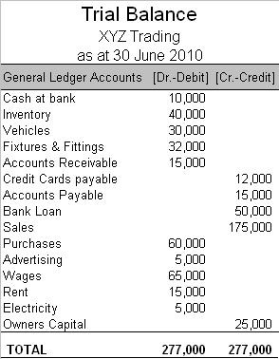
Trial Balance

Slide 15
Recording Adjusting Entries
Required by the accrual basis of accounting
Prepared at the end of the fiscal period
Records (recognizes) for the current period
  Expenses incurred
  Revenues earned
Recorded in the general journal
Posted to the general ledger

Slide 16
Preparing the Financial Statements
The output of the accounting system
Based on the adjusted general ledger account balances
Directly from the general ledger
  Income statement
  Balance sheet
From analysis of general ledger accounts
  Statement of cash flows

Slide 17
Auditor’s Opinion
Audit is conducted by CAs
The audit report is the formal statement of audit opinion
  Unqualified opinion
  Qualified opinion
  Adverse opinion
  Disclaimer of opinion

Slide 18
Unqualified Opinion
The unqualified opinion has no reservations concerning the financial statements. This is also known as a clean opinion.
The financial statements present fairly
  The financial position
  Results of operations
  Cash flows
In conformity with generally accepted accounting principles
For the user: the highest degree of reliability

Slide 19
Qualified Opinion
This means that the auditor has taken exception to certain current-period accounting applications or is unable to establish the potential outcome of a material uncertainty
Except for the matter to which the exception relates
The financial statements present fairly
  The financial position
  Results of operations
  Cash flows
In conformity with generally accepted accounting principles
For the user: determine the significance of the exception

Slide 20
Adverse Opinion
This is a type of audit opinion which states that the financial statements do not fairly present the financial position, results of operations, and changes in financial position.
The financial statements do not present fairly
  The financial position
  Results of operations
  Cash flows
In conformity with generally accepted accounting principles
For the user: reliability of financial statements need to be seriously questioned

Slide 21
Disclaimer of Opinion
This is a special type of audit report that should be issued when the auditor permits his or her name to be associated with financial statements that were not examined in accordance with generally accepted auditing standards.
The auditor does not express an opinion
Auditor
  Has not preformed an audit sufficient in scope to form an opinion or
  Is not independent
For the user: auditor’s statement conveys no indication of financial statement reliability

Slide 22
Unqualified Auditor’s Report
Paragraph #1:
  Financial statements have been audited
  Financial statements are responsibility of management
  Auditors have responsibility to express or disclaim an opinion

Slide 23
Unqualified Auditor’s Report (cont’d)
Paragraph #2
  Audit conducted in accordance with the standards of the ISA Board
  Auditor is required to plan and perform the audit
    Obtain reasonable assurance
    Financial statements are free from material misstatement
  Audit provides a reasonable basis for opinion
    Examining evidence
    Assessing accounting principles and estimates

Slide 24
Unqualified Auditor’s Report (cont’d)
Paragraph #3
  Opinion: in conformity with generally accepted (GAAP) accounting principles
Also: for public companies, reference to the audit of internal control effectiveness
  In accordance with the ISA Based on criteria established by ISA

Slide 25
Auditor’s Report on Internal Control
Audit Report combined with audit opinion Paragraphs
  Scope
  Responsibility and procedures
  Opinion
  Reference to financial statement audit

Slide 26
Other Types of Engagements
Review
  Less in scope than an audit
  An opinion is not expressed
  Provides negative assurance
    “Not aware of any material misstatements or required modifications”
Compilation
  Presents only financial information provided by management
  No opinion or any other assurance is given

Slide 27
Management’s Responsibility
Management is responsible for
  The preparation of the financial statements
  The integrity of the financial statements
Management’s Statement of Responsibility
  May be included in the annual report

Slide 28
Harmonization of International Accounting Standards
Accounting standards can vary by country
  Development is often in response to domestic needs
International accounting standards set by
  IASC (1973 – 2001)
  IASB (2001 to present) has no enforcement power

Slide 29
Consolidated Financial Statements
Parent consolidates with subsidiary
  Report results of operations separately
  Sum subsidiary and parent results of operations
Legal control vs. effective control
Consolidation occurs when parent has effective control over the subsidiary
  Holds a majority of risks, rewards, and decision-making ability

Slide 30
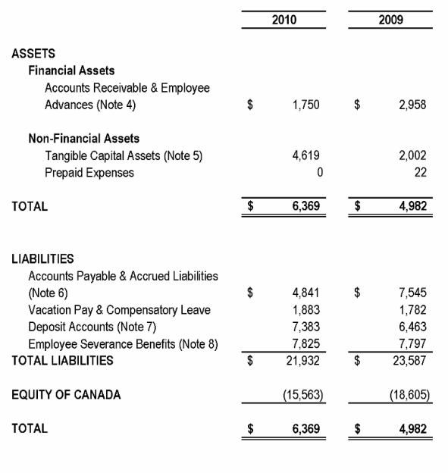
Consolidated Financial Statements

Slide 31
Lecture 03
Balance Sheet
Consolidated Statements
Basic Elements of the Balance Sheet
Assets,

Slide 32
The Balance Sheet
“Statement of Financial Position”
Dated as of a specific date
Format
  Account
  Report

Slide 33
Balance Sheet – Report Form

Slide 34
Balance Sheet – Account Form

Slide 35
Assets
Probable future economic benefits obtained or controlled by an entity as a result of past transactions or events
  Current Assets
  Long-Term Assets

Slide 36
Current Assets
Cash and assets that will be converted into cash during the operating cycle or within a year, whichever is longer
Presented in order of liquidity

Slide 37
Current Assets (cont’d)
Cash
  Negotiable checks, unrestricted balance in
  checking accounts, savings accounts
Marketable Securities
  Debt or equity securities
  Carried at fair value
  Intention to convert into cash during the
  current period

Slide 38
Current Assets (cont’d)
Accounts Receivable
  Amounts due from sales or services
  Carried at net realizable value (net of allowances)
Other receivables due from nontrade sources

Slide 39
Current Assets (cont’d)
Inventories
  Carried at lower of cost or market
  Categories
    Goods on hand
    Raw materials
    Work in process
    Finished goods
Manufacturer

Slide 40
Chapter End Problem
The Following are the inventory records of Herrick House
Units Cost Total
January 1 10 $ 8 $80
Purchase:
April 18 32 9 288
November 3 41 10 410
December 10 4 11 44
Ending inventory consist of 6 units. These units are from the November purchase.
Calculate ending inventory and cost of sales using: (a) FIFO (b) LIFO (c) Average.

