Slide 1
Course Title: | Financial Statement Analysis
Course Code: | MGT-537
Course Instructor: | Dr. Hafiz Muhammad Ishaq
Total Lectures: | 32

Slide 2
Previous Lecture Summary
Statement of Cash Flows
Operating Cash Flow/Current Maturities of Long-Term
Debt and Current Notes Payable,
Operating Cash Flow/Total Debt,
Operating Cash Flow Per Share, Operating
Alternative Cash Flow
Procedures for Development of the Statement of Cash Flows
Practical Exercises

Slide 3
Today's Lecture Topics
Statement of Cash Flows
Practical Exercises

Slide 4
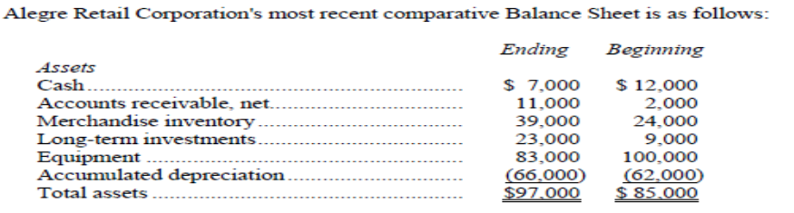
Practical Exercise

Slide 5
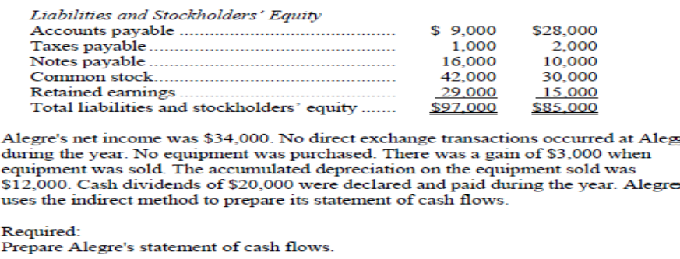

Slide 8
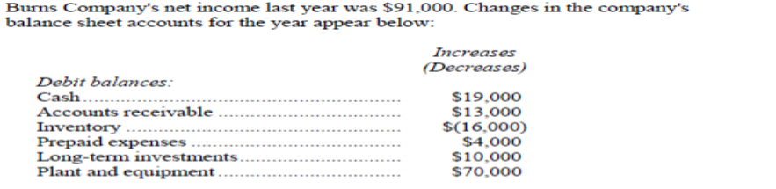
Practical Exercise

Slide 9
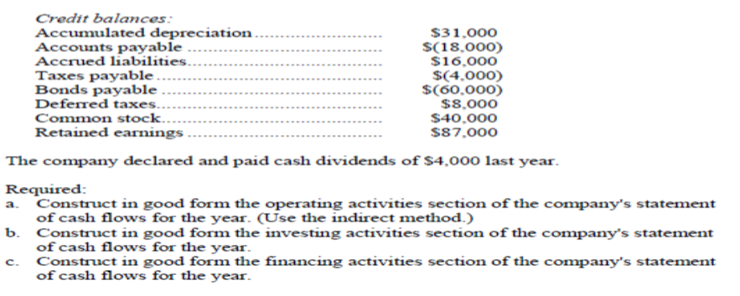

Slide 12
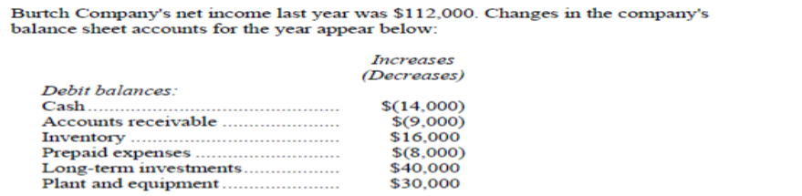
Practical Exercise

Slide 13
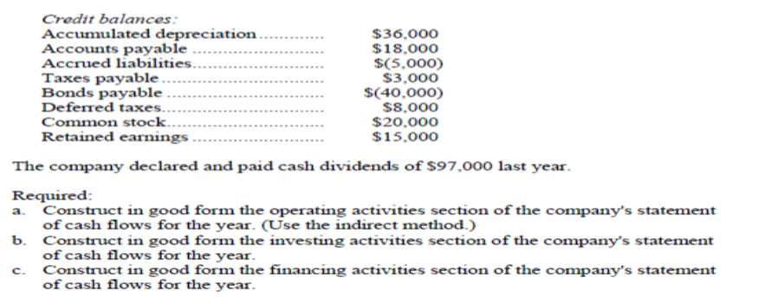

Slide 16
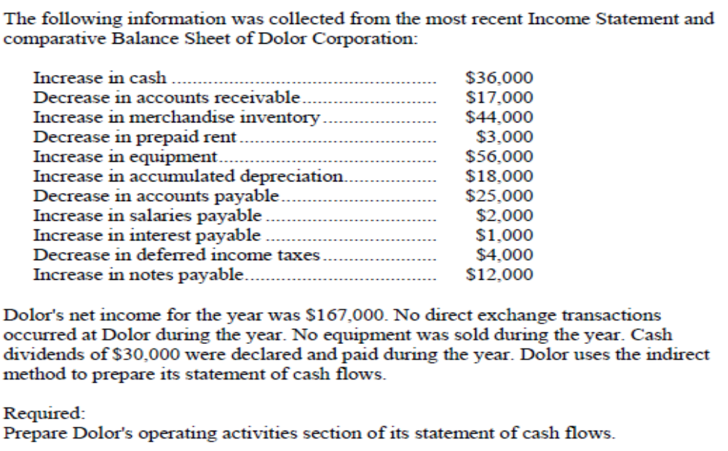
Practical Exercise

Slide 18
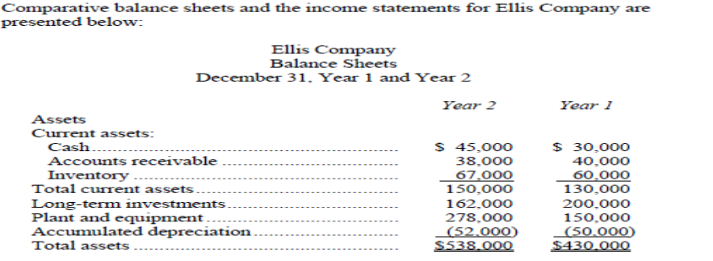
Practical Exercise

Slide 19
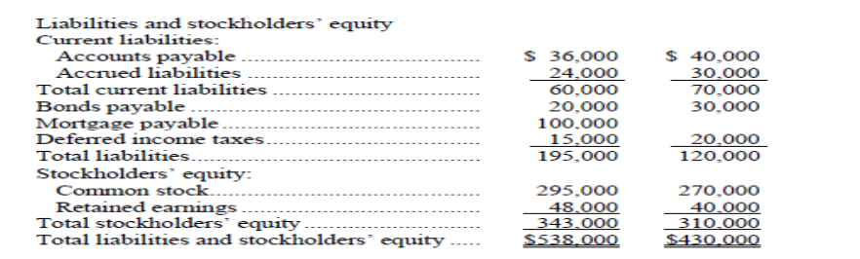

Slide 20
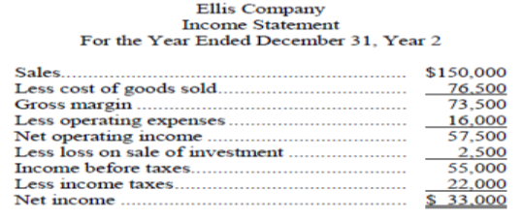
Practical Exercise

Slide 21
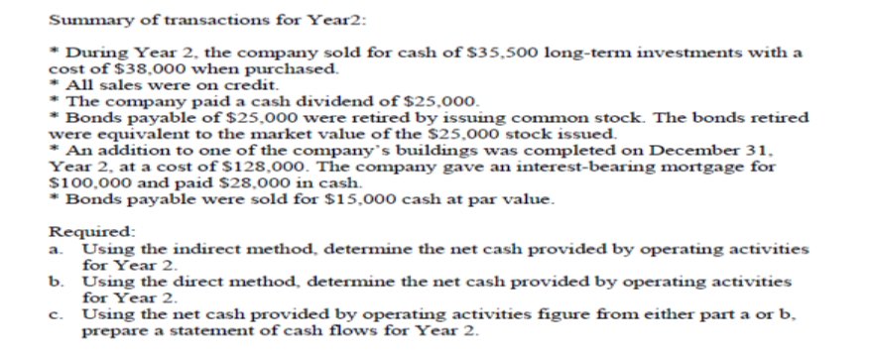

Slide 26
Lecture Summary
Statement of Cash Flows
Practical Exercise

