Slide 1
Course Title: | Financial Statement Analysis
Course Code: | MGT-537
Course Instructor: | Dr. Hafiz Muhammad Ishaq
Total Lectures: | 32

Slide 2
Lecture 2nd Topics
Forms of Business Entities
The Financial Statements
Balance Sheet (Statement of Financial Position)
Income Statement (Statement of Earnings)
Statement of Owners Equity
Statement of Cash flows
The Accounting Cycle, Auditor’s Report

Slide 3
Forms of Business Entities

Slide 4
The Financial Statements
Income statement
Statement of stockholders’ equity
Balance sheet
Statement of cash flows
Support for the financial statements is
provided by notes

Slide 5
Income Statement
Dated for a specific period
Summarizes revenues and expenses
Reports net income
  Excess of revenues over expense
Net income increases retained earnings
Income Statement
Revenue $ 120,000
Expenses (100,000)
Net Income $ 20,000

Slide 6
Statement of Stockholders’ Equity
Dated for a specific period
Reconciles beginning and
ending balances of the
stockholders’ equity
accounts
  Capital Stock
  Retained Earnings Etc.
Links the income statement
and the balance sheet
Income Statement
Revenue $ 120,000
Expenses (100,000)
Net Income $ 20,000
Statement of Stockholders’ Equity
Capt. Stk. Ret. Earn.
Beginning Balance $20,000 $ 5,000
Net income 20,000
Dividends (10,000)
Ending Balance $20,000 $ 15,000

Slide 7
Balance Sheet
Shows the financial condition of an entity as of a particular date
  Assets: the resources of the business
  Liabilities: the debts of the business
  Equity: the owners’ interest in the business
The Accounting Equation:
Income Statement
Revenue $ 120,000
Expenses (100,000)
Net Income $ 20,000
Statement of Stockholders’ Equity
Capt. Stk. Ret. Earn.
Beginning Balance $20,000 $ 5,000
Net income 20,000
Dividends (10,000)
Ending Balance $20,000 $ 15,000
Assets = Liabilities +
Stockholders’ Equity
Assets = Liabilities +
Capital Stock +
Retained Earnings
Balance Sheet
Assets $110,000
Liabilities 25,000
Stockholders’ Equity
Capital Stock 50,000
Retained Earnings 35,000
$110,000

Slide 8
Statement of Cash Flows
Covers the same period as the income statement
Three sections
  Cash flows from operating activities
  Cash flows from investing activities
  Cash flows from financing activities

Slide 9
Notes
An integral part of the financial statements
Required presentation
  Summary of significant accounting policies
  Contingent liabilities
  Subsequent events relating to conditions that
  existed at the balance sheet date
  Disclose and adjustment of the financial statements
  Subsequent events relating to conditions that did
  not exist at the balance sheet date
    Disclosure but no adjustment of the financial statements

Slide 10
The Accounting Cycle
Recording transactions
Recording adjusting entries
Preparing the financial statement

Slide 11
Recording Transactions
Internal or external event that causes a change in a company’s assets, liabilities, or stockholders’ equity
Recorded in a journal (journal entry)
Posted to general ledger accounts
Double-entry system
  Debit: left side of an account
  Credit: right side of an account
  Debits = Credits
Account Title
Debit | Credit

Slide 12
Example for Adjusting Entries
Example.No.1
The owner of a lawn service company prepares monthly financial statements. Prepare the appropriate adjusting entries for July 31 based on the following information available at the end of July.
a. The annual insurance amounting to $1,200 went into effect on July 1. The Prepaid Insurance account was debited and Cash credited on the same date.
b. The lawn service company’s lawn tractor was purchased for $3,200 last year. The value of the lawn tractor at the end of its estimated four-year useful life was determined to be $800. This information was made available to record amortization for July.
c. A customer paid for the entire summer’s service in April. The journal entry credited the Unearned Service Fees account when the payment was received. The monthly fee is $500.
d. The last weekly salary of $1,400 was paid to employees on Friday, July 27. Employees are paid based on a five-day workweek. Salaries for July 30 and 31have accrued.
e. Service fees of $1,800 were earned by July 31 but not recorded.
Refer to (d) above. Prepare the entry to pay the salaries on Friday, August 3.

Slide 15
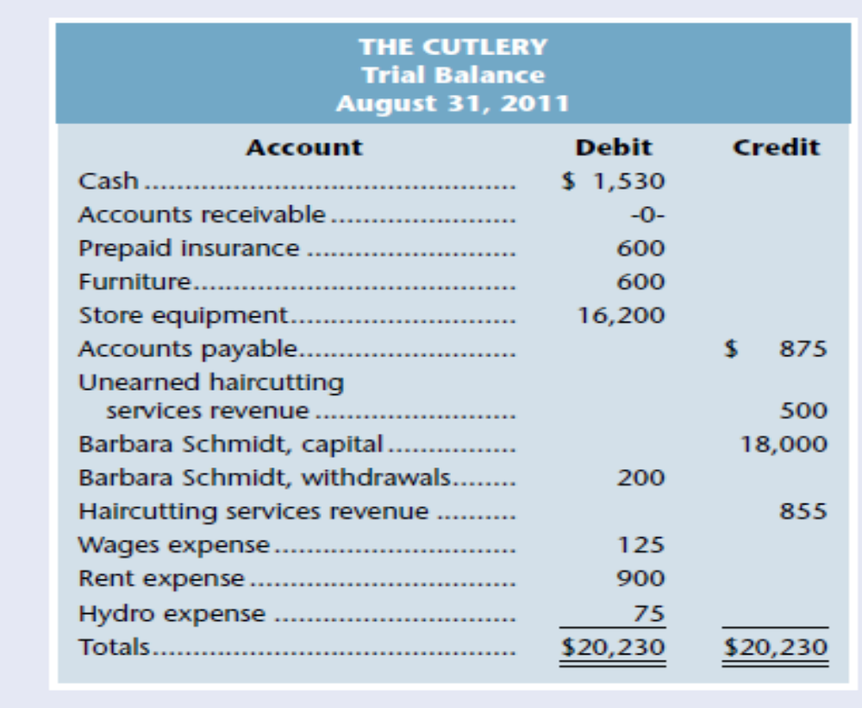
Example for Adjusting Entries and Effect in Income Statement and Balance Sheet
The Cutlery’s August 31, 2011, unadjusted trial balance appeared as follows:

Slide 16
Example for Adjusting Entries and Effect in Income Statement and Balance Sheet
The following additional information is available for the month just ended:
a. Amortization of $50 per month will be taken on the furniture.
b. It is estimated that the store equipment will have no value at the end of its estimated five-year (or 60-month) useful life. Barbara Schmidt will record a full month of amortization for August.
c. It was determined that the balance in unearned revenue at August 31 should be $420.
d. The prepaid insurance represents six months of insurance beginning August 1.
e. Accrued revenues at August 31 totaled $65.
Required
1. Prepare the adjusting entries needed on August 31, 2011, to record the previously unrecorded items.
2. Prepare T-accounts for accounts affected by the adjusting entries. Post the adjusting entries to the T-accounts.
3. Prepare an adjusted trial balance.
4. Prepare an income statement, a statement of owner’s equity, and a balance sheet.

Slide 17
Chapter End Problem
The Mike Szabo Company engaged in the following transactions during the month of December
December 2 Made credit sales of $4000 (accepted accounts receivable).
6 Made cash sales of $2500.
10 Paid office salaries of $ 500
14 Sold lands that originally cost $2,200 for $3,000 cash
17 Paid $6,000 for equipment
21 Billed clients $900 for services (accepted accounts
receivable).
24 Collected $1,200 on an account receivable.
28 Paid an account payable of $700
Required : Record the transactions using T- accounts.

