Slide 1
Course Title: | Financial Statement Analysis
Course Code: | MGT-537
Course Instructor: | Dr. Hafiz Muhammad Ishaq
Total Lectures: | 32

Slide 2
Course Outline:

Slide 3
Lecture 1
Fundamental Concepts and Introduction to Financial Reporting
Generally Accepted Accounting Principles (GAAP)
Security Exchange Commission (SEC)
American Institute of Certified Public Accountants(AICPA)
Financial Accounting Standard Boards (FASB)
Traditional Assumptions of the Accounting Model
Business Entity, Going Concern or Continuity, Time Period, Monetary Unit, Realization, Matching, Consistency, Cash Basis, Accrual Basis

Slide 4
Lecture 2
Introduction to Financial Statements and other Financial Reporting Topics
Forms of Business Entities
The Financial Statements
Balance Sheet (Statement of Financial Position)
Income Statement (Statement of Earnings)
Statement of Owners Equity
Statement of Cash flows
The Accounting Cycle, Auditor’s Report

Slide 5
Lecture 3
Balance Sheet
Consolidated Statements
Basic Elements of the Balance Sheet
Assets, Liabilities, Owner’s Equity,

Slide 6
Lecture 4 & 5
Balance Sheet
Quasi Reorganization, Foreign Currency Translation, Unrealized holding gains and losses
Equity-Oriented Deferred Compensation, Employee Stock ownership Plans, Treasury Stock, Practical Exercises

Slide 7
Lecture 6
Income Statement
Single – step income statement
Basic Elements of the Income Statement: Net Sales Cost of goods sold Other operating revenue, Operating expenses, other income and expenses.

Slide 8
Lecture 7
Income Statement Multiple-step income statement, Special Income Statement Items: Unusual item disclosed separately, Discontinued operations, Extraordinary items, Minority share of earnings
Earnings per share, Retained Earnings, Dividends and stock splits
Practical Exercises

Slide 9
Lecture 8
Basics of Analysis
Ratio Analysis, Common size analysis (Vertical and Horizontal), Financial Statement Variations by type of Industry, Comparison, Trend Analysis,

Slide 10
Lecture 9
Liquidity of Short-Term Assets; Related Debt Paying Ability
Current Assets, Current Liabilities and the Operating Cycle
Cash, Marketable Securities, Receivable, Inventories, Prepayments, Other Current Assets, Current Liabilities,

Slide 11
Lecture 10 & 11
Liquidity of Short-Term Assets; Related Debt Paying Ability
Current Assets Compared with Current Liabilities
Working Capital, Current Ratio, Acid Test Ratio (Quick Ratio), Cash Ratio

Slide 12
Lecture 12 & 13
Liquidity of Short-Term Assets; Related Debt Paying Ability
Sales to Working Capital (Working Capital Turnover),Liquidity Considerations Not on the Face of the Statements
Liquidity of Short-Term Assets; Related Debt Paying Ability
LIFO-FIFO, Rising Prices, a Time to Switch Off LIFO?
The Other Side of LIFO

Slide 13
Lecture 14 & 15
Long Term Debt-Paying Ability
Income Statement Consideration when Determining Long-Term Debt-Paying Ability, Times interest earned, fixed charge coverage.
Balance Sheet Consideration when Determining Long-Term Debt-Paying Ability, Debt Ratio, Debt/Equity Ratio, Debt to Tangible net worth ratio, Other Long-Term Debt-Paying Ability Ratios

Slide 14
Lecture 16
Long Term Debt-Paying Ability
Special Items that Influence a Firm’s Long-Term Debt-Paying Ability,
Long–Term Assets Versus Long Term Debt, Long term leasing, Pension Plans,
Postretirement Benefits Other than Pensions, Joint Ventures, Contingencies,
Financial Instruments with Concentrations of Credit Risk, Disclosures About Fair Value of Financial Instruments,

Slide 15
Lecture 17
Analysis of Profitability
Net Profit Margin, Total Asset Turnover, Return on Assets, DuPont Return on Assets, Interpretation through DuPont Analysis, Operating Income Margin, Operating Asset Turnover, Return on Operating Assets,
Sales to Fixed Assets, Return on Investment, Return on Total Equity, Return on Common Equity, The relationship between profitability ratios, Gross Profit Margin

Slide 16
Lecture 18
Analysis of Profitability
Trends in Profitability, Segment Reporting, Gains and Losses that Bypass the Income Statement, Interim Reports

Slide 17
Lecture 19, 20,21 &22
Analysis for the Investor
Definition of Financial Leverage, Computation of Financial Leverage
Earnings per common share, Price/Earnings ratio, Percentage of Retained earnings, Dividend Payout, Book value per share, Stock appreciation rights
Stock Split, Stock Option Plan, Consideration of Stock Dividend,

Slide 18
Lecture 23 & 24
Statement of Cash Flows
A Review of the Funds Statement
Basic Elements of the Statements of Cash Flows
Financial Ratios and the Statement of Cash Flows, Operating Cash Flow/Current
Maturities of long-term debt and current notes payable, operating cash flow/total debt, operating cash flow per share, operating cash flow/cash dividend

Slide 19
Lecture 25 & 26
Statement of Cash Flows
Alternative cash flow
Procedures for development of the Statement of cash flows
Direct Method, Consolidated Cash Flow Statements

Slide 20
Lecture 27
Impact of Changing Prices on Financial Statements
Constant Dollar Accounting
Current Cost Accounting
Financial Reporting and Changing Prices

Slide 21
Lecture 28
Practical Questions

Slide 22
Lecture 29
Statement Analysis for Special Industries:
Utilities, Oil and Gas, Transportation, Insurance, Real Estate Companies,
Banks, Balance Sheet, Income Statement, Ratios for Banks

Slide 23
Lecture 30
Statement Analysis for Special Industries:
Banks, Utilities, Oil and Gas, Transportation, Insurance, Real Estate Companies
Electric Utilities, Financial Statements, Ratios for Electric Utilities
Oil and Gas, Successful efforts Versus Full Cost, Supplementary information on Oil and Gas Exploration, Development and Production Activities, Cash Flow.
Transportation, Financial Statements, Ratios
Insurance, Balance Sheet under GAAP, Income Statement, Ratios

Slide 24
Lecture 31 & 32
Practical Questions

Slide 25
Recommended Text
1. Financial Statement Analysis by Charles H. Gibson (7th Edition).
2. Financial Management
Author: James C. Van Horne
3. Financial Management
Author: Kaplan publishing

Slide 26
GAAP
The common set of accounting principles, standards and procedures that companies use to compile their financial statements. GAAP are a combination of authoritative standards (set by policy boards) and simply the commonly accepted ways of recording and reporting accounting information.
GAAP cover such things as revenue recognition, balance sheet item classification and outstanding share measurements. Companies are expected to follow GAAP rules when reporting their financial data via financial statements. keep in mind that GAAP is only a set of standards.
Major Sources of GAAP
  Securities and Exchange Commission (SEC)
  American Institute of Certified Public Accountants (AICPA)
  Financial Accounting Standards Board (FASB)

Slide 27
Objectives of Financial Reporting
Provide information useful in making business and
economic decisions
Information is comprehensible to those having a
reasonable understanding of business and
economic activities
Helps users to assess future cash flows
Primary focus is earnings and its components
Information is provided about economic resources
and the claims against those resources

Slide 28
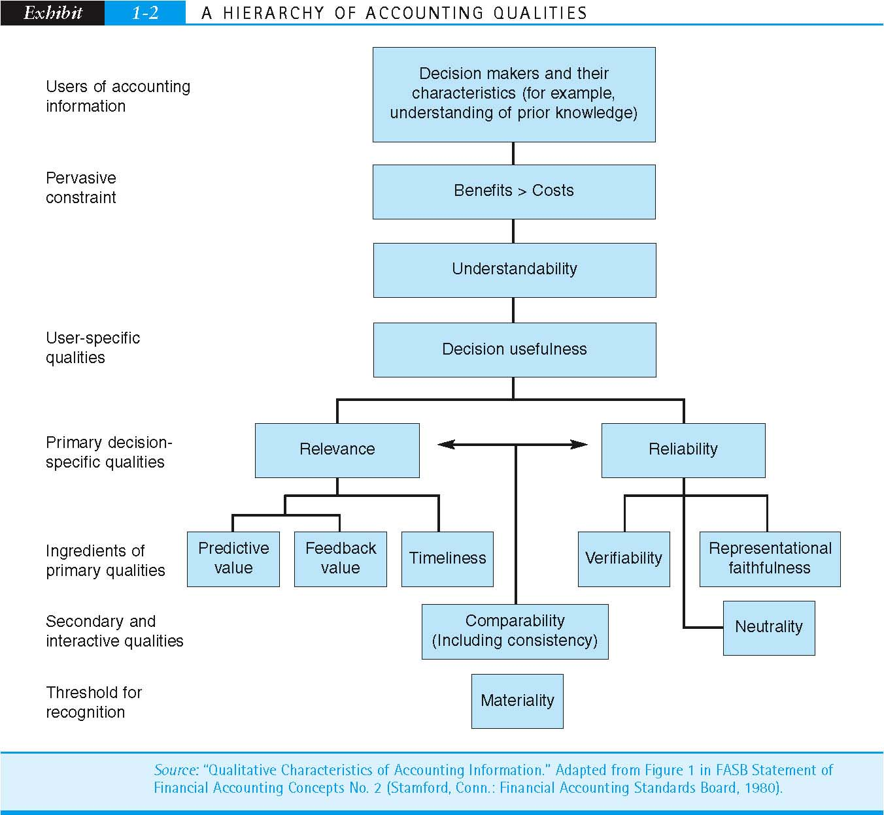
A Hierarchy of Accounting Qualities

Slide 29
Elements of Financial Statement
Assets
  Probable future economic benefits obtained or controlled; the result of past business transactions
Liabilities
  Obligations to transfer assets or provide services in the future; the result of past business transactions
Equity
  The owner’s residual interest in the assets after deducting liabilities

Slide 30
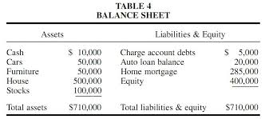
Simple Balance Sheet Format

Slide 31
Elements of Financial Statements
(Con’t)
Investments by owners
  Increases in equity due to transfers of value for the purpose of obtaining or increasing ownership
Distribution to owners
  Decrease in equity resulting from transfer of asset, rendering of service, or incurrence of liabilities by the entity to owners
Comprehensive income
  The change in equity during a period due to non owner transactions, events, and circumstances

Slide 32
Elements of Financial Statements
(con’t)
Revenues
  Inflows and other enhancements of revenue or reductions of liabilities from delivering or providing goods or services related to the central operations
Expenses
  Outflows or consumption of assets from delivering or providing goods or services related to the central operations
Gains
  Increases in equity from fringe transactions of the entity
Losses
  Decreases in equity from fringe transactions of the entity

Slide 33
Annual Report on Internal Control Systems
Required by the SEC to include
  A statement of management’s responsibilities for established and maintaining an adequate system
  Identification of the framework used to evaluate the internal controls
  A statement as to whether or not the internal control system is effective as of year-end
  The disclosure of any material weaknesses in the system
  A statement that the company’s auditors have issued an audit report on management’s assessment

Slide 34
Traditional Assumptions of the Accounting Model
Business Entity
Going Concern (Continuity)
Time Period
Monetary Unit
Historical Cost
Conservatism
Realization
Matching
Consistency
Full Disclosure
Materiality
Industry Practices
Transaction Approach
Cash Basis
Accrual Basis

Slide 35
Business Entity
The business entity is separate and distinct from
the owners of the entity
The entity is an economic unit that stands on its
own

Slide 36
Business Entity (cont’d)
In accounting we treat a business or an organization and its owners as two separately identifiable parties.
This concept is called business entity concept. It means that personal transactions of owners are treated separately from those of the business.

Slide 37
Business Entity (cont’d)
In other words, businesses, related businesses, and the owners should be accounted for separately. Even though the tax law looks at a sole proprietorship and the owner as one entity, GAAP disagrees.
The owner and the business are two separate entities and should be accounted for separately.
The same goes for partnership and corporations. The partners and shareholders' activities should be kept separate from the partnership and corporate transactions because they are separate economic entities.

Slide 38
Business Entity (cont’d)
Example:
Mike, a partner in Big House Realty, LLC, often uses his company credit card for personal expenses like dry cleaning and new clothes. He insists that these are business expenses because he must wear new clothes in order to show houses. Unfortunately, these are not business expenses. Clothing is a personal expense and can't be recorded in the company financial statements. This would violate the business entity concept. Instead, these transactions should be accounted for as an owner withdrawal.

Slide 39
Going Concern
A term for a company that has the resources needed in order to continue to operate indefinitely. If a company is not a going concern, it means the company has gone bankrupt.
In other words, the going concern concept assumes that businesses will have a long life and not close or be sold in the immediate future. Companies that are expected to continue are said to be a going concern.

Slide 40
Going Concern (cont’d)
One of the most significant contributions that the going concern makes to GAAP is in the area of assets. The entire concept of depreciating and amortizing assets is based on the idea that businesses will continue to operate well into the future.
Assets are also reported on the balance sheet at historical costs because of the going concern assumption. If we disregard the going concern and assume the business could be closed within the next year, a liquidation approach to valuing assets would be more appropriate.
Assets would be recorded at net realizable values and all assets would be considered current assets rather than being segregated into current and long-term categories.

Slide 41
Going Concern (cont’d)
Assume Microsoft is currently suing a small tech company for copyright violation over its software package. Since this software package is the only operation the small tech company does, following this lawsuit would be detrimental. There is a 95 percent expectation that Microsoft will win the lawsuit. The small tech company is not a going concern because it is probably they will be out of business after the lawsuit is settled.

Slide 42
Time Period
Finite reporting periods applied to the presumed
indefinite life of a business:
  Natural business year
  Calendar year
  Fiscal year
  52-53 Week fiscal year
Allows measurement of the results of operations
prior to the liquidation of a business entity’s life

Slide 43
Time Period (cont’d)
The period of time reflected in financial statements.
Usually, the accounting period is either the calendar year or a quarter.
For example, publicly-traded companies must report their financial statements for the accounting period since their previous report.

Slide 44
Monetary Unit
Standard of measure for business transactions
U.S. dollar for domestic entities
Supplementary disclosure of inflation-adjusted financial data currently not required by U.S. GAAP

Slide 45
Monetary Unit
Accountants need some standard of measure to bring financial transactions together in a meaningful way.
Without some standard of measure, accountants would be forced to report in such terms as 3 Cars, 50 acres and 2 factories.
There are a number of standards of measure, such as a yard, a gallon, and money.

Slide 46
Monetary Unit (cont’d)
Examples
The company's property, plant, and equipment on 2009 balance sheet amounted to $2 billion. During 2010 inflation was 10%. The monetary unit and stable dollar assumption prohibits any adjustment to current or prior period figures to account for the inflation.
The BP oil spill in Gulf of Mexico was a natural disaster but accounting only reports the financial impaction the form of claims paid, damages paid, clean-up costs, etc. This is due to the limitation imposed by the monetary unit assumption.

Slide 47
Historical Cost
Often used because it is objective and
determinable
Acceptable deviations
  When it becomes apparent that the historical cost cannot be recovered (justified by the conservatism concept)
  Where specific standards call for another measurement attribute such as current market value, net realizable value, or present value

Slide 48
Historical Cost
Historical cost or historical costing is the concept that assets should be valued based on their purchase price or the money actually paid for the assets.
GAAP requires that assets be reported on the balance sheet at historical cost.
Historical cost is the preferred method of valuing assets because it can be proven. It is easy for a company to look at the title of a piece of property and see what was paid for it.
Other valuation or costing methods like replacement cost or current cost fluctuate with the market and economy. If these methods were used, the company would report the same piece of property at different values every year based on the market. This fluctuation violates the accounting concept or consistency.

Slide 49
Historical Cost (cont’d)
If Big Red Car, Inc. buys a piece of land for $10,000 in 1950 to build a car lot on it, BRC, Inc. would report the land on its 1950 balance sheet at $10,000. If BRC, Inc. still owns that land in 2015, it would still be presented on the balance sheet for $10,000 even though the land could be worth $100,000 in 2015 standards. This is one of the major short falls with the historical cost concept.

Slide 50
Conservatism
Select from various measures of value
Each of the alternatives must have reasonable support
Conservatism guides selection of the alternative that has the
  Least favorable impact on net income
  Least favorable impact on financial position

Slide 51
Conservatism (cont’d)
A conservative approach to accounting which requires a high degree of scrutiny of probable losses, expenditures, and revenue prior to making any legal claim of profits, in order to insure clearly recognized and validated financial reports.
Generally speaking, there are many accounting practices that are deemed conservative.
For example, overestimating an allowance for doubtful accounts can give a more accurate picture of recoverable receivables given a specific economic outlook. This overestimate may lower earnings for a certain period, but it may be more accurate than if the original amount were used.

Slide 52
Realization of Revenue
In general, the point of recognition of revenue should be the point in time when revenue can be reasonably and objectively determined
Point of sale Earning process is virtually complete
End of production If price of item is known and a
ready market exists
Receipt of cash Collection cannot be reasonably
estimated

Slide 53
Realization of Revenue (cont’d)
In accounting, a principle stating that a company can realize revenue only when it earns revenue.
An accounting standard that recognizes revenue only when it is earned. Generally, realization occurs when goods are sold or a service is rendered.

Slide 54
Realization of Revenue (cont’d)
Example
SUZUKI Motors is a car dealer. It receives orders from customers in advance against 20% down payment. SUZUKI Motors delivers the cars to the respective customers within 30 days upon which it receives the remaining 80% of the list price.
In accordance with the revenue realization principle, SUZUKI Motors must not recognize any revenue until the cars are delivered to the respective customers as that is the point when the risks and rewards incidental to the ownership of the cars are transferred to the buyers.

Slide 55
Matching
Match costs associated with revenue recognized
Direct association (i.e., inventory sales and cost of the inventory)
Costs that have no direct connection with revenue
Systematic recognition, usually in the period incurred

Slide 56
Matching (cont’d)
The matching concept is an accounting practice whereby expenses are recognized in the same accounting period as the related revenues are recognized.
In other words, expenses shouldn't be recorded when they are paid. Expenses should be recorded as the corresponding revenues are recorded. This matches the revenues and expenses in a period. In this sense, the matching principle recognizes expenses as the revenue recognition principle recognizes income.

Slide 57
Matching (cont’d)
In general, there are two types of costs: product and period costs. Product costs can be tied directly to products and in turn revenues. Period costs, on the other hand, cannot.
Period costs do not have corresponding revenues. Administrative salaries, for example, cannot be matched to any specific revenue stream. These expenses are recorded in the current period.
The matching principle also states that expenses should be recognized in a "rational and systematic" manner. This is the key concept behind depreciation where an asset's cost is recognized over many periods.
In short, the matching principle states that where expenses can be matched with revenues, we should do so because the benefits of an asset or revenue should be linked to the costs of that asset or revenue.

Slide 58
Matching (cont’d)
Example
Angle Machining, Inc. buys a new piece of equipment for $100,000 in 2013. This machine has a useful life of 10 years. This means that the machine will produce products for at least 10 years into the future. According to the matching principle, the machine cost should be matched with the revenues it creates. Thus, the machine is depreciated over its 10-year useful life instead of being fully expensed in 2013.

Slide 59
Consistency
Same accounting treatment given to comparable transactions from period to period
Entity results from several years are comparable
Supports trend analysis
If a change is made
  Justification of change is discussed
  Impact of the change on the financial must be explained

Slide 60
Consistency (cont’d)
The idea in accounting that once an accounting method is adopted, it should be followed consistently from one accounting period to the next.
If, for any reason, the accounting method is changed, a full disclosure of the change and an explanation of its effects on the items of the financial statements must be given.

Slide 61
Consistency (cont’d)
A quality of accounting information that facilitates comparing a company's reporting of one accounting period to another.
For example, the reader of a company's financial statements can assume that the company is using the same inventory cost flow assumption this period as it used last period or last year. (If the company did change, it must be disclosed to the reader.)
In other words, companies shouldn't use one accounting method today, use another tomorrow, and switch back the day after that. Similar transactions should be accounted for using the same accounting method over time. This creates consistency in the financial information given to creditors and investors.

Slide 62
Consistency (cont’d)
Example
Bob's Computers, a computer retailer, has historically used FIFO for valuing its inventory. In the last few years, Bob's has become quite profitable and Bob's accountant suggests that Bob switch to the LIFO inventory system to minimize taxable income. According to the consistency principle, Bob's can change accounting methods for a justifiable reason. Whether minimizing taxes is a justifiable reason is debatable.

Slide 63
Full Disclosure
As one of the principles in Generally Accepted Accounting Principles(GAAP), the Full Disclosure Principle requires that all situations, circumstances and events that are relevant to financial statement users have to be disclosed.
In other words, all of a company’s financial records and transactions have to be available for viewing.

Slide 64
Full Disclosure (cont’d)
Accounting reports must disclose all the facts that may influence the judgment of an informed reader
Methods of disclosure
  Parenthetical
  Supporting schedules
  Cross-references
  Footnotes
Reasonable summary of significant financial information

Slide 65
Materiality
The materiality concept, also called the materiality constraint, states that financial information is material to the financial statements if it would change the opinion or view of a reasonable person.
In other words, all important financial information that would sway the opinion of a financial statement user should be included in the financial statements.

Slide 66
Materiality (cont’d)
Considers the relative size and importance of an item to the business entity
Immaterial items not subject to concepts and principles
  Handle in most economical and convenient manner
Does the information influence an informed reader of the financial statements?
  Yes: material
  No: immaterial

Slide 67
Materiality (cont’d)
Example
A small company bookkeeper doesn't do a very good job of keeping track of expenses. Most random expenses get recorded in the miscellaneous expense account. At the end of the year the miscellaneous expense account has a total of $1424.25 in it. The total net income of the company is $36,940. The miscellaneous account is immaterial to the overall financial picture of the company and there is no need to reclassify the expenses in it.

Slide 68
Industry Practices
The industry practices constraint, also called the industry practices
concept, states that the nature of certain industries and their
practices can require the departure of traditional accounting theory.
In other words, some industries have practices unlike any other
that require specialized accounting or reporting.
The industry practices constraint allows these industries to go outside of traditional accounting principles as long as it is infrequent and justifiable

Slide 69
Industry Practices (cont’d)
Example
Most public utility companies report all non-current assets before current assets on their balance sheets. The utility industry presents its balance sheet this way to emphasize the fact that it is highly capitalized. In other words, utility companies want to show financial statement users that they have large investments in long-term assets, so they report them first on the balance sheet.

Slide 70
Industry Practices (cont’d)
Industry-specific reports
Do not conform to general accounting guidelines
  Government regulation
  Unique needs or peculiarities of an industry
Effort to minimize but will probably never be completely eliminated

Slide 71
Transaction Approach
An accounting transaction is a business event having a monetary impact on the financial statements of a business. It is recorded in the accounting records of the business. Examples of accounting transactions are:
Sale in cash to a customer
Sale on credit to a customer
Receive cash in payment of an invoice owed by a customer
Purchase fixed assets from a supplier
Record the depreciation of a fixed asset over time
Purchase consumable supplies from a supplier
Investment in another business
Investment in marketable securities

Slide 72
Transaction Approach (cont’d)
Record transactions that
  Affect the financial position of the entity
  Can be reasonably determined in monetary terms
Many transactions are nonmonetary in nature
  Not recorded
  May be disclosed in compliance with “full disclosure” principle

Slide 73
Accrual Basis
Business transactions are recorded when they occur and not when the related payments are received or made. This concept is called accrual basis of accounting and it is fundamental to the usefulness of financial accounting information.
Example
An airline sells its tickets days or even weeks before the flight is made, but it does not record the payments as revenue because the flight, the event on which the revenue is based has not occurred yet.

Slide 74
Accrual Basis
Revenue recognized when realized (realization concept)
Expenses recognized when incurred (matching concept)
Numerous year-end adjustments required
More complex than cash basis

Slide 75
Cash Basis
An accounting method in which income is recorded when cash is received, and expenses are recorded when cash is paid out.
Cash basis accounting does not conform with the provisions of GAAP and is not considered a good management tool because it leaves a time gap between recording the cause of an action (sale or purchase) and its result (payment or receipt of money).
It is, however, simpler than the accrual basis accounting and quite suitable for small organizations that transact business mainly in cash. Also called cash accounting.

Slide 76
Cash Basis
Recognize revenue when cash is collected
Recognize expense when cash is paid
Usually does not provide reasonable information about the earning capability of the entity in the short run
Acceptability
  Usually not GAAP
  May be used if difference between cash basis and accrual basis is not material

Slide 77
Accrual vs Cash Basis Accounting (Example)
Sold inventory for $25,000 on credit, which cost $12,500.
Purchase inventory of $30,000 on credit.
Paid suppliers $18,000 for inventory this year.
Collected $15,000 from previous sales.
Accrual Cash
Sales $25,000 Receipts $15,000
Cost of Goods Sold -12,500 Expenditures -18,000
Income $12,500 Loss $- 3,000

