Slide 1

INTERNATIONAL FINANCE
Lecture 27

Slide 2
Review
Cross Hedging
Currency Diversification
Economic Exposure
Empirical Analysis Source: Adopted from South-Western/ Thomson Learning 2006

Slide 3
Managing Economic Exposure
And Translation Exposure
Lecture 27

Slide 4
Economic Exposure
The model may be revised to handle additional currencies by including them as additional independent variables.
By replacing the dependent variable (cash flows), the impact of exchange rates on the firm’s value (as measured by its stock price), earnings, exports, sales, etc. may also be assessed.

Slide 5
Economic Exposure
The economic impact of currency exchange rates on us is complex because such changes are often linked to variability in real growth, inflation, interest rates, governmental actions, and other factors. These changes, if material, can cause us to adjust our financing and operating strategies.
PepsiCo

Slide 6
Economic Exposure
An MNC can determine its exposure by assessing the sensitivity of its cash inflows and outflows to various possible exchange rate scenarios.
The MNC can then reduce its exposure by restructuring its operations to balance its exchange-rate-sensitive cash flows.
Note that computer spreadsheets are often used to expedite the analysis.

Slide 7
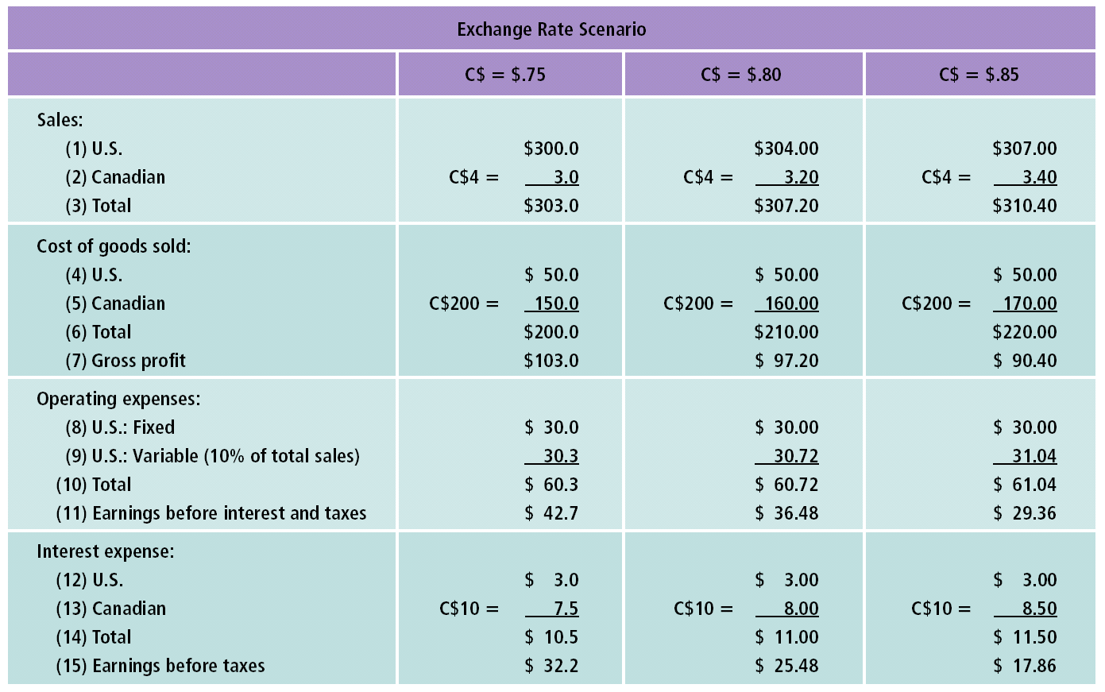
Original Impact of Exchange Rate Movements on Earnings: Madison, Inc. (In Millions)

Slide 8
Economic Exposure
Madison’s earnings before taxes is inversely related to the Canadian dollar’s strength, since the higher expenses more than offset the higher revenue when the Canadian dollar strengthens.
Madison may reduce its exposure by increasing Canadian sales, reducing orders of Canadian materials, and borrowing less in Canadian dollars.

Slide 9
Restructuring
MNCs may restructure their operations to reduce their economic exposure.
The restructuring involves shifting the sources of costs or revenue to other locations in order to match cash inflows and outflows in foreign currencies.

Slide 10
Restructuring and Reduction in Economic Exposure
Restructuring to reduce economic exposure involves shifting the sources of costs or revenue to other locations in order to match cash inflows and outflows in foreign currencies.
The proposed structure is then evaluated by assessing the sensitivity of its cash inflows and outflows to various possible exchange rate scenarios.

Slide 11
Issues in Restructuring
Restructuring operations is a long-term solution to reducing economic exposure. It is a much more complex task than hedging any foreign currency transaction.
MNCs must be very confident about the long-term potential benefits before they proceed to restructure their operations, because of the high reversal costs.

Slide 12
Issues in the Restructuring
Restructuring may involve:
  increasing/reducing sales in new or existing foreign markets,
  increasing/reducing dependency on foreign suppliers,
  establishing/eliminating production facilities in foreign markets, and/or
  increasing/reducing the level of debt denominated in foreign currencies.

Slide 13
Review
Economic Exposure with Empirical Analysis
An MNC can determine its exposure by assessing the sensitivity
MNC can reduce its exposure
Restructuring
Issues in Restructuring Source: Adopted from South-Western/ Thomson Learning 2006

