Slide 1
Consultancy Project Experiential Learning
MGT529
Dr. Khurrum S. Mughal

Slide 2
Lecture 4

Slide 3
Social Constructivism

Slide 4
Constructivism
Constructivism views learning as a process in which the learners constructs knowledge based on their past experiences.

Slide 5
Social Constructivism
Grew out of and in response to Cognitivism, framed around metacognition
  Metacognition refers to higher order thinking which involves active control over the cognitive processes engaged in learning. Activities such as planning how to approach a given learning task, monitoring comprehension, and evaluating progress toward the completion of a task are metacognitive in nature.
  Metacognition – simply put is learning about learning, but more realistically, it’s about knowing who you are as a learner, and developing the capacity to leverage your strengths to your advantage while purposefully addressing your weaknesses
Knowledge is actively constructed
Notes:
Knowledge is actively constructed by individuals in light of and in relation to our past experiences, the context of learning, personal motivation, and our beliefs/attitudes/prior knowledge
Think of the lab…instead of just watching it being done, the student acts as the active agent conducting the lab, with expert support leading them to the edge of their knowledge and beyond.
Dialogic: central focus is on written & spoken dialogue
Recursive: new learning is built upon prior learning…scaffolding

Slide 6
Social Constructivism
Learning is…
  A search for meaning by the learner
  Contextualized
  An inherently social activity
  Dialogic and recursive
  The responsibility of the learner
Notes:
Knowledge is actively constructed by individuals in light of and in relation to our past experiences, the context of learning, personal motivation, and our beliefs/attitudes/prior knowledge
Think of the lab…instead of just watching it being done, the student acts as the active agent conducting the lab, with expert support leading them to the edge of their knowledge and beyond.
Dialogic: central focus is on written & spoken dialogue
Recursive: new learning is built upon prior learning…scaffolding

Slide 7

Social Constructivism in the Classroom
Journaling
Experiential activities
Personal focus
Collaborative & cooperative learning

Slide 8
Critiques of Social Constructivism
Suggests that knowledge is neither given nor absolute
Often seen as less rigorous than traditional approaches to instruction
Does not fit well with traditional age grouping and rigid terms/semesters
Notes:
Suggests that knowledge is neither given nor absolute, but is rather an individual construct
Does not fit well with traditional age grouping and rigid terms/semesters that do not provide a flexible timeframe for learning

Slide 9
Multiple Intelligences (MI)

Slide 10
Multiple Intelligences (MI)
Grew out of Constructivism, framed around metacognition
H. Gardner (1983 to present)
All people are born with eight intelligences:
Enables students to leverage their strengths and purposefully target and develop their weaknesses
1. Verbal-Linguistic | 5. Musical
2. Visual-Spatial | 6. Naturalist
3. Logical-Mathematical | 7. Interpersonal
4. Kinesthetic | 8. Intrapersonal
Notes:
Metacognition – simply put is learning about learning, but more realistically, it’s about knowing who you are as a learner, and developing the capacity to leverage your strengths to your advantage while purposefully addressing your weaknesses

Slide 11
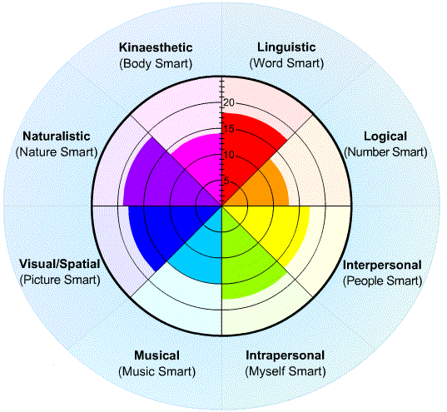
MI in the Classroom
Delivery of instruction via multiple mediums
Student-centered classroom
Authentic Assessment
Self-directed learning

Slide 12
Critiques of MI
Lack of quantifiable evidence that MI exist
Lack of evidence that use of MI as a curricular and methodological approach has any discernable impact on learning
Suggestive of a departure from core curricula and standards

Slide 13
Brain Based Learning

Slide 14
Brain-Based Learning (BBL)
Grew out of Neuroscience & Constructivism
D. Souza, N. Caine & G. Caine, E. Jensen (1980’s to present)
12 governing principles
1. Brain is a parallel processor | 7. Focused attention & peripheral perception
2. Whole body learning | 8. Conscious & unconscious processes
3. A search for meaning | 9. Several types of memory
4. Patterning | 10. Embedded learning sticks
5. Emotions are critical | 11. Challenge & threat
6. Processing of parts and wholes | 12. Every brain is unique

Slide 15
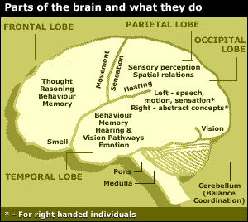
BBL in the Classroom
Opportunities for group learning
Regular environmental changes
A multi-sensory environment
Opportunities for self-expression and making personal connections to content
Community-based learning

Slide 16
Critiques of BBL
Research conducted by neuroscientists, not teachers & educational researchers
Lack of understanding of the brain itself makes “brain-based” learning questionable
Individual principles have been scientifically questioned
Notes:
Individual principles have been scientifically questioned (left/right brain laterality)

Slide 17
Other Learning Theories of Note
Andragogy (M. Knowles)
Flow (M. Czikszentmihalyi)
Situated Learning (J. Lave)
Conditions of Learning (R. Gagne)

Slide 18
Humanist
All students are intrinsically motivated to self actualize or learn
Learning is dependent upon meeting a hierarchy of needs (physiological, psychological and intellectual)
Learning should be reinforced.
Notes:
Humanism is a philosophical and ethical stance that emphasizes the value and agency of human beings, individually and collectively, and generally prefers critical thinking and evidence (rationalism, empiricism) over established doctrine or faith (fideism).

Slide 19
Formal and Informal Settings for Learning

Slide 20
Formal Settings
Schools
Colleges
Universities
On the job trainings
Off the job trainings

Slide 21
Informal settings
Social settings
  Peer group
  Friends
  Family
  Social networks
Informal situations
Workplace

Slide 22
So what?
Why is an understanding of learning theory important for educators and students?

Slide 23
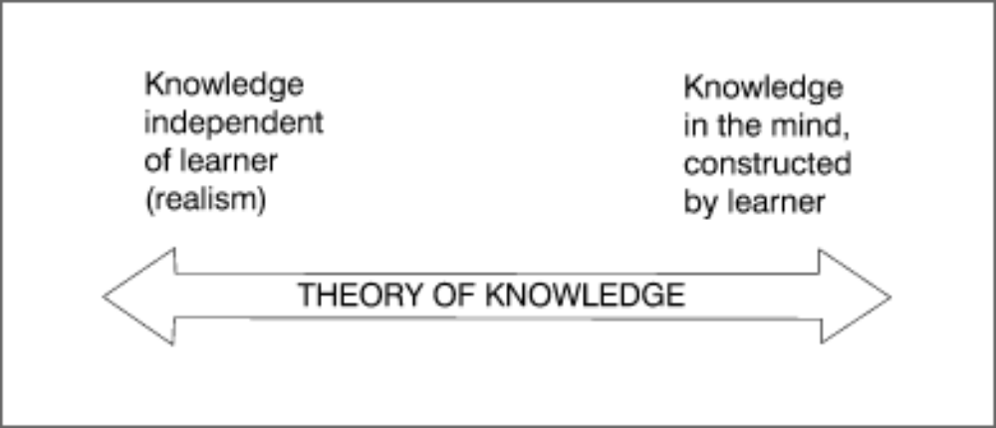
Epistemology
Our beliefs about the nature of knowledge, our epistemology, profoundly influence our approach to education.
Notes:
is the branch of philosophy concerned with the nature and scope of knowledge and is also referred to as "theory of knowledge".

Slide 24
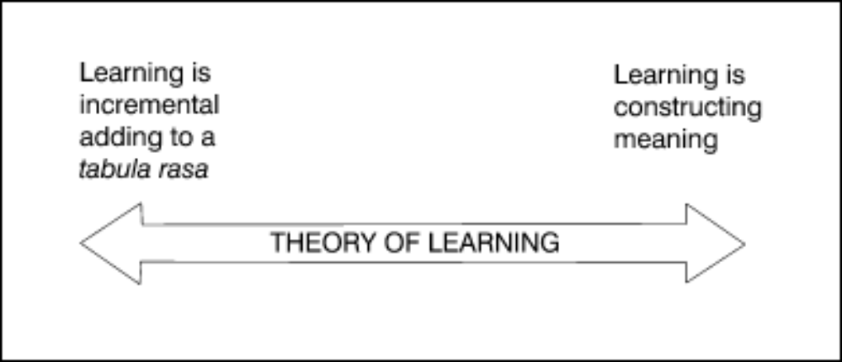
Psychology of Learning
Our beliefs about how people learn, our psychology of learning, profoundly influence our approach to education or our approach to learning process.

Slide 25
Epistemology – Theory - Practice
All three of these need to align
  Our beliefs about knowledge
  Our beliefs about learning
  Our strategies for practice

Slide 26
Learning theories as glasses
What would a classroom look like as viewed through the lens of:
  Plato (rationalist)
  Aristotle (empiricist)
  Locke (tabula rasa)
Or from these perspectives?
  Behaviorism
  Constructivism
  Sociocultural
  Cognitivism

Slide 27
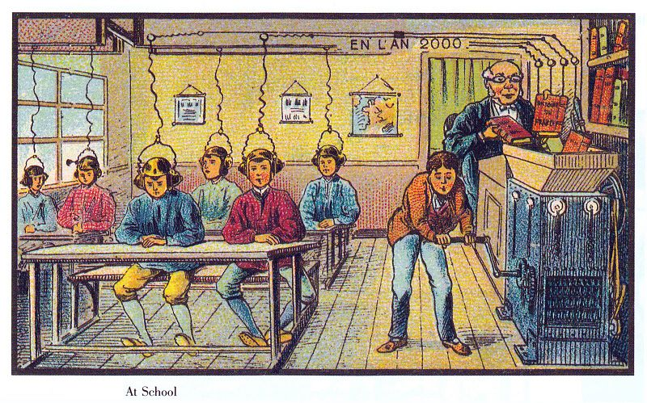
What does learning look like?

