Slide 1
Consultancy Project Experiential Learning
MGT529
Dr. Khurrum S. Mughal

Slide 2
Lecture 2

Slide 3
Learning Theory
Q: How do people learn?
A: Nobody really knows.
But there are 6 main theories:
Behaviorism
Cognitivism
Social Learning Theory
Social Constructivism
Multiple Intelligences
Brain-Based Learning

Slide 4
Behaviorism
The learner is Passive eventually responding to the environmental stimuli.
The theory originates from the works of Ivan Pavlov’s, classical conditioning, and B. F. Skinner’s, operant conditioning.
  Classical Conditioning
  Operant Conditioning

Slide 5
Changing Behavior via Learning
Associative learning - learning that occurs by making a connection or association between two events.
Classical conditioning – association between stimuli in the environment and involuntary reflexive behaviors.
Operant conditioning – association between the consequences of our behaviors and our voluntary actions.

Slide 6
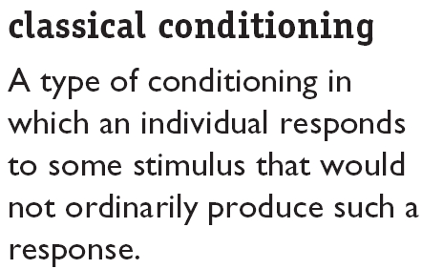

Slide 7
Classical Conditioning Theory
the unconditioned stimulus (US) is one that unconditionally, naturally, and automatically triggers a response
the conditioned stimulus is a previously neutral stimulus

Slide 8
Classical Conditioning Theory
Learning a conditioned response involves building up an association between the unconditioned stimuli and the conditioned stimuli.
When unconditioned and conditioned stimuli are paired, the conditioned stimuli takes on the properties of the unconditioned stimuli and generates a conditioned response.

Slide 9
Classical Conditioning Theory
In classical conditioning, the conditioned stimulus is a previously neutral stimulus that, after becoming associated with the unconditioned stimulus, eventually comes to trigger a conditioned response.

Slide 10
Pavlovian Model of Classical Conditioning
Unconditioned Stimulus
Meat
Unconditioned Response
Salivation
Conditioned Stimulus
Bell
AFTER REPEATED PAIRINGS
Conditioned Stimulus
Bell
Conditioned Response
Salivation

Slide 11
Example
Visit from head office and cleaning of windowpanes.
First of each month and getting salary.

Slide 12
Operant Conditioning Theory

Slide 13
Operant Conditioning
Learning that takes place when the learner recognizes the connection between a behavior and its consequences.
  Individuals learn to behave in certain ways to achieve desirable consequences or avoid undesirable consequences.

Slide 14
Operant conditioning
Law of effect
  Behaviors that are reinforced will increase in likelihood.
  Behaviors that are punished will decrease in likelihood.

Slide 15
Reinforcer vs. Punisher
Reinforcer
  Something that tends to increase the likelihood of the behavior
Punishers
  Something that tends to decrease the likelihood of the behavior

Slide 16
Changing behavior
Addition
  Positive reinforcement
  Punishment
Subtraction
  Negative reinforcement
  Extinction

Slide 17
Positive reinforcement
Addition of anything positive that increases the likelihood of good responses.
Example:
  A person remains punctual for getting praise, (any reward)
  A child studies regularly to get first position
  A manager works hard to get timely promoted
  A racer drives fast to win the race
  Positive reinforces include pay, promotion, interesting work, praise, awards etc.

Slide 18
Punishment
Addition of something unpleasant resulting in in decrease in repeat “bad behavior”.
Example:
  Additional hours to work for coming late.
  Putting a fine for parking at wrong place.
  Slapping a child for doing something wrong.

Slide 19
Negative reinforcement
Removal of an unpleasant stimulus increases the likelihood of repeat ‘good’ behavior
Remove negative stimulus to increase positive/good behavior.
Remove criticism, pay cuts, etc. upon having punctuality from a person.
[you have imposed punishments for negative behavior i.e coming late. Now the behavior has beeen reverted back to desired so removal of those negative things]

Slide 20
Extinction
Removal of a pleasant stimulus decreases the likelihood of repeat “bad” behavior.
Removing whatever is currently reinforcing the behavior
When you remove something in order to decrease a bad behavior.
Example
[if someone at the workplace tells jokes for getting the attention of workers. And if workers stop paying attention to him. This negative behavior of telling the jokes will stop].

Slide 21
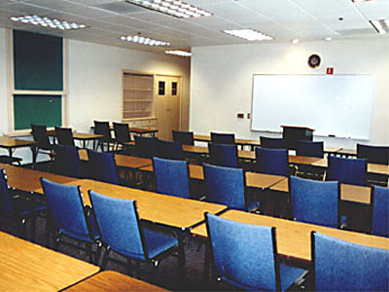
Behaviorism in the Classroom
Rewards and punishments
Responsibility for student learning rests squarely with the teacher
Lecture-based, highly structured

Slide 22
Critiques of Behaviorism
Does not account for processes taking place in the mind that cannot be observed
Advocates for passive student learning in a teacher-centric environment
One size fits all
Knowledge itself is given and absolute
Programmed instruction & teacher-proofing

Slide 23
Why organizations use reinforcement
To increase productivity
To reduce absenteeism
To increase safety behaviors
To reduce time wastage

