Slide 1
Consultancy Project Experiential Learning
MGT529
Dr. Khurrum S. Mughal

Slide 2
Lecture 1

Slide 3
Definition: Learning is…
A change in behavior as a result of experience or practice.
The acquisition of knowledge.
Knowledge gained through study.
To gain knowledge of, or skill in, something through study, teaching, instruction or experience.
The process of gaining knowledge.
A process by which behavior is changed, shaped or controlled.
The individual process of constructing understanding based on experience from a wide range of sources.

Slide 4
Definitions: Learning is:
1. “a persisting change in human performance or performance potential . . . (brought) about as a result of the learner’s interaction with the environment” (Driscoll, 1994, pp. 8-9).
2. “the relatively permanent change in a person’s knowledge or behavior due to experience” (Mayer, 1982, p. 1040).
3. “an enduring change in behavior, or in the capacity to behave in a given fashion, which results from practice or other forms of experience” (Shuell, 1986, p. 412).

Slide 5
Some First Principles
Learning is something all humans do
  Fetuses learn
  Infants learn
  Children learn
  Adults learn
Learning is not uniquely human – all living things learn
Learning evolved as an adaptation for promoting survival

Slide 6
What is Learning?
Learning is a process
Learning is a product

Slide 7
Process of Learning
Learning involves the individual
  Brain
  Body
Learning involves others
  Dyads
  Groups
  Organizations
  Communities
  Society
Learning takes place somewhere
  In physical environment
  With things and tools
Learning occurs over time

Slide 8
Products of Learning
Learning is about ideas and concepts
Learning is about behaviors and skills
Learning is about attitudes and values

Slide 9
Definition: Theories are…
What is a theory?
  A theory provides a general explanation for observations made over time.
  A theory explains and predicts behavior.
  A theory can never be established beyond all doubt.
  A theory may be modified.
  Theories seldom have to be thrown out completely if thoroughly tested but sometimes a theory may be widely accepted for a long time and later disproved.

Slide 10
So, how do people learn?
Easy answer: We don’t know for sure.
Difficult answer: We have multiple theories that provide glimpses of an answer from many different perspectives. These stem from psychologists, philosophers, sociologists, anthropologists, evolutionary biologists, linguists, neuroscientists…

Slide 11
Broad domains of theories
I believe that (the) educational process has two sides—one psychological and one sociological. . . Profound differences in theory are never gratuitous or invented. They grow out of conflicting elements in a genuine problem.
-John Dewey, In Dworkin, M. (1959) Dewey on Education

Slide 12
How did we get to this point?
A bit of history…
Where can truth and knowledge be found?

Slide 13
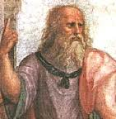
Plato (428-347ish B.C.E.)
Truth is found within ourselves (rationalist)
Ideas do not belong to the actual world: They are too perfect (e.g., one’s conception of triangles or circles). They belong to the REAL world, in which ideas are eternal and flawless.
Knowledge innate—in place at birth
Knowledge “drawn out” when teacher asks questions; help students recall fundamental insights they possess (self reflection)
Learning passive process

Slide 14
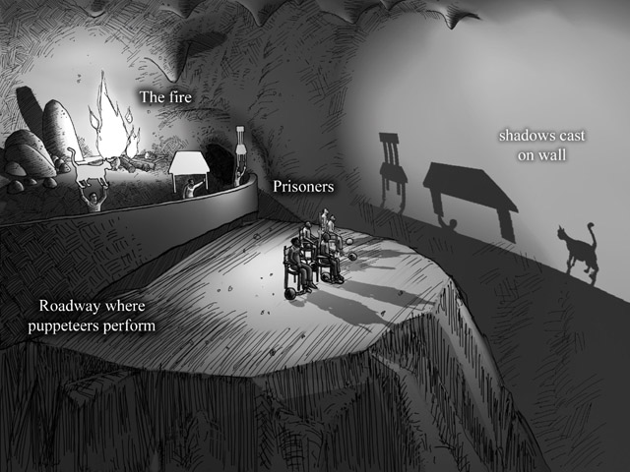
Plato’s Allegory of the Cave

Slide 15
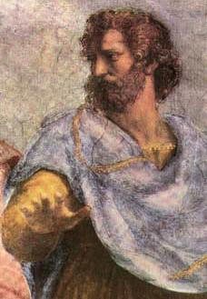
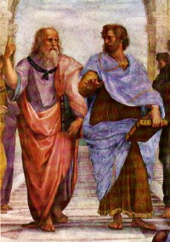
Aristotle (470–399 BCE)
Truth is found outside of ourselves using our senses (Empiricist)
Developed a scientific method of gathering data to study the world around him.
“There’s nothing in the intellect that wasn’t previously in the senses”

Slide 16
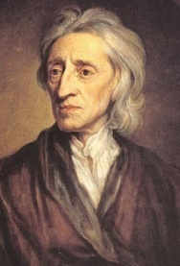

John Locke (1632-1704)
“Tabula rasa” or “blank slate” theory of learning.
“Let us then suppose the mind to be … white paper, void of all characters, without any ideas. How comes it to be furnished? Whence comes it by that vast store, which the busy and boundless fancy of man has painted on it with an almost endless variety? Whence has it all the materials of reason and knowledge? To this I answer, in one word, from experience. In that all our knowledge is founded; and from that it ultimately derives itself.”

Slide 17
John Locke (1632-1704)
Enter world devoid of content but with biologically preformed capacities & processes.
Immediately experience environment through senses.
“Simple ideas” remembered and built upon by “internal” phenomena (concentration, puzzlement, etc.).
Simple ideas not invented; child must have experience to develop & all complex ideas trace back to combinations of simple ideas.
Learner still passive; experience happens to learner rather than learner engaging in it, even perhaps creating it.

Slide 18
Learning Theory
Q: How do people learn?
A: Nobody really knows.
But there are 6 main theories:
Behaviorism
Cognitivism
Social Learning Theory
Social Constructivism
Multiple Intelligences
Brain-Based Learning

