Slide 1
Business Case Study-MGT 528
A Self-Study Guide
By
yalman ansari

Slide 2
Analyzing Case Question
How to Understand a Question
How to Identify Areas of Focus
How to Break up in Segments

Slide 3
Case Question
Taking into account competition in the market, how would you handle this issue in a win-win way if you were in the shoes of Mohsin Hameed?
Solution to the Problem A win-win option for both the customer and the company
Market Competition

Slide 4
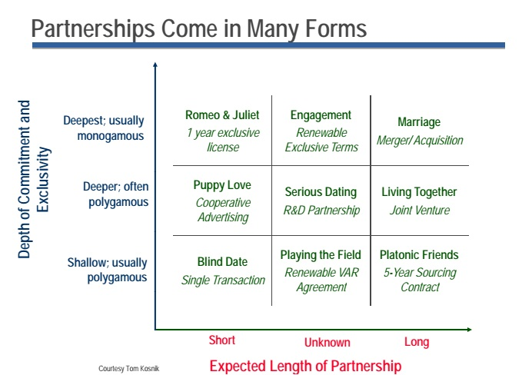

Slide 5
Two Ways of Dealing With the Question
Deductive Approach
Discussion on Application of Theory
Testing of Prediction

Slide 6
Worksheet-a

Slide 7
Two Ways of Dealing With the Question
Inductive Approach
Discussion on Issue at Hand
Observation of Pattern

Slide 8
Worksheet -b

Slide 9
Some Important Links
http://www.cornerstonedynamics.com/3-strategies-for-a-positive-corporate-culture-shift/
also look into these links and try to embellish your report as much as you can: http://www.chasminstitute.com/METHODOLOGY/MarketDevelopmentStrategyChecklist/tabid/59/Default.aspx
i like the financial part: here is more you can find: http://kfknowledgebank.kaplan.co.uk/KFKB/Wiki%20Pages/Risk%20and%20the%20Financial%20Manager.aspx?mode=none
Strategy into action: http://kfknowledgebank.kaplan.co.uk/KFKB/Wiki%20Pages/Strategy%20into%20action%20.aspx

Slide 10
Practicing Deductive Method
http://www.metapraxis.com/newsroom/business-analysis-case-studies/

Slide 11
Recap
Analyzing Case Study Questions
Deductive Method
Practicing Deductive Method

