Slide 1
MGT-519
STRATEGIC MARKETING
AAMER SIDDIQI

Slide 2
LECTURE 8

Slide 3
Summary
Marketing’s role in the business
Cross-functional issues
Customer Satisfaction & feed back
Customer Relationship Management
Strategic Market planning process
Environment and situation research

Slide 4
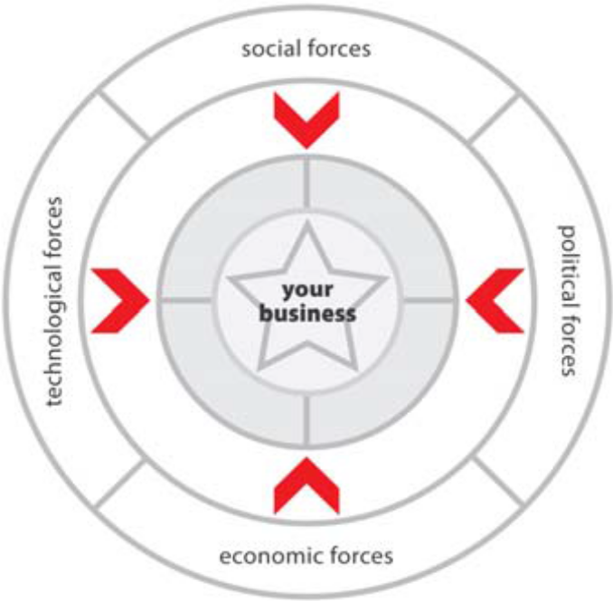
PESTLEDI analysis
Done before corporate, SBU and PD strategies are determined
Examines the current macro-environment of the company
PESTLEDI analysis; political, economic, socio-cultural, technological, legal, environmental, demographic technological trends
MNCs also study the International aspects

Slide 5
BCG Matrix
Boston Consulting Group analysis: A chart created by Bruce Henderson for the Boston Consulting Group in 1968
Helps corporations with analyzing their business units or product lines
Helps the company allocate resources
Used as an analytical tool
  Brand marketing
  Product management
  Strategic Management
  Portfolio analysis

Slide 6
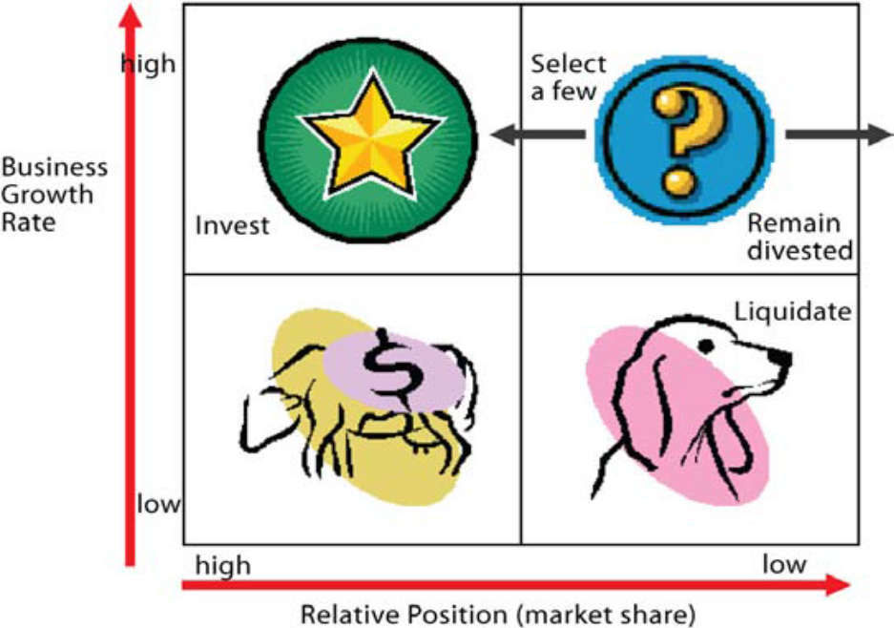
BCG Matrix (Cont’d)
Two controlling aspects;
  Market share (relative to competition) and
  Market growth
Market share- serves as a measure of SBU strength in the market, plotted on the horizontal axis
Market growth rate- measure of market attractiveness, plotted on the vertical axis

Slide 7
BCG Matrix (Cont’d)
Stars - High growth businesses or products
Relatively strong compared with the competition
Often they need heavy investment to sustain their growth
Eventually their growth will slow and
Relative market share, will become cash cows
Cash Cows - Low-growth businesses or products
Relatively high market share
Mature, successful businesses
Little need for investment
Need to be managed for continued profit for strong cash flows needed by the company forStars

Slide 8
BCG Matrix (Cont’d)
Question marks - Businesses or products with low market share
operate in higher growth markets.
They have potential
Require substantial investment in order to grow market share at the expense of more powerful competitors
Management careful about "question marks" - which ones should they invest in?
Which ones should they allow to fail or shrink?

Slide 9
BCG Matrix (Cont’d)
Dogs - businesses or products that have low share
In unattractive, low-growth markets
Dogs may generate enough cash to break-even
Rarely, if ever, worth investing in
Four possible strategies for each SBU:
1. Build Share: Company can invest to increase market share (for example turning a "question mark" into a star)
2. Hold: The company invests just enough to keep the SBU in its present position

Slide 10
BCG Matrix (Cont’d)
3. Harvest: Company reduces the amount of investment
In order to maximise the short-term cash flows and profits from the SBU
This may have the effect of turning Stars into Cash Cows
4. Divest: The company can divest the SBU by phasing it out or selling it
To use the resources elsewhere (e.g. investing in the more promising "question marks").

Slide 11
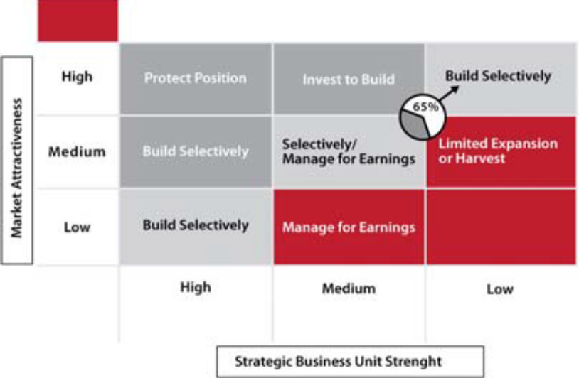
GE/McKinsey Matrix (Cont’d)
The GE/McKinsey Matrix developed in the 1970s by McKinsey & Co.
Tool to screen General Electric’s large portfolio of SBUs.
The idea behind the matrix; GE Business Screen or GE Strategic Planning Grid) is to evaluate businesses along two composite dimensions:
  industry attractiveness
  industry strength

Slide 12
GE/McKinsey Matrix (Cont’d)
BCG approach Improved in two ways:
1) it utilizes more comprehensive axes
2) it consists of nine-cells rather than four, allowing for greater precision
Overcomes disadvantages of the BCG Box as follows: -
Firstly, market attractiveness replaces market growth as the dimension of industry attractiveness, and includes a broader range of factors other than just the market growth rate. The key factors in this measure are;
- Market Size
- Market growth
- Market profitability
- Pricing trends

Slide 13
GE/McKinsey Matrix (Cont’d)
- Competitive intensity / rivalry
- Overall risk of returns in the industry
- Opportunity to differentiate products and services
- Segmentation
Distribution structure (e.g. retail, direct, wholesale)
Secondly, competitive strength replaces market share as the dimension by which the competitive position of each SBU is assessed. The key factors in this measure are
  - Strength of assets and competencies
  - Relative brand strength
  - Market share
  - Customer loyalty

Slide 14
GE/McKinsey Matrix (Cont’d)
  - Relative cost position (cost structure compared with competitors)
  - Distribution strength
  - Record of technological or other innovation
  - Access to financial and other investment resources

Slide 15
Summary
Marketing’s role in the business
Cross-functional issues
Customer Satisfaction & feed back
Customer Relationship Management
Strategic Market planning process
Environment and situation research
PESTLEDI analysis; political, economic, socio-cultural, technological, legal, environmental, demographic technological trends

Slide 16
Summary
BCG Matrix
GE/McKinsey Matrix

Slide 17
THANKYOU

