Slide 1
MGT-519
STRATEGIC MARKETING
AAMER SIDDIQI

Slide 2
LECTURE 6

Slide 3
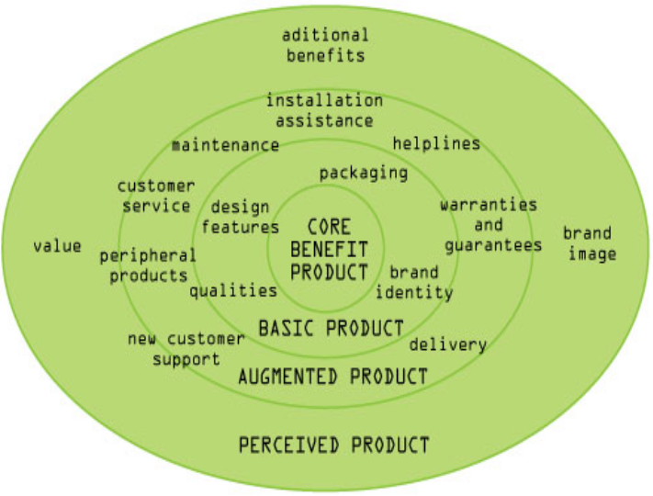
The Total Product Offering (Cont’d)
TPO consists of four levels
  The Core
  The Basic product
  The Augmented product
  The Perceived product

Slide 4
The Core Product
Core benefit is the central reason for the product to exist
Simplest possible answer to an expressed need
  no frills
  no branding or packaging
  no warranties or service promises
Just the most basic reason why the product is needed
Very few instances of new core needs

Slide 5
The Core Product (Cont’d)
However ever increasing and new ways of satisfying those core needs
Example: E-mail, SMS text, messenger programs new ways of satisfying the need to communicate, and have supplanted letters, faxes, telegrams, and public phone boxes as earlier ways to satisfy this communication need, but they haven’t created a new need in themselves
Marketers must be sure that their products will satisfy a need in its most basic sense. Products that fail to offer a sound core benefit are usually failures

Slide 6
The Basic Product
Product stripped down to its essentials
Often referred to as the FAB;
  Features: qualities or characteristics
  Attributes: features presented in a way that add value from the customer’s perspective
  Benefits: favourable results customers expect to obtain by using a product
Product attributes reside in the product, can be tangible or intangible – a service aspect of the product

Slide 7
The Basic Product (Cont’d)
Benefits reside in the customer.
Are always abstract
Often the result of cluster of product attributes
Some of which may be abstract attributes
Benefits can be
  Functional –deriving from product features and attributes
  Symbolic – deriving from performance expectations
  Experimental – deriving from actual usage of the product
Example: Q-Mobile A500, QUAD CORE cell phone

Slide 8
Augmented product
The next level of the TPO
contains supporting features
Among these are
  customer service,
  guarantees,
  service network,
  delivery,
  after-sales service,
  credit facilities.

Slide 9
Augmented Product (Cont’d)
They aim to provide ways to enhance the offering
Can be used to counter objections
Resolve doubts in the customer’s mind.

Slide 10
Perceived product
The outer ring of the TPO is the perceived product
Varies according to customers’ perceptions of the product, e.g. different customers have different views
Perception involves interpretation of our world
Built from our life experiences and our personalities
Customers have different likes and dislikes, different tastes

Slide 11
Perceived product (Cont’d)
Premise behind choice of products offered by suppliers
Challenge of marketing to ensure customers perceive product in the way that is intended or Product Positioning
  The place product is perceived to occupy in the minds of customers/consumers relative to other competing brands
If there is a mismatch of customer perception and supplier intention, then there is a problem

Slide 12
Branding
Branding spans two levels in the total product model.
  Brand Identity &
  Brand Image
As Brand Identity, it is a part of the basic product, giving it a name and signalling its level of quality
Brand Image is also an important part of the customer’s perception of the product
Fits into the model’s outer ring

Slide 13
Summary
All goods or services can be marketed
All can be made into a product
The way that different products are marketed is different
Promoting a product is dependent on the
  nature of the product and
  on the target market
Second approach classifies product them on the basis of their uses.
This organization facilitates the identification of prospective users and the design of strategies to reach them.

Slide 14
Summary (Cont’d)
The major distinction in this system is between consumer and business products, ( ‘industrial’ products)
Marketing to a business – we call this Business to Business marketing (B2B)
Business to Consumer marketing (B2C).
These terms are based on the target market not on the product or service, as it is perfectly possible for a product or service to be a need for a business and a consumer, e.g. car insurance, buildings insurance, stationery

Slide 15
Summary (Cont’d)
The marketing of goods and services to members of the general public, as an individual or as part of a social group, e.g. family, friends.
Covers all types of products and services, which are aimed at satisfying the needs that arise from the various levels of Maslow’s Hierarchy
B2B marketing involves marketing to an organisation
  have a variety of different people
  several have a role in the choice of the goods and services to be used by the organisation.

Slide 16
Summary (Cont’d)
  Decision to purchase any goods or service is more complex than that in B2C marketing.
  non-traditional marketing
    not-for-profit sector
    Promoting goods over the web

Slide 17
THANKYOU

