Slide 1
CHAPTER 14:
MANAGING BRANDS OVER GEOGRAPHIC BOUNDARIES AND MARKET SEGMENTS
Lecture 28

Slide 2
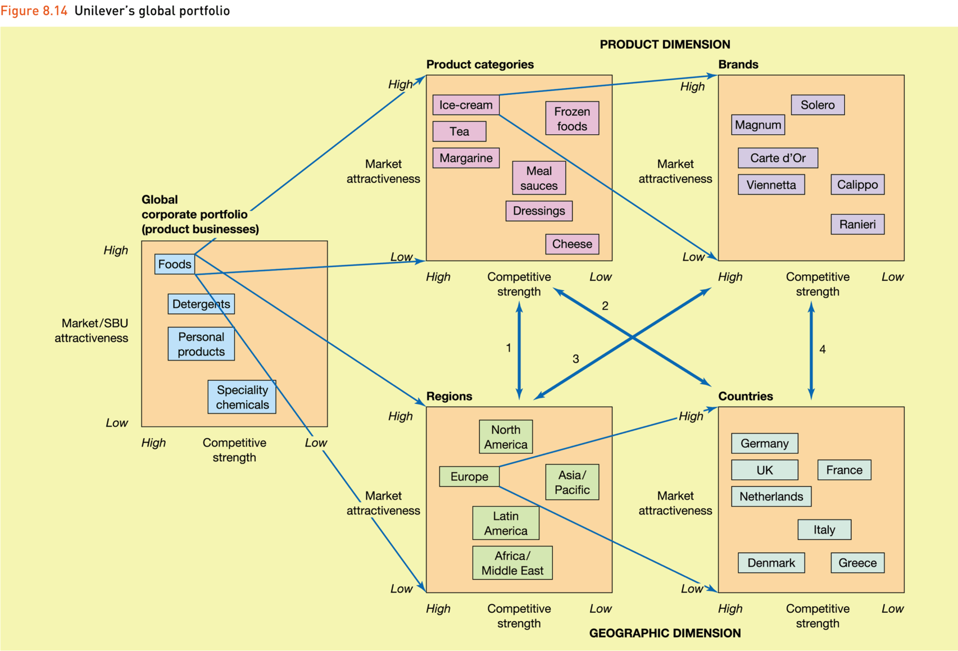
Unilever’s global portfolio

Slide 3
External factors affecting
market entry mode decision
Entry mode
decision
-
Sociocultural
distance
-
+
Country risk/
demand
uncertainty
Number of
export
intermediaries
+
+
-
Market size/
growth
Direct/
indirect
trade barriers
Intensity of
competition

Slide 4
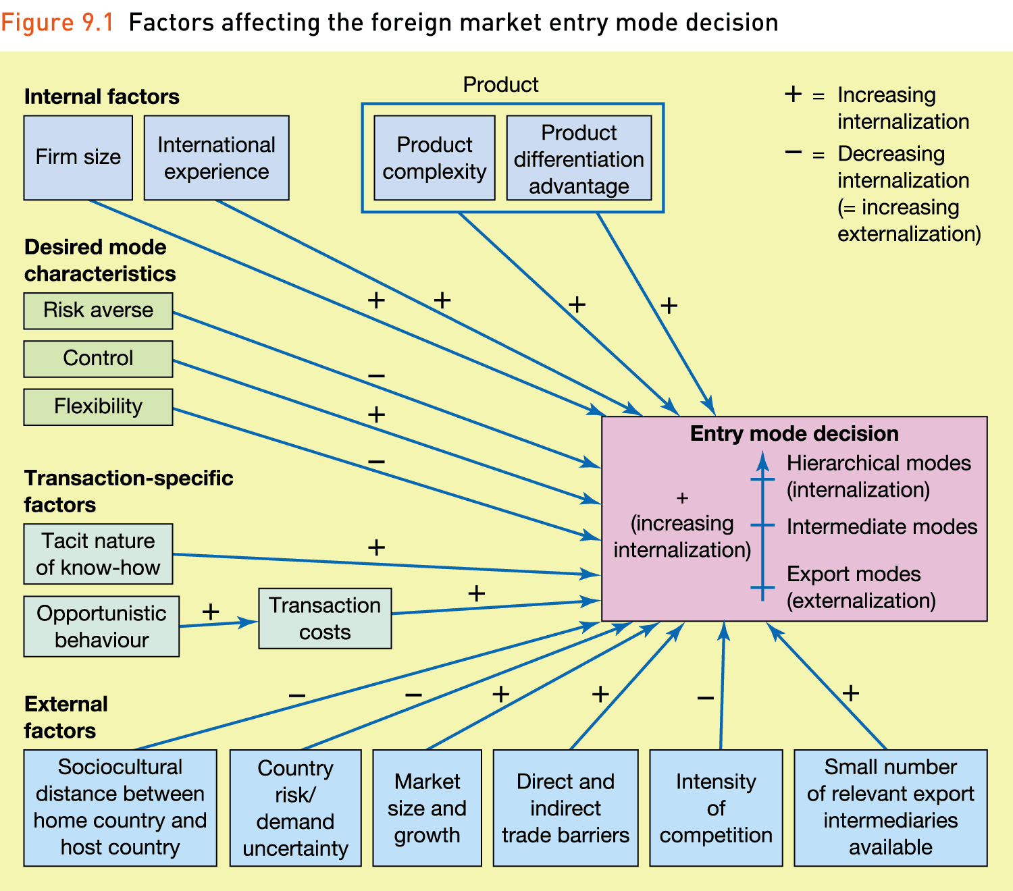
All Factors Affecting Decision

Slide 5
Standardization vs. Customization
According to Levitt, because the world is shrinking—due to leaps in technology, communication, and so forth—well-managed companies should shift their emphasis from customizing items to offering globally standardized products that are advanced, functional, reliable, and low priced for all.

Slide 6
Standardization vs. Customization
Blending global objectives with local or regional concerns
“Think global. Act local.”
A global brand has a clear consistent equity across geographies: same positioning, same benefits plus local tailoring if needed

Slide 7
Global Brand Strategy
To build brand equity, it is often necessary to create
different marketing programs to address different market
segments.
Identify differences in consumer behavior
  How they purchase and use products
  What they know and feel about brands
Adjust branding program
  Choice of brand elements
  Nature of supporting marketing program
  Leverage of secondary associations
Notes:
89

Slide 8
Building a Global Brand
How valid is the mental map in the new market?
  What is the level of awareness?
  How valuable are the associations?
What changes need to be made to the mental map?
By what means should this new mental map be created?

Slide 9
Global Customer-Based Brand Equity
To build customer-based brand equity, marketers must:
  Establish breadth and depth of brand awareness
  Create points-of-parity and points-of-difference
  Elicit positive, accessible brand responses
  Forge intense, active brand relationships
Achieving these four steps, in turn, requires establishing six core brand building blocks.

Slide 10
Core Brand Building Blocks
Creating brand salience
Developing brand performance
Crafting brand image
Eliciting brand responses. Example: positive brand judgments
Creating brand feelings
Cultivating resonance

Slide 11
Questions for Global Branding Positioning
How valid is the mental map in the new market? How appropriate is the positioning? What is the existing level of awareness? How valuable are the core brand associations, points-of-parity, and points-of-difference?
What changes should we make to the positioning? Do we need to create any new associations? Should we not re-create any existing associations? Should we modify any existing associations?
How should we create this new mental map? Can we still use the same marketing activities? What changes should we make? What new marketing activities are necessary?

Slide 12
Building Global Customer-Based Brand Equity
In designing and implementing a marketing program to create a strong global brand, marketers want to realize the advantages of a global marketing program while suffering as few of its disadvantages as possible

Slide 13
Ten Commandments of Global Branding
Understand similarities and differences in the global branding landscape
Don’t take shortcuts in brand building
Establish marketing infrastructure
Embrace integrated marketing communications
Cultivate brand partnerships
Balance standardization and customization
Balance global and local control
Define operable guidelines
Implement a global brand equity measurement system
Leverage brand elements
Notes:
16

