Slide 1
CHAPTER 11:
DESIGNING AND IMPLEMENTING
BRANDING STRATEGIES
Lecture 19

Slide 2
Brand Hierarchy Tree: Toyota
Toyota
Corporation
Toyota
(Trucks)
Toyota
(SUV/vans)
Toyota
(Cars)
Toyota
Financial
Services
Lexus
Corolla
MR2
Spyder
Camry
Avalon
Celica
ECHO
Matrix
Prius
Platinum
Edition
XL
XLS
CE
S
LE
SE
LE
XLE
SE
SLE

Slide 3
Brand Hierarchy Levels
Corporate Brand (General Motors)
Family Brand (Buick)
Individual Brand (Park Avenue)
Modifier: Item or Model (Ultra)
Notes:
65

Slide 4
Corporate Brand Equity
Occurs when relevant constituents hold strong, favorable, and unique associations about the corporate brand in memory
Encompasses a much wider range of associations than a product brand
Notes:
66

Slide 5
Family Brands
Brands applied across a range of product categories
An efficient means to link common associations to multiple but distinct products
Notes:
66

Slide 6
Individual Brands
Restricted to essentially one product category
There may be multiple product types offered on the basis of different models, package sizes, flavors, etc.
Notes:
66

Slide 7
Modifiers
Signals refinements or differences in the brand related to factors such as quality levels, attributes, functions, etc.
Plays an important organizing role in communicating how different products within a category that share the same brand name are
Notes:
66

Slide 8
Corporate Image Dimensions
Corporate product attributes, benefits or attitudes
  Quality
  Innovativeness
People and relationships
  Customer orientation
Values and programs
  Concern with the environment
  Social responsibility
Corporate credibility
  Expertise
  Trustworthiness
  Likability
Notes:
66

Slide 9
Brand Hierarchy Decisions
The number of levels of the hierarchy to use in general
How brand elements from different levels of the hierarchy are combined, if at all, for any one particular product
How any one brand element is linked, if at all, to multiple products
Desired brand awareness and image at each level
Notes:
66

Slide 10
Number of Hierarchy Levels
Principle of simplicity
  Employ as few levels as possible
Principle of clarity
  Logic and relationship of all brand elements employed must be obvious and transparent

Slide 11
Levels of Awareness and Associations
Principle of relevance
  Create global associations that are relevant across as many individual items as possible
Principle of differentiation
  Differentiate individual items and brands

Slide 12
Linking Brands at Different Levels
Principle of prominence
  The relative prominence of brand elements affects perceptions of product distance and the type of image created for new products

Slide 13
Linking Brands Across Products
Principle of commonality
  The more common elements shared by products, the stronger the linkages

Slide 14
Brand Architecture Guidelines
Adopt a strong customer focus
Avoid over-branding
Establish rules and conventions and be disciplined
Create broad, robust brand platforms
Selectively employ sub-brands as means of complementing and strengthening brands
Selectively extend brands to establish new brand equity and enhance existing brand equity

Slide 15
Corporate Brand Campaign
Different objectives are possible:
  Build awareness of the company and the nature of its business
  Create favorable attitudes and perceptions of company credibility
  Link beliefs that can be leveraged by product-specific marketing
  Make a favorable impression on the financial community
  Motivate present employees and attract better recruits
  Influence public opinion on issues

Slide 16
Using Cause Marketing to Build Brand Equity
The process of formulating and implementing marketing activities that are characterized by an offer from the firm to contribute a specified amount to a designated cause when customers engage in revenue-providing exchanges that satisfy organizational and individual objectives
Notes:
66

Slide 17
Advantages of Cause Marketing
Building brand awareness
Enhancing brand image
Establishing brand credibility
Evoking brand feelings
Creating a sense of brand community
Eliciting brand engagement
Notes:
66

Slide 18
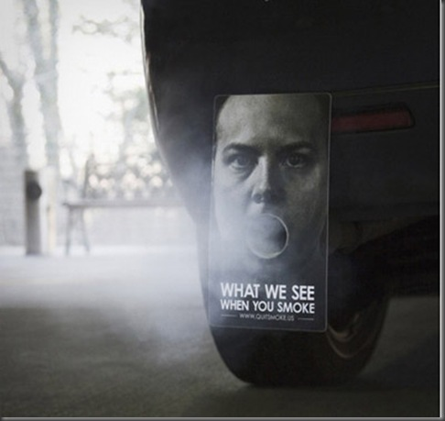

Slide 19
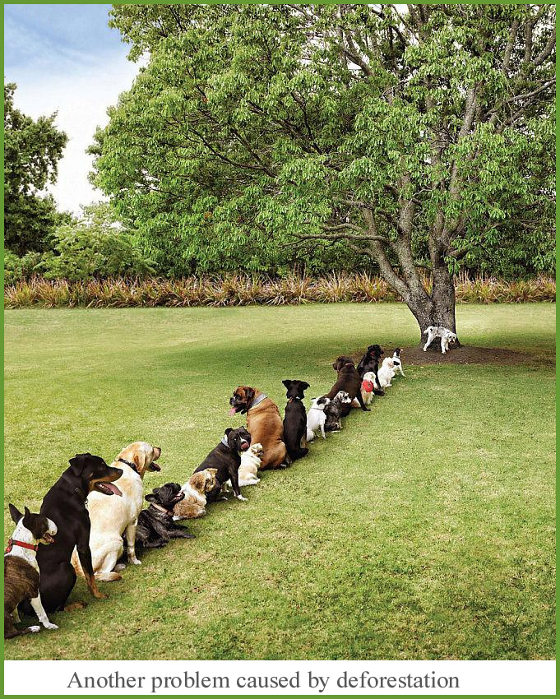

Slide 20
Green Marketing
A special case of cause marketing that is particularly concerned with the environment
Explosion of environmentally friendly products and marketing programs
Notes:
66

Slide 21
Crisis Marketing Guidelines
The two keys to effectively managing a crisis are that the firm’s response should be swift and that it should be sincere.

