Slide 1
Brand Planning and the Advertising Spiral

Slide 2
Learning Objectives
Discuss the birth and basics of branding.
Explain brands and integrated marketing.
Discuss brand equity.
Explain IMC strategic planning.
Explain the importance of the product life cycle.
Discuss the relationship of the advertising spiral.

Slide 3
Brand
A brand is a name, term, sign, design, or a unifying combination, intended to identify and distinguish the product or service from competing products or services.

Slide 4
Brand Equity
Brand equity is the value of how such people as consumers, distributors, and salespeople think and feel about a brand relative to its competition over a period of time.
Many powerful brands today were among the earliest brands
  Budweiser, Ivory, Coca-Cola, Campbell Soup, Hershey’s Chocolate, Maxwell House Coffee, and Levi’s

Slide 5
Young & Rubicam’s Brand Asset Valuator
Claim: Brands are built over the progression of four primary consumer perceptions
Differentiation
Relevance
Esteem
Knowledge

Slide 6
Y&R’s Brand Value Structure
Brand
Vitality
Differentiation
Relevance
Brand
Value
Esteem
Brand
Stature
Knowledge

Slide 7
Developing IMC Strategic Plans
Brand equity audit analysis
Strategic options
Brand equity research
Creative brief

Slide 8
Areas Examined in a
Brand Equity Audit Analysis
Market context
Brand equity weaknesses and strengths
Brand equity descriptions
Competitive strategies and tactics

Slide 9
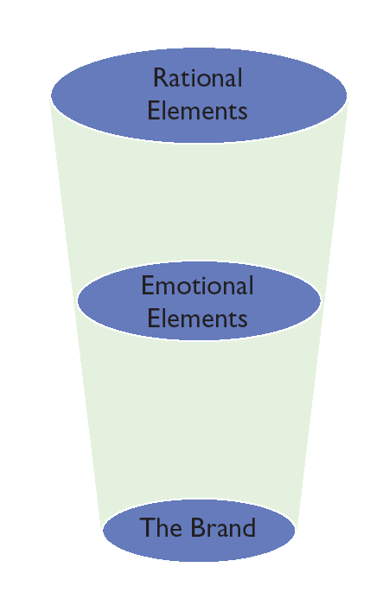
Exhibit 3.3
Basic Elements of a Brand

Slide 10
Brand Equity Description: Golf GTI
Emotional Elements
Little sports car
Sets me free
Makes me look good
Simple
There when I want it
I’m in control
Rational Elements
Inexpensive
High gas mileage
Retains value
Durable
Dependable
Handles well

Slide 11
Strategic Options/ Recommendations
Communication objectives
Audience
Source of business
Brand positioning and benefits
Marketing mix
Rationale

Slide 12
Creative Brief
A creative brief (strategy or work plan) is a short statement that clearly defines the audience, how consumers think or feel and behave, what the communication should achieve, and the promise that will create a bond between the consumer and the brand.

Slide 13
Key Components of a Creative Strategy
Key observations
Communication objective
Consumer insight
Promise
Support
Audience
Mandatories

Slide 14
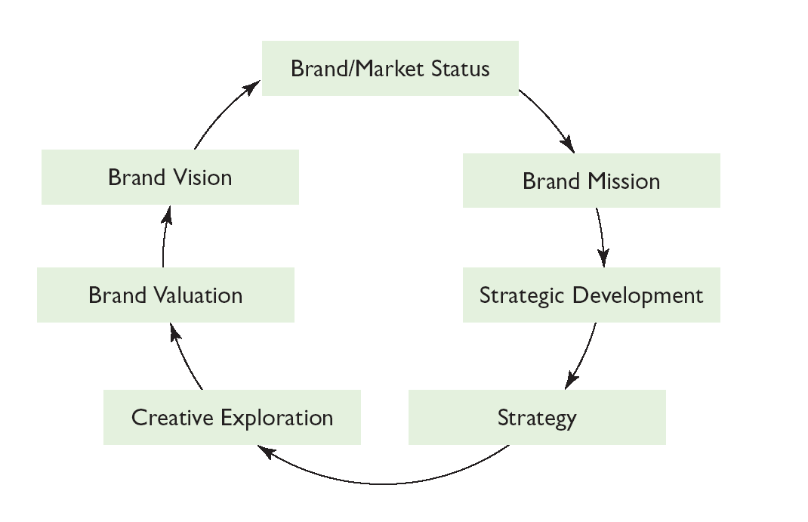
Exhibit 3.4 AFG Planning Cycle

Slide 15
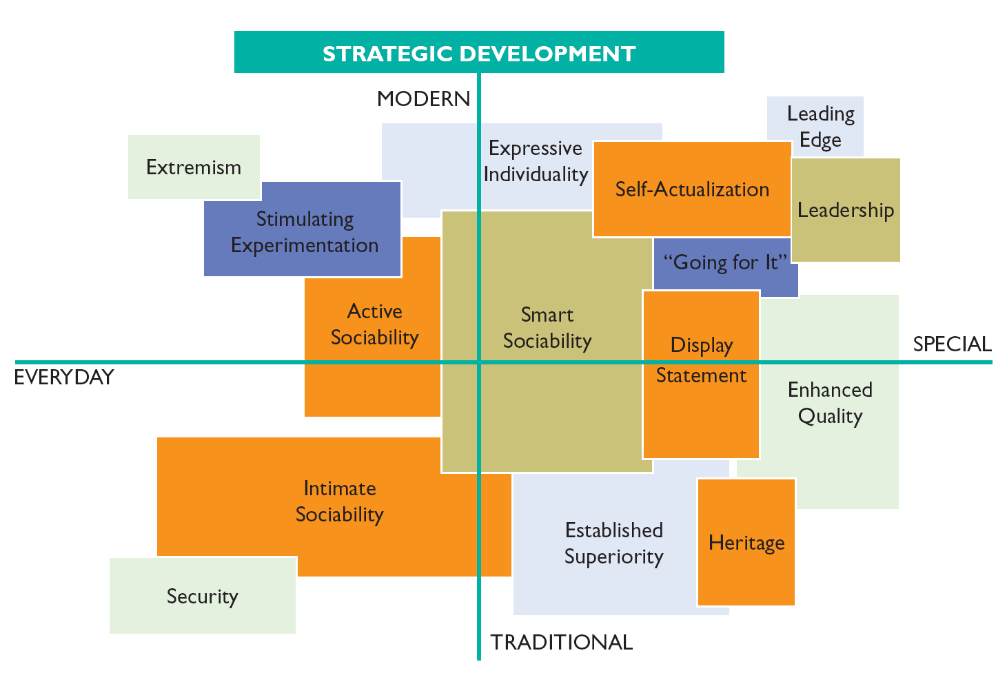
Exhibit 3.5 Example of
AFG’s Need-Mapping Process

Slide 16
Typical Steps in the Planning Process
Evaluate current brand status
Develop brand insights
Identify brand vision
Express a big idea
Evaluate whether objectives are met

Slide 17
What Great Brands Do
A great brand
is in it for the long haul
can be anything
knows itself
invents or reinvents an entire category
taps into emotions
is a story that is never completely told
is relevant

Slide 18
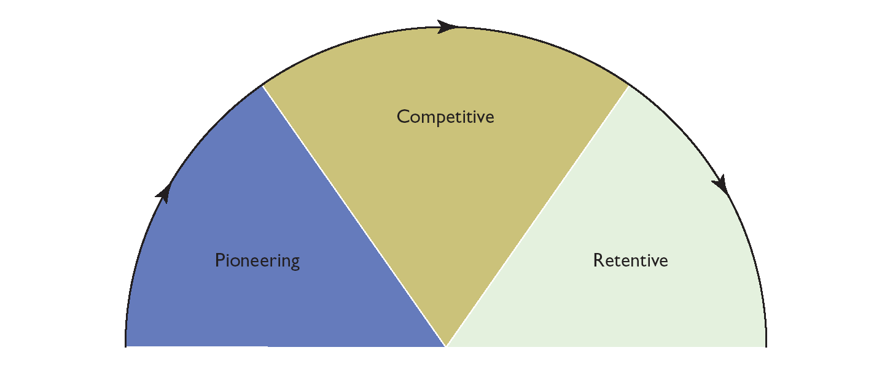
Exhibit 3.6 Primary Stages of the Life-Cycle Model

Slide 19
Purpose of the Pioneering Stage
To educate consumers about new products
To show people they have a need and that advertised product can fulfill it
To show that a product now exists that is capable of meeting a need that had been recognized but previously unfulfilled

Slide 20
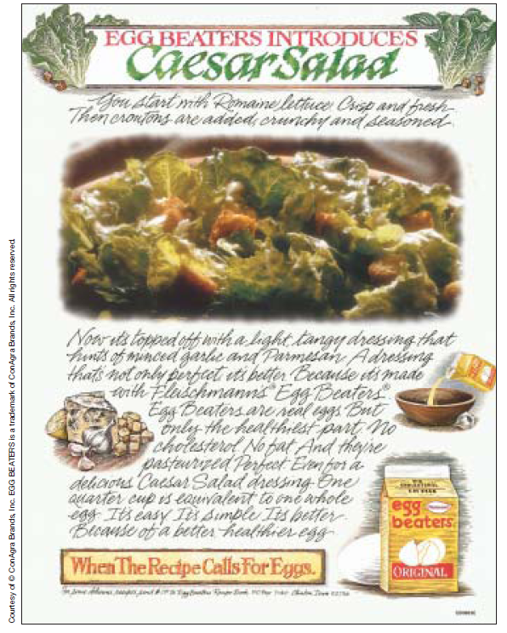
Egg Beaters: Egg Alternative

Slide 21
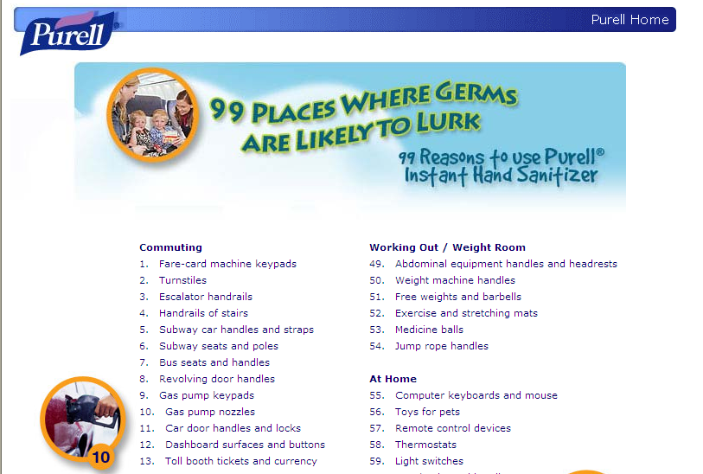
Purell Built a Need for Hand Sanitizer

Slide 22
Competitive Stage
The competitive stage is the advertising stage a product reaches when its general usefulness is recognized but its superiority over similar brands has to be established in order to gain preference.

Slide 23
Competitive Headlines
All the sound without the wires – Bose Wave Music System
There is a better way to soothe your skin – Nivea
He spent decades researching the right wood for his wine barrels. You can taste the results in just a sip - Woodbridge Wine
The most fuel-efficient midsized sedan – Ford Fusion+Hybrid

Slide 24
Retentive Stage
The retentive stage is the third advertising stage of a product, reached when its general usefulness is widely known, its individual qualities are thoroughly appreciated, and it is satisfied to retain its patronage merely on the strength of its past reputation.

Slide 25
Brands in the Retentive Stage
McDonald’s
Nike
Jell-O
Pepsi-Cola
Mountain Dew
Budweiser
Disney
ESPN
Google
Gillette

Slide 26
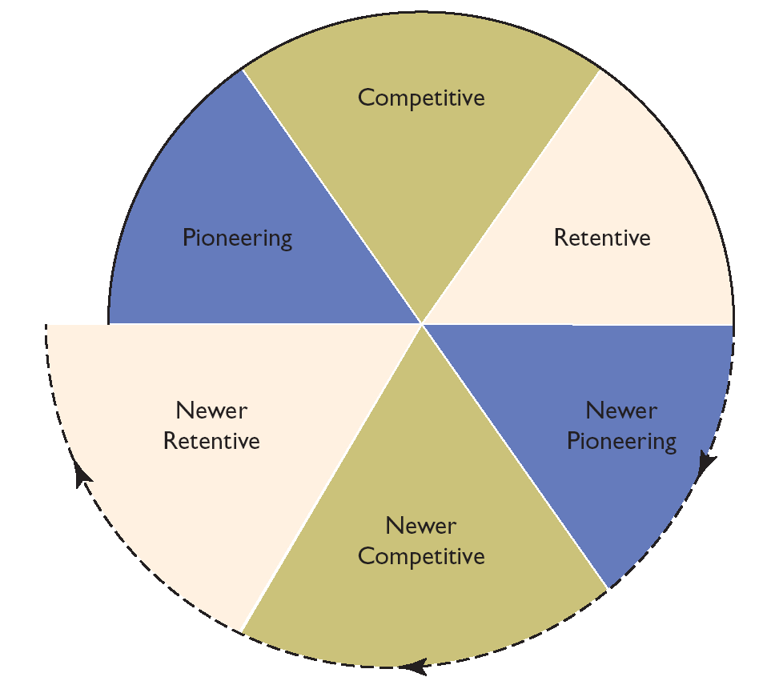
Exhibit 3.11 The Advertising Spiral

Slide 27
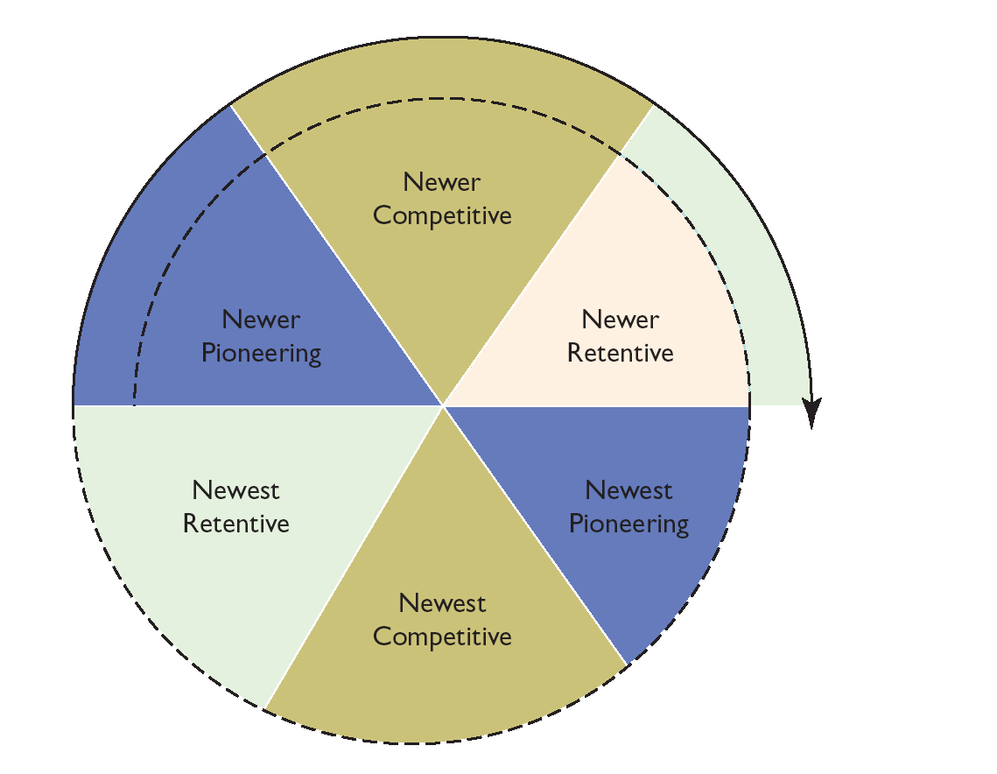
Exhibit 3.14 Expanded Advertising Spiral

Slide 28
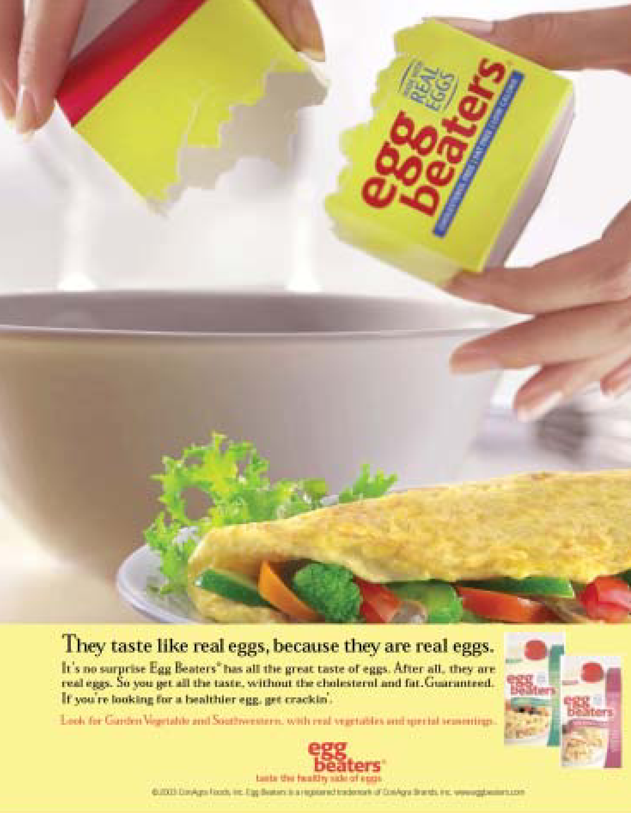
Exhibit 3.15 Egg Beaters Expansion
The “newest pioneering”
stage focuses on
getting more people
to use the product.

