Slide 1
Communications in Customer Service

Slide 2
Communication:
The process in which information, ideas, and understanding are shared between two (or more) people.

Slide 3
Customer intelligence:
The process of gathering information; building a historical database; and developing an understanding of current, potential, and lapsed customers.

Slide 4
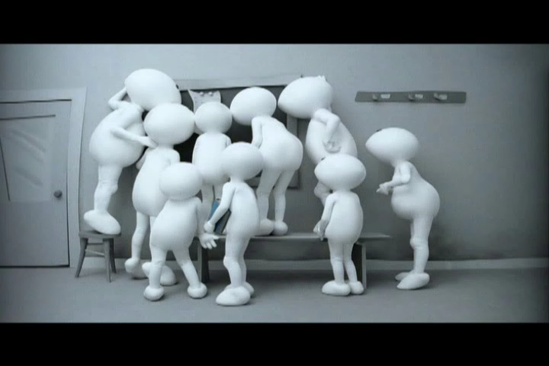

Slide 5
Relationship Marketing:
Cultivating a lasting and mutually beneficial connection with customers.

Slide 6
Sources of Customer Intelligence
Method by which customers choose to conduct business
Time of day that customers have questions
Depth of their expected interactions
Purchasing patterns
Expectations
And so on

Slide 7


Slide 8
Methods of Communication
Listening: the ability to hear and understand what the speaker is saying.
Writing: Communicating by using the written word so that others can understand the intended message.
Talking: Speaking, using words and terminology that others can comprehend.
Reading: the ability to look at and comprehend the written word.
Nonverbal communication: Tone and inflection of voice, facial expressions, posture, and eye contact. Nonverbal communication can contradict the message conveyed through another method of communication.

Slide 9
A good listener:
Conveys sincerity
Does not interject his or her own thoughts
Nods head
Does not finish the sentence for the speaker
Paraphrases what was said
Leans toward the speaker
Shares positive
Comments
Shows good eye contact

Slide 10
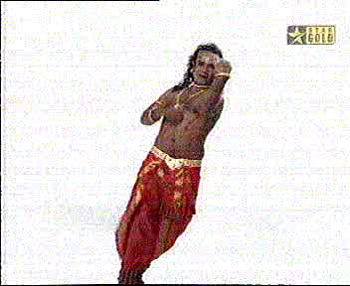

Slide 11
To improve listening skills:
Focus on the speaker and what he or she is saying.
Look at the speaker and make eye contact when possible. If you are listening on the telephone, make notes as you listen.
Listen with an open mind.
Rephrase what was said to clarify that you understood the intended message.
Control your body language. Do not show impatience or disapproval.

Slide 12
Voice Inflection:
A variation in the pitch, timing, or loudness of the voice.

Slide 13


Slide 14


Slide 15
Pitch:
The highs and lows of the voice.

Slide 16
Characteristics revealed by your voice and message
Level of job satisfaction
Attitude
Gender
Education
Knowledge level
Speed that you work and react
Confidence
The part of the country that you are from
Status
Energy level
Mood

Slide 17
Seven Steps to Answering a Call Successfully
Smile!
Answer with an enthusiastic and professional greeting.
Ask questions.
Give answers and assistance as quickly as possible.
Thank the caller.
Conclude the call in a positive manner.
Follow up on the call.

Slide 18


Slide 19


Slide 20


Slide 21
Words to Use
Please
Yes
May I
Consider this
Do
Let’s negotiate
Will
Thank you
You
Us
Appreciate
Can
Use the customer’s name
Would you like
Opportunity
Challenge
Regret

Slide 22
Words to Avoid
Can’t
Never
Don’t
You have to
Don’t tell me no
Won’t
Not our policy
Not my job
Profanity
Vulgarity
Love slang (honey, etc.)
We’ll try
Haven’t had time
I do
I know
Hang on for a second

Slide 23
Power Phrases
Due to your specialized knowledge.
What a unique suggestion!
I’d like your considered opinion.
Please.
You are absolutely right!
If I could borrow just a moment of your time.
May I?
As you, of course, know.
I’d like your advice.
I would appreciate it if.

Slide 24
Eye Contact:
Allowing our eyes to make visual contact with someone else’s eyes.

Slide 25
When leaving a message on voice mail:
Speaking clearly and slowly, identify yourself, your company, the day and date, and the time.
State the reason for your call.
Suggest to the customer what the next step should be. Does he or she to call you back or wait for more information?
Leave your name and the phone number where you can be reached.
Close with a positive farewell.

