Slide 1
Learning and Memory

Slide 2
The Learning Process
Learning:
  A relatively permanent change in behavior caused by experience
Incidental Learning:
  Casual, unintentional acquisition of knowledge
Learning is an Ongoing Process:
  Constantly being revised
  Can be either simple association (logo recognition) or complex cognitive activity (writing an essay)

Slide 3
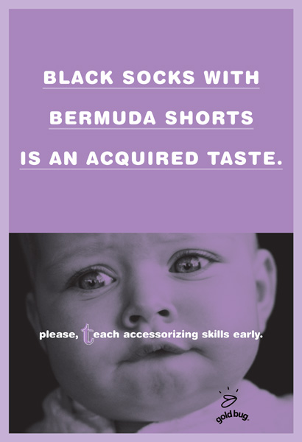
Learning is a Process
Our tastes are formed as a result of a learning process, sometimes with painful results.

Slide 4
Behavioral Learning Theories
Assume that learning takes place as the result of responses to external events.
View is represented by two major approaches to learning:
  1) Classical Conditioning
  2) Instrumental Conditioning
People’s experiences shaped by feedback they receive as they go through life
Actions result in rewards and punishments, which influences future responses to similar situations.

Slide 5
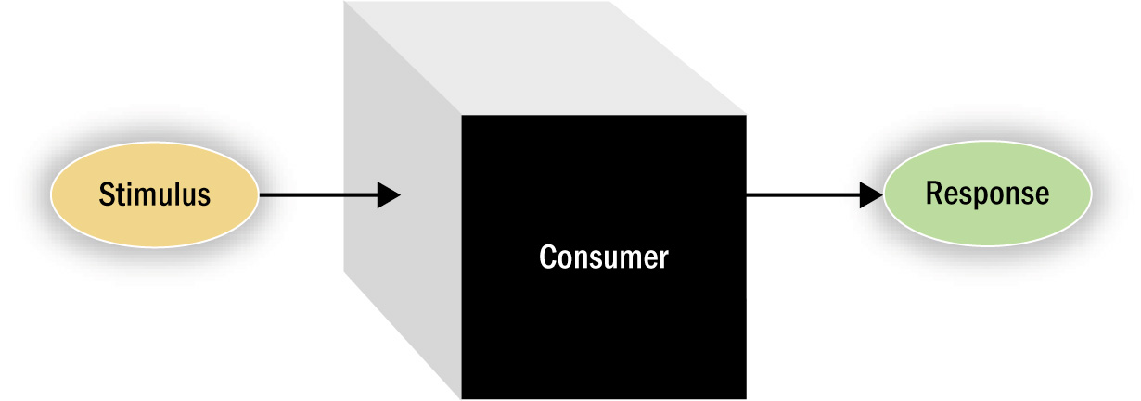
The Consumer as a “Black Box”
A Behaviorist Perspective on Learning
Figure 3.1

Slide 6
Classical Conditioning
Ivan Pavlov’s Dogs
  Unconditioned stimulus (UCS) – Naturally capable of causing a response.
  Conditioned stimulus (CS) – Does not initially cause a response
  Conditioned response (CR) – Response generated by repeated paired exposures to UCS and CS. Eventually, through learned association and repetition, the CS will cause the CR.

Slide 7
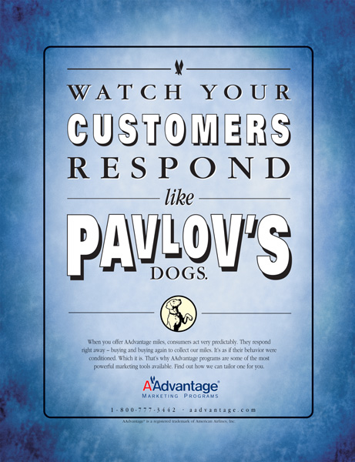
Classical Conditioning in Advertising
This American Airlines ad points to classical conditioning as an explanation for why their AAdvantage Marketing Programs will work.
Can you identify the UCS, CS, and the CR in this example?

Slide 8
Classical Conditioning (cont.)
Stimulus generalization:
  Tendency of a stimulus similar to a CS to evoke similar, conditioned responses
    Masked branding: Deliberately hiding a product’s true origin
Stimulus discrimination:
  Occurs when a UCS does not follow a stimulus similar to a CS.

Slide 9
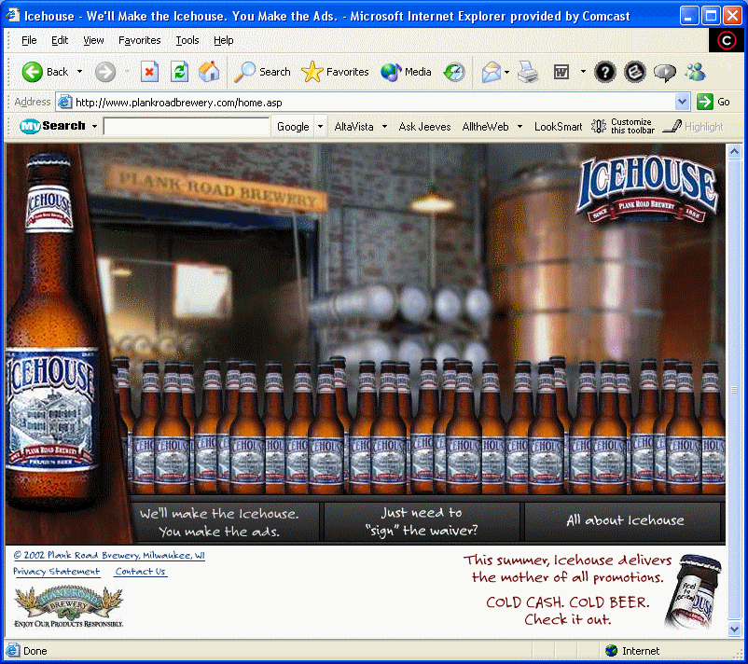

Masked Branding

Slide 10
Marketing Applications of
Behavior Learning Principles
Brand Equity:
  A brand has strong positive associations in a consumer’s memory and commands loyalty.
Applications of Repetition
Applications of Conditioned Product Associations:
  Semantic associations
  Phonemes

Slide 11
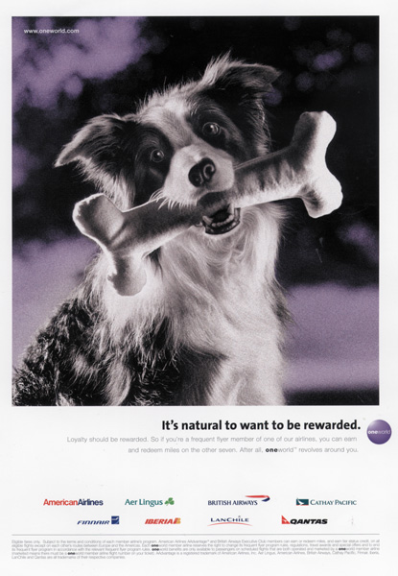
Loyalty to Brands
Rewarding consumers with frequent flyer miles is an effective way to reinforce them and build brand loyalty.

Slide 12
Marketing Applications of
Behavior Learning Principles (cont.)
Applications of Stimulus Generalization:
  Family branding
  Product line extensions
  Licensing
  Look-alike packaging
Applications of Stimulus Discrimination:
  Consumers learn to differentiate a brand from its competitors
  Unique attributes of the brand

Slide 13
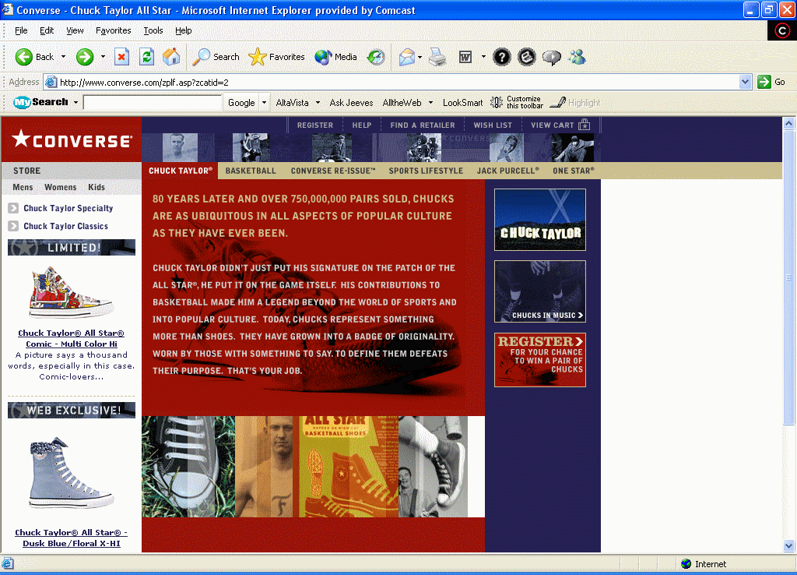
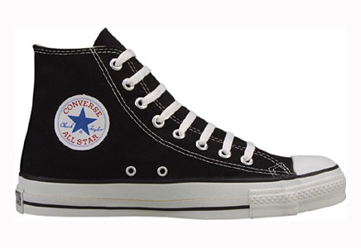
Beware of Knockoffs

Slide 14
Instrumental Conditioning
Occurs as the individual learns to perform behaviors that produce positive outcomes and avoid behaviors that yield negative outcomes
A.K.A. “Operant Conditioning”
Occurs one of three ways:
  Positive reinforcement
  Negative reinforcement
  Punishment

Slide 15
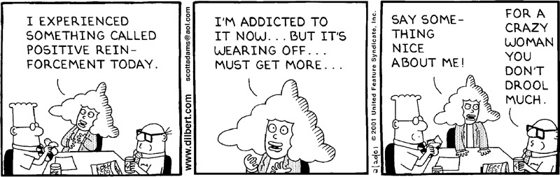
Positive Reinforcement
The power of positive reinforcement.

Slide 16
Instrumental Conditioning (cont.)
Extinction: When a positive outcome is no longer received, the learned stimulus-response connection will not be maintained.
Reinforcement Schedules:
  Fixed-interval reinforcement
  Variable-interval reinforcement
  Fixed-ratio reinforcement
  Variable-ratio reinforcement

Slide 17
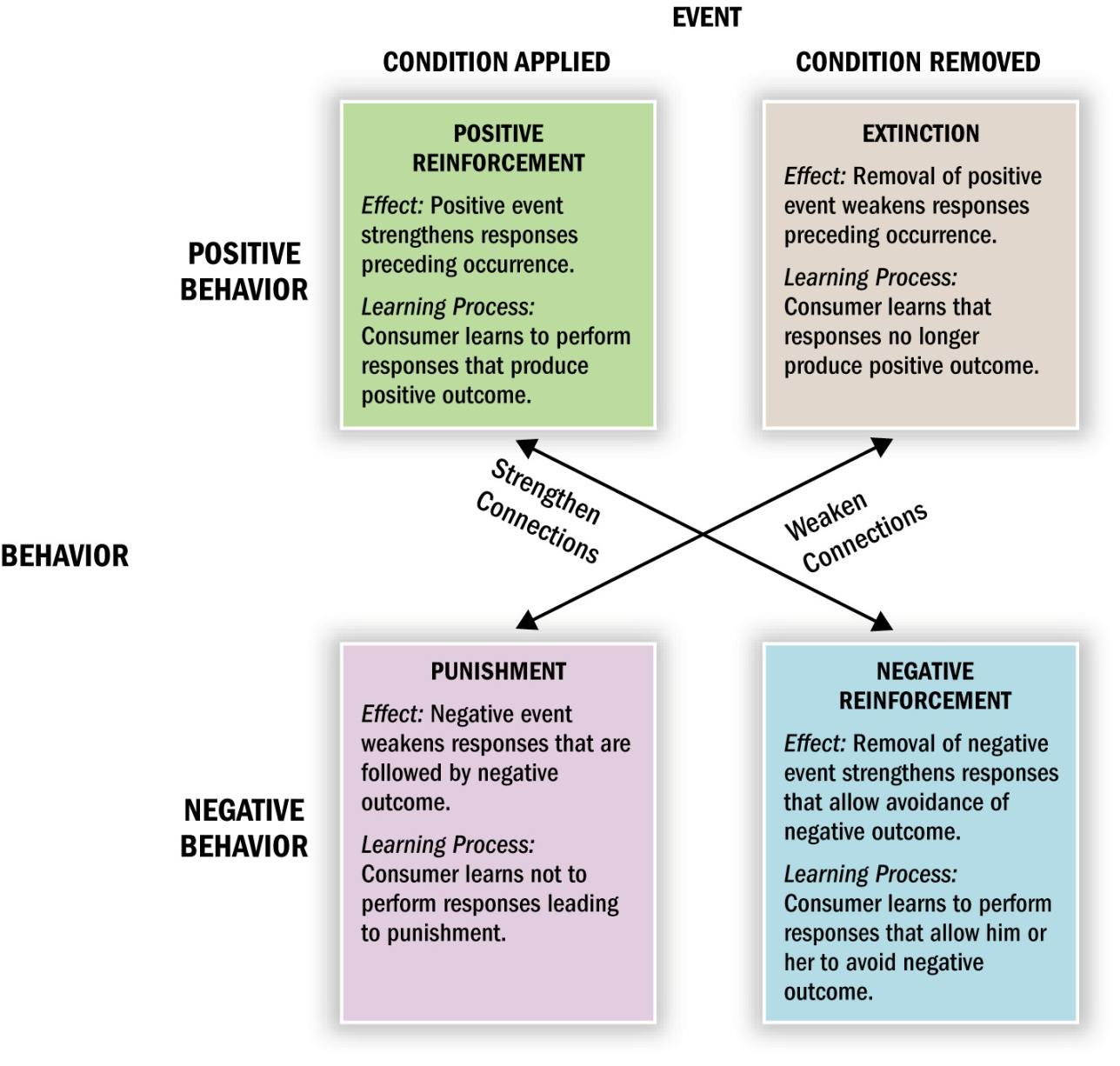
Four Types of Learning Outcomes
Figure 3.2

Slide 18
Applications of Instrumental Conditioning Principles
Reinforcement of Consumption:
  Thank you
  Rebates
  Follow-up phone calls
Frequency Marketing:
  Reinforces regular purchases by giving them rewards with values that increase along with the amount purchased
    Frequent flyer miles

Slide 19
Cognitive Learning Theory
Is learning cognitive or not?
  Trigger feature
    A stimulus that cues an individual toward a particular pattern and activates a reaction
Observational learning:
  Occurs when people watch the actions of others and note reinforcements received for their behaviors
  Learning occurs as a result of vicarious, rather than direct, experience.

Slide 20
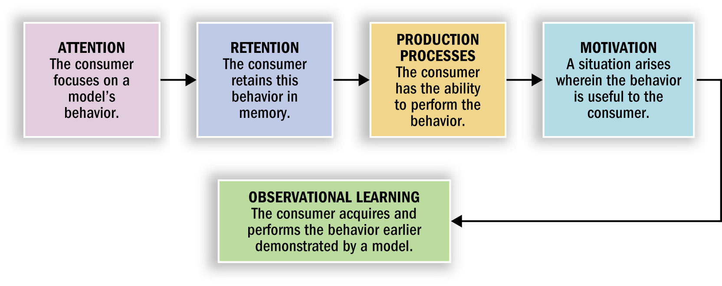
Components of Observational Learning
Figure 3.3

Slide 21
Applications of Cognitive
Learning Principles
Consumers learn vicariously by seeing others receive reinforcement for their behaviors.
Marketers can reinforce or punish consumers indirectly by showing what happens to desirable models who do or do not use their products.
Consumers’ evaluations of models are not limited to stimulus-response connections.
  Attractiveness can be based on several components (e.g. physical attractiveness, expertise, similarity to the evaluator)

Slide 22
The Role of Memory in Learning
Memory
  A process of acquiring and storing information such that it will be available when needed.
Stages of Memory
  Encoding stage
    Information entered in a recognizable way
  Storage stage
    Knowledge integrated into what is already there and warehoused
  Retrieval stage
    The person accesses the desired information

Slide 23
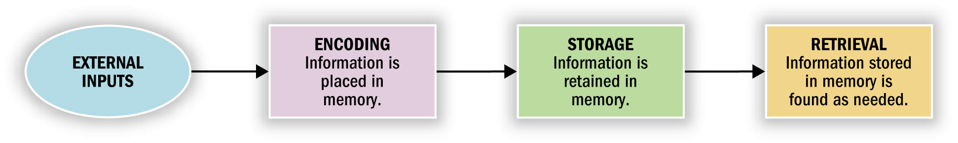
The Memory Process
Figure 3.4

Slide 24
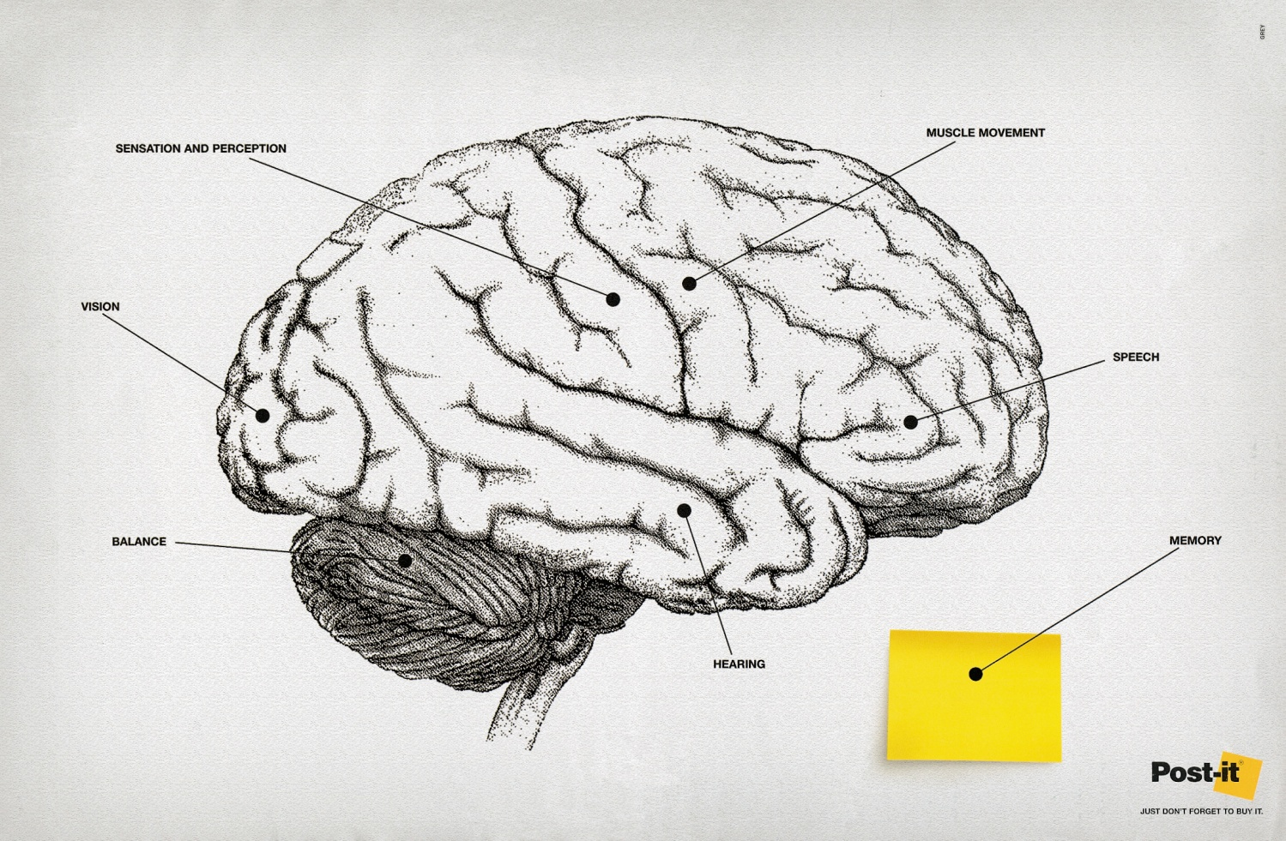
Memory and Advertising
This Brazilian ad illustrates that external memory aids like
Post-Its can help us to remember many of the details of modern life.

Slide 25
Encoding Information for Later Retrieval
Types of meaning:
  Sensory meaning (e.g. color or shape)
  Sense of familiarity (e.g. seeing a food that we have tasted)
  Semantic meaning: Symbolic associations (e.g. rich people drink champagne)
Personal relevance:
  Episodic memories: Relate to events that are personally relevant
  Flashbulb memories: Especially vivid associations
  Narrative: An effective way of persuading people to construct a mental representation of the information that they are viewing

Slide 26
Memory Systems
Sensory Memory:
  Very temporary storage of information we receive from our senses
Short-Term Memory (STM):
  Limited period of time & limited capacity
  Working memory (i.e., holds memory we are currently processing)
Long-Term Memory (LTM):
  Can retain information for a long period of time
  Elaboration rehearsal is required: Process involves thinking about a stimulus and relating it to information already in memory

Slide 27
Storing Information in Memory
Multiple Store Models of Memory:
  Traditional perspective which assumes that STM & LTM are separate systems.
Activation Models of Memory:
  Argues that different levels of processing occur depending on the nature of the processing task.
  The more effort it takes to process information, the more likely that information will be placed in LTM.

Slide 28
Storing Information in Memory (cont.)
Associative Networks:
  Contains many bits of related information organized according to some set of relationships
  Knowledge structures: Complex “spider webs” filled with pieces of data
  Hierarchical processing model: Message is processed in a bottom-up fashion (i.e., starts at a basic level and is subject to increasingly complex processing which requires increased cognitive capacity)
  Node: A concept related to a category
  An associative network is developed as links form between nodes.

Slide 29
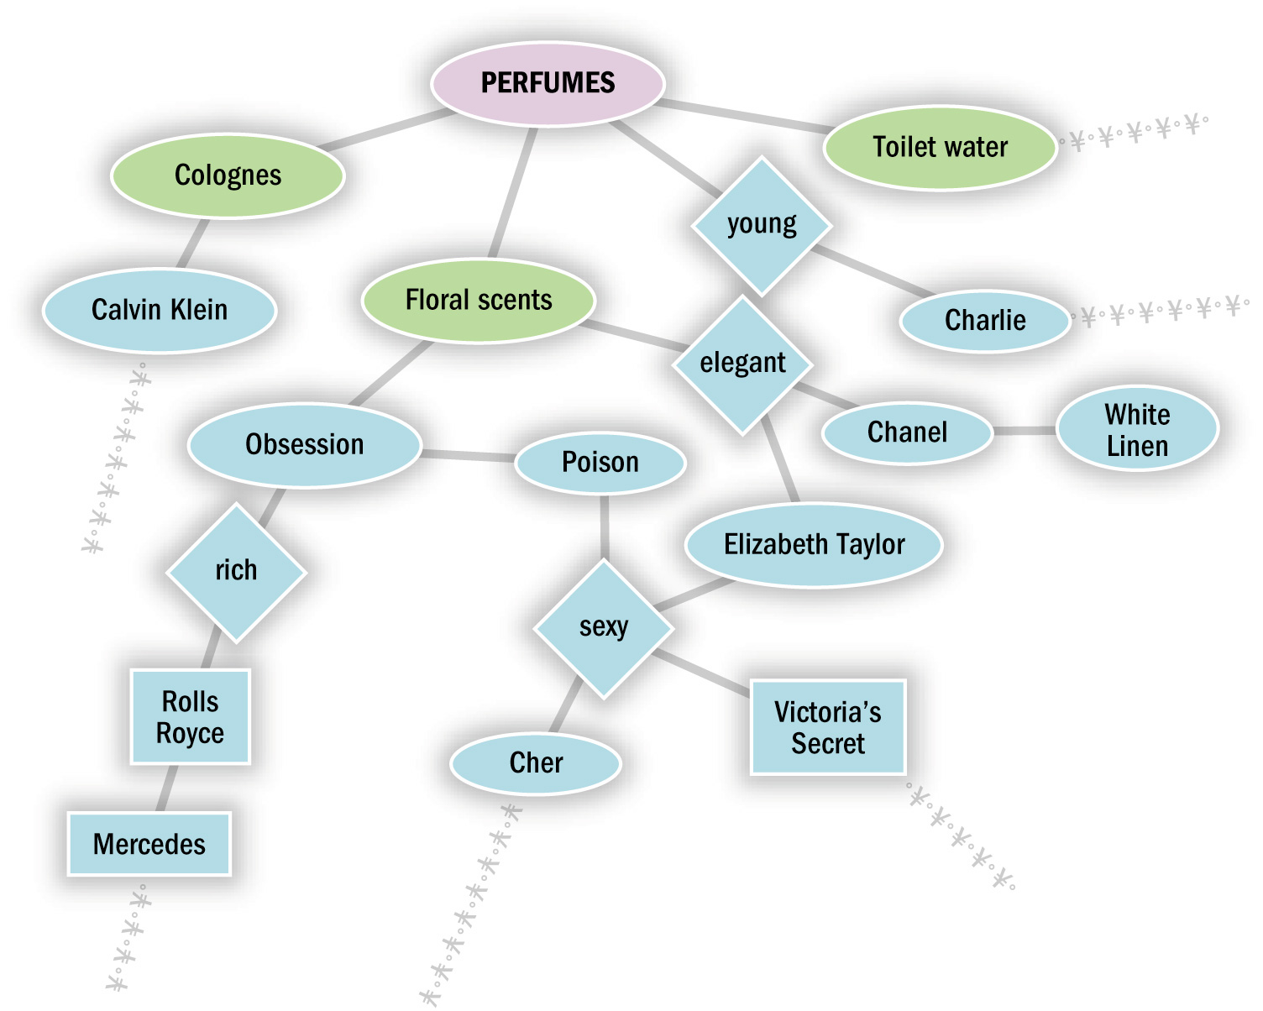
An Associative Network for Perfumes
Figure 3.6

Slide 30
Storing Information in Memory (conc.)
Spreading Activation:
  A process which allows consumers to shift back and forth between levels of meaning
Levels of Knowledge:
  Knowledge is coded at different levels of abstraction and complexity.
  Proposition (a.k.a. belief): A larger unit of meaning (i.e., formed by combinations of nodes)
  Schema: A cognitive framework (comprised of propositions) developed through experience
    Script: A type of schema consisting of a sequence of events expected by an individual

Slide 31
Retrieving Information for
Purchase Decisions
Factors Influencing Retrieval:
  Physiological Factors (e.g. age)
  Situational Factors:
    Pioneering brand: First brand to enter a market. Is generally easier to retrieve from memory.
    Descriptive brand names easier to recall than names that do no provide cues to what the product is.
  Viewing environment: Commercials shown first in a series of ads are recalled better than those shown last.
  Postexperience advertising effects:
    When consumers confuse recently viewed ads with their own experiences.

Slide 32
Retrieving Information for
Purchase Decisions (cont.)
State-Dependent Retrieval:
  (a.k.a. mood congruence effect) A process by which consumers are better able to access info if their mood is the same at the time of their recall as when the info was learned.
  A few marketing researchers use hypnosis to dredge up past memories of experiences with products.
Familiarity and Recall:
  Prior familiarity enhances recall.
Salience and Recall:
  Salience: The prominence or level of activation of stimuli in memory
  Von Restorff Effect: Any technique that increases the novelty of a stimulus also improves recall.

Slide 33
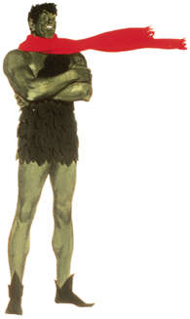
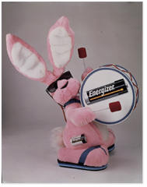
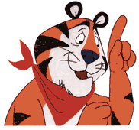


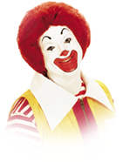
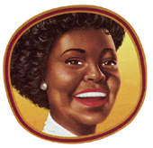
Pictorial versus Verbal Cues
There is some evidence for the superiority of visual memory over verbal memory.
Pictorial ads may enhance recall, but do not necessarily improve comprehension.
How many of these Ad icons can you remember from the picture alone?

Slide 34
Factors Influencing Forgetting
Decay:
  Structural changes in the brain produced by learning simply go away.
Retroactive Interference:
  Consumers forget stimulus-response associations when new responses to the same or similar stimuli are learned.
Proactive Interference:
  As new responses are learned, a stimulus loses its effectiveness in retrieving the old response.
Part-list Cueing Effect:
  When only a portion of the items in a category are presented to consumers, the omitted items are not as easily recalled.

Slide 35
Products as Memory Markers
Products and ads can serve as powerful retrieval cues.
  Autobiographical memories: Consumer memories related to their own past.
  Mnemonic qualities: Aspects of a consumer’s possessions that serve as a form of external memory which prompts the retrieval of episodic memories.
The Marketing Power of Nostalgia
  Spontaneous recovery: The ability of a stimulus to evoke a response years after it is initially perceived.
Memory and Aesthetic Preferences
  Ads and products that remind consumers of their past also help to determine what they like now.

Slide 36
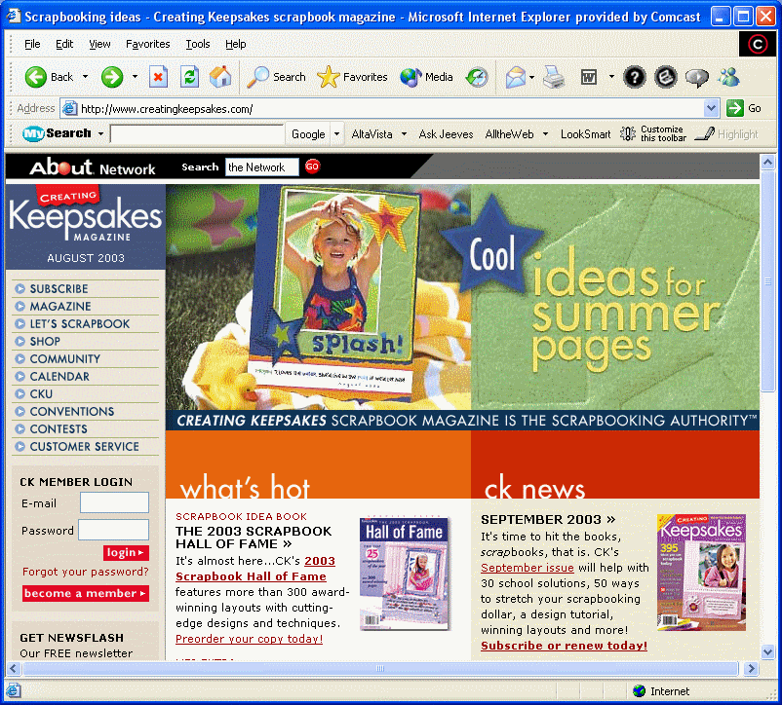
Memories of the Past as Retrieval Cues

Slide 37
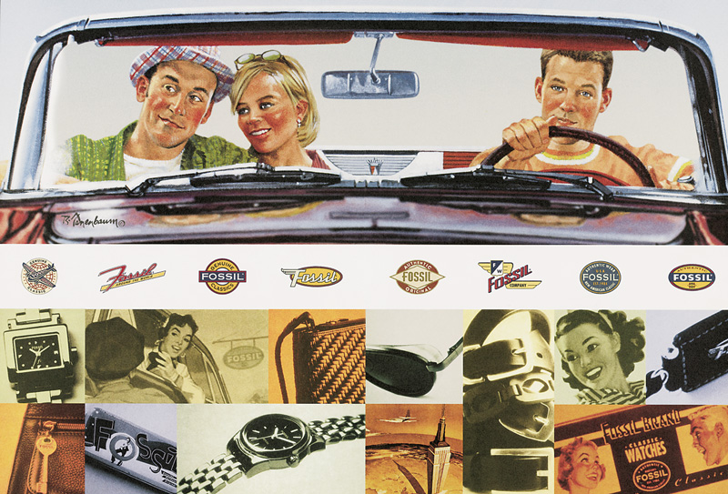
Nostalgia Appeal
Fossil’s product designs evoke memories of earlier classic
designs

Slide 38
Measuring Memory for Marketing Stimuli
Recognition Versus Recall:
  Two basic measures of impact.
    Typical recognition test: Subjects are shown ads and asked if they have seen them before.
    Typical recall test: Subjects are asked to independently think of what they have seen without being prompted first.
The Starch Test
  A widely used commercial measure of advertising recall for magazines.

Slide 39
Problems with Memory Measures
Response Biases
  A contaminated result due to the instrument or the respondent, rather than the object that is being measured.
Memory Lapses
  Unintentionally forgetting information:
    Omitting: Leaving facts out
    Averaging: “Normalizing” memories by not reporting extreme cases
    Telescoping: Inaccurate recall of time
Memory for Facts Versus Feelings
  Recall is important but not sufficient to alter consumer preferences
  More sophisticated attitude-changing strategies are needed.

