Slide 1

What Drive
Consumers’ Attitudes
Towards Brands?

Slide 2
Why is it Important to Segment a Market?
Identifying patterns of consumption can be superior to knowledge of individual purchases when crafting a lifestyle marketing strategy.
Personality: a person’s unique psychological makeup and how it consistently influences the way a person responds to his/her environment

Slide 3
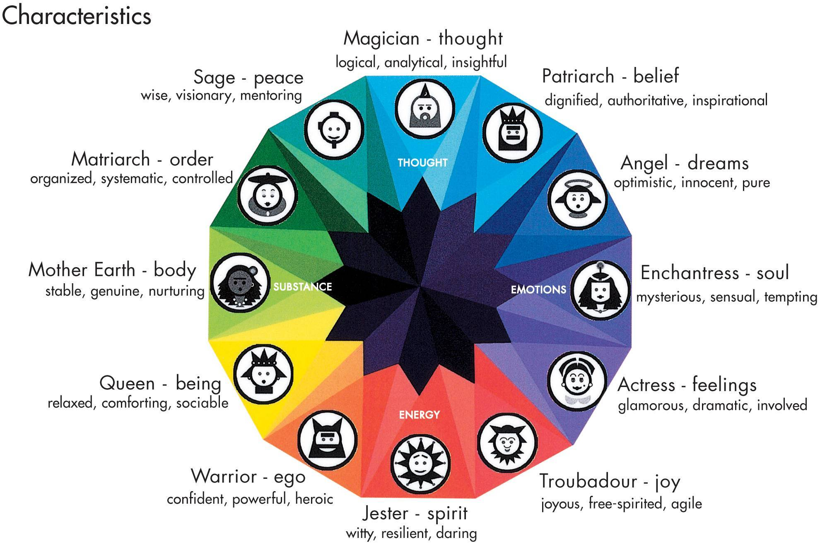
BrandAsset Valuator Archetypes

Slide 4
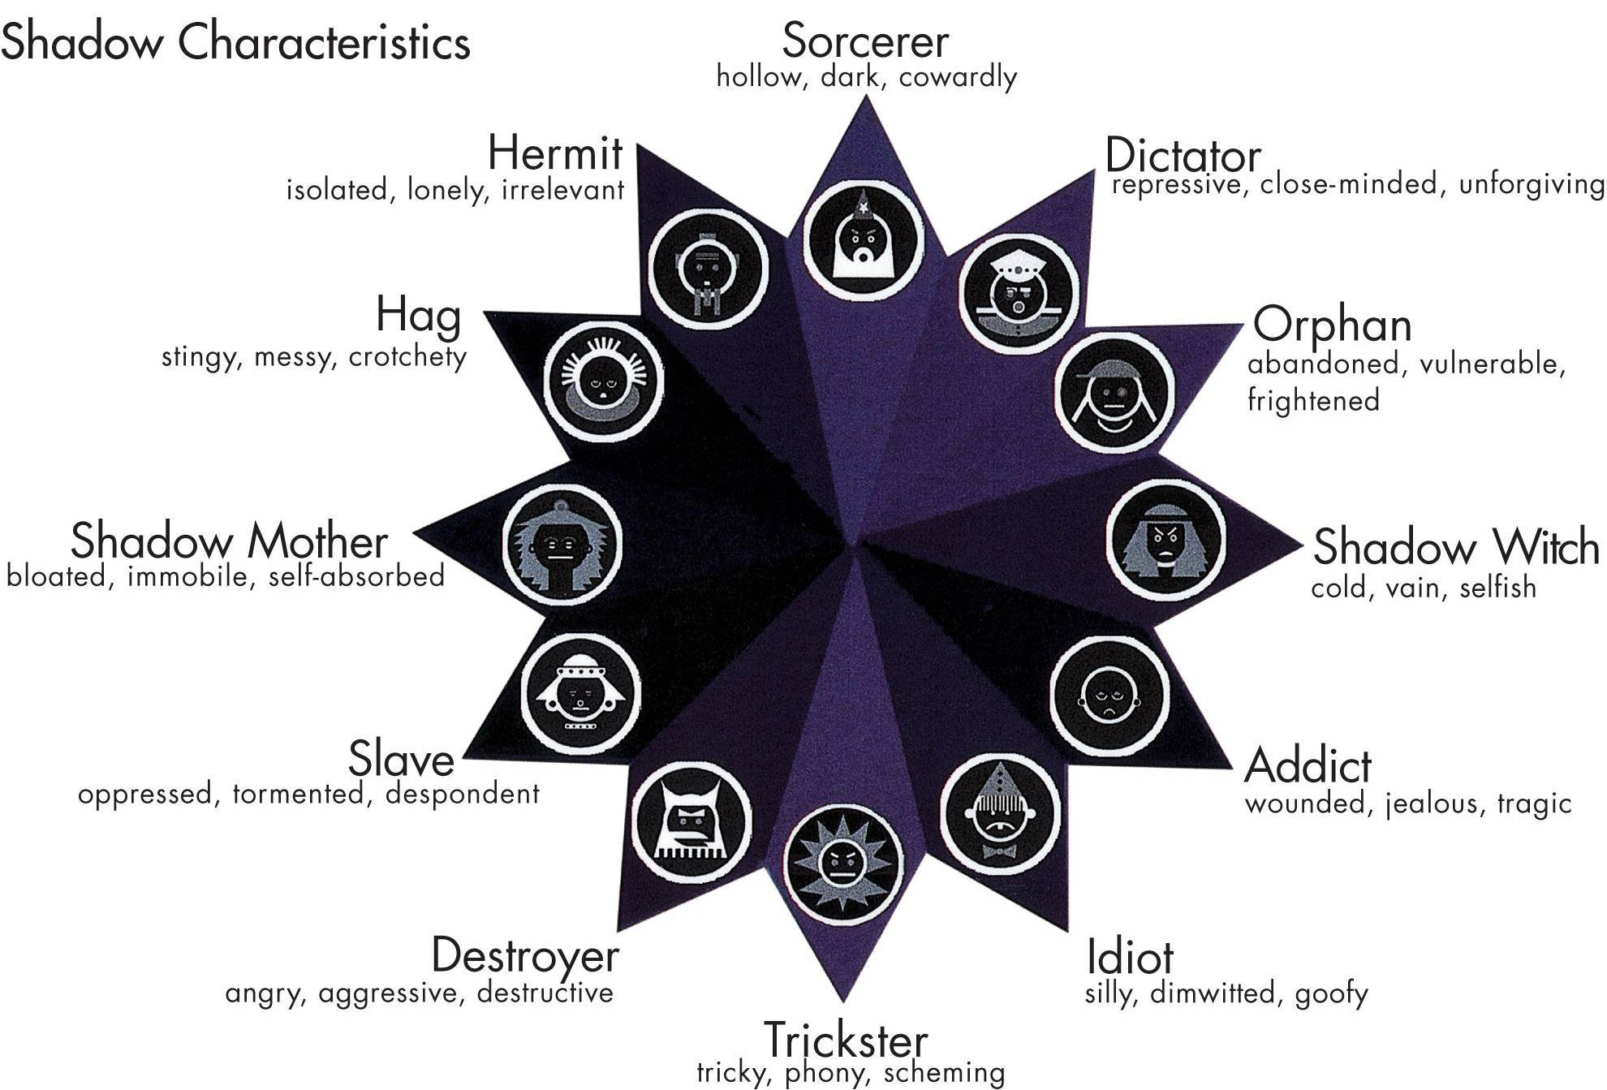
BrandAsset Valuator Archetypes

Slide 5
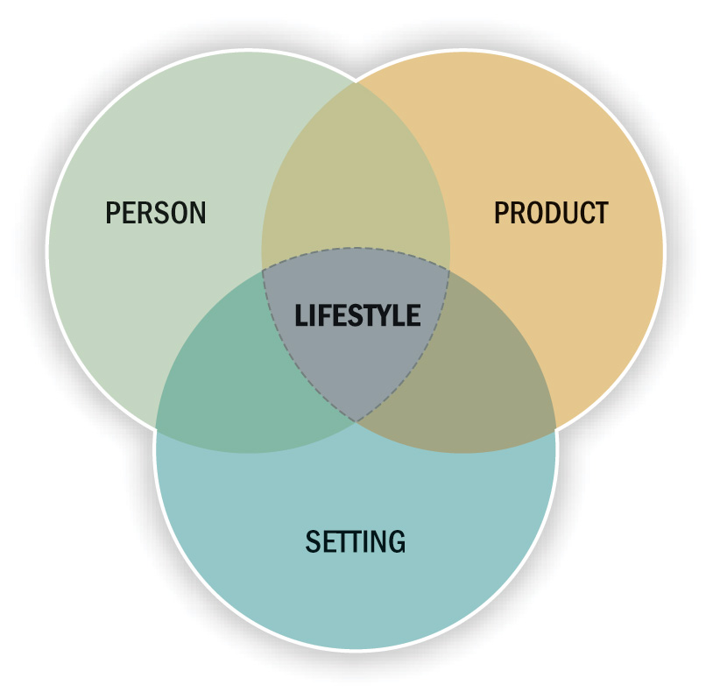
Linking Products to Lifestyles

Slide 6
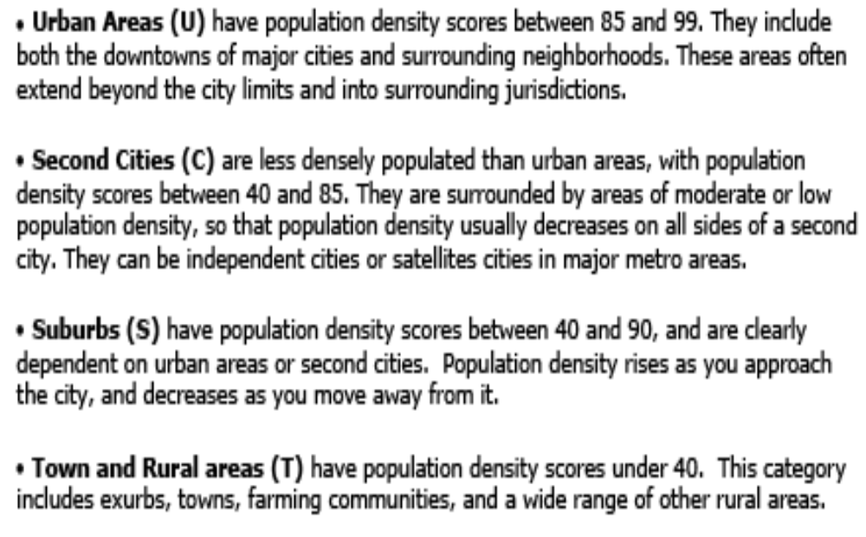

Slide 7
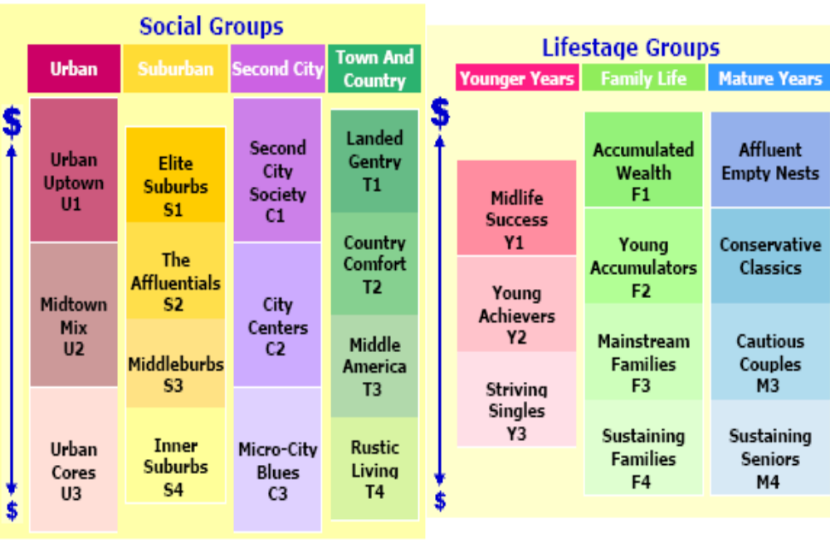

Slide 8
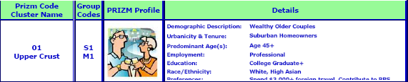
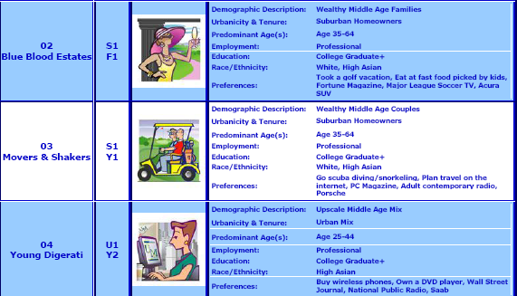

Slide 9
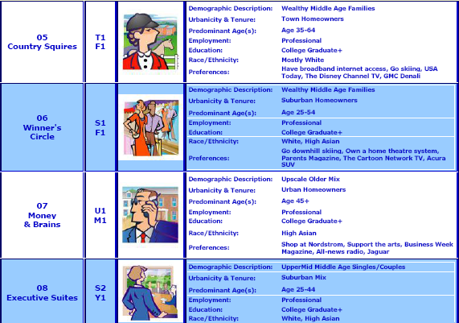

Slide 10
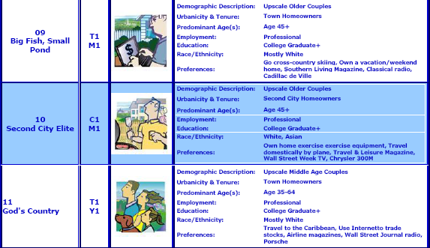

Slide 11
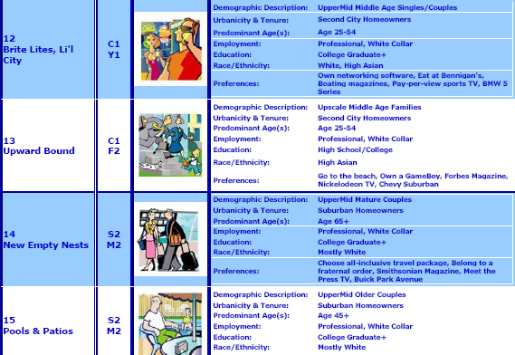

Slide 12
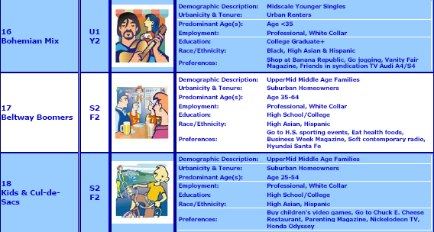

Slide 13
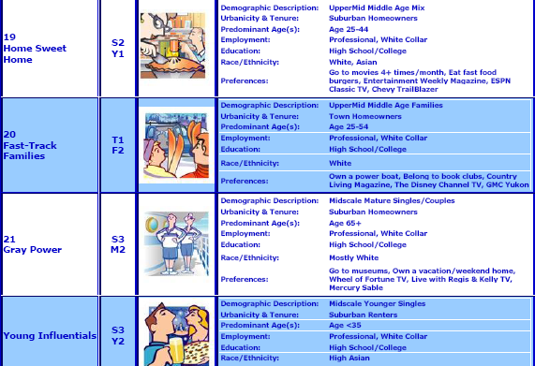

Slide 14
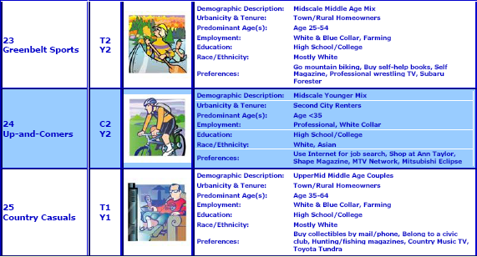

Slide 15
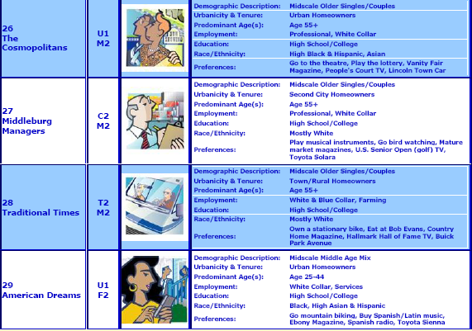

Slide 16
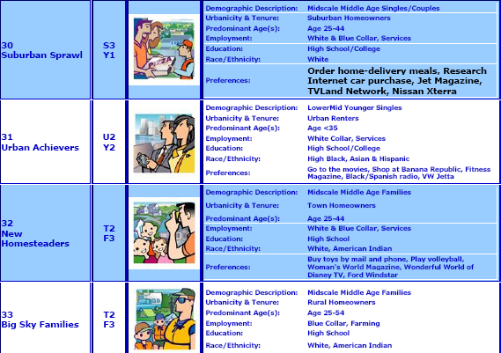

Slide 17
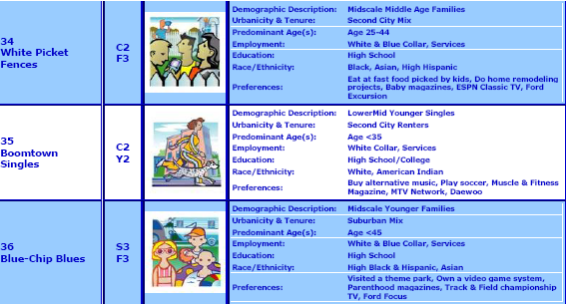

Slide 18
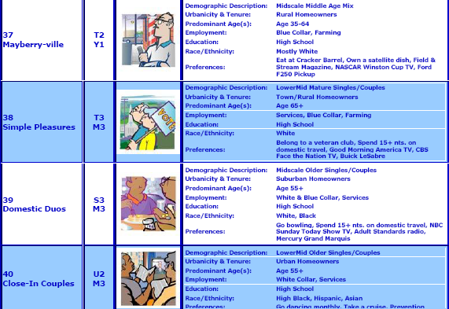

Slide 19
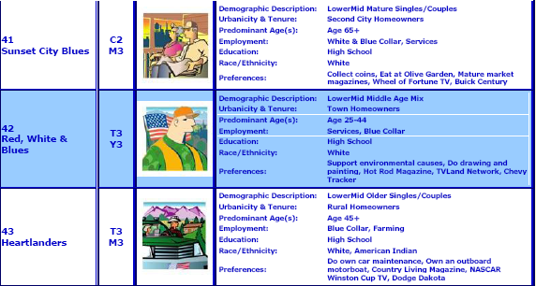
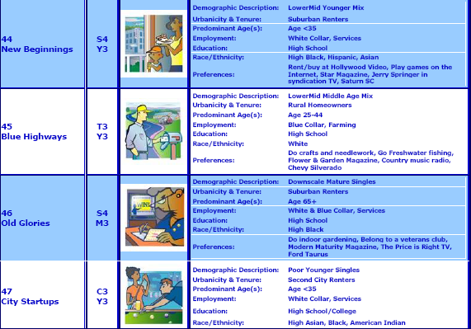

Slide 20
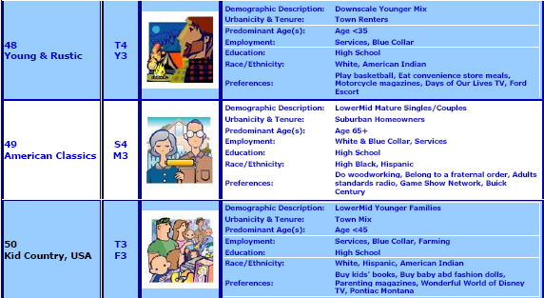
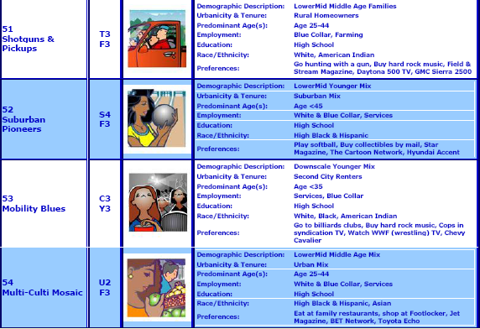

Slide 21
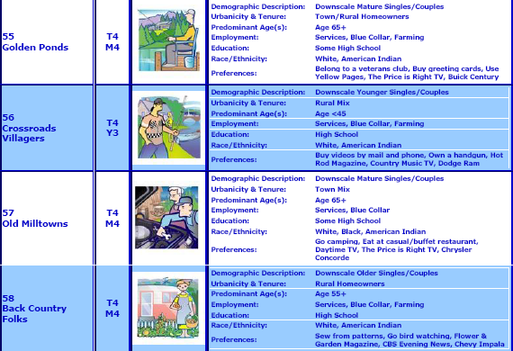
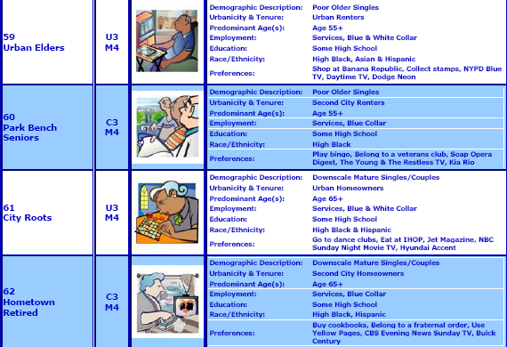

Slide 22
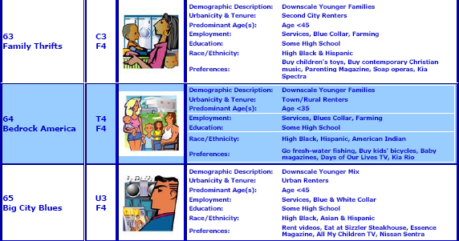
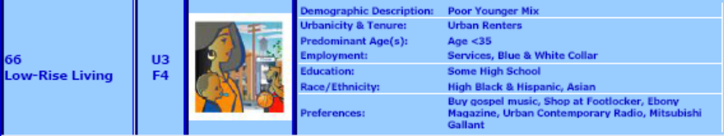

Slide 23
BB SUPREME

Slide 24
MOBILINK

Slide 25
JOY

Slide 26
NIKE

Slide 27
NIKE CRICKET

Slide 28
SHREDDIES

