Slide 1
Personality and Lifestyles

Slide 2
Consumer Behavior on the Couch:
Freudian Theory
Freudian Systems:
  Id: Oriented toward immediate gratification
    Pleasure principle: Behavior is guided by the primary desire to maximize pleasure and avoid pain
    The id is selfish, illogical, and ignores consequences
  Superego: A person’s conscience
  Ego: The system that mediates between the id and the superego
    Reality principle: The ego finds ways to gratify the id that will be acceptable to the outside world
Sometimes a Cigar is Just a Cigar
  Phallic symbols: Male-oriented symbolism

Slide 3
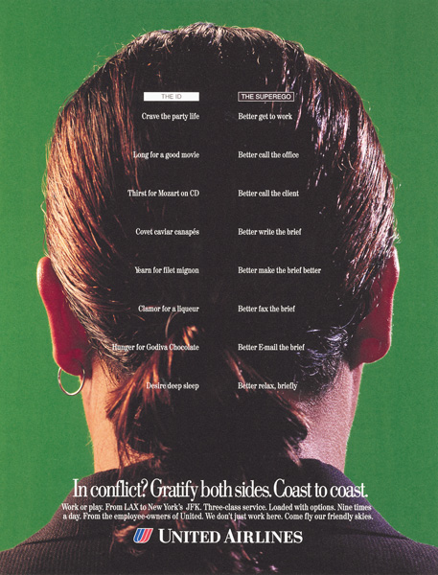
Conflict Between the Id and Superego
This ad focuses on the conflict between the desire for hedonic gratification (represented by the id) versus the need to engage in rational, task-oriented activities (represented by the superego).

Slide 4
Motivational Research
Motivational Research:
  Attempts to use Freudian ideas to understand the deeper meanings of products and advertisements
  Depth Interviews: Technique that probes deeply into a few consumers’ purchase motivations
  Latent motives: Underlying motives
Appeal of Motivational Research
  Less expensive than quantitative survey research
  Uncovers deep seated needs which can be targeted with advertising
  Findings seem intuitively plausible after the fact

Slide 5
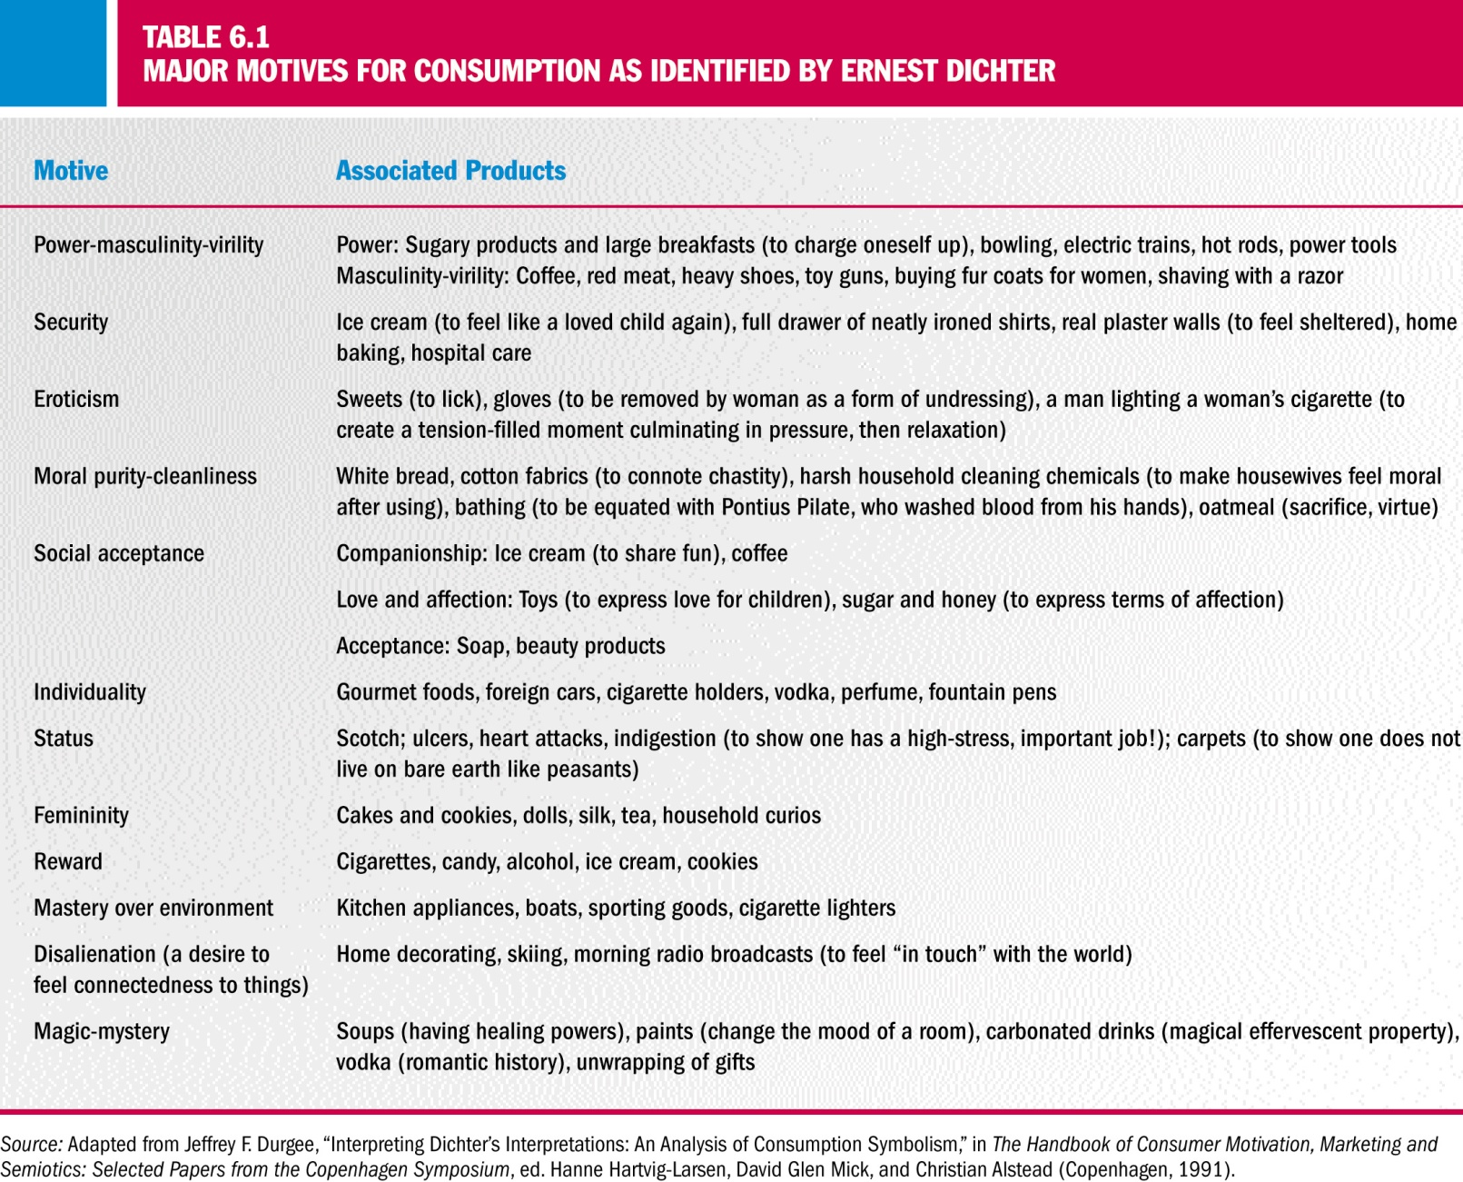
Motives for Consumption

Slide 6
Neo-Freudian Theories
Karen Horney:
  Described people as moving toward others (compliant), away from others (detached), or against others (aggressive).
Carl Jung:
  Disciple of Freud but did not accept Freud’s emphasis on sexual aspects of personality
  Analytical psychology: Jung’s own method of psychotherapy
  Collective unconscious: A storehouse of memories inherited from our ancestral past
  Believed people are shaped by cumulative experiences of past generations
  Archetypes: Universally shared ideas and behavior patterns created by shared memories

Slide 7
Trait Theory
Trait Theory:
  An approach to personality that focuses on the quantitative measurement of personality traits
Personality Traits:
  Identifiable characteristics that define a person.
  Extroversion: Trait of being socially outgoing
    Extrovert: A person that possesses the trait of extroversion
  Introversion: Trait of being quiet and reserved
    Introvert: A person that possesses the trait of introversion

Slide 8
Traits Specific to Consumer Behavior
Innovativeness:
  The degree to which a person likes to try new things
Materialism:
  Amount of emphasis placed on acquiring and owning products
Self-consciousness:
  The degree to which a person deliberately monitors and controls the image of the self that is projected to others
Need for cognition:
  The degree to which a person likes to think about things (i.e., expend the necessary effort to process brand information)
Frugality:
  Deny short-term purchasing whims and resourcefully use what one already owns

Slide 9
Are You an Innie or an Outie?
David Reisman:
  Sociologist who introduced the terms inner-directed and outer-directed
Power of Conformity:
  The impact of shaping one’s behavior to meet the expectations of a group
Need for Uniqueness
  Degree to which a person is motivated to conform to the preferences of others versus standing apart from the crowd

Slide 10
Idiocentrism or Allocentrism
Idiocentrics:
  Individuals who have an individualist orientation
Allocentrics:
  Individuals who have a group orientation
Differences between idiocentrics and allocentrics:
  Contentment: Idiocentrics tend to be more content with life and their financial situation
  Health Consciousness: Allocentrics are more likely to avoid unhealthy foods
  Food preparation: Allocentrics spend more time preparing food
  Travel and Entertainment: Idiocentrics are more interested in traveling. Allocentrics are more likely to work on crafts.

Slide 11
Problems with Trait Theory in CB
Explanations for the inability of traits to predict consumer behaviors in research:
  Scales which are not valid or reliable.
  Scales misapplied to the general population
  Tests not administered under the proper conditions
  Ad hoc changes to the measures dilute the validity of the measures
  Generalized trait measures used to make predictions about specific behaviors
  Shotgun approach using a number of scales

Slide 12
Brand Personality
Brand personality:
  The set of traits people attribute to a product as if it were a person
Brand equity:
  The extent to which a consumer holds strong, favorable, and unique associations with a brand in memory
Advertisers are keenly interested in how people think about brands.

Slide 13
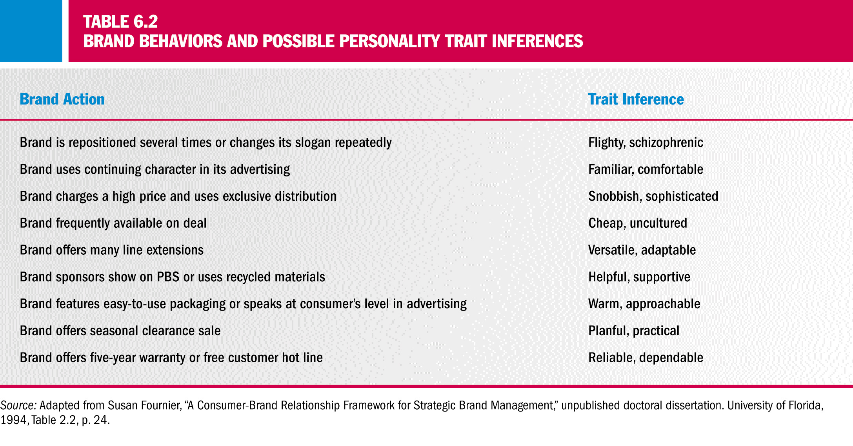
Brands and Trait Inferences

Slide 14
Animism
Animism:
  The practice found in many cultures whereby inanimate objects are given qualities that make them somehow alive
Two types of animism:
  Level 1: People believe the object is possessed by the soul of the being (e.g. celebrity spokespersons)
  Level 2: Objects are anthropomorphized, or given human characteristics. (e.g. Charlie the Tuna, Keebler Elves, or the Michelin Man)

Slide 15
Lifestyle: Who We Are, What We Do
Lifestyle:
  A pattern of consumption reflecting a person’s choices of how he or she spends time and money
Lifestyle Marketing Perspective:
  Recognizes that people sort themselves into groups on the basis of things they like to do, how they like to spend their leisure time, and how they choose to spend their disposable income
Lifestyles as Group Identities:
  Self-definitions of group members

Slide 16
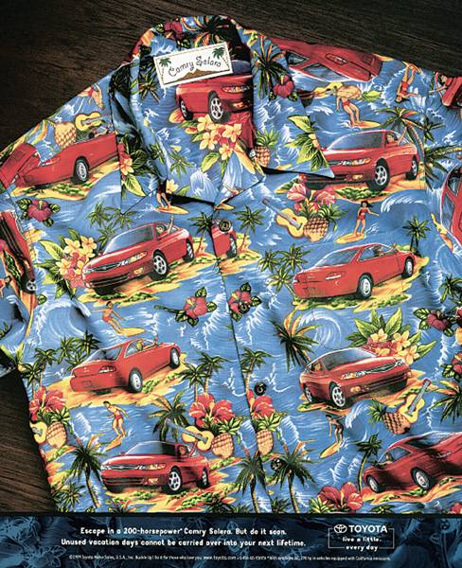
Integrating Products into
Consumer Lifestyles
This ad illustrates the way that products like cars are tightly integrated into consumers’ lifestyles, along with leisure activities, travel, music, and so on.

Slide 17
Products are the
Building Blocks of Lifestyles
Choosing products:
  We often choose products because of their association with a certain lifestyle.
Goal of Lifestyle Marketing:
  To allow consumers to pursue their chosen ways to enjoy life and express their social identities.
Adopting Lifestyle Marketing:
  Implies that we must look at patterns of behavior to understand consumers

Slide 18
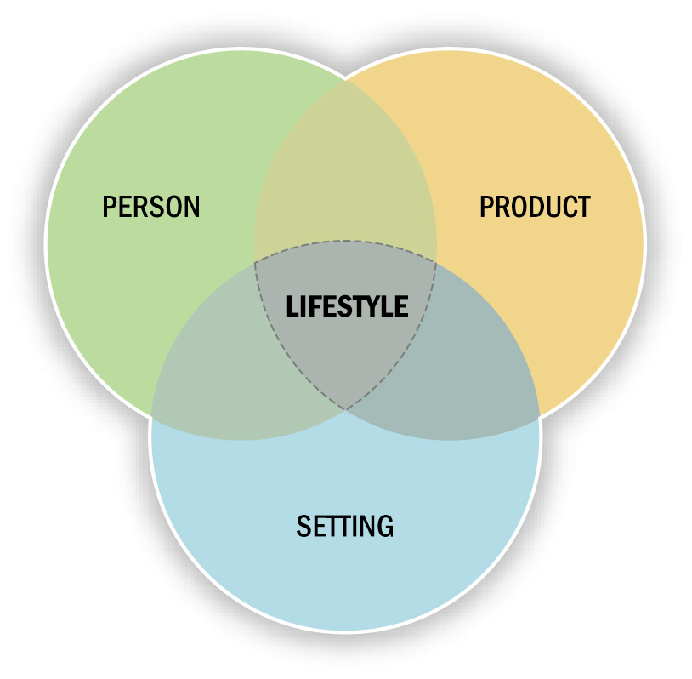
Linking Products to Lifestyles
Figure 6.2

Slide 19
Product-Lifestyle Linkages
Co-branding strategies:
  Strategies that recognize that even unattractive products are more attractive when evaluated with other, liked products
    Porsche – Fairmont Hotel
    Unilever – Dove
    Nike – Polaroid
    Roxy – Toyota
Product complementarity:
  Occurs when symbolic meanings of products are related to each other
Consumption constellations:
  Sets of complementary products used to define, communicate and perform social roles

Slide 20
Psychographics
Psychographics:
  Use of psychological, sociological, and anthropological factors for market segmentation
The Roots of Psychographics:
  Developed in the 1960’s and ’70’s to address the shortcomings of motivational research and quantitative survey research
Forms of Psychographic Studies:
  Lifestyle profile
  Product-specific profile
  General lifestyle segmentation profile
  Product-specific segmentation

Slide 21
AIOs
AIOs:
  Psychographic research groups consumers according to activities, interests, and opinions (AIOs)
80/20 Rule:
  Only 20 percent of a product’s users account for 80 percent of the volume of product sold
  Researchers attempt to identify the heavy users of a product
  Heavy users can then be subdivided in terms of the benefits they derive from the product or service.

Slide 22
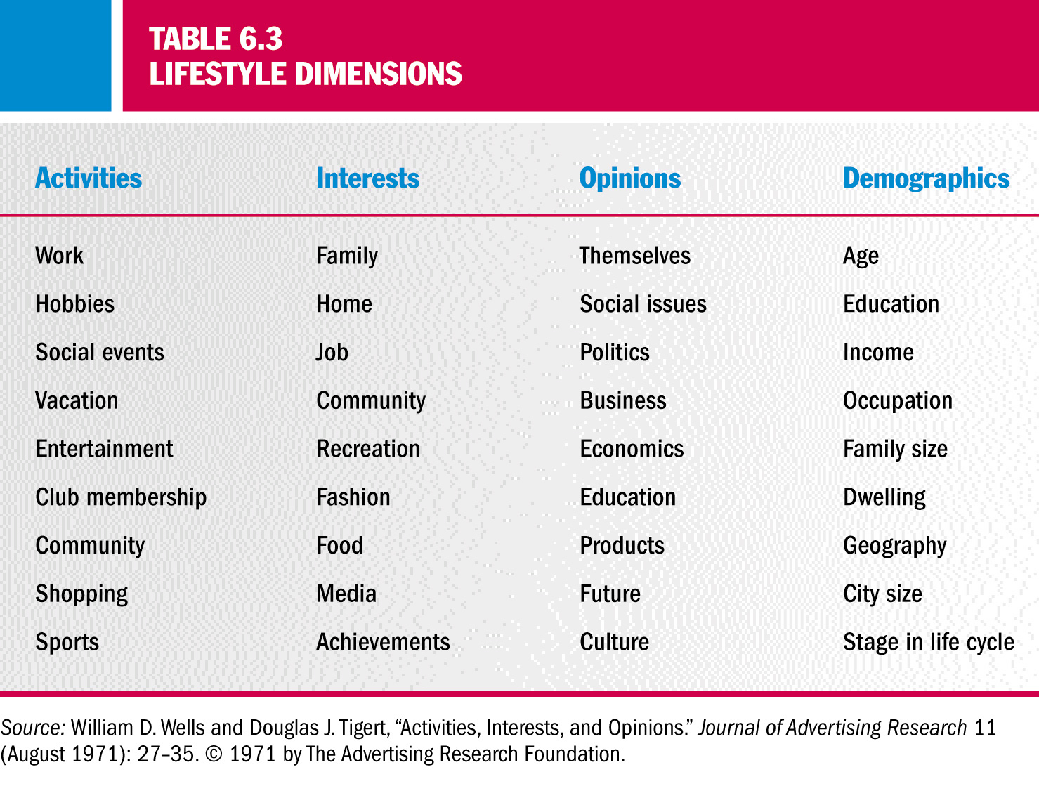
AIOs and Lifestyle Dimensions

Slide 23
Uses of Psychographic Segmentation
Psychographic segmentation can be used:
  To define the target market
  To create a new view of the market
  To position the product
  To better communicate product attributes
  To develop overall strategy
  To market social and political issues

Slide 24
Psychographic Segmentation Typologies
Segmentation Typologies:
  Developed by companies and advertising agencies to identify groups of consumers with common lifestyles
  Similarities in segmentation typologies:
    Respondents answer a battery of questions
    Researchers classify them into “clusters” of lifestyles
    Each cluster is given a descriptive name
    A profile of the “typical” member is provided to the client
Proprietary Systems:
  Information is developed and owned by the company and the company will not release the info to outsiders

Slide 25
VALS 2
The Values and Lifestyles System
Three Self-Orientations:
  Principle orientation: Guided by a belief system
  Status orientation: Guided by opinions of peers
  Action orientation: Desire to impact the world around them
VALS Groups:
- Actualizers | - Believers
- Fulfilleds | - Strivers
- Achievers | - Makers
- Experiencers | - Strugglers

Slide 26
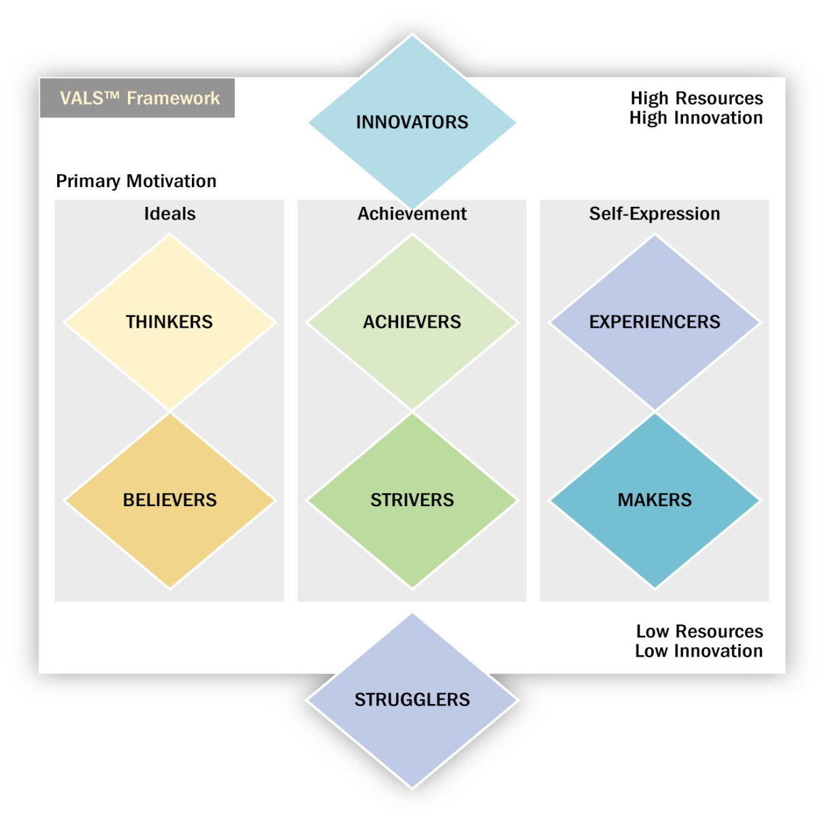
VALS 2 Segmentation System
Figure 6.3

Slide 27
Lifestyle Classification of Consumers
Global MOSAIC:
  Developed by a British Firm called Experian
  Analyzes consumers in 19 countries
  Identified 14 common lifestyles
RISC (Research Institute on Social Change):
  Identifies 10 segments based on three axes:
    Exploration/Stability
    Social/Individual
    Global/Local

Slide 28
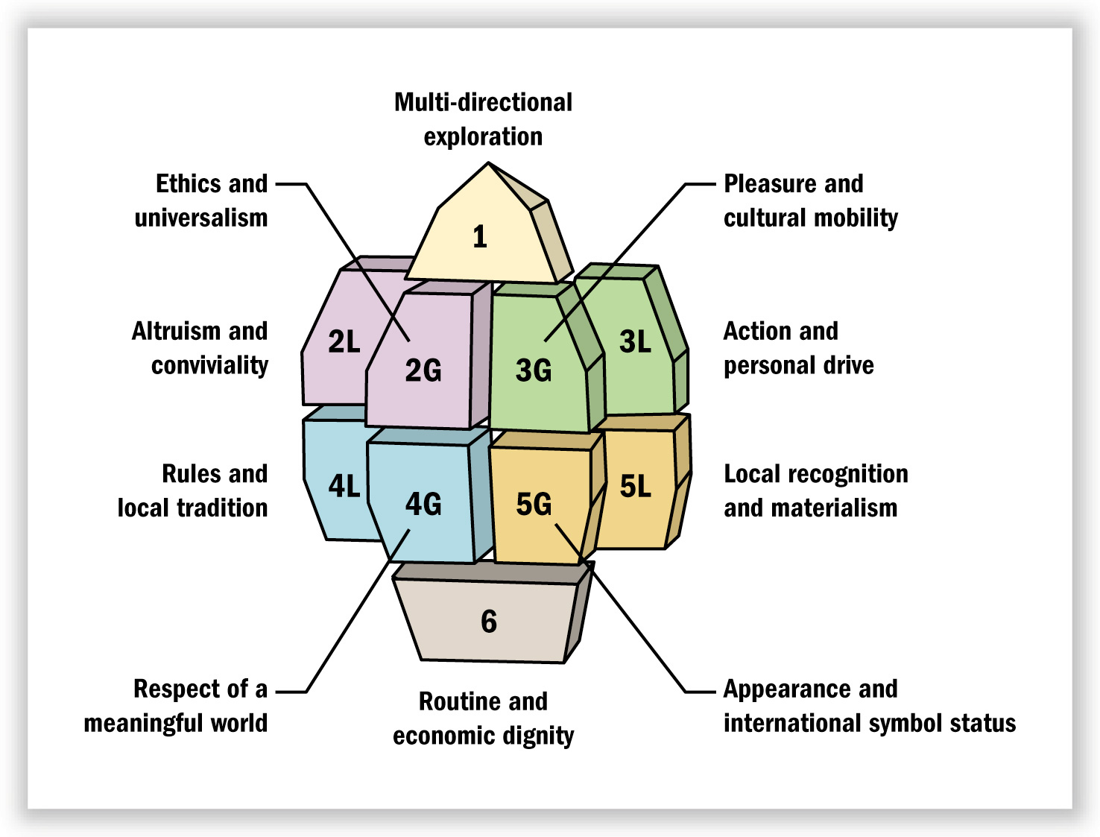
The Ten RISC Segments
Figure 6.5

Slide 29
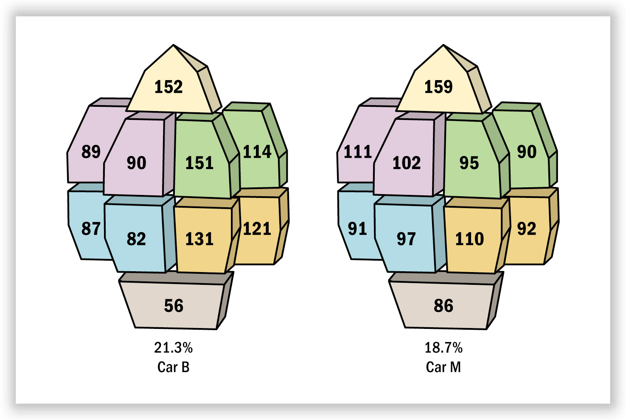
Choice of Brand for the Next New Car
Figure 6.7

Slide 30
Regional Consumption Differences:
You Are What You Eat!
Food Culture:
  A pattern of food and beverage consumption that reflects the values of a social group
Geodemography:
  Analytical techniques that combine data on consumer expenditures and other socioeconomic factors with geographic info about areas in which people live to identify consumers with common consumption patterns
Cluster Analysis:
  A statistical technique for market segmentation
Single Source Data:
  Information about purchase history is combined with geodemographic data to learn more about people

Slide 31
PRIZM
PRIZM (Potential Rating Index by Zip Market):
  Classifies every U.S. Zip Code into one of 62 categories
  Rankings in terms of income, home value, and occupation on a ZQ (Zip Quality) Scale
  Categories range from most affluent “Blue-Blood Estates” to the least well-off “Public Assistance”
  Different clusters exhibit different consumption patterns

Slide 32
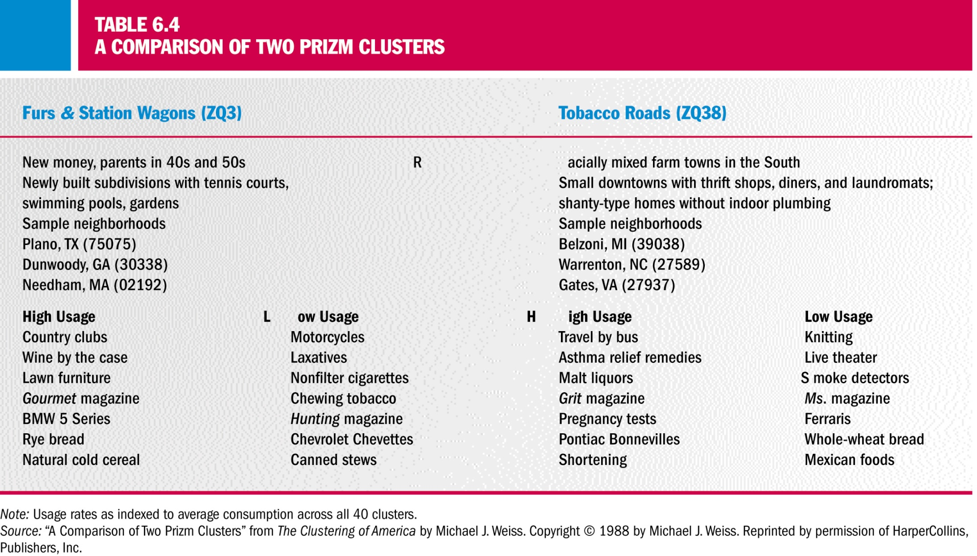
A Comparison of Two PRIZM Clusters

Slide 33
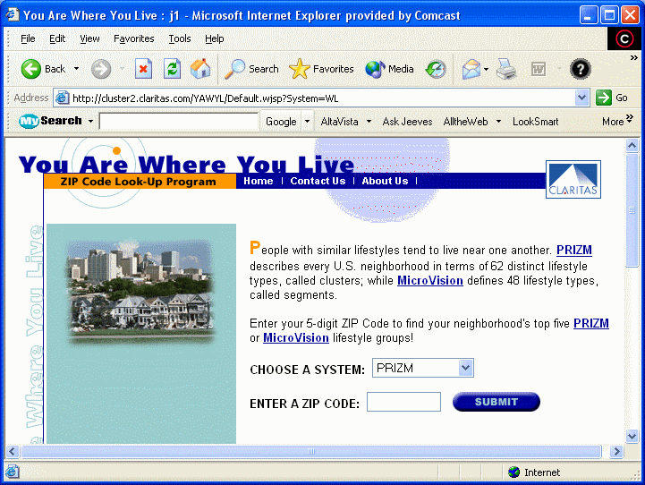

PRIZM Online

