Slide 1
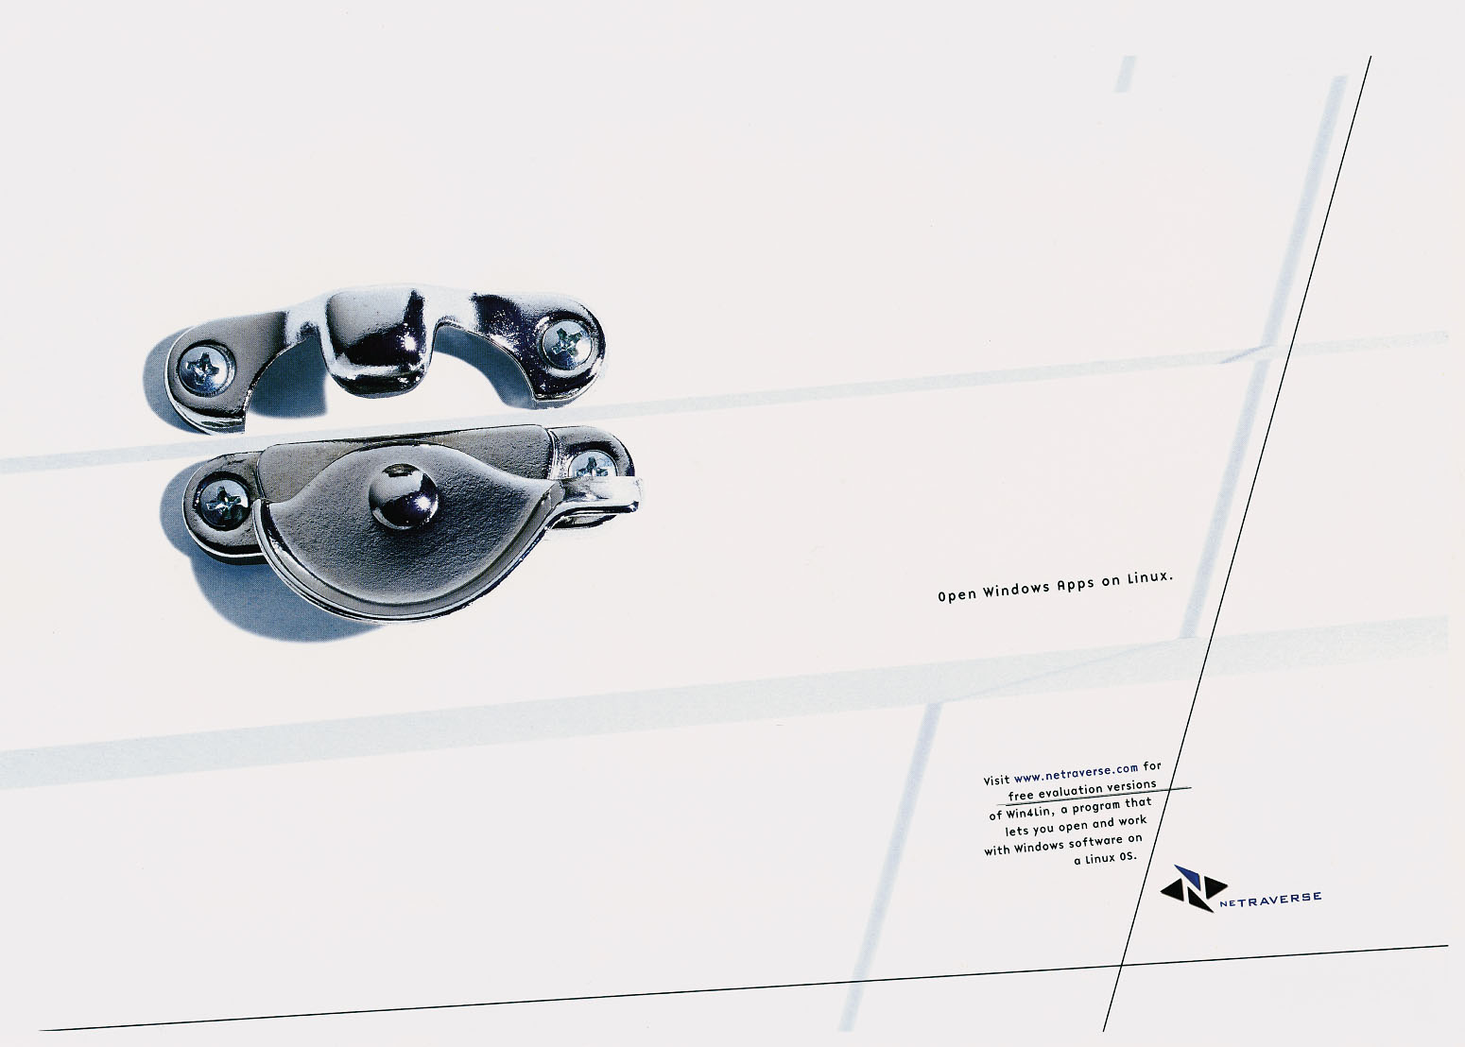
COMMUNICATION
DESIGN

Slide 2
COKE 4 EVERYONE

Slide 3
ATL COMMUNICATION DESIGN
Advertising design.
  Hierarchy of Effects Model
  Means-End Theory
  Visual and Verbal Imaging
Advertising appeals.

Slide 4
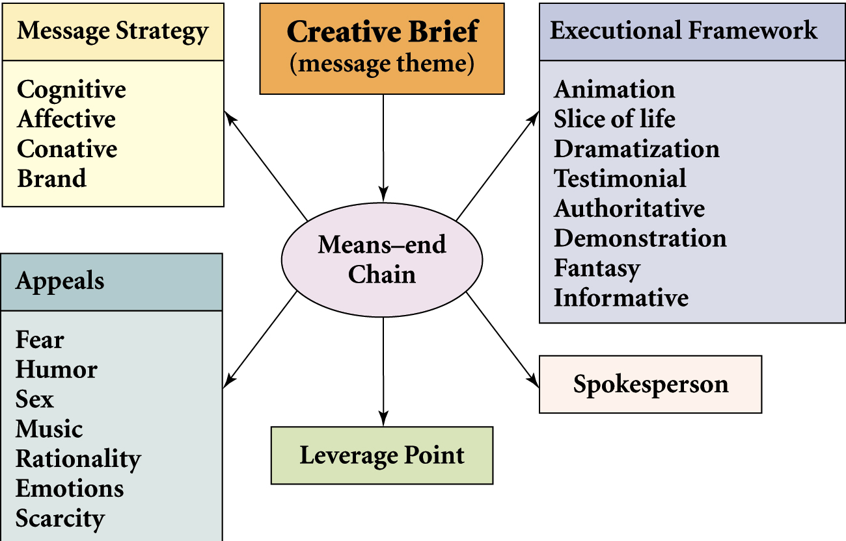
Creating an Advertisement

Slide 5
HALEEB

Slide 6
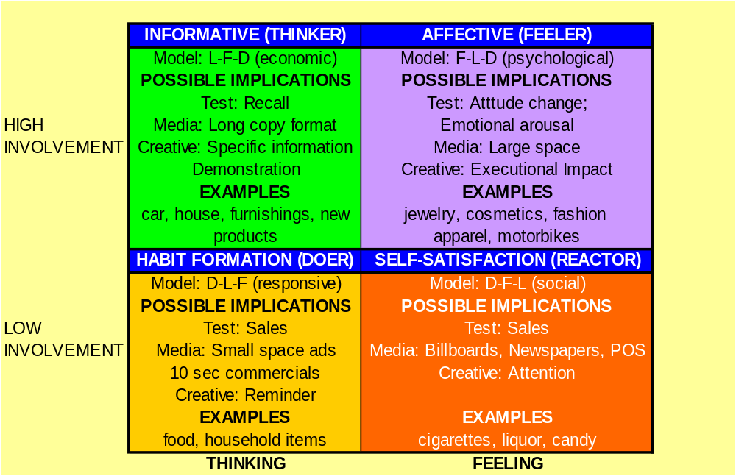
THE FCB GRID

Slide 7
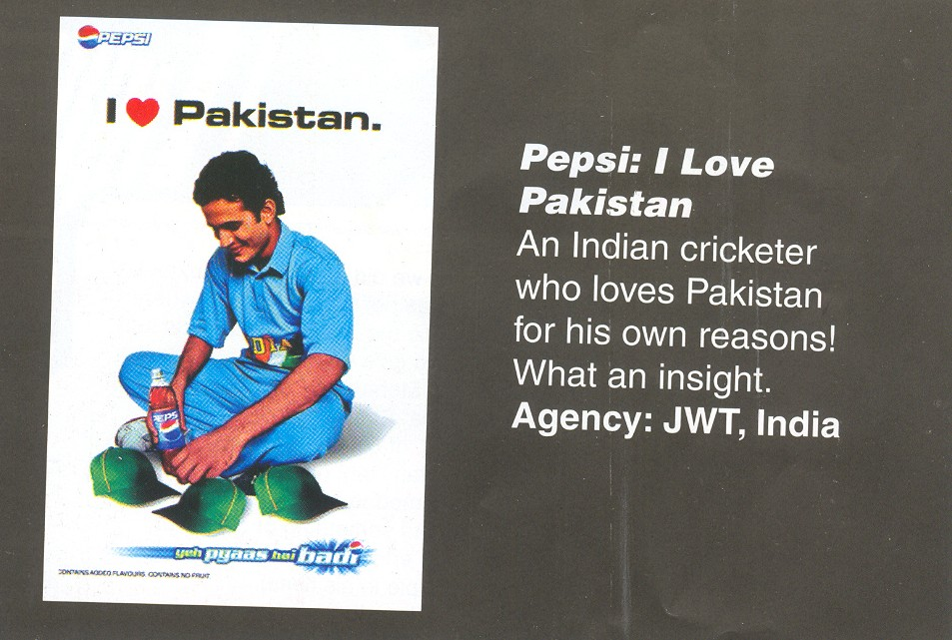

Slide 8


Slide 9
Hierarchy of Effects Model
Cognitive
Awareness
Affective
Knowledge
Conative
Liking
Preference
Conviction
Purchase

Slide 10
HONDA IT MUST BE LOVE

Slide 11
HONDA

Slide 12
MENTOS

Slide 13
Means-End Chain
Product
Attributes
Executional Framework
Leverage
Point
Consumer
Benefits
Personal
Value

Slide 14
PEUGOT 607

Slide 15
PERSONAL VALUES
Comfortable life
Equality
Excitement
Freedom
Fun, exciting life
Happiness
Inner peace
Mature love
Personal accomplishment
Pleasure
Salvation
Security
Self-fulfillment
Self-respect
Sense of belonging
Social acceptance
Wisdom

Slide 16
PHAETON VW

Slide 17


Slide 18


Slide 19
Means End Chain for Milk

Slide 20
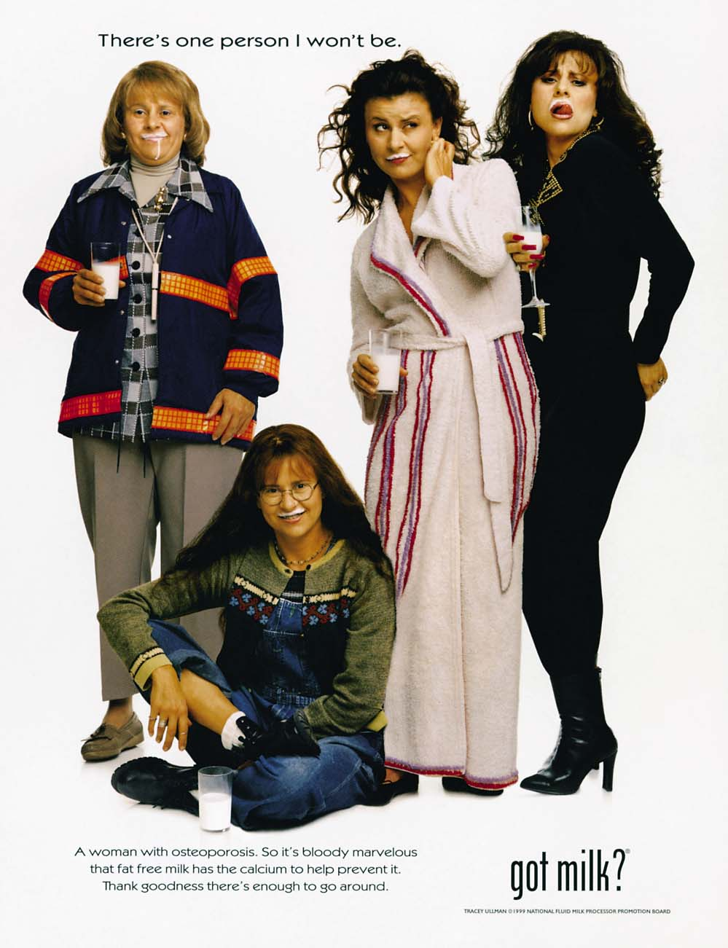

Slide 21

Verbal and Visual Elements
Visual processing
  Easier to recall
  Stored both as pictures and words
  Concrete vs abstract

Slide 22
CREATIVE BRIEF
The objective.
The target audience.
The message theme
The support.
The constraints.

Slide 23
TAPAL

Slide 24


Slide 25
Advertising Appeals
Fear
Humor
Amorous
Music
Rationality
Emotions

Slide 26
Principles of Effective Advertising
Visual consistency.
Campaign duration.
Repeated taglines.
Consistent positioning.
Simplicity.
Identifiable selling point.

Slide 27

Fear Appeal

Slide 28


Slide 29

Humor Appeal
Used in 30% of all advertisements.
Excellent at capturing attention.
Score high in recall tests.
Should be related directly to customer benefit.

Slide 30


Slide 31
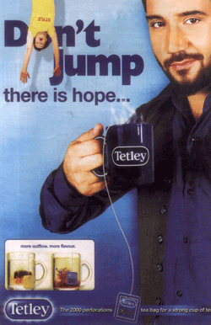

Slide 32
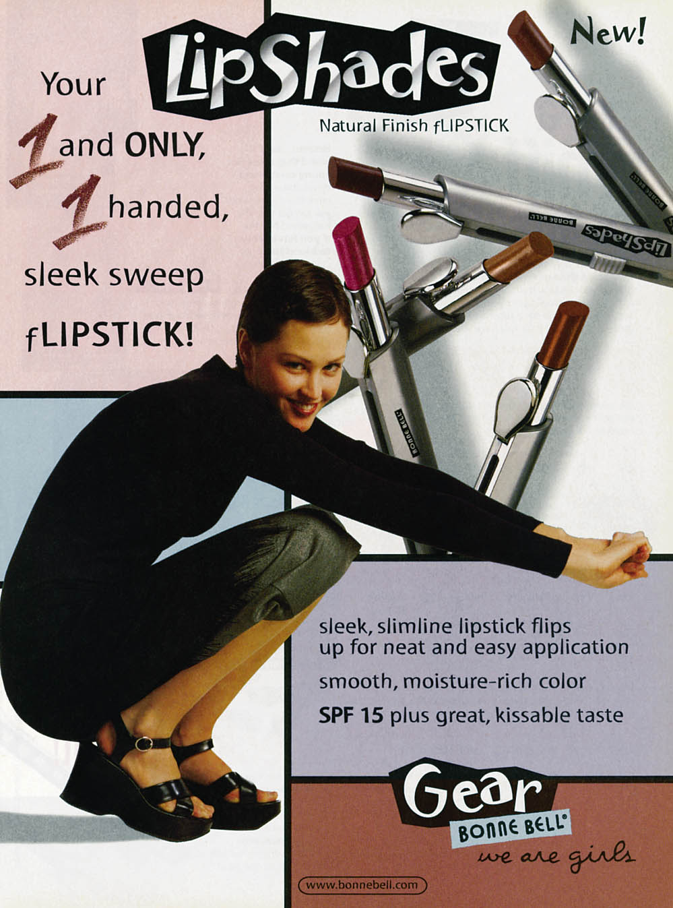
Using Sex Appeals Effectively
Be aware of differences in the international arena.
Should be an integral part of the product.
Should consider using “regular person” models.
Be careful sensuality does not overpower advertisement.

Slide 33
Emotional Appeals
Based on three ideas:
  Consumers ignore most ads.
  Rational ads go unnoticed.
  Emotional ads can capture attention.
Viewed by creatives as key to developing brand loyalty.
Uses peripheral processing route.
B-to-B advertisements using more emotional appeals.
Works well when tied with other appeals.

Slide 34
Emotions Used in Advertisements
Trust
Reliability
Friendship
Happiness
Security
Glamour/luxury
Serenity
Anger
Protecting loved ones
Romance
Passion
Family Bonds
* with parents
*with siblings
* with children
*with extended family members

Slide 35
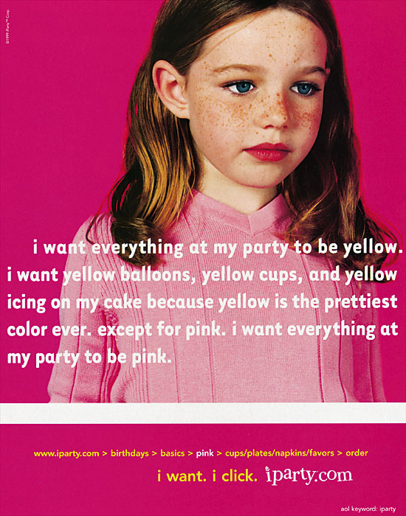

Slide 36
Executional Frameworks
Animation
Slice-of-life
Dramatization
Testimonial
Authoritative
Demonstration
Fantasy
Informative

