Slide 1
Attitude Change and Interactive Communications

Slide 2
Changing Attitudes
Through Communication
Persuasion:
  An active attempt to change attitudes
  Basic psychological principles that influence people to change their minds or comply with a request:
Reciprocity Scarcity Authority | Consistency Liking Consensus

Slide 3
Decisions, Decisions:
Tactical Communications Options
Who will be the source of the message?
  Man, woman, child, celebrity, athlete?
How should message be constructed?
  Emphasize negative consequences?
  Direct comparison with competition?
  Present a fantasy?
What media will transmit the message?
  Print ad, television, door-to-door, Web site?
What are the characteristics of the target market?
  Young, old, frustrated, status-oriented?

Slide 4
The Elements of Communication
Communications Model:
  Specifies that a number of elements are necessary for communication to be achieved.
    Source: Where the communication originates
    Message: Content of the message itself
    Receivers: Interpret the message
    Feedback: Must be received by the source
Launch uses the Web to collect information from subscribers

Slide 5
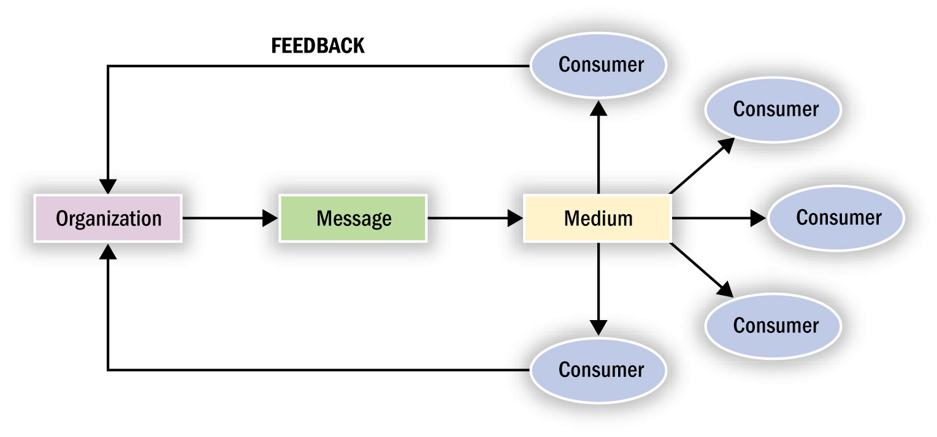
The Traditional Communications Model
Figure 8.1

Slide 6
An Updated View:
Interactive Communications
Permission Marketing:
  Based on the idea that a marketer will be more successful in persuading consumers who have agreed to let him or her try.
Uses and Gratifications Theory:
  Argues that consumers are an active, goal-directed audience that draws on mass media as a resource to satisfy needs.
Who’s In Charge of the Remote?
  Technological and social developments are turning the passive consumer into interactive “partners.”
Levels of Interactive Response
  First-order response: A product offer that directly yields a transaction.
  Second-order response: Customer feedback in response to a marketing message that is not in the form of a transaction.

Slide 7
The Source
Source effects: A message will have different effects if communicated by a different source.
Two important source characteristics:
  Credibility and Attractiveness
Source credibility: A source’s perceived expertise, objectivity, or trustworthiness.
Sleeper effect: A process by which differences in attitude change between positive sources and less positive sources seem to get erased over time.
  Dissociative cue hypothesis
  Availability-valence hypothesis

Slide 8
The Source (cont.)
Building Credibility: Credibility can be enhanced if the source’s qualifications are relevant to the product.
Source Biases:
  Knowledge bias: Implies a source’s knowledge is not accurate.
  Reporting bias: When a source has the required knowledge, but the willingness to convey it is compromised
Hype versus Buzz: The Corporate Paradox
  Corporate Paradox: The more involved a company appears to be in the dissemination of news about its products, the less credible it becomes.
    Buzz: Word of mouth, viewed as authentic
    Hype: Corporate propaganda, viewed as inauthentic

Slide 9
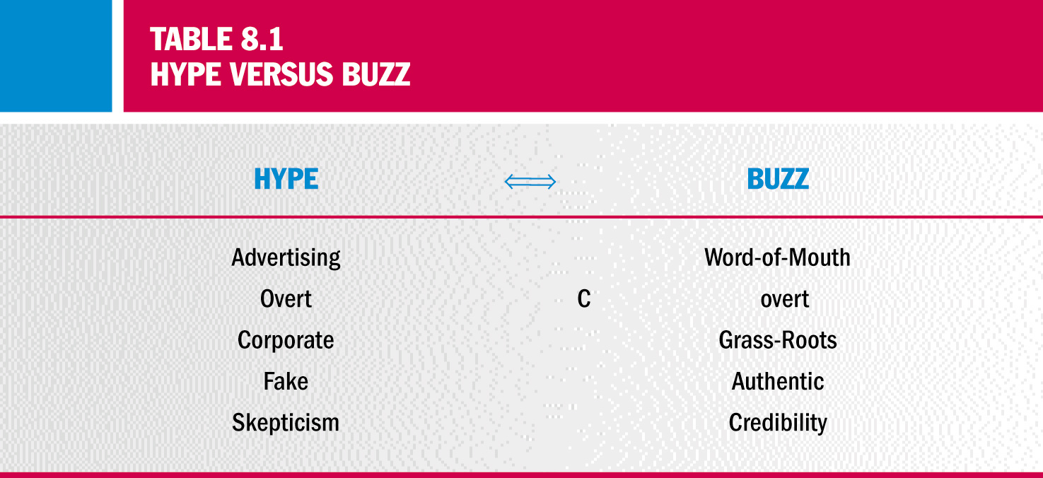
Hype Versus Buzz

Slide 10
Source Attractiveness
Source Attractiveness:
  Refers to the source’s perceived social value
“What is Beautiful Is Good”:
  A physically attractive source tends to facilitate attitude change.
  Social adaptation perspective
    Assumes that the perceiver will weight information seen to be instrumental in forming an attitude more heavily.

Slide 11
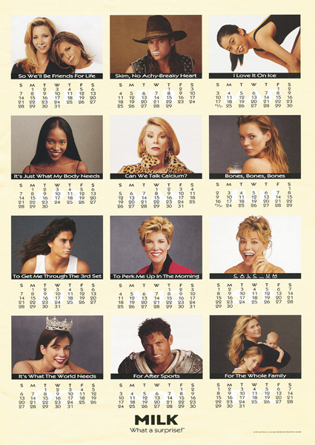
Source Attractiveness in Ads
To stimulate demand for milk, an industry trade group tapped a huge range of celebrities to show off their milk mustaches.

Slide 12
Star Power: Celebrities as Communications Sources
Cultural meanings:
  Symbolizes important categories such as status, social class, gender, age, and personality type.
  Match up hypothesis: The celebrity’s image and that of the product are similar
  Q rating (Q stands for quality) considers two factors:
    Consumers’ level of familiarity with a name
    The number of respondents who indicate that a person, program, or character is a favorite.
Nonhuman Endorsers:
  Avatar: The manifestation of a Hindu deity in superhuman or animal form.

Slide 13
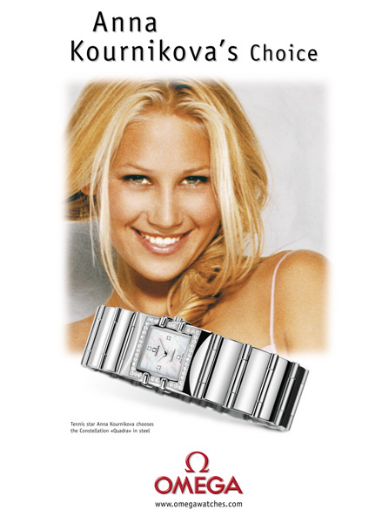
Celebrity Endorsers
Omega uses tennis star Anna Kournikova as a celebrity endorser

Slide 14
The Message
Sending The Message:
  Framed: Message in the picture is strongly related to the copy
  Chunk: Visual images allow the receiver to group information at the time of encoding
Vividness:
  Pictures and words can differ in vividness
  Powerful descriptions or graphics command attention and are more strongly embedded in memory

Slide 15
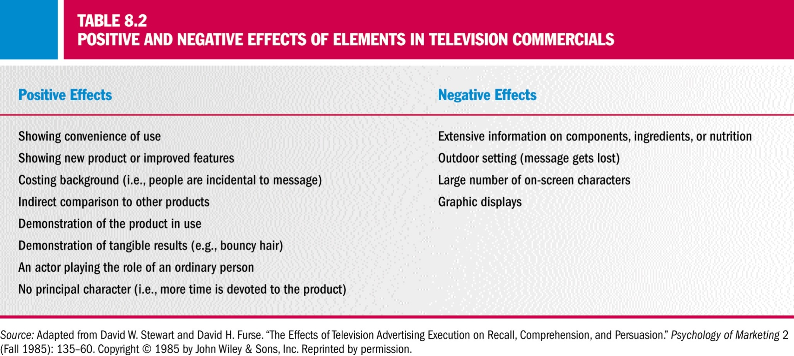
Positive and Negative Effects of Elements in TV Commercials

Slide 16
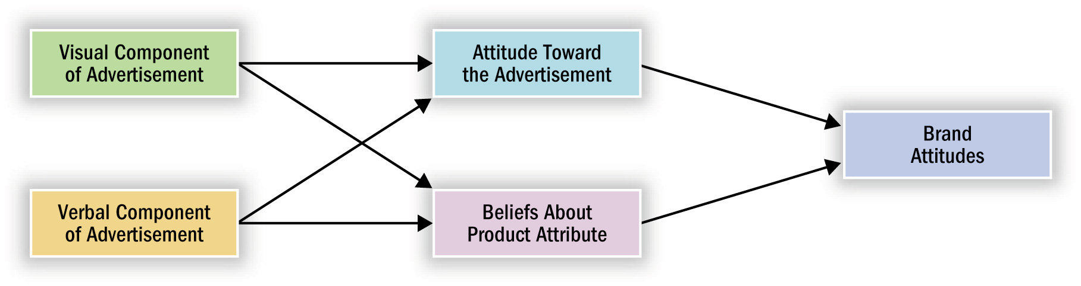
Dual Component Model of Brand Attitudes
Figure 8.3

Slide 17
Sending the Message
Repetition:
  Mere Exposure: People tend to like things that are more familiar to them, even if they are not keen on them initially.
  Habituation: Consumer no longer pays attention to the stimulus because of boredom or fatigue
  Two-factor Theory: Explains the fine line between familiarity and boredom.
    Positive affect: Increases familiarity, reduces uncertainty
    Negative affect: Boredom increases with each exposure

Slide 18
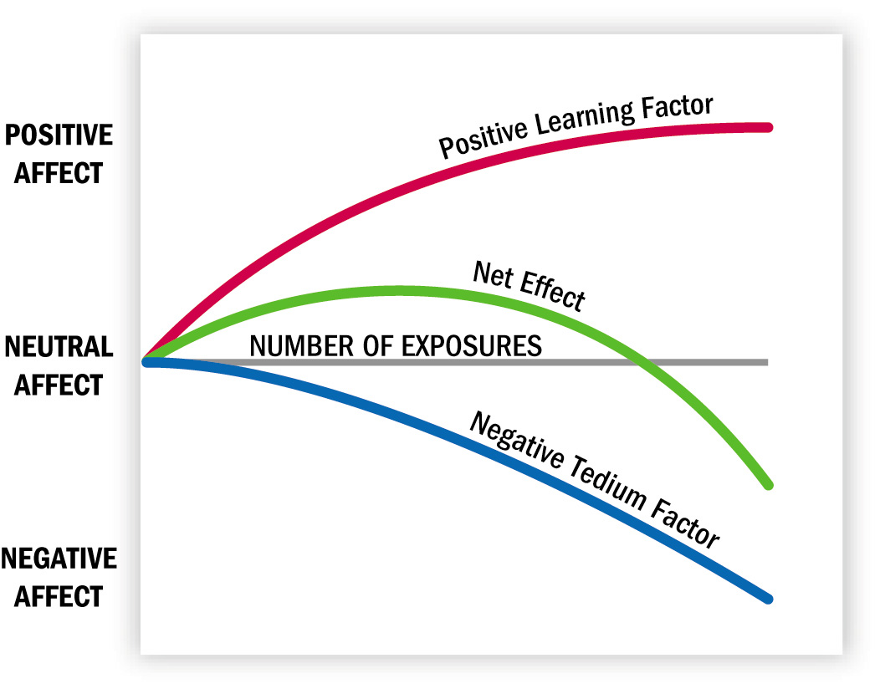
Two-Factor Theory
Figure 8.4

Slide 19
Constructing the Argument
One- Versus Two-Sided Arguments:
  Supportive argument: Presents only positive arguments
  Two-sided message: Presents positive and negative info
Drawing Conclusions
Comparative Advertising:
  A strategy in which a message compares two or more recognized brands and compares them on the basis of attributes.

Slide 20
Types of Message Appeals
Emotional Versus Rational Appeals:
  Choice depends on the nature of the product and the type of relationship that consumers have with it
  Recall of ad content tends to be better for “thinking” rather than “feeling” ads
Amorous Appeals:
  It draws attention to the ad but may be counterproductive unless the product itself is related to sex
Humorous Appeals:
  Distraction: Humorous ads inhibit the consumer from counter arguing (thinking of reasons not to agree with the message), increasing the likelihood of message acceptance

Slide 21
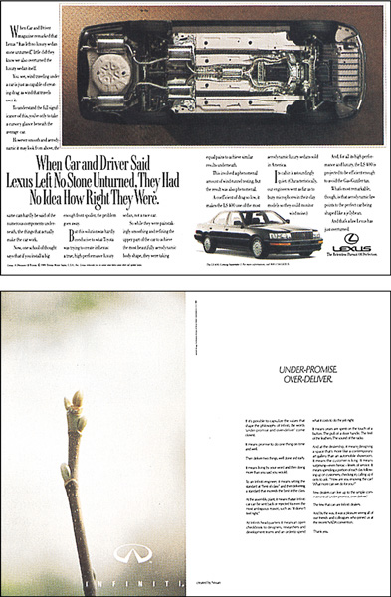
Emotional vs. Rational
These ads demonstrate rational versus emotional message appeals. At the time of the initial ad campaign for the new Infiniti automobiles, the ads for rival Lexus (top) emphasized design and engineering, while the ads for Infiniti (bottom) did not even show the car.

Slide 22
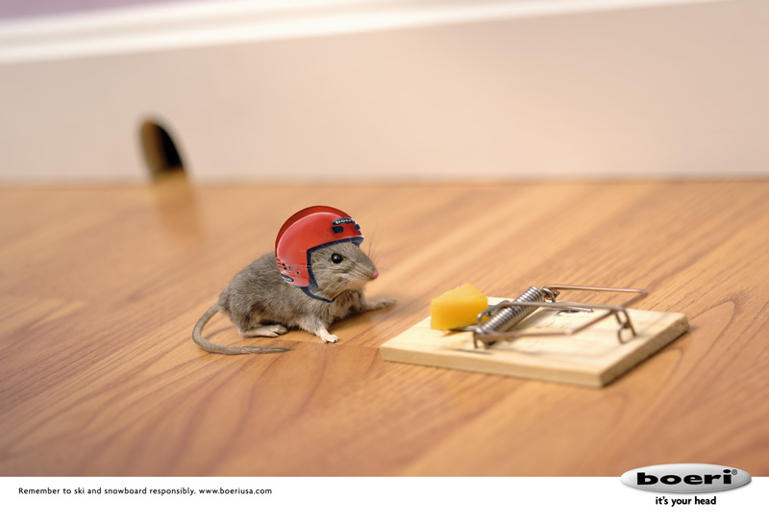
Humor Appeals
This ad relies upon humor to communicate the message that skiers and snowboarders should wear helmets.

Slide 23
Types of Message Appeals (cont.)
Fear Appeals:
  Emphasize the negative consequences that can occur unless the consumer changes a behavior or an attitude
  Used mostly in social marketing contexts
  Effective only when the threat is moderate and a solution is presented
  Threat: The literal content of the message
  Fear: An emotional response to the message

Slide 24

Fear Appeals
Life insurance companies often use a fear appeal to motivate consumers to buy policies.

Slide 25
Types of Message Appeals (conc.)
The Message as Art Form: Metaphors Be with You:
  Metaphor: Involves placing two dissimilar objects in a close relationship such that “A is B”
  Simile: Compares two objects “A is like B”
  Resonance: A form of presentation that combines a play on words with a relevant picture
Forms of Story Presentation:
  Drama: Attempt to be experiential, involving the audience emotionally
  Lecture: A speech where the source speaks directly to the audience to inform and persuade them
  Transformational Advertising: Consumer associates the experience of product usage with some subjective sensation

Slide 26
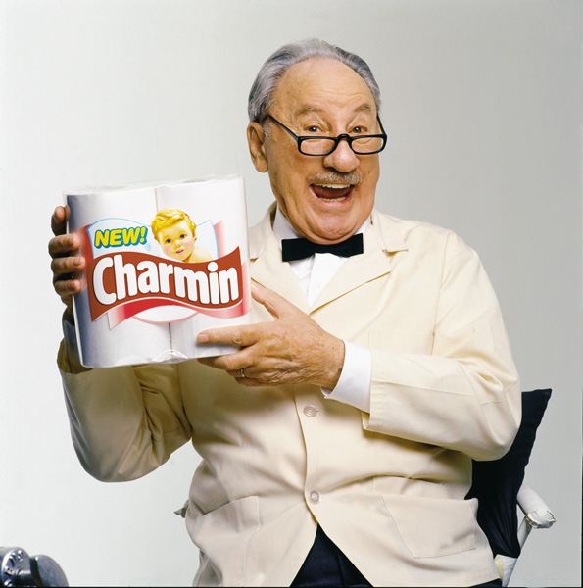
Personification
Many products are personified by make-believe characters.

Slide 27

Advertising Metaphors
This Chinese detergent ad uses a handcuff metaphor as it urges the viewer, “Free yourself from the burden of handwash.”

Slide 28
The Source vs. The Message:
Sell the Steak or the Sizzle?
Elaboration Likelihood Model (ELM):
  Assumes that once a customer receives a message, he or she begins to process it.
The Central Route to Persuasion:
  The processing route taken under conditions of high involvement
  Cognitive Responses
The Peripheral Route to Persuasion
  The processing route taken under conditions of low involvement
  Peripheral Cues

Slide 29
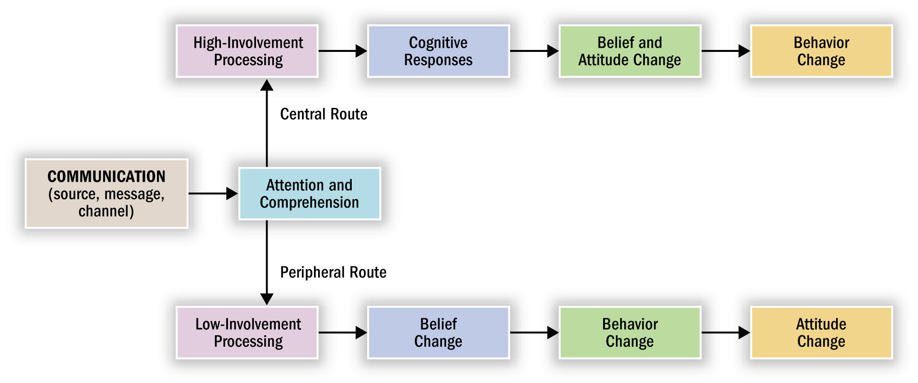
The ELM Model
Figure 8.5

Slide 30
Support for the ELM
The ELM has received a lot of research support
Example: Typical ELM Study
  Thought listing
  Independent variables:
    Message-processing involvement
    Argument strength
    Source characteristics
  Findings:
    High involvement subjects had more cognitions
    High involvement subjects swayed by powerful arguments
    Low involvement subjects influenced by attractive sources

